Slide 1
Nuclear Orbital Entanglement Entropy of Short Range Correlations
4-th International Workshop on Quantitative Challenges in Short-Range Correlations and the EMC Effect Research
CEA Paris-Saclay
February 1st
Ehoud Pazy
NRCN

Slide 2



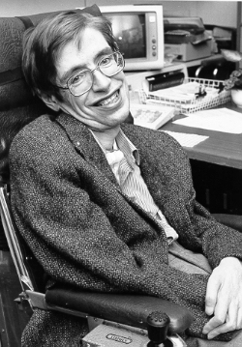




Outline-Introduction
Entanglement
Entanglement entropy
Area law
Short Range Correlated (SRC) pairs
Orbital Entanglement entropy

Slide 3


Outline-Introduction
A Secret Ingredient
The Generalized Contact Formalism (GCF)
Calculating Entanglement Entropy for SRC:
Calculating the entanglement entropy of a single SRC pair in term of the contact.
Summing up the Entanglement Entropy of SRC pairs.
Comparing results with the ⁴He calculations.

Slide 4

The Main Questions
How to calculate the entanglement entropy of the SRC?
Does it obey an Area Law?
Is most of the entanglement entropy in SRC?

Slide 5
Entanglement

Slide 6

Entanglement Entropy
Arises due to tracing out some part of the system
In contrast to thermal states this entropy does not originate from a lack of knowledge about the microstate of the system.
In quantum mechanics positive entropies may arise even
without an objective lack of information.
Even at zero temperature we will encounter a non-zero entropy!
This entropy arises because of a very fundamental property of quantum mechanics: Entanglement”
J. Eisert, M. Cramer, and M.B. Plenio, Reviews of Modern Physics (2010)

Slide 7
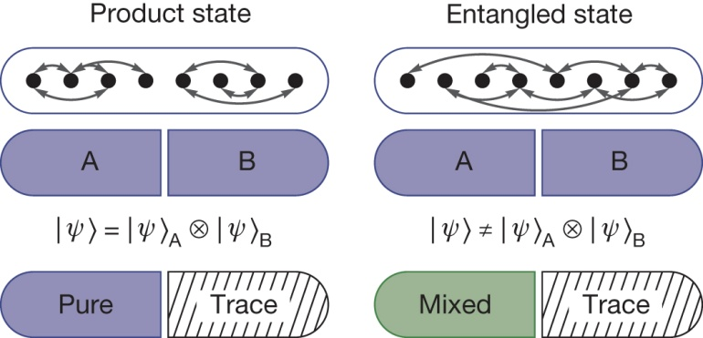
Entanglement Entropy:
Product verses Entangled
S>0
S=0
R Islam et al. Nature 528, 78 (2015) doi:10.1038/nature15750

Slide 8
Definition of Entanglement Entropy
Divide a given quantum system into two parts A and B.
Then the total Hilbert space becomes factorized
We define the reduced density matrix for A by
Tracing over the Hilbert space of B .
Now the entanglement entropy is defined by the
von Neumann entropy

Slide 9
Simple example of Entanglement Entropy
Non Entangled case
Entangled case
Master Thesis, Oliver Gorton , 2018

Slide 10
Entangled Entropy Area Law
A
B
“At first sight one might be tempted to think that the entropy of a distinguished region B, will always possess an extensive character. Such a behavior is referred to as a volume scaling and is observed for thermal states.
Intriguingly, for typical ground states, however, this is not at all what one encounters:
Instead, one typically finds an area law, or an area law with a small (often logarithmic) correction: This means that if one distinguishes a region, the scaling of the entropy is merely linear in the boundary area of the region.”
J. Eisert, M. Cramer, and M.B. Plenio, Reviews of Modern Physics (2010)

Slide 11

The Holographic Principle and Black Hole Entropy
“It has been suggested that the area law of the geometric entropy for a discrete version of a massless free scalar field— then numerically found for an imaginary sphere in a radial
symmetry—could be related to the physics of black holes, in particular the Bekenstein-Hawking entropy of a black hole which is proportional to its boundary surface.
It has been noted that the holographic principle—the conjecture that the information contained
in a volume of space can be represented by a theory which lives in the boundary of that region—could be related to the area law behavior of the entanglement entropy in microscopic theories”
An analogy with Black hole entropy
The boundary region ~ the event horizon
J. Eisert, M. Cramer, and M.B. Plenio, Reviews of Modern Physics (2010)

Slide 12
Why is the Nuclear Structure Entanglement Entropy Important?
Computational- efficiency.
Physics- dynamics of reactions:

Slide 13
Why is Entanglement Entropy Important?
Nuclear physics:
Is there a simple picture in which we can understand nuclear properties?
Is there an efficient scheme in which to model nuclear structure for applications?

Slide 14
Computational Impossibility

Slide 15
Why is Entanglement Entropy Important for Nuclear Structure?
It is shown here that short-range correlations, which induce high-momentum tails of the single-particle occupation probabilities, increase the entropy of fermionic systems, which in its turn will affect the dynamics of many reactions, such as heavy-ion collisions and nuclear fission.

Slide 16
A Complication Orbital Entanglement
Entanglement in systems with distinguishable particles:
Well understood – Hilbert Space has a tensor like structure
Entanglement in systems with indistinguishable particles:
Not well understood-under debate
Define entanglement between modes Rather than particles (second quantization)

Slide 17
Orbital Entanglement
Trace
one orbital
density matrix
von Neumann entropy
Trace

Slide 18
Calculating Orbital Entanglement
One Orbital Density Matrix
Slater determinant
The ω_{k}are eignevalues of ρ_{i}

Slide 19
Entanglement in the Nucleus

Slide 20
What has been Calculated for
Nuclear Structure?
Limited to light nuclei

Slide 21
Single-Orbital Entanglement in ⁴He
Limited to light nuclei

Slide 22
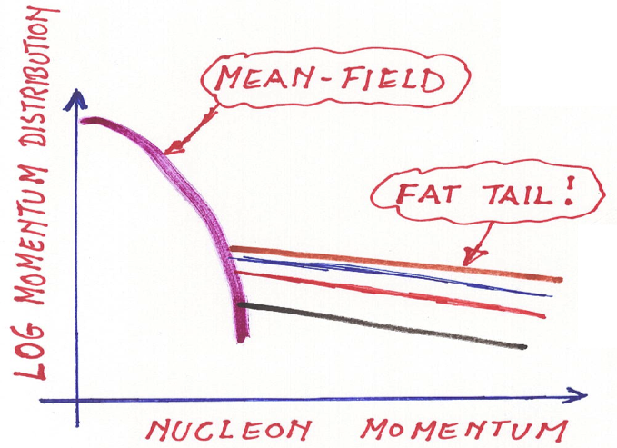
A Different Approach Based on the
General Contact Formalism (GCF)
A-1
~k_{F}
n
A-2
p
A universal two particle state
Pappalardo Fellowship
20th Anniversary Colloquium, April 28th (2022)
Universal in some sense.
Simple to calculate.

Slide 23
A Different Approach Based on the
General Contact Formalism (GCF)
The two particle state is Universal
It can be viewed as a further “orbital” particles can occupy.
It’s “occupancy” is given by the contact.
The entanglement of the SRC can be given as a simple formula based on the contact.

Slide 24
General Contact Formalism (GCF)
ansatz
Two Body Universal wave function
in terms of:
Relative coordinate
A function of the A-2 remaining nucleons
also in terms of:
Center of mass coordinate
The Contact
The contact traces over all of the degrees of freedom aside from the pair

Slide 25
SRC Momentum Distribution in GCF
Given the following normalization
The Contact can be viewed as the probability for obtaining a SRC in the nucleus /
The occupation of the universal two state “orbital”

Slide 26
Calculating the SRC Entanglement Entropy
The Universal two-particle wave function can be viewed as a further “orbital”.
The occupation probability of this orbital is given by the contact.

Slide 27
SRC Entanglement Entropy is a sum of the Entanglement Entropy of Single SRC
Assumption: the total SRC entanglement entropy is the sum of the number of SRC pairs-
Meaning assuming SRC pairs are not entangled

Slide 28
The Normalized Contact
The probability for obtaining a single SRC pair
Calculations for the single SRC entanglement entropy will be done with the normalized contact which is A independent

Slide 29
Calculating the SRC Entanglement Entropy
One Orbital Density Matrix
SRC
Sum over momentum

Slide 30
SRC Entanglement Entropy is a Sum of the Entanglement Entropy of Single SRC
Assumption: the total SRC entanglement entropy is the sum of the number of SRC pairs-
Meaning assuming SRC pairs are not entangled between themselves
The probability for obtaining a single SRC pair is given by the normalized contact

Slide 31
The Normalized Contact
The probability for obtaining a single SRC pair
This normalization of the contact
Gives the fraction of the one body momentum density above KF
Calculations for the single SRC entanglement entropy will be done with the normalized contact which is A independent

Slide 32
Calculating the Single SRC Entanglement Entropy
One Orbital Density Matrix
SRC
The probability an SRC is occupied

Slide 33
Calculating the SRC Entanglement Entropy
The SRC Entanglement Entropy is extensive ~A
E. Pazy, Orbital Entanglement Entropy of Short Range Correlated Pairs in Nuclear Structure arXiv:2206.10702

Slide 34
Comparing to Previous Results for ⁴He
Proton-Proton and Neutron –Neutron pairs were not considered.
Two orbital entanglement was not considered.
Quite a good agreement with previous results
E. Pazy, Orbital Entanglement Entropy of Short Range Correlated Pairs in Nuclear Structure arXiv:2206.10702

Slide 35
What has been Calculated for
Nuclear structure
The Entropy in Terms of the Canonical momentum occupation function

Slide 36
The Entropy in Terms of the Canonical Momentum Occupation Function

Slide 37
The Entropy in Terms of the Canonical Momentum Occupation Function

Slide 38
Summary
A general expression was obtained for the SRC Entanglement Entropy.
The SRC Entanglement Entropy was found to be extensive.
The SRC entanglement entropy seems to fit previous ⁴He calculations.
Thank You for your Attention
and
Bonne Appetit

