Slide 1
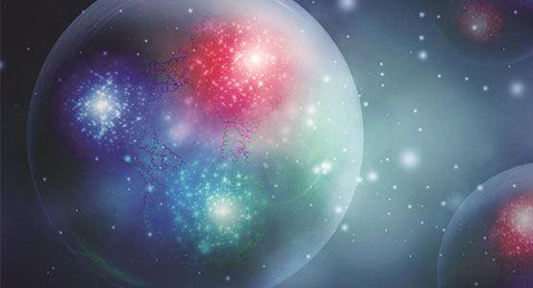
Upcoming SRC-EMC Experiments at Jefferson Lab

Slide 2
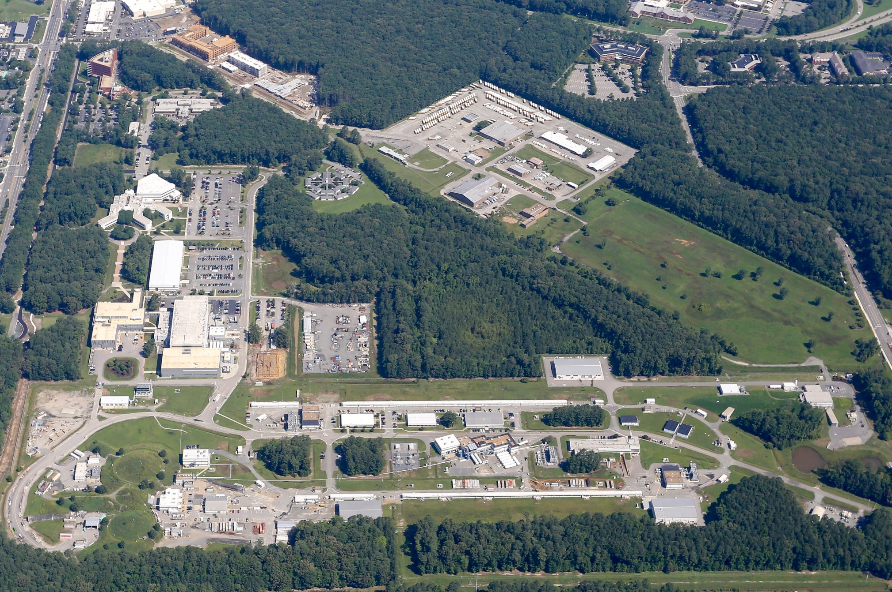
Thomas Jefferson National Accelerator Facility

Slide 3
Thomas Jefferson National Accelerator Facility
United States Department of Energy National Lab (Primary Focus Nuclear Physics)
2000 Scientists
U.S. Universities
International
Train Next Generation
10 Ph.D.’s/Year
College Programs
High School Programs
Primary Mission of the lab is to understand the transition from hadronic to partonic degrees of freedom.
SRC-EMC experiments naturally are part of this mission.

Slide 4
Virtual Tour of Jefferson Lab’s Accelerator

Slide 5
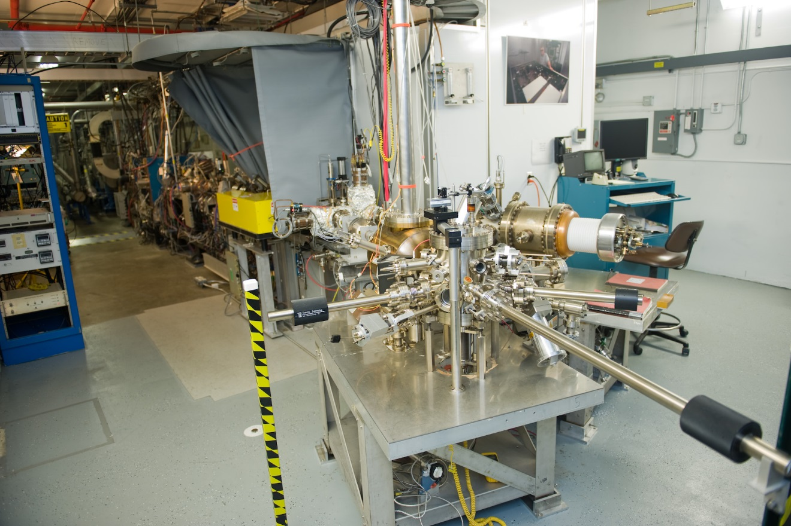
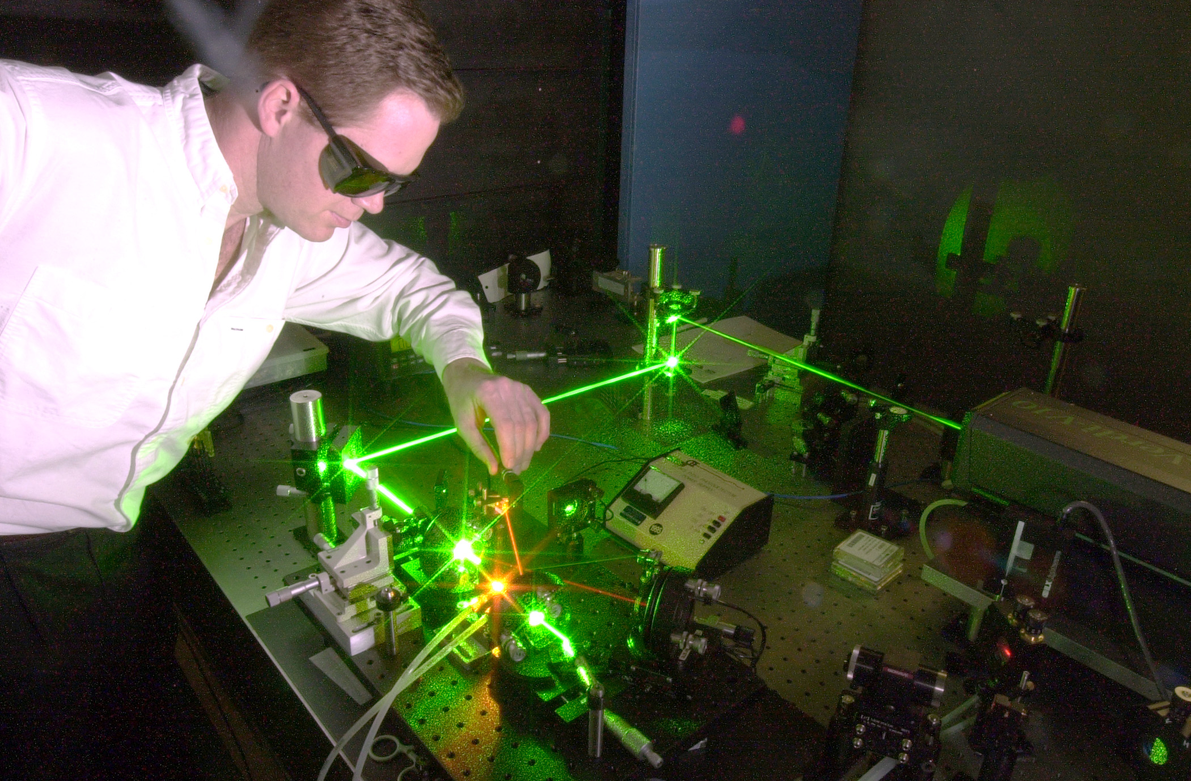
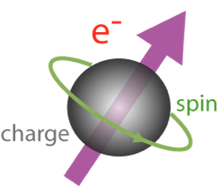
Injector: Photoelectric Effect
By using polarized laser light and strained GaAs, ~85% polarized has
become absolutely standard.

Slide 6
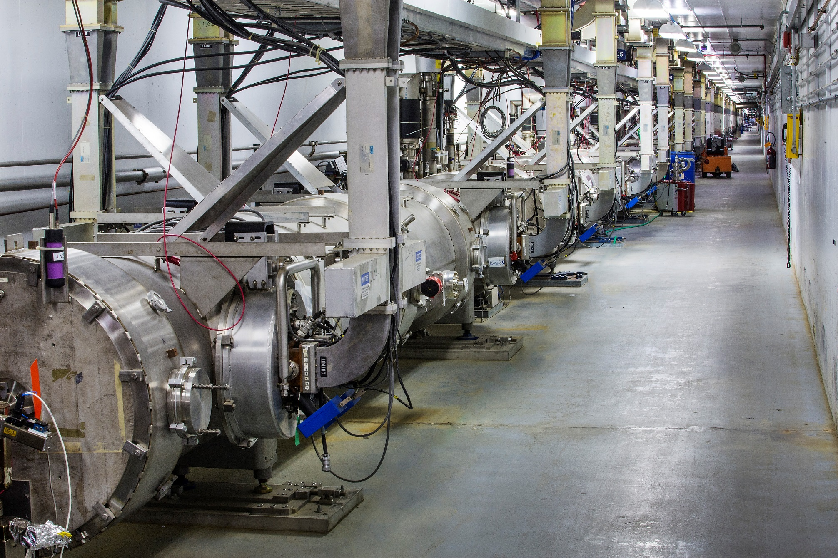
Linear Accelerator
Presently accelerating 2.1 GeV/pass around the machine.

Slide 7
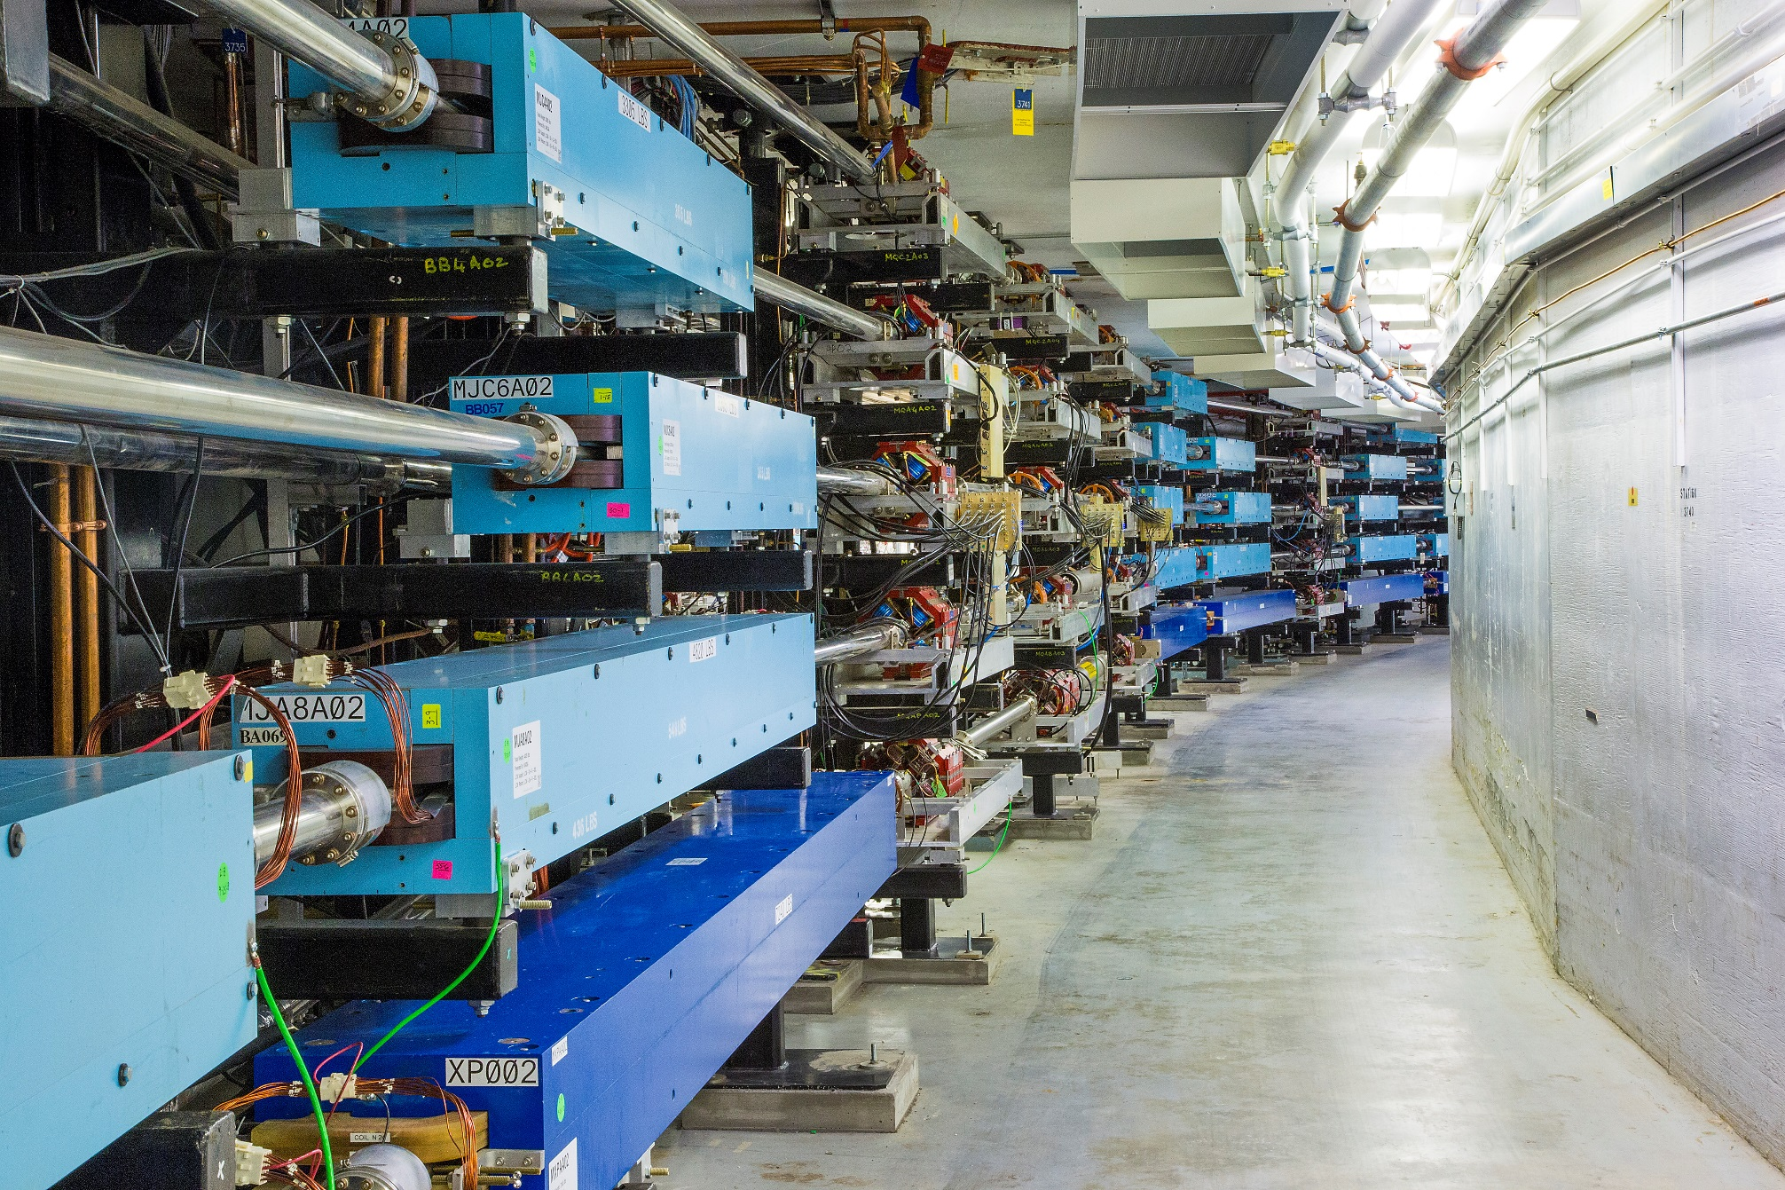
Race Track Design
Accelerators are expensive (>100 million dollars) while bending magnets are cheap.

Slide 8
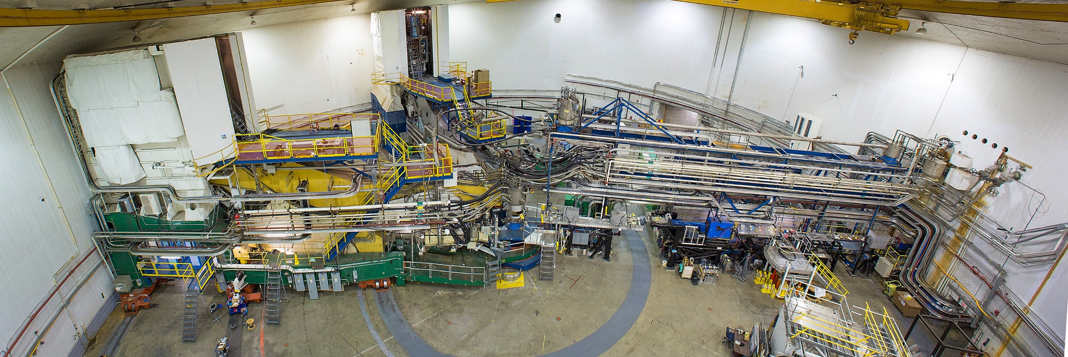
Jefferson Lab’s Experimental Hall A
Now the home of the SBS / BB experiments and will be the home of MOLLER & SoLID

Slide 9
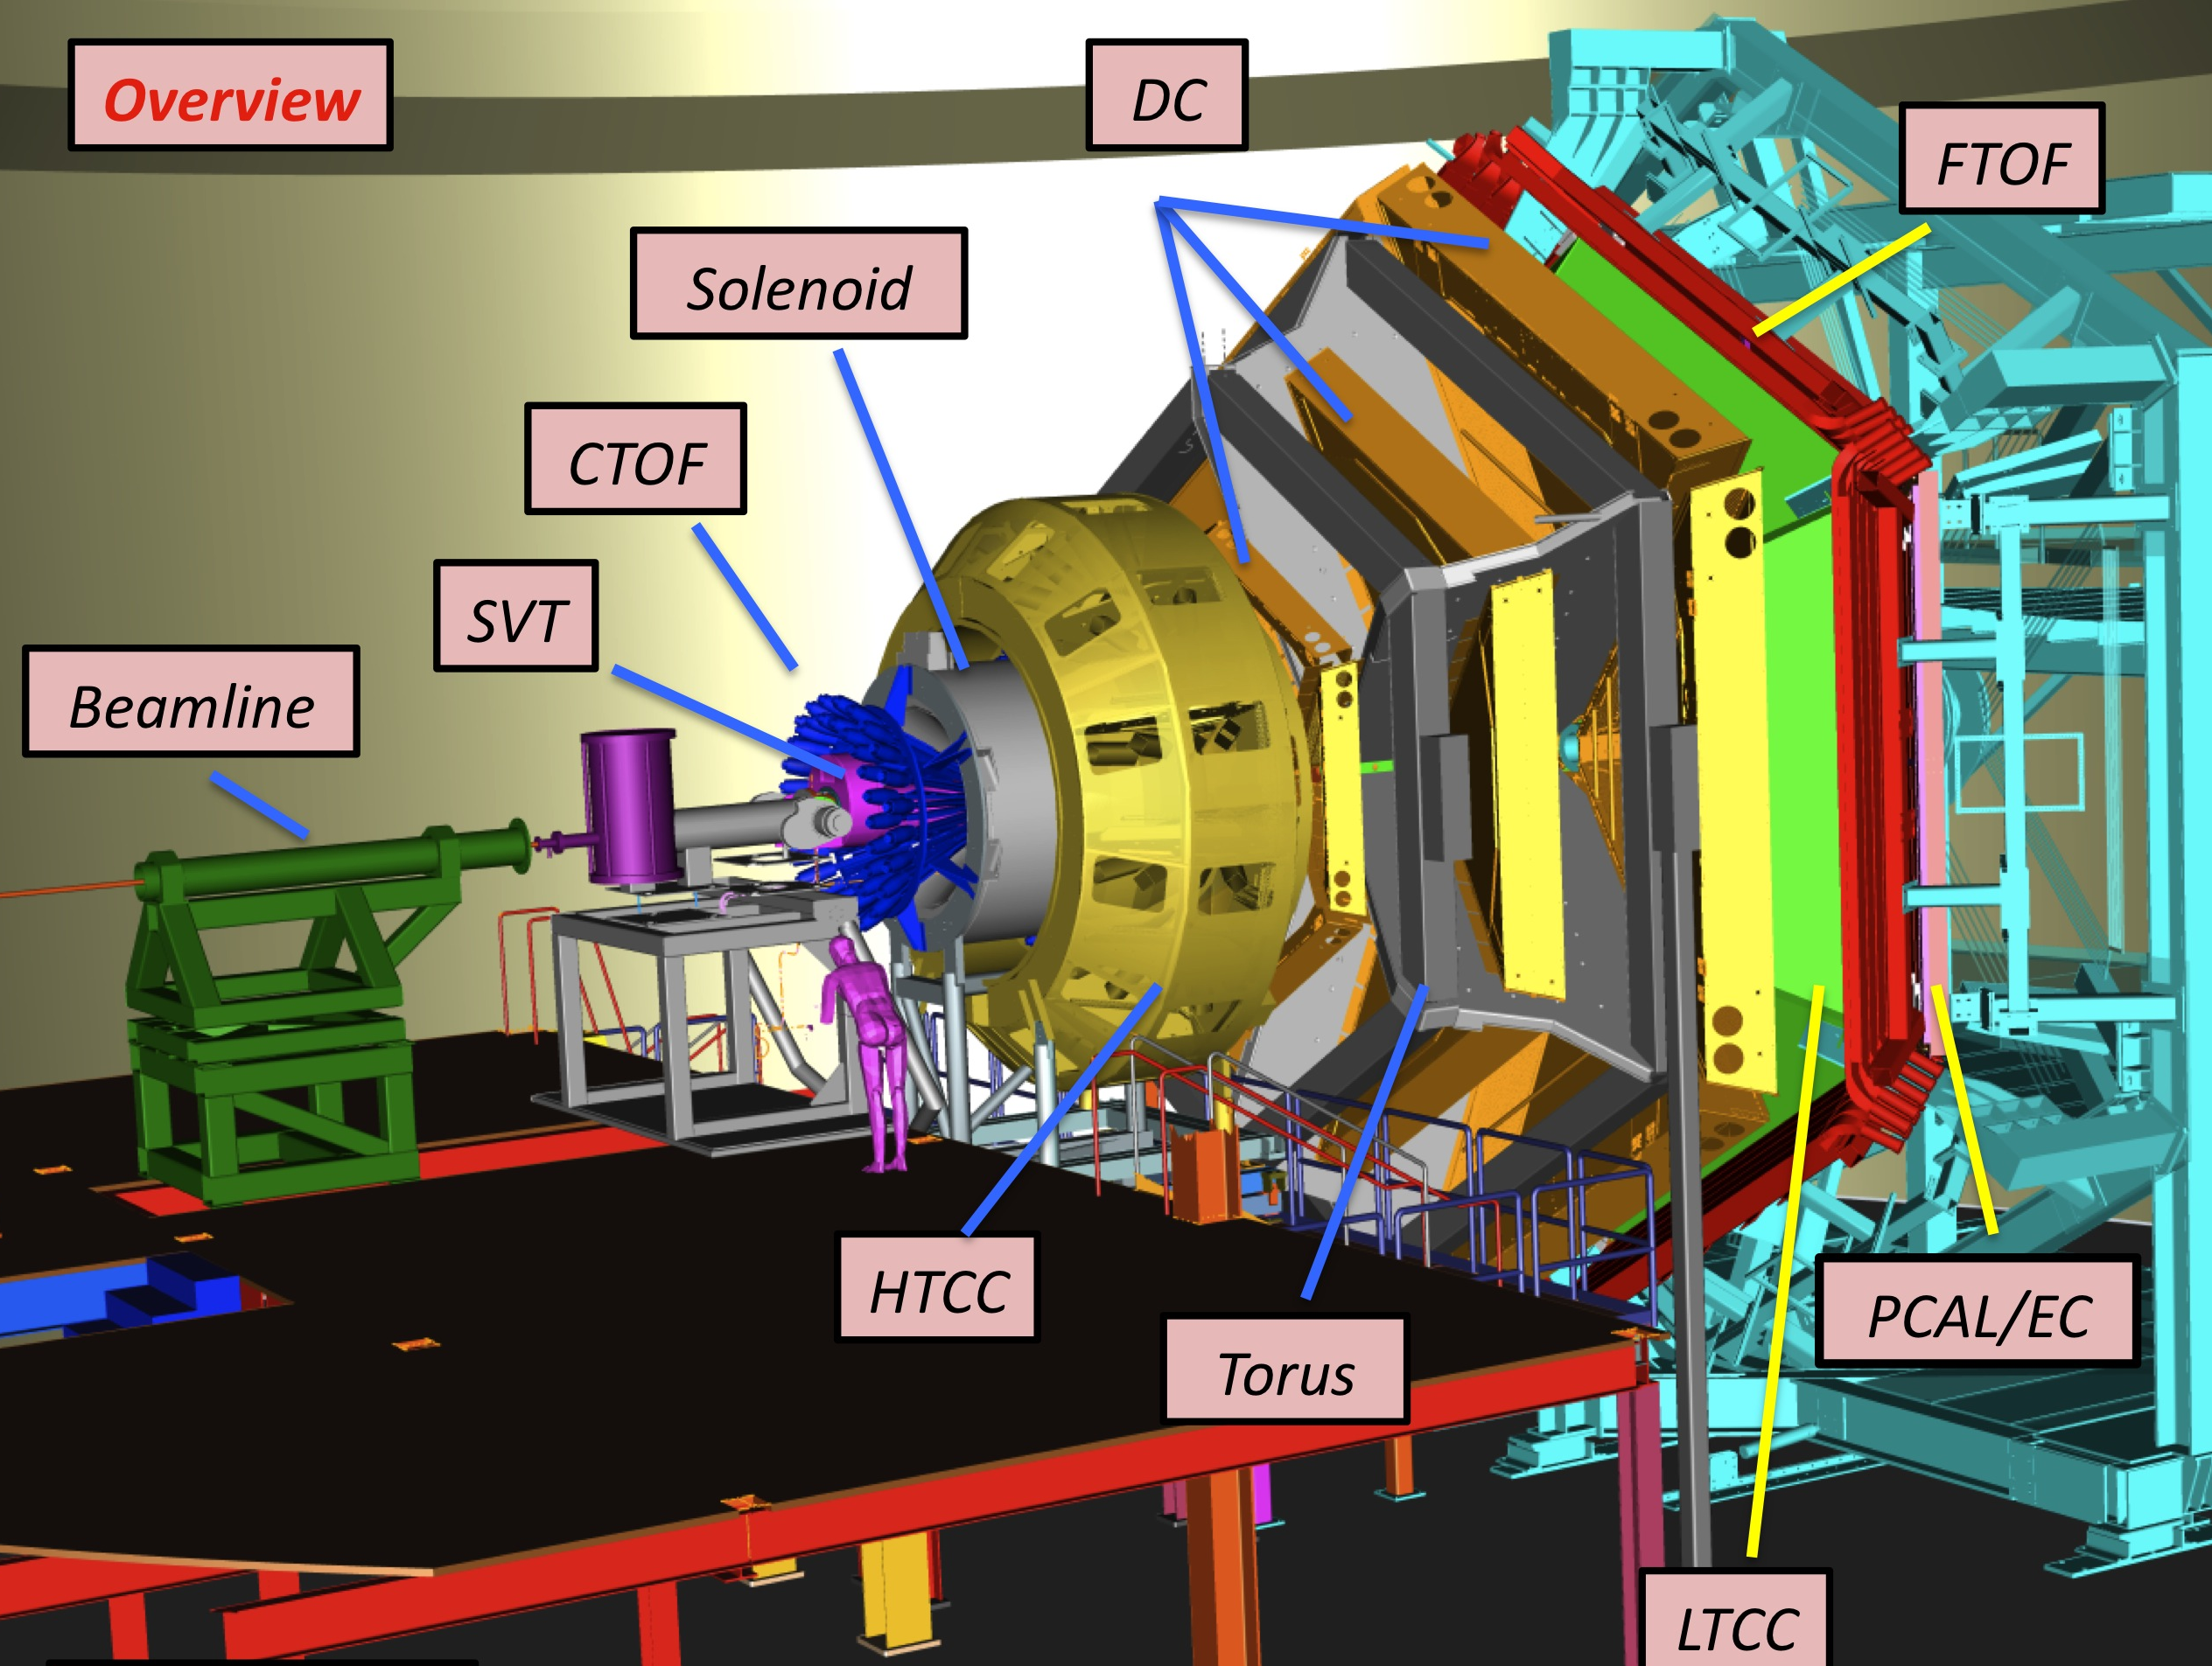
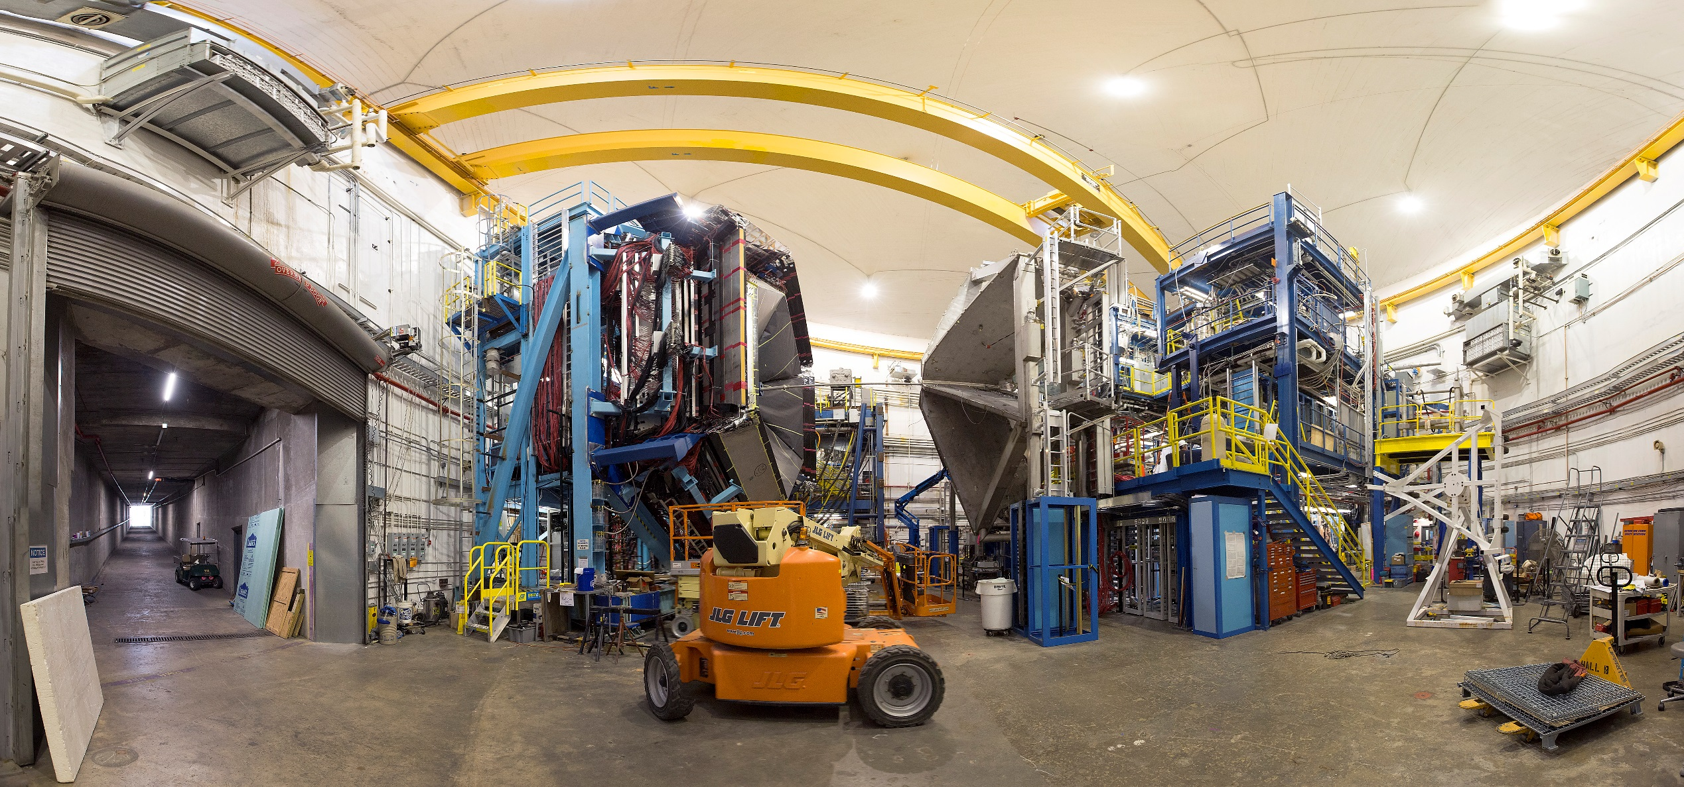
Jefferson Lab’s Experimental Hall B

Slide 10
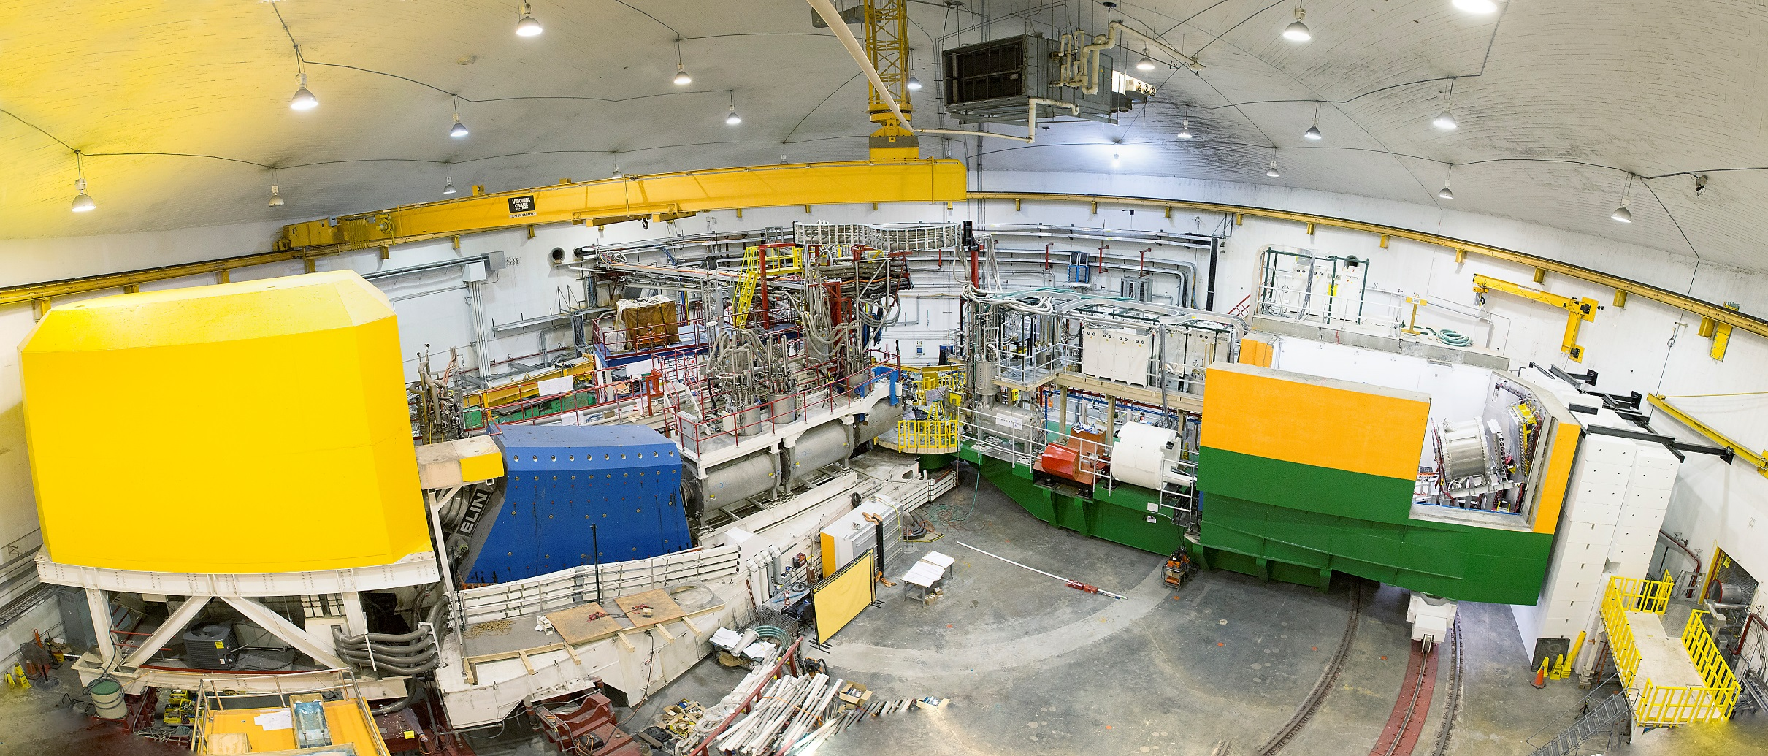
Jefferson Lab’s Experimental Hall C

Slide 11
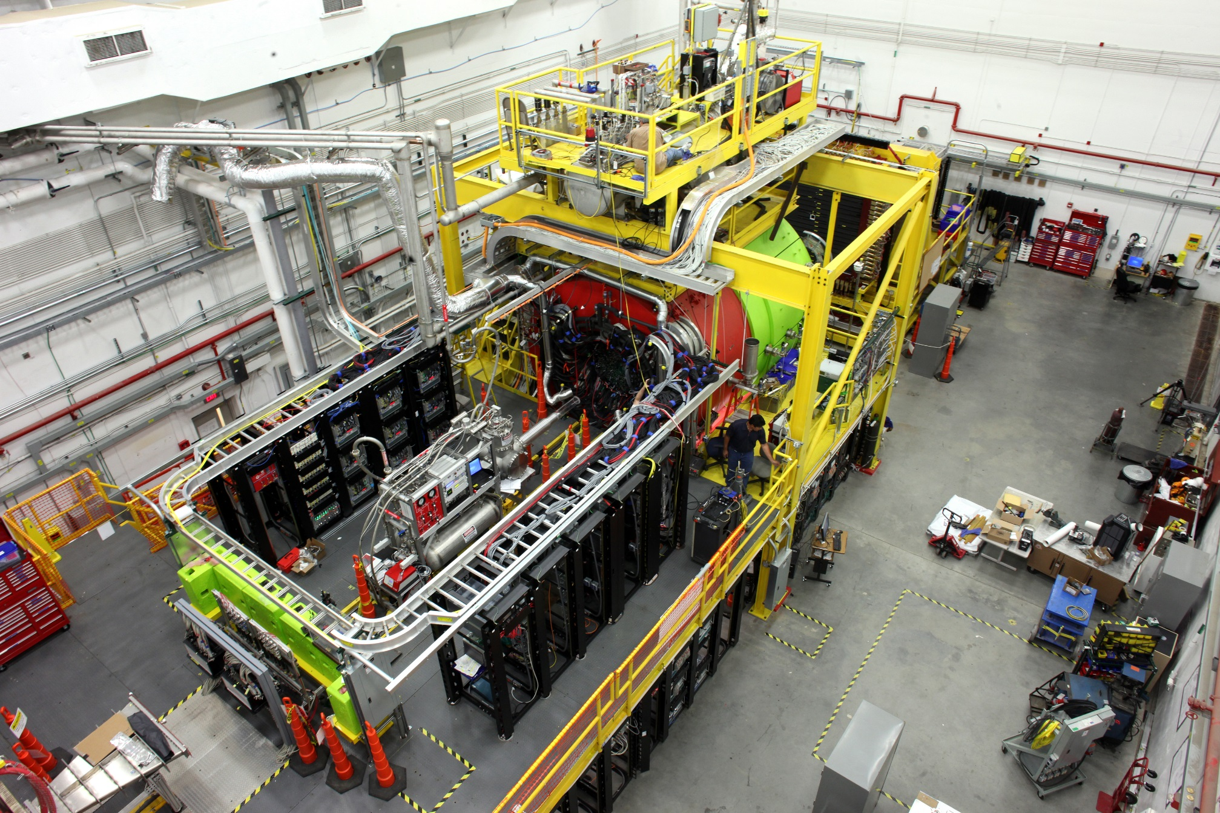
Jefferson Lab’s Experimental Hall D

Slide 12
Some Key Parameters
We can run four halls at one time! ( 1.5 GHz machine sending 250 MHz to the halls )
When running just A,B, C it is 500 MHz to the three halls.
Highly polarized electron beams to Hall A, B, and C
Can always send full longitudinal polarization to one hall
Making carefully selection of the beam energy (making use of g-2) it is possible to get high polarization to two or even three halls at once
Energies to Hall A, B, C up to ~11GeV and to Hall D up to 12 GeV
~0.5 to ~2 GeV/pass
All halls can receive their highest pass.
Any one hall can receive beam from a lower pass

Slide 13
12 GeV Era JLab SRC-EMC Experiments: General
Quasielastic Scattering:
(e,e’) QE High-Q², high-x_{B} | (e,e’p) QE High-Q², high-x_{B}, high-P_{m} | (e,e’2N) & (e,e’3N) High-Q², wide-x_{B}, high-P_{m}
Tensor Polarized d @ Hall C | d @ Hall C [Yero PRL + 2023] | d, ⁴He, ¹²C, ⁴⁰Ca, ⁴⁸Ca, ¹²⁰Sn @ Hall B [2021/22] *All final states possible, starting with charged particles and working towards neutrons
A=3 @ Hall A [Li Nature] | A=3 @ Hall A [Cruz Torres PRL + PLB] Hall B [2025+]
D, ⁴He, ⁶Li, ⁷Li, ⁹Be,¹⁰B,¹¹B,¹²C; ⁴⁰Ca,⁴⁸Ca, Fe, Ni, Cu, Ag, Au, Th Hall C [2022/23] | ⁹Be-¹⁰B-¹¹B-¹²C; ⁴⁰Ca-⁴⁸Ca-⁵⁴Fe; Au Hall C [2022 (23)]
Nuclear DIS:
Hall C – (e,e’) on ⁹Be-¹⁰B-¹¹B-¹²C; ⁴⁰Ca-⁴⁸Ca-⁵⁴Fe; Au …
Hall B – (e,e’π) on nuclei from deuterium to Lead
Tagged DIS / SIDIS – (e,e’N_{recoil}) / (e,e’πN_{recoil})
BAND (d): CLAS12 + recoil neutron
ALERT (d, He, ..): CLAS12 + recoil proton + light nuclei
LAD (d): Hall C + recoil proton
Photonuclear:
d, ⁴He, ¹²C @ Hall D [2021/22] [Jackson’s talk]

Slide 14
SRC-EMC Experiments Running Early 2023
Experimental Hall C
E12-06-105: Inclusive Scattering from Nuclei at xB > 1 in the QE and DIS regimes
E12-10-008: Detailed studies of the nuclear dependence of F2 in light nuclei.
Running right now as a pair and unfortunately the key members couldn’t come here.
Burcu Duran, Casey Morean, Nadia Fomin, Dave Gaskell, John Arrington, and many others
I EXPECT TO SEE SOME GREAT PRELIMINARY RESULTS AT THE 5th SRC-EMC Workshop
E12-10-003: Deuteron Electro-Disintegration at Very High Missing Momentum
Scheduled to start late next month and run until March 20th
Chat with Werner Boeglin and/or Carlos Yeros for more details.

Slide 15
Upcoming Jefferson Lab Experiment Schedule WARNING: FURTHER OUT IN TIME GETS FUZZIER AND FUZZIER
2023 Scheduled accelerator down starts on March 20th
Adding two C100 modules (i.e. 100 MeV of gradient each)
Upgrading the injector of the machine getting ready for the MOLLER experiment
2023 Resumption of Physics Planned for July 21st
Same energy as 2022, but mostly two hall running and now plenty of overhead from the two new C100’s.
Hall D is doing detector upgrades for their 2024 GlueX 2
Hall C NPS experiments: E12-06-114, E13-010, and E12-22-006
Hall B Run Groups D, K, and E (discription experiments in the run groups)
D = Color Transparency & Nuclear TMD’s
E = Quark formation and hadron formation ( nucleus as the laboratory )
K = DVCS, Nuclear Resonances
Hall A SBS experiments E12-17-004 (GEN-PR) and E12-20-008 (K_{LL})
2024 SAD tentatively starts March 17th
After two new C75’s, CEBAF should be back to a true 2.2 GeV / pass machine (i.e. 12 GeV)
2024 Resumption of Physics Late July / Early August
Hall A: GEP-V once finished and start Moller detector installation
Hall B: RG-L (ALERT: Tagged EMC) & RG-K
Hall C: E12-11-107 (LAD) & E12-06-104, E12-06-107 (Color Transparency / Hadronization)
Hall D: GLUE-X 2
Fall 2025 is a possible time for non-standard beam energy experiments
Late 2025 / Early 2026 Moller Starts Physics ( effects what can be scheduled in the other halls )

Slide 16
Some Upcoming Nuclear Highlights
Beyond what is on the two-year published schedule.
Tensor Polarized Deuteron in Hall C
Inclusive QE approved
Nathaly Santiesteban (UNH) looking into (e,e’p)
Tritium and 3He in Hall B
Getting the next JLab tritium target will take some years
We have discussed adding 3He to ALERT
Also could be a run group experiment
Polarized EMC Effect in Hall B ( Lithium target)
And I think it would be great to see another nuclear run in Hall D (see Jackson talks)

Slide 17
Notional CEBAF Long Range Schedule timeline from David Dean
 | 24 | 25 | 26 | 27 | 28 | 29 | 30 | 31 | 32 | 33 | 34 | 35 | 36 | 37 | 38 | 39 | 40 | 41
Moller (funded)
SoLID (science rev)
Positron Source Dev
Pre-Project Dev
Upgrade Phase 1
Transport comm/e+
Upgrade Phase 2
CEBAF Up
FY23 $$
Phase 1: tie LERF to CEBAF & injector for e+ $101M ($78M – $152M)
Phase 2: High Energy Upgrade (includes FFAs) $244M ($188M – $366M)
Total cost (Class 4 estimate) $345M ($265M – $517M)
Schedule assumptions based on a notional timing of when funds might be available (i.e. EIC construction cost ramp down)

Slide 18
Discussion: what else should we measure?
Quasielastic Scattering:
(e,e’) QE High-Q², high-x_{B} | (e,e’p) QE High-Q², high-x_{B}, high-P_{m} | (e,e’2N) & (e,e’3N) High-Q², wide-x_{B}, high-P_{m}
Tensor Polarized d @ Hall C | d @ Hall C [Yero PRL + 2023] | d, ⁴He, ¹²C, ⁴⁰Ca, ⁴⁸Ca, ¹²⁰Sn @ Hall B [2021/22] *All final states possible, starting with charged particles and working towards neutrons
A=3 @ Hall A [Li Nature] | A=3 @ Hall A [Cruz Torres PRL + PLB] Hall B [2025+]
D, ⁴He, ⁶Li, ⁷Li, ⁹Be,¹⁰B,¹¹B,¹²C; ⁴⁰Ca,⁴⁸Ca, Fe, Ni, Cu, Ag, Au, Th Hall C [2022/23] | ⁹Be-¹⁰B-¹¹B-¹²C; ⁴⁰Ca-⁴⁸Ca-⁵⁴Fe; Au Hall C [2022 (23)]
Nuclear DIS:
Hall C – (e,e’) on ⁹Be-¹⁰B-¹¹B-¹²C; ⁴⁰Ca-⁴⁸Ca-⁵⁴Fe; Au …
Hall B – (e,e’π) on nuclei from deuterium to Lead
Tagged DIS / SIDIS – (e,e’N_{recoil}) / (e,e’πN_{recoil})
BAND (d): CLAS12 + recoil neutron
ALERT (d, He, ..): CLAS12 + recoil proton + light nuclei
LAD (d): Hall C + recoil proton
Photonuclear:
d, ⁴He, ¹²C @ Hall D [2021/22] [Jackson’s talk]

