Slide 1
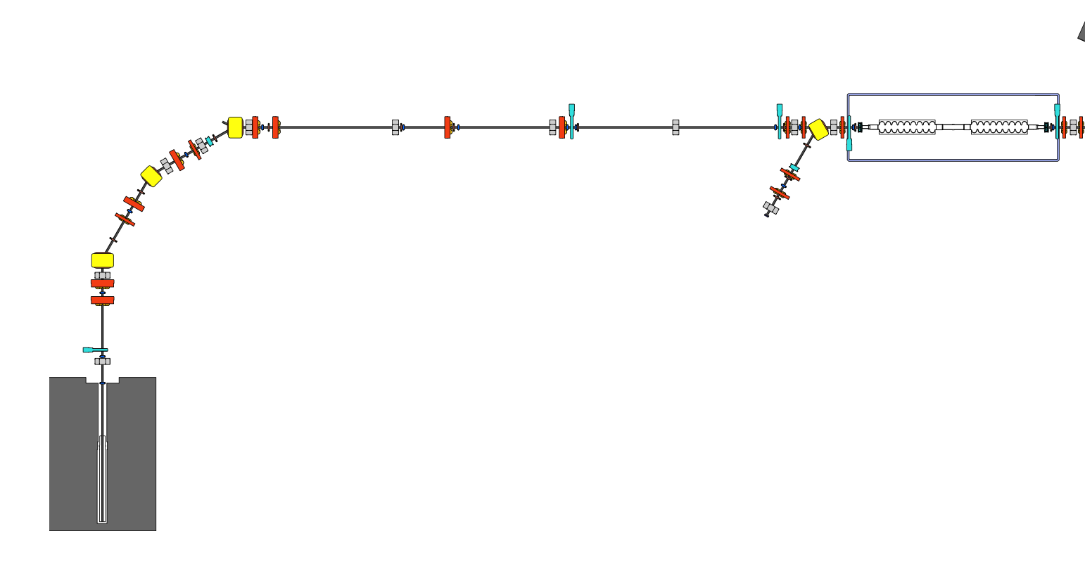
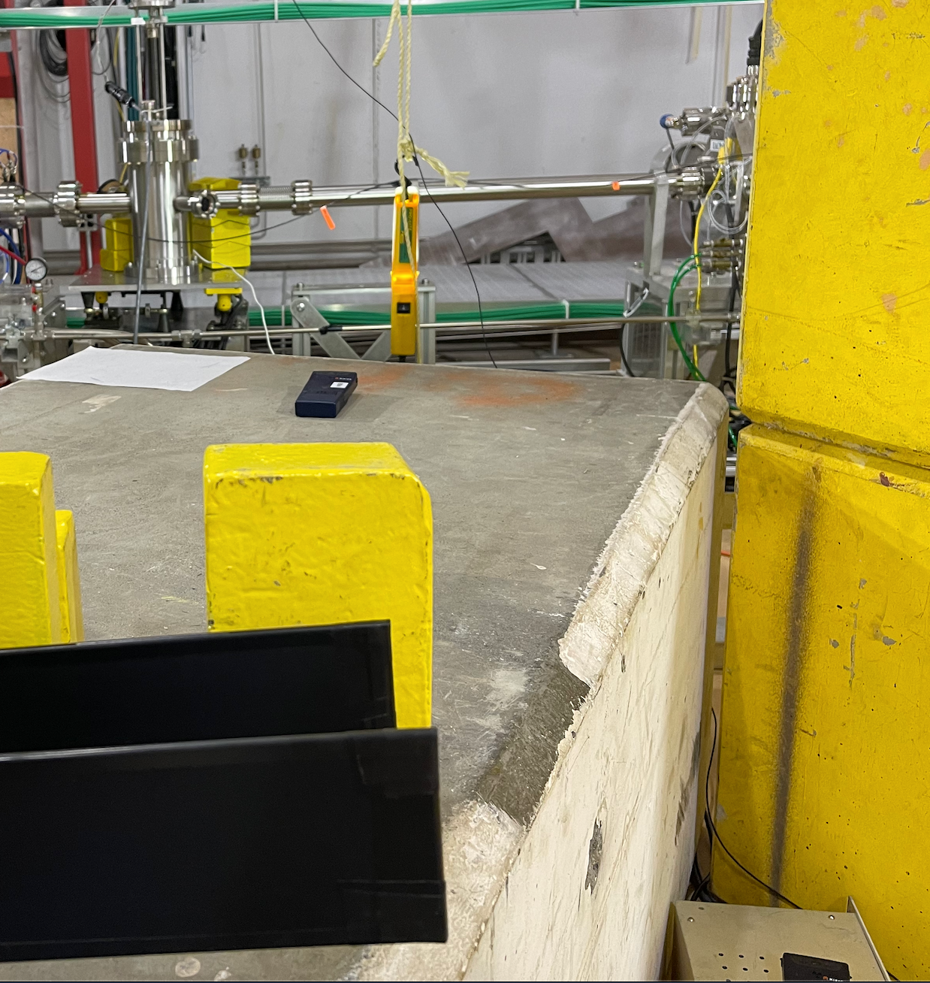
Compare Dump & Cryomodule locations
DL Target
near Cryomodule
near Dump
D884 on top of white block
D883 on floor—shielded
by concrete blocks

Slide 2
Aug 3 Beam on Target
only 10% reaches the dump
-- 10 um Tgt
(12:09, 12:48, 14:56)
–- 1 um Tgt
(12:20, 12:38, 15:05)
D884 on top of white block
D883 on floor—shielded
by concrete blocks

Slide 3
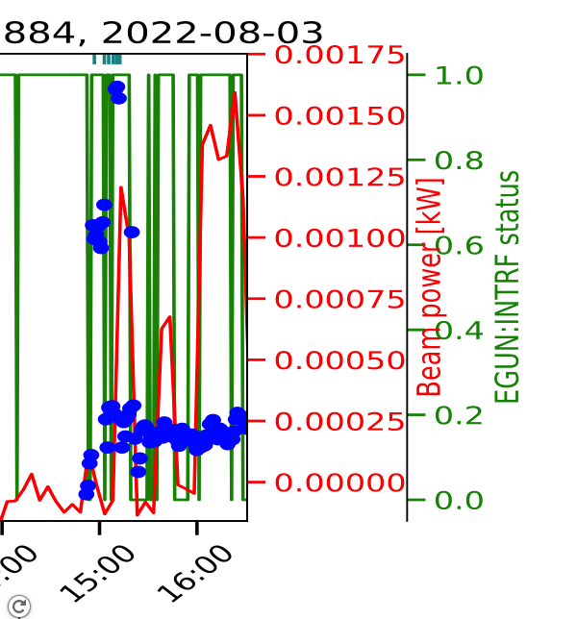
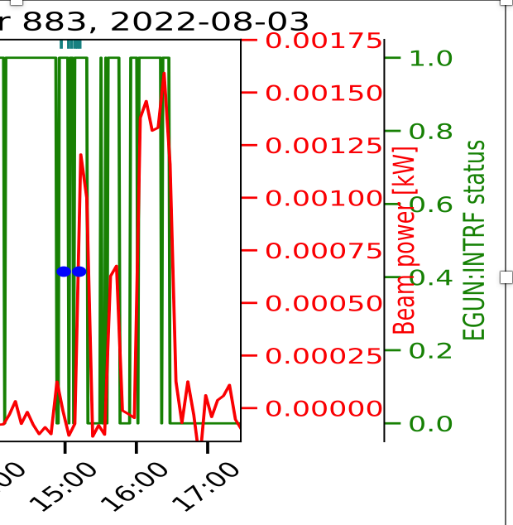
Aug 3 Beam on Target
only 10% reaches the dump
-- 10 um Tgt
(12:09, 12:48, 14:56)
–- 1 um Tgt
(12:20, 12:38, 15:05)
neutron flux
3x10⁵
1x10⁴
15
D884 on top of white block
D883 on floor—shielded
by concrete blocks

Slide 4
Aug 5 Beam on Target
only 10% reaches the dump
14:26 -- 1 um Tgt
14:34, 24;37– 10 um Tgt
14:10, 14:44 -- scintillator
D884 on top of white block
D883 on floor—shielded
by concrete blocks

Slide 5
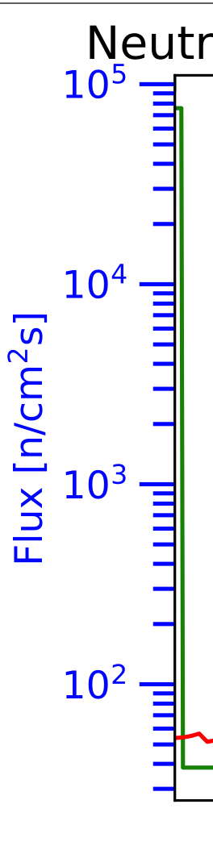
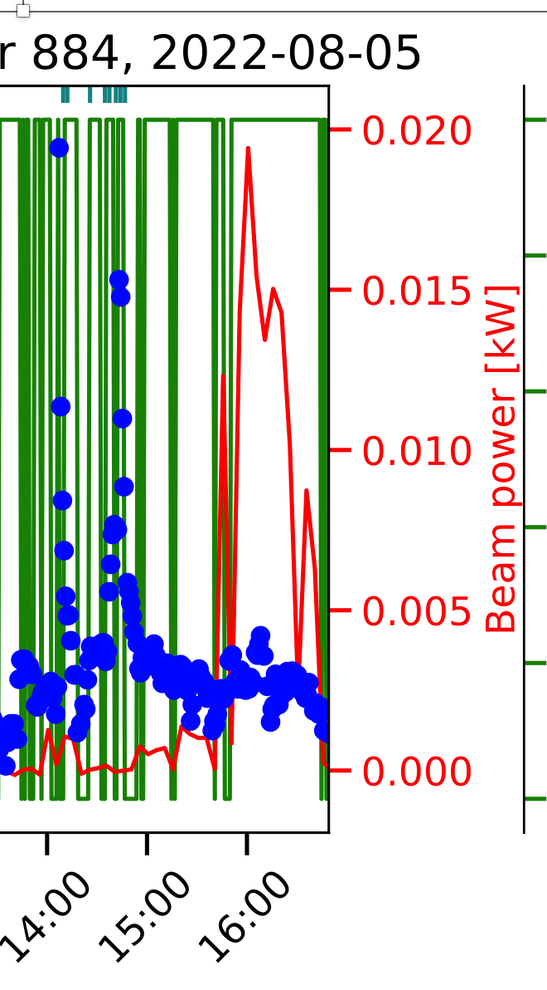
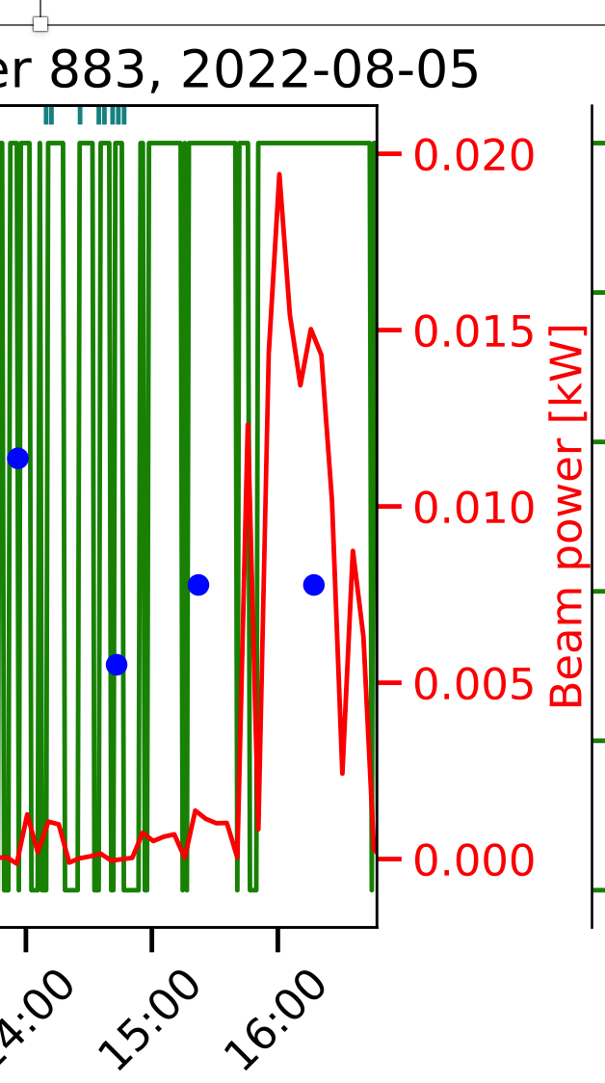
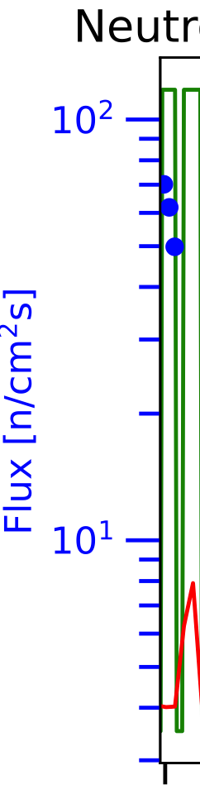
Aug 5 Beam on Target
only 10% reaches the dump
14:26 -- 1 um Tgt
14:34, 24;37– 10 um Tgt
14:10, 14:44 -- scintillator
D884 on top of white block
D883 on floor—shielded
by concrete blocks

Slide 6
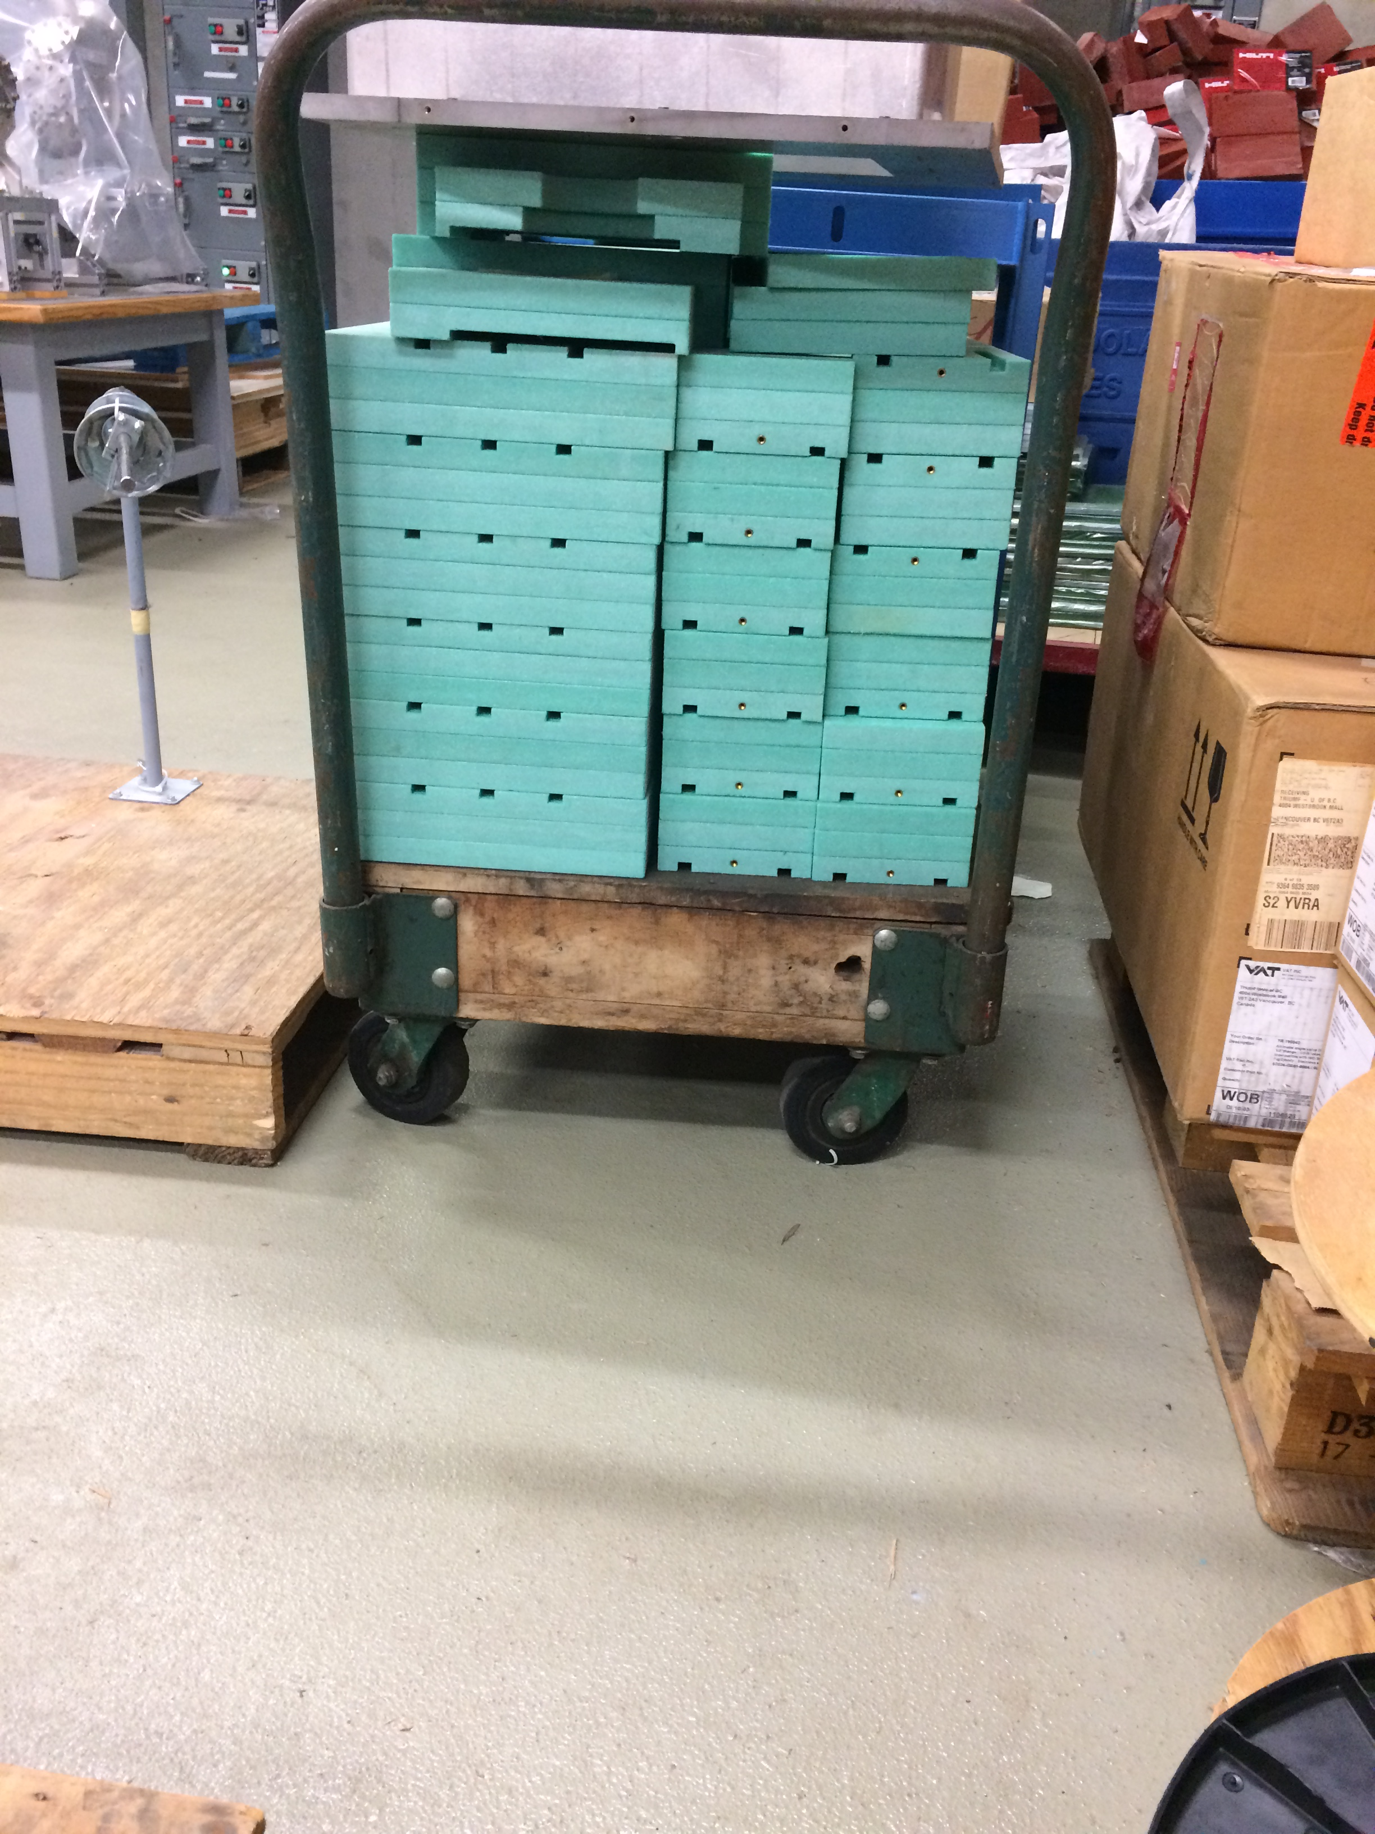
TRIUMF Borated Polyethelyne
--used for shielding monitors
--will be tested by us – asap
--once there is stable beam
at 30 MeV

Slide 7
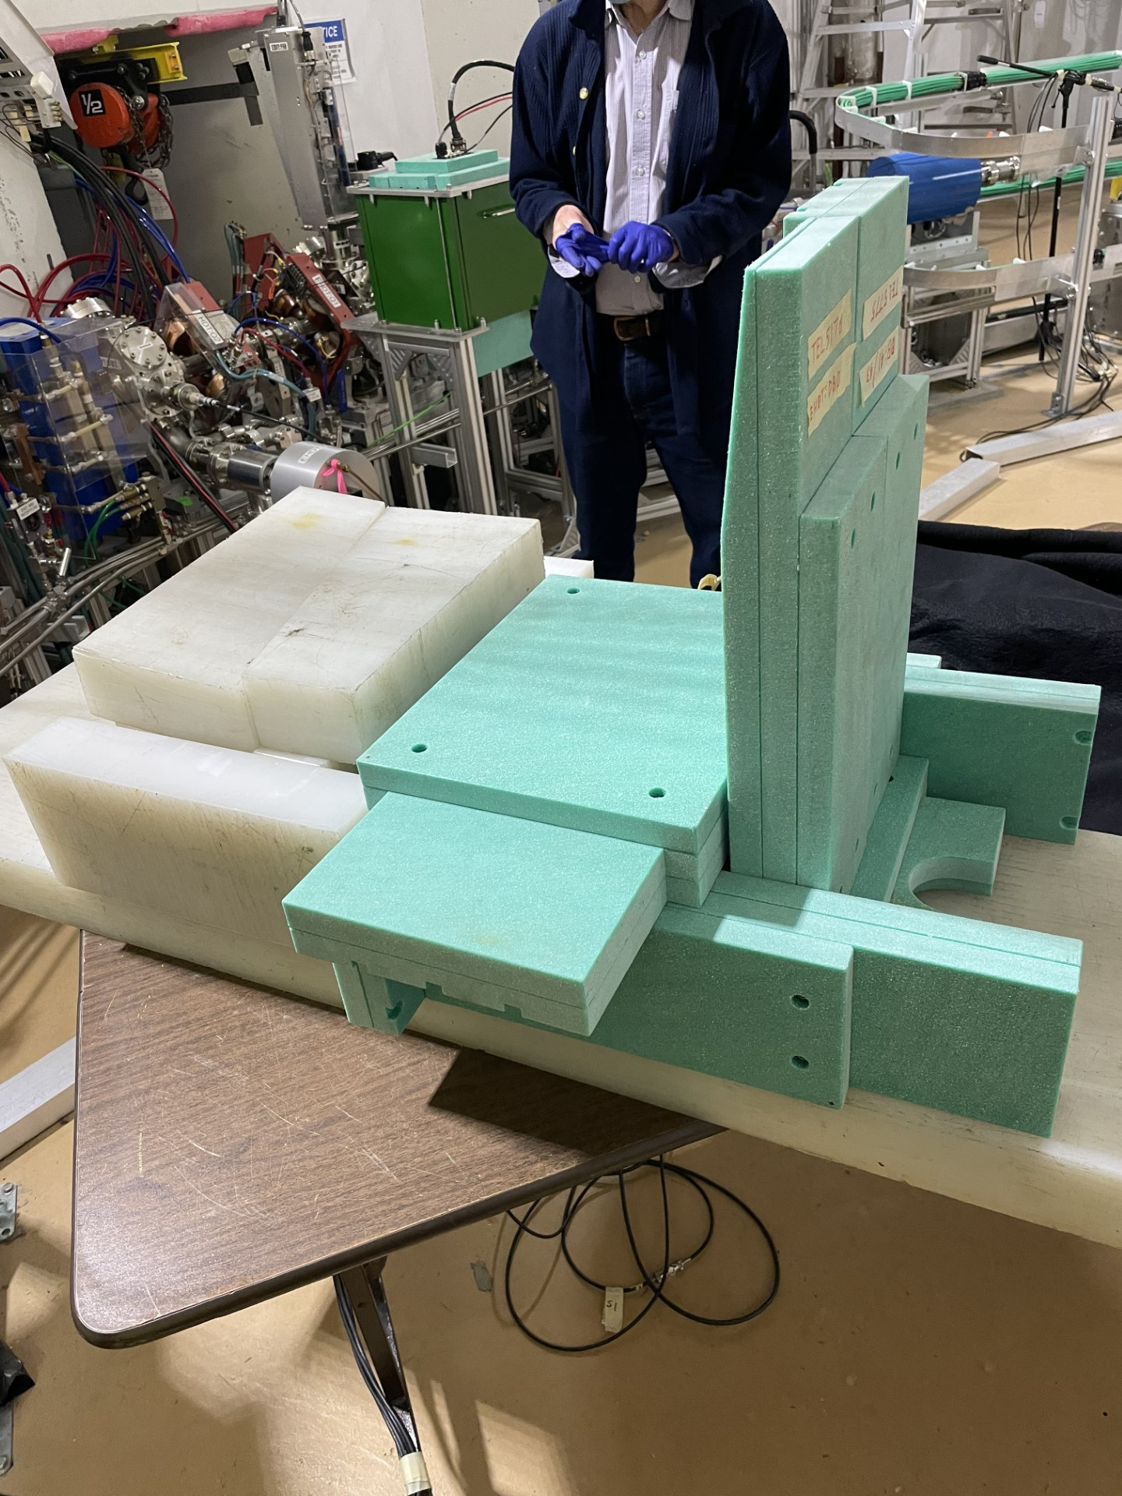
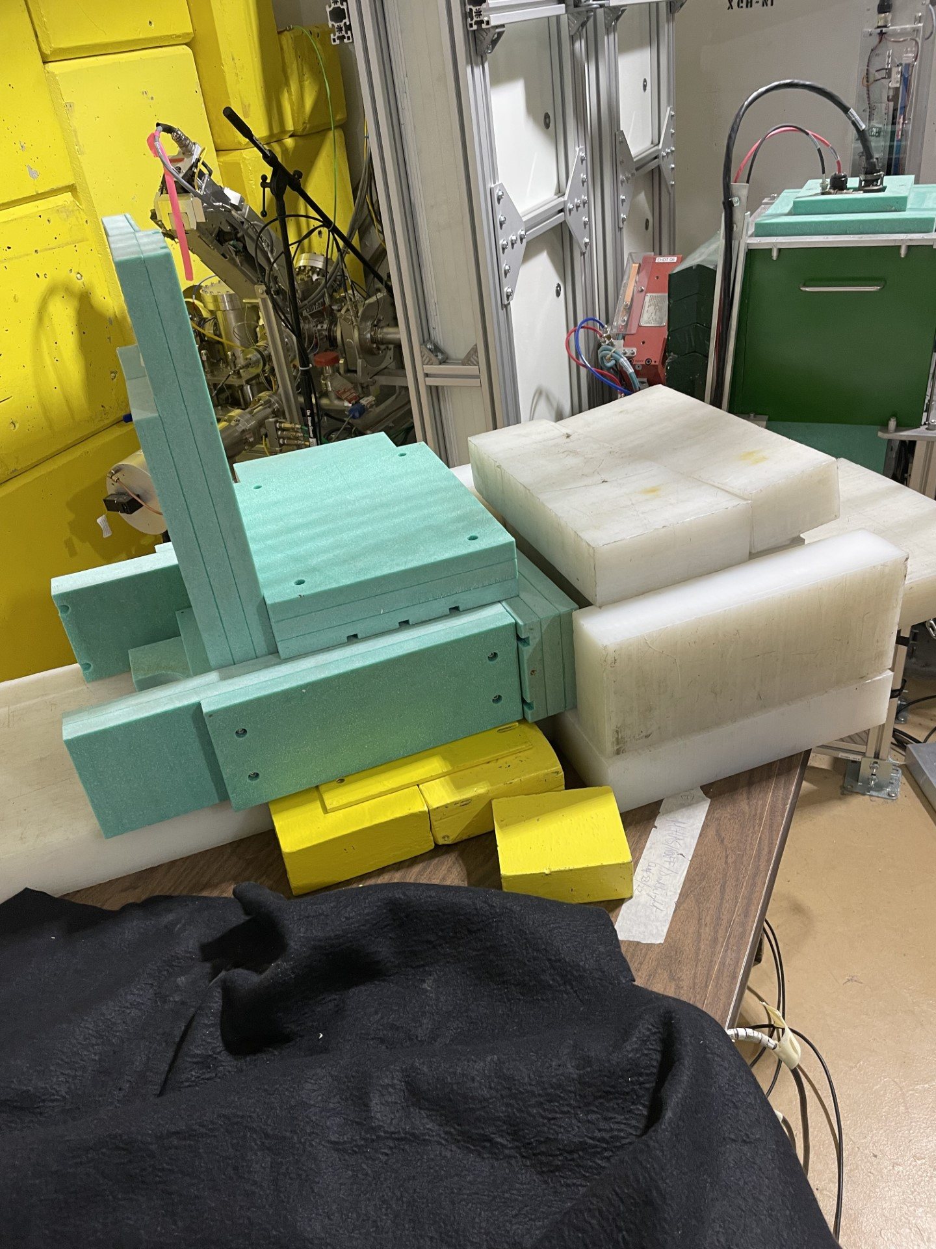
Bkgd Test near the beam dump
Dec 22/22

Slide 8
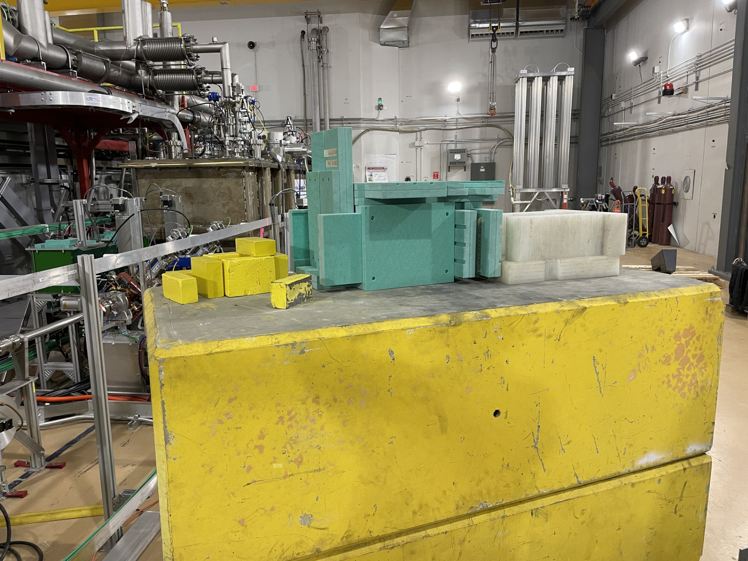
Bkgd Test near the cryomodule

Slide 9
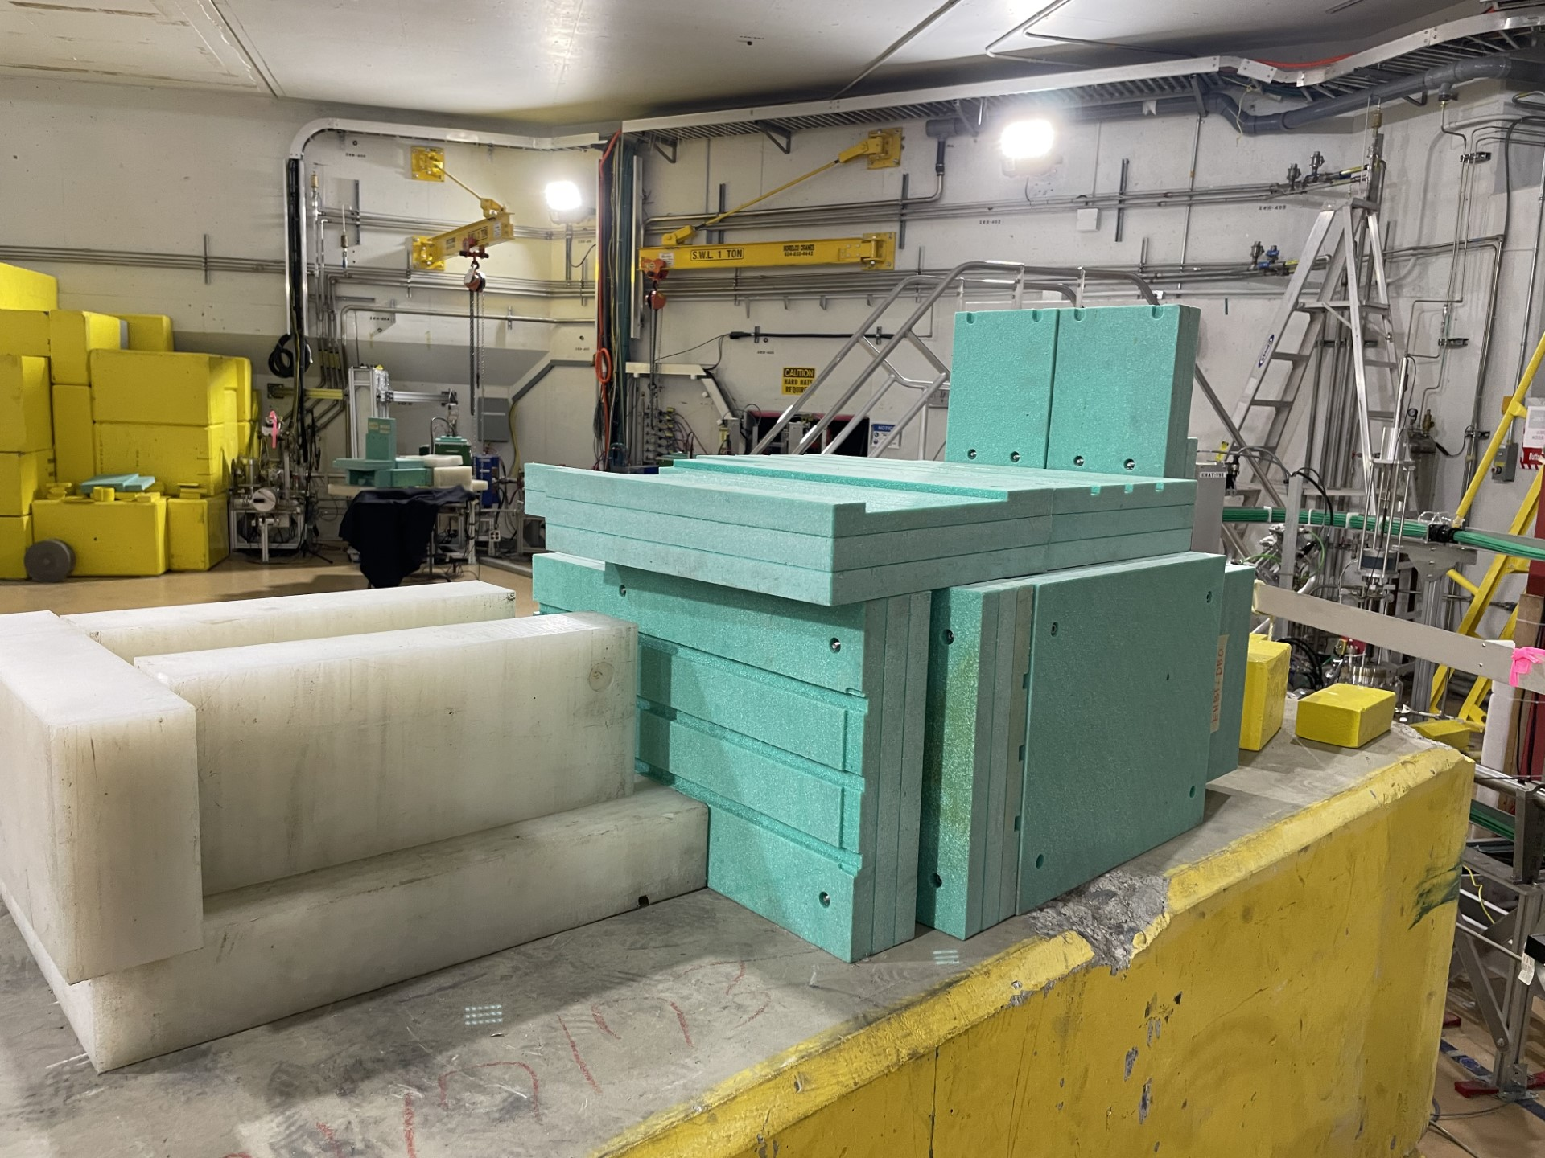
Bkgd Test near the cryomodule

