Slide 1
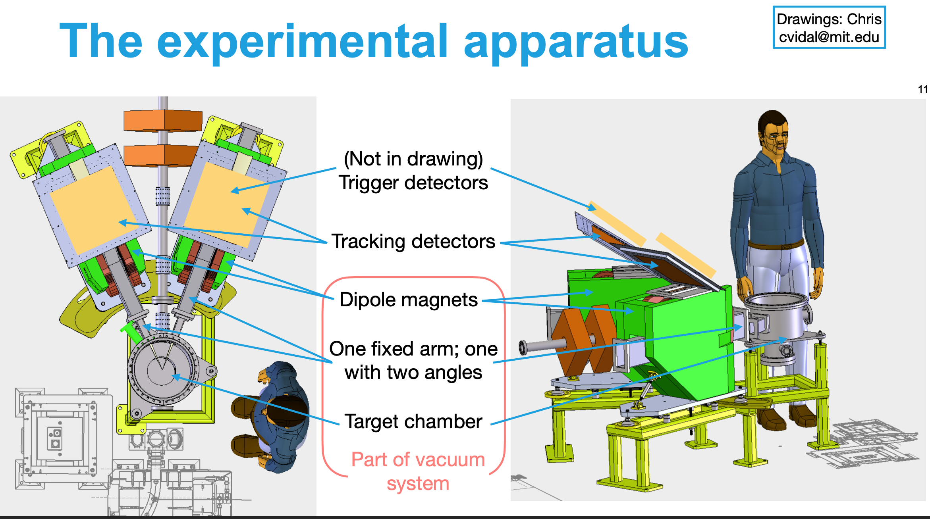

DarkLight
BC-404
68 cm
33 cm
8 -- 15 x 3.8 cm² scint
30 cm
15 cm
26 cm

Slide 2
electron (3.6 MHz)
positron (30 kHz)
150mm
150mm
8-o
7-o
6-o
5-o
4-o
3-o
2-o
1-o
8-i
7-i
6-i
5-i
4-i
3-i
2-i
1-i
16-i
15-i
14-i
13-i
12-i
11-i
10-i
9-i
16-o
15-o
14-o
13-o
12-o
11-o
10-o
9-o
38mm
38mm
304mm
Different FPGA programs required
Need to be able to trigger on single counters for calibration.
Need to adjust timing for each counter to account for the different path lengths in the spectrometers.
Need to form L-R coincident triggers for each bar, then form OR of 8 e- bars, 8 e+ bars, then trigger e- * e+
Need to generate the fast trigger for readout of the GEM tracking chambers – within 1 usec (??)
For each of the 16 scintillators that have signals above threshold –
  -- make in-out coincidence
  -- make electron – positron coincidence ( want < 200 psec time resolution )
  -- output LE and TE time for an offline time walk correction

Slide 3
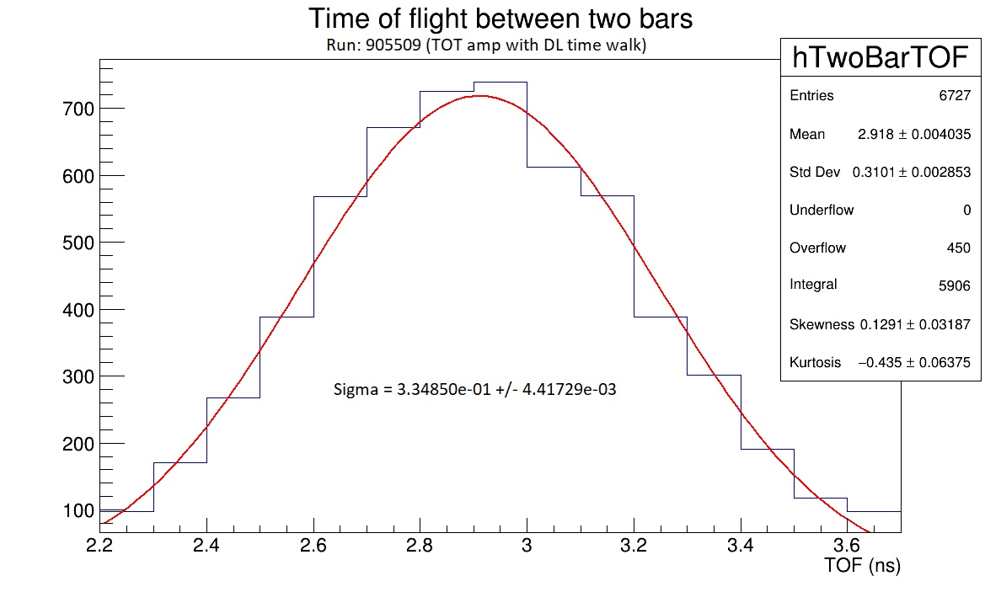
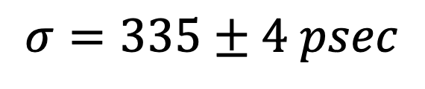
TOF Alpha bar with #1 DL Prototype Bar
$$σ=335±4 psec$$

Slide 4
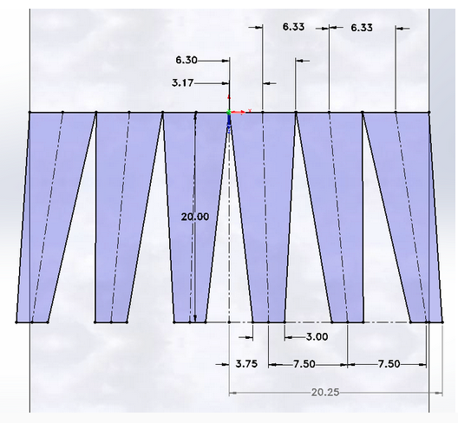
v1b -- 6 SiPM DarkLight Scintillator 38mm wide
BC-404
SiPM spacing at 7.50mm to match the
existing frontend readout board designed
for 4 SiPMs on 30mm scintillator
-- not tested

Slide 5
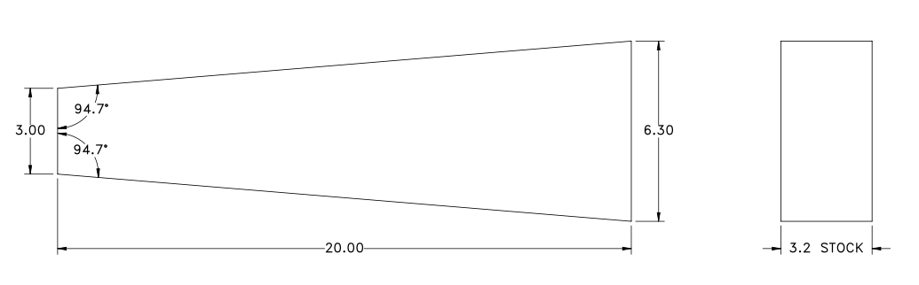
v2 -- 6 SiPM DarkLight Scintillator 38mm wide
BC-404

Slide 6
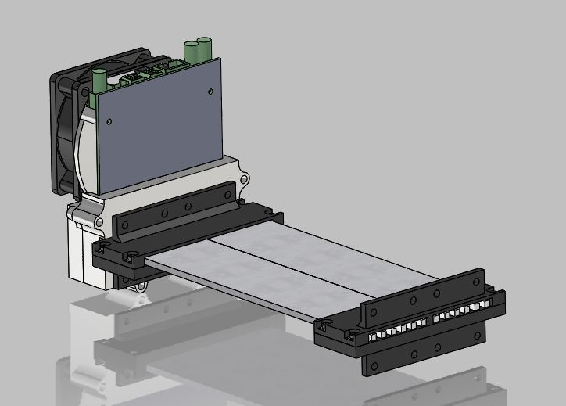
v2-- Prototype Scintillator May 2023
38 mm wide with 6 SiPMs at each end
One Electronic card holds
2 scintillators and 12 SiPMs

Slide 7
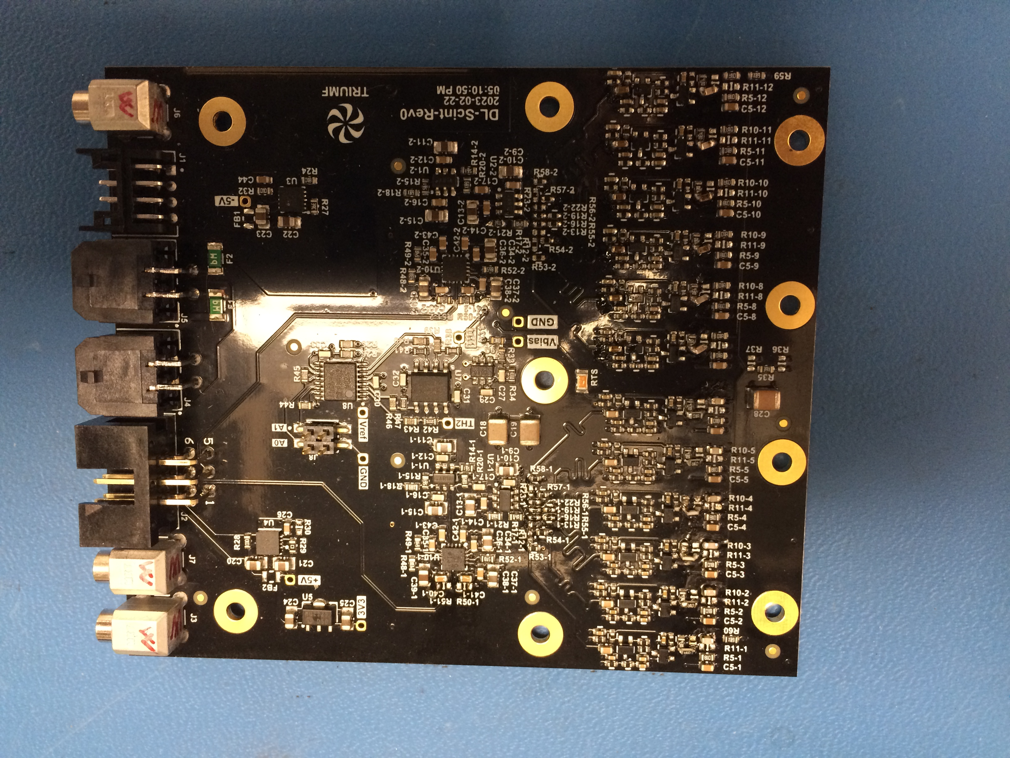
NEW v2 front end readout card (top side)
Preamp, Sum Amp, Discriminator
holds 12 SiPMs/2 scintillators
SUM(6)→fast amp→discriminator
FPGA will check e+ e- coincidence
FPGA will readout LE and TE time
J3 = Pulser-in
J7 = TS1 out
J2 = Logic Out
Next Stages—
measure time resolution (L-R)
measure time resolution -- 2 bars
design power dist’n board
design test pulse dist’n system
develop trigger FPGA system
J4 = +/-5V
J5 = +/-5V
J1 = BIAS 55 V
J6 = TS2 out

Slide 8
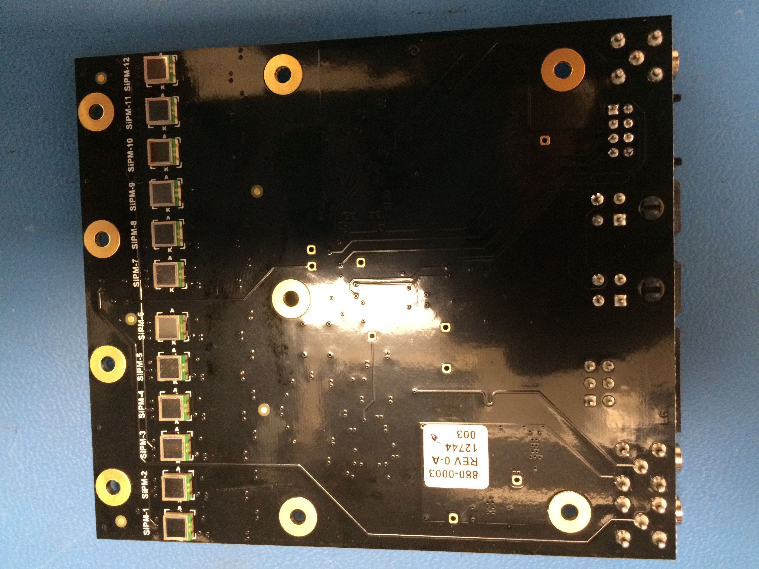
NEW v2 front end readout card (bottom side)
SiPMs--7-12
SiPMs--1-6

Slide 9
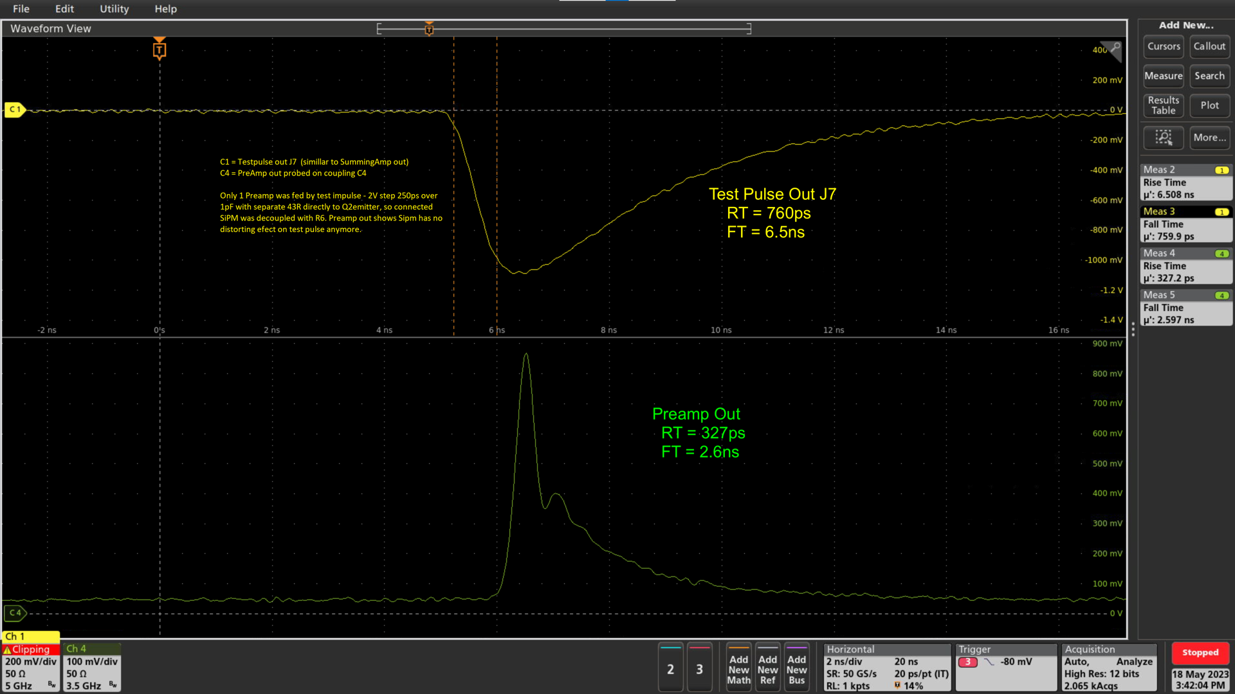
Square wave Test Input pulse

Slide 10
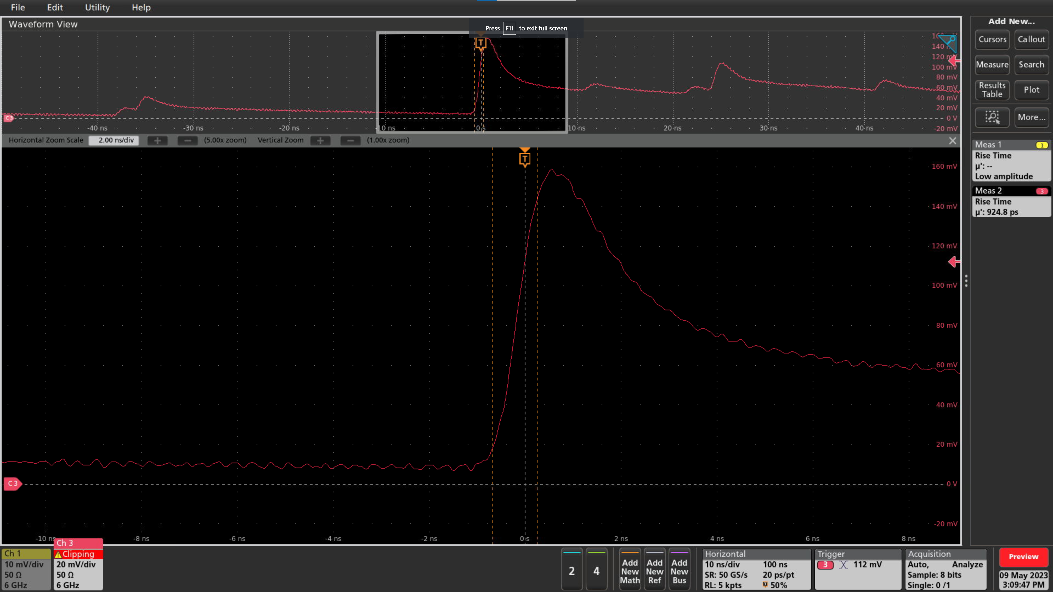
SiPM Dark Noise @ 8V overvoltage
RT= 924 ps

Slide 11
MCX output connectors

Slide 12
v2– Schematic
May 2023
MCX output connectors
for Test-out &
pulser-in signals

Slide 13
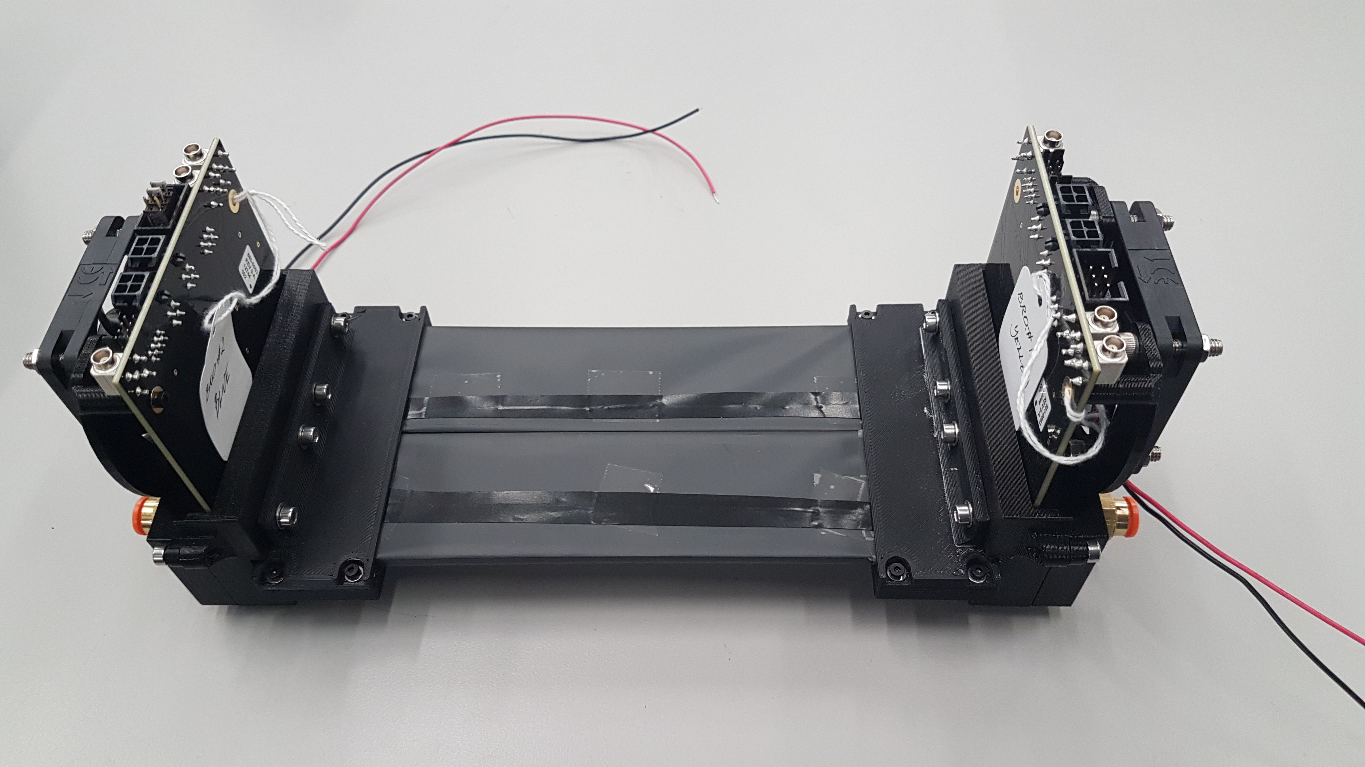
v2-- Prototype Scintillator May 2023

Slide 14
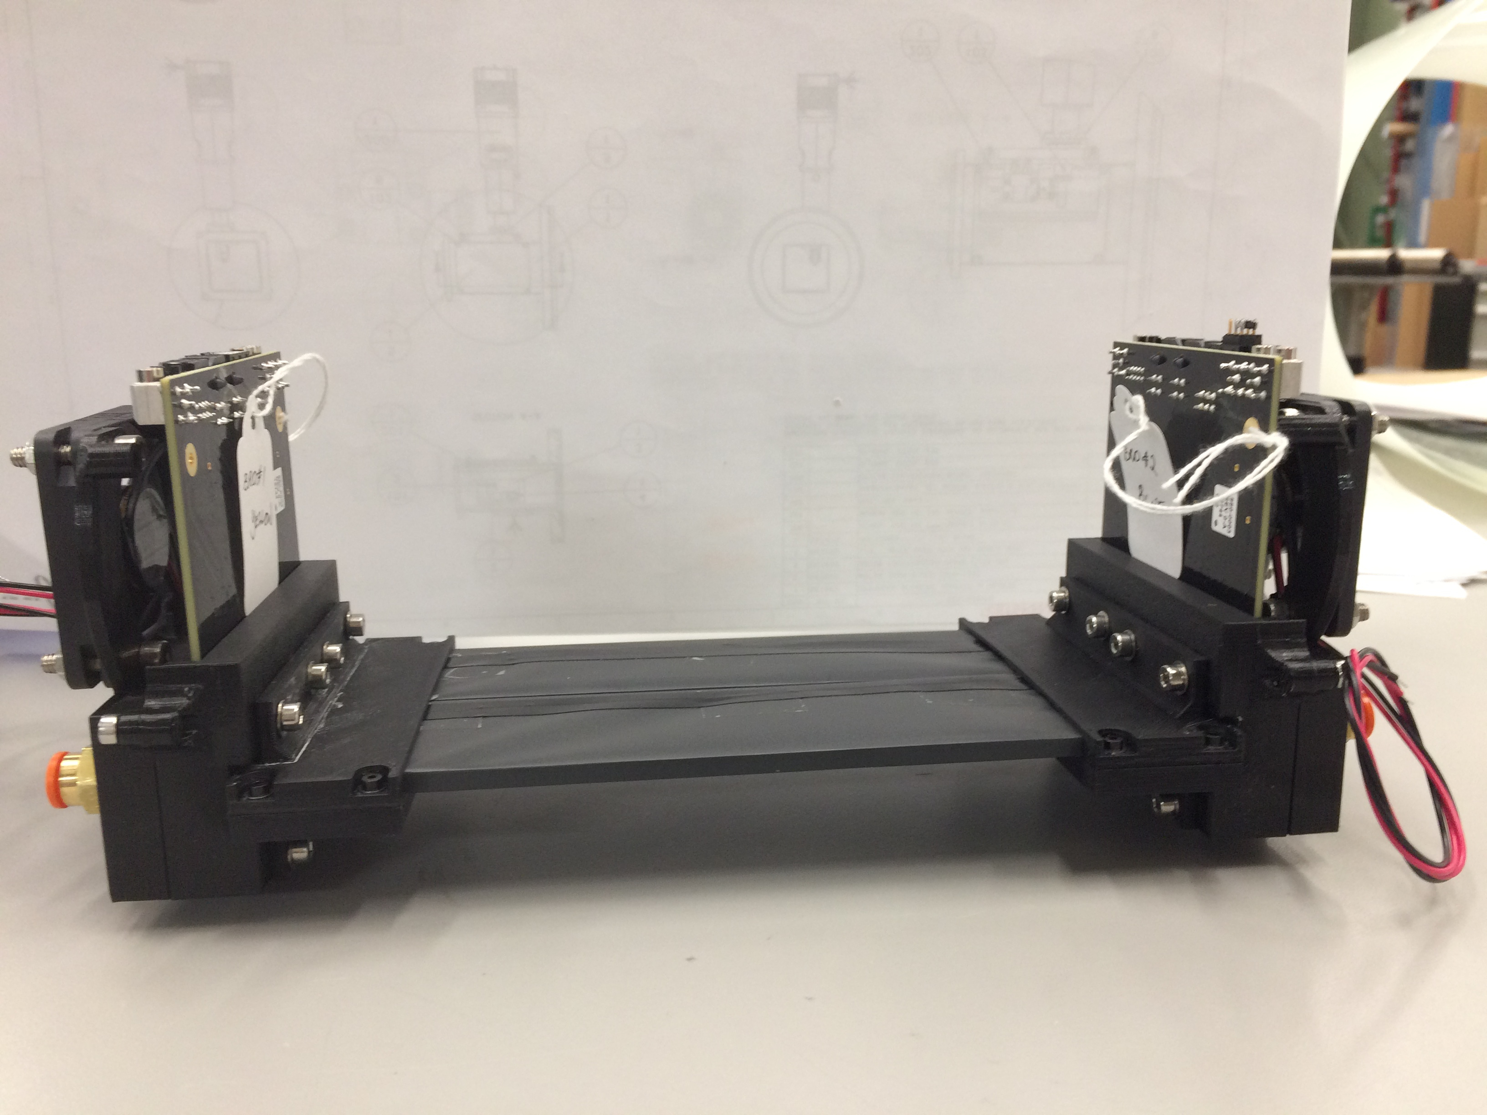
v2-- Prototype Scintillator May 2023
Bottom Support plate--5mm thick
--will be reduced in area
Cooling Fan and possible compressed air flow

