Slide 1
Shielding Requirements
Stephanie Diana Rädel
Accelerator Division

Slide 2
Dose rate limits in accessible areas of TRIUMF facilities are based on Occupancy Factors
Two requirements:
under normal operation, for a chronic beam loss, the shielding must be sufficient to limit dose rates in high (low) occupancy areas to 0.5 (10) µSv/hr; and
under an abnormal or accidental beam loss condition the dose rate be limited to 50 mSv/hr.

Slide 3
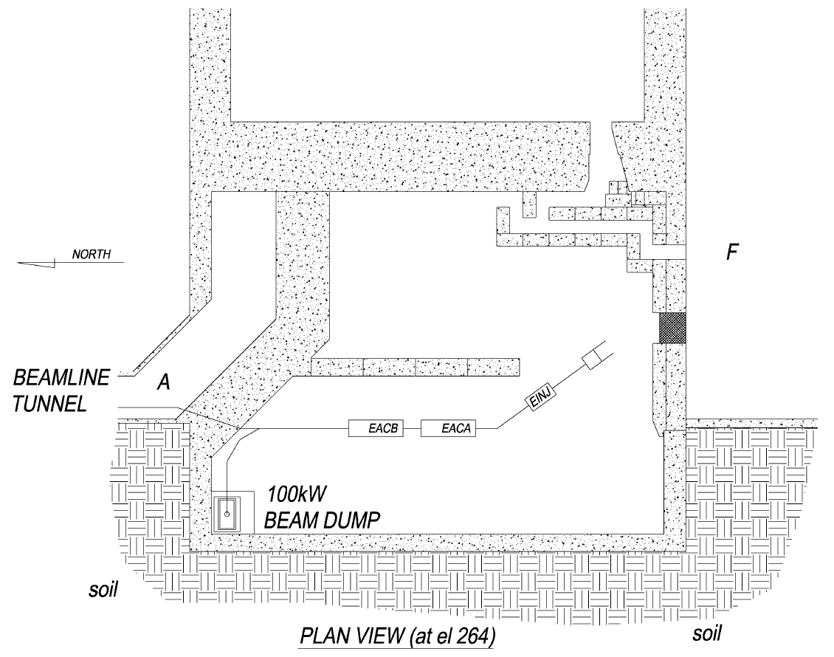
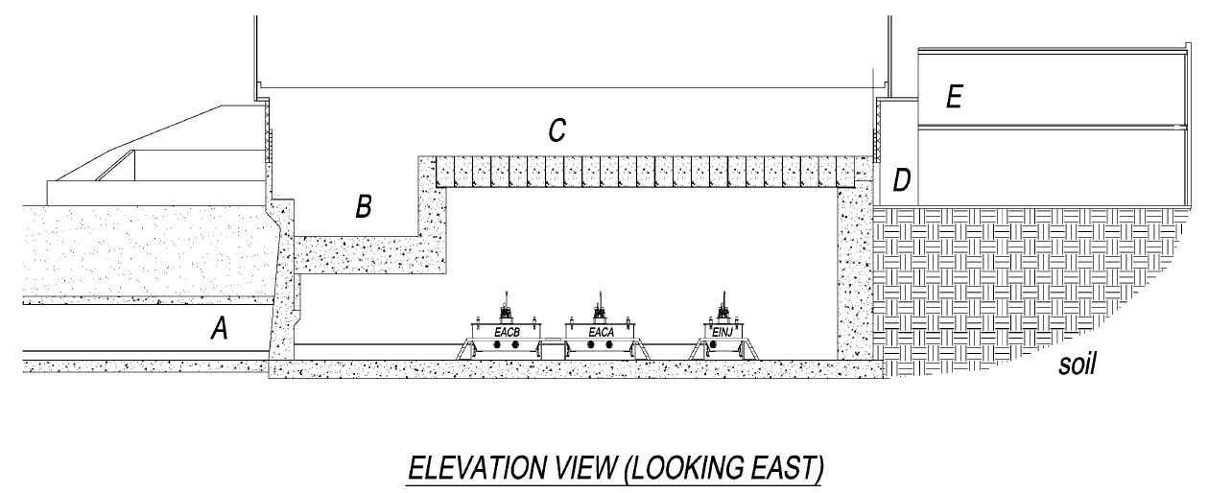
Occupancy levels and where do we need to measure dose rates?
Location | Distance (m) | Occupancy area | Design dose rate limit – chronic loss (µSv/hr) | Design dose rate limit – Full point loss (mSv/hr)
A | 4.6 | Low (B2) | 5 | 50
B | 6.3 | Low (B1) | 5 | 50
C | 10.2 | Low (roof) | 5 | 50
D | 24.9 | Low | 5 | 50
E1 | 29 | High (office area, north end) | 0.5 | N/A
E2 | 33.1 | High (office area, south end) | 0.5 | N/A
F | 23.4 | Low (B2) | 5 | 50

Slide 4
TRIUMF policy on radiation exposure
The accrual of effective dose to workers on the TRIUMF site not classified as Nuclear Energy Workers (NEWs), will be limited to 0.3 mSv in any one quarter.
For normal, ongoing operations the effective dose for all nuclear energy workers on the TRIUMF site will be limited to10 mSv per year and
the equivalent dose to an organ or tissue of a NEW shall further be limited to:
75 mSv per year to the lens of the eye,
250 mSv per year to the skin, hands and feet.
The effective dose to a pregnant NEW shall be limited to 1 mSv for the duration of the pregnancy. It is the supervisor’s responsibility to assign duties such that the exposure to a pregnant NEW is minimized and that this limit is not exceeded.
For temporary employees or outside contractors who are designated NEWs, the effective dose shall be further limited to 5 mSv per quarter and
the equivalent dose to an organ or tissue shall further be limited to:
40 mSv per quarter to the lens of the eye
125 mSv per quarter to the skin, hands and feet.

Slide 5
Further requirements
Requirement | Rational
The beam dump prompt radiation shielding shall attenuate the prompt neutron fluence in the soil to less than 1x10⁴ neutrons/cm² -sec for high energy neutrons (Energy >20 MeV) and less than 1x10⁵ neutrons /cm² -sec for low energy neutrons. | To limit soil and ground water activation.
The beam dump prompt radiation shielding in the vertical direction at a distance of 3 meters outside the shielding shall attenuate neutrons to a dose rate of 50 mSv/hour and photons to a dose rate of 5 mSv/hour. | To meet a design limit for the total chronic loss dose rates outside the 1.8 m concrete roof shielding of 5 µSv/hour for a low occupancy area. The above dose rate requirements will result in a combined neutron and gamma dose rate of 1 µSv/hour to the area immediately above the dump, In addition this area will have a contribution from chronic losses along the accelerator shining through the vertical wall of ~2 µSv/hour, thereby keeping the total dose below 5 µSv/hour. [The TRIUMF policy on dose limits for a low occupancy area is 10 µSv/hour TRIUMF Safety Note 1.8 – Document-544]
The neutron dose rate outside the dump shielding shall be limited to 10 mSv/hour, in order to keep long-lived concrete activation below the CNSC regulatory Unconditional Clearance Level (UCL) of 0.1 Bq/g | Trace quantities of naturally occurring Europium in the Main Accelerator Building concrete (~0.25ppm), when exposed to thermal neutrons leads to long-lived activation products. The Electron Hall wall activation should be kept below the UCL so as to limit the cool-down time at the time of decommissioning.
The beam dump prompt radiation shielding shall result in a combined neutron and gamma dose rate outside the dump shielding of less than 1 mSv/hour, at 3 meters in the upstream direction from the outside of the beam dump shielding. | To limit the additional contribution to the chronic loss dose rate in the hall to less than 10%. The latter is required to protect radiation-sensitive components such as CCD cameras.
The beam dump prompt radiation shielding in the vertical direction at a distance of 3 meters outside the shielding shall attenuate neutrons to a dose rate of 50 mSv/hour and photons to a dose rate of 5 mSv/hour.
The neutron dose rate outside the dump shielding shall be limited to 10 mSv/hour, in order to keep long-lived concrete activation below the CNSC regulatory Unconditional Clearance Level (UCL) of 0.1 Bq/g.
The beam dump prompt radiation shielding shall result in a combined neutron and gamma dose rate outside the dump shielding of less than 1 mSv/hour, at 3 meters in the upstream direction from the outside of the beam dump shielding.

Slide 6
Thank you Merci
www.triumf.ca
Follow us @TRIUMFLab

