Slide 1
ARIEL Status, Plans, Access, Installation and Alignment
Thomas Planche and Stephanie Diana Rädel
Accelerator Division

Slide 2
Milestones & Plans
31 MeV at low beam power
8-hour continuous beam delivery
30 MeV at 10 kW
Feb. 2020
Dec. 2020
Sep. 2021
Mar. 2022
Oct. 2022
End of 2023
26 MeV at 1 kW
Start up in less than 30 min
3-days continuous beam delivery
Upcoming ARIEL milestones:
Mid-2026: commissioning of the ARIEL tunnel
Late-2026: start of rare isotope beam production with the electron beam

Slide 3
e-Linac timeline
Shut down period
About 6 weeks starting first week of July to mid August
Commissioning license until November 30th 2023
Need an operational license to deliver beam to DarkLight
May
June
July
August
September
October
November
December
January

Slide 4
e-Linac timeline
From December on we are good to go to start with the installation
Until the installation start:
As soon as the magnets/ their power supplies and hall probes are available, please ship them to TIRUMF so controls group has the chance to change them in time
May
June
July
August
September
October
November
December
January

Slide 5
e-Linac timeline
Until the installation start:
As soon as the magnets/ their power supplies and hall probes are available, please ship them to TIRUMF so controls group has the chance to change them in time
Write a work request for installation
With enough time (of notice) prep work during summer shutdown from beamlines
Writing a new Safety Analysis Report (SAR) in order to apply for a delivery license
May
June
July
August
September
October
November
December
January

Slide 6
Access

Slide 7
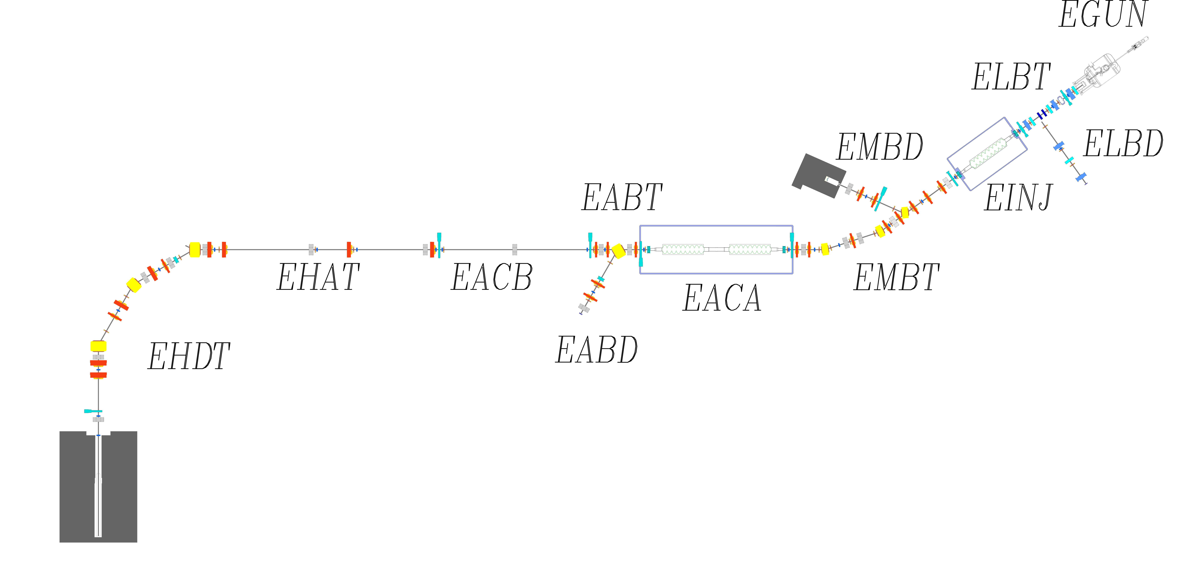
e-Linac General Hall access
ARIEL Targets
& Ion Sources
Time:
Every week will be one day of maintenance day
We must open the hall at the end of every day to recharge the battery (shall be changed during next shutdown)
Place:
Hatch entrance via crane
Maze => south east
Hatch
(north and south)
Electron
Linear
Accelerator
520MeV
Cyclotron
Maze

Slide 8
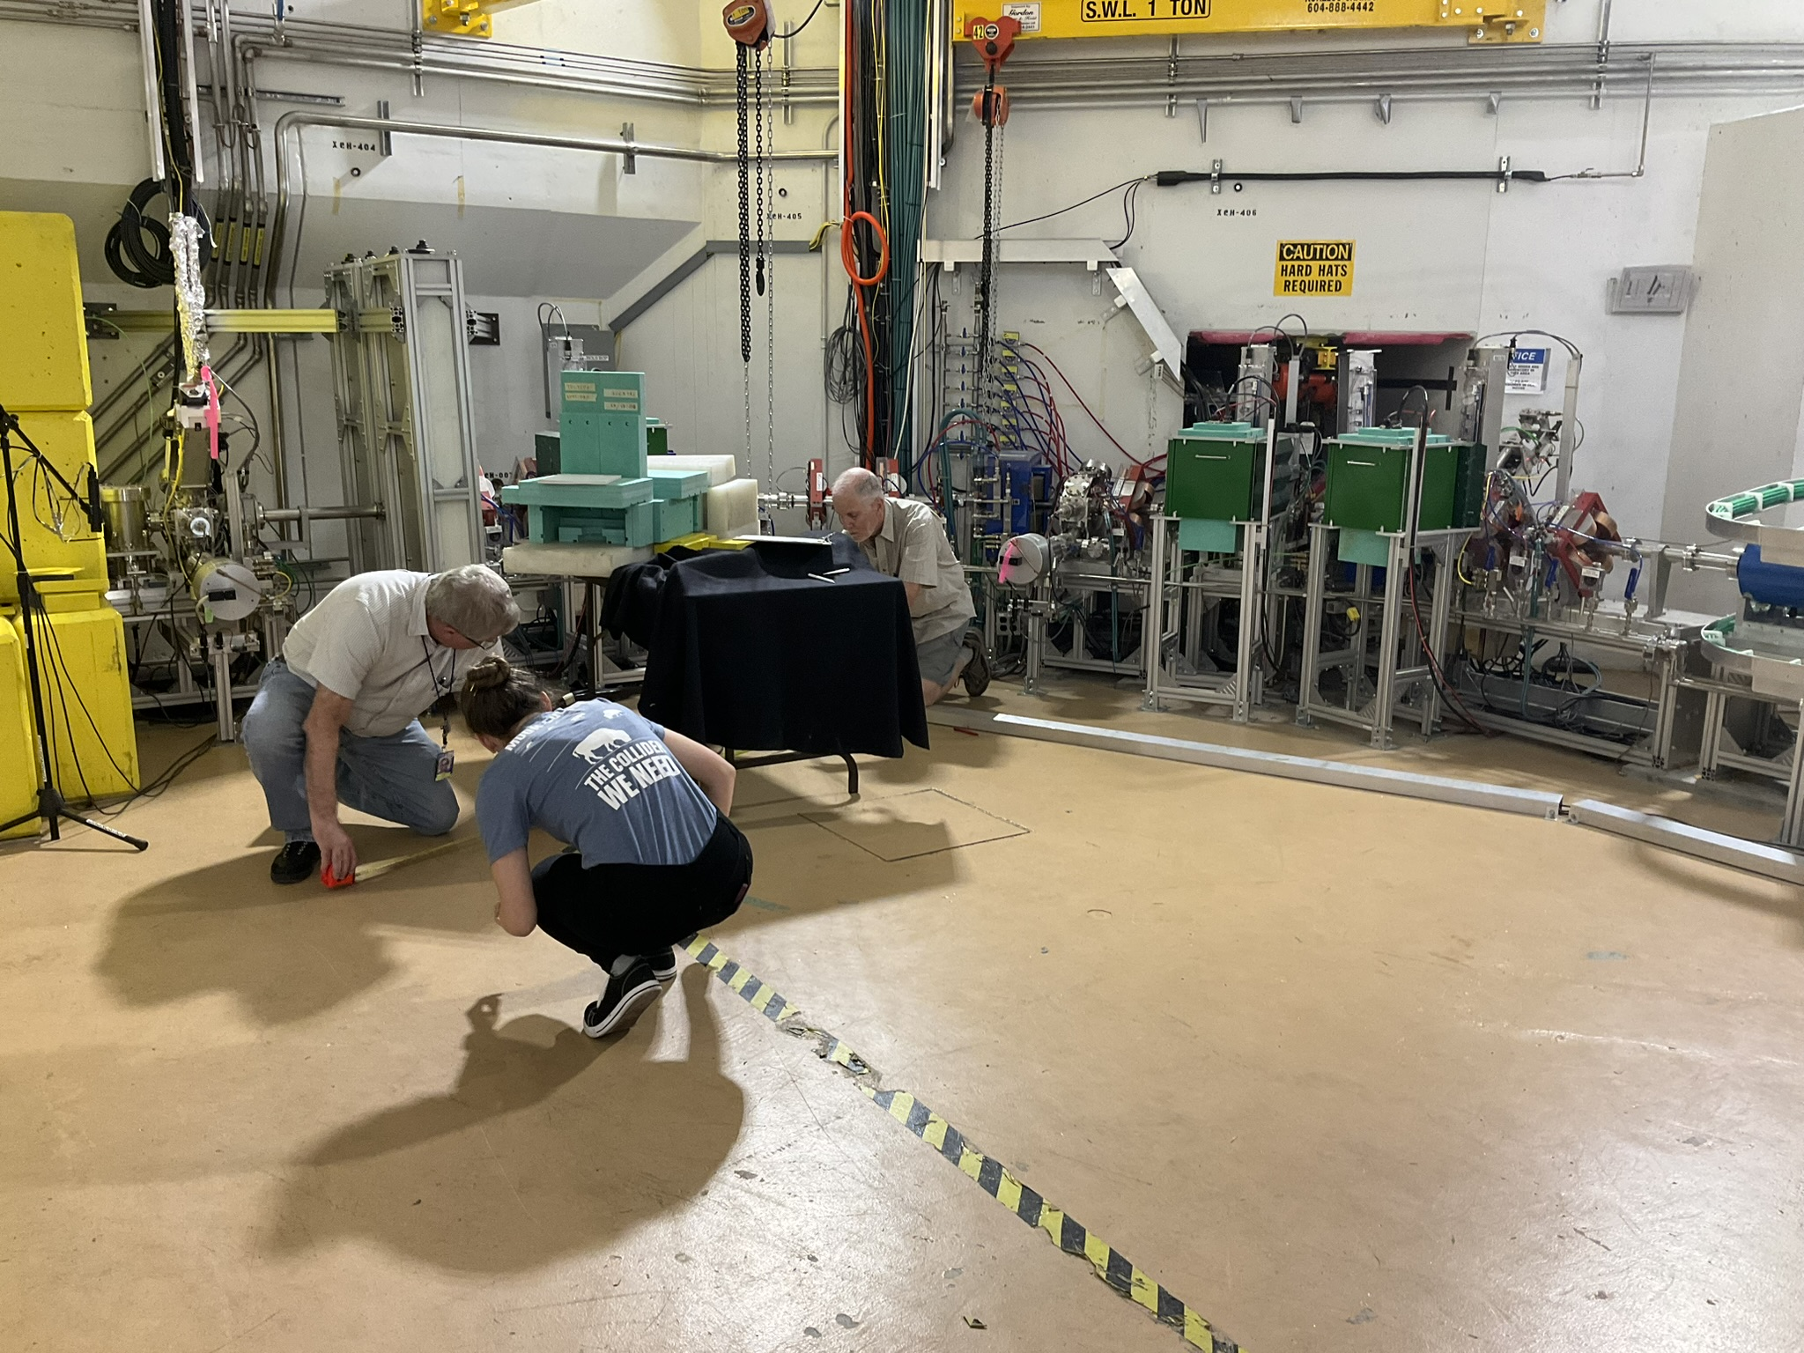
Installation & Alignment

Slide 9
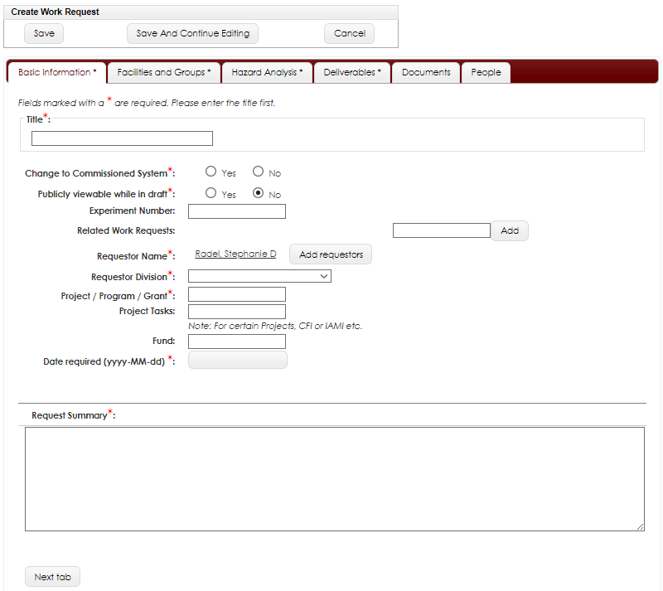
Installation and alignment will be done by Beamlines group (Doug Preddy)
Beamlines need a work request!
Will need including multiple groups since it is one job

Slide 10
Scattering chamber
The hall has a good fiducial grid for alignment.
Accurately placing laser for alignment.
Transfer fiducial points to beam center.
Permanent quads will be aligned by Doug’s group and field mapped.
This way the quads can be aligned to the field center.
Doug can put fiducial marks on the outside (for alignment).
Target ladder needs to be out (so nothing in the beam).
Are the magnets build by Bukley in New Zeeland?
If so, please ask for field measurements and sent them to TRIUMF.

Slide 11
Spectrometer cabling and testing
Beamlines group (Doug Preddy) and Electrical Engineering (Dan Loui):
Physical cabling
operational (functional) test
water flow
Power supplies work
polarity is correct and trip when interlock is pulled
controllable; typical no readback test
Actual beam commissioning between DarkLight and beam physics group.

Slide 12
Up-stream beamline connection
ConFlat connection
Will be established by Vacuum group (Dimo)
Pump down and leak check
vacuum chamber with magnets (and GEMs?) check before going in beamline

Slide 13
Down-stream beamline connection
ConFlat connection
Will be established by Vacuum group
Instal beam-dump collimator
south AND NORTH hatch block are needed for accessing shielding and thus dump => lift plans

Slide 14
GEM detectors
position on spectrometer supports
how accurate do they need to be: mm?
cable HV and HDMI cables
Test if 15m cable are okay, otherwise back to 9m (30 ft)
measure distance to preferred hut location
Trigger and clock is the key
connect gas lines
begin flushing with dry N2 : vent lines can be used
later with Ar:CO₂ 75:25 : control not in the hall, bottles are up in the gas shack, controls are outside of hall due to high radiation

Slide 15
Thank you Merci
www.triumf.ca
Follow us @TRIUMFLab

