Slide 1
DarkLight at ARIEL Dipole Magnet Spectrometers

Slide 2
Experiment layout

Slide 3
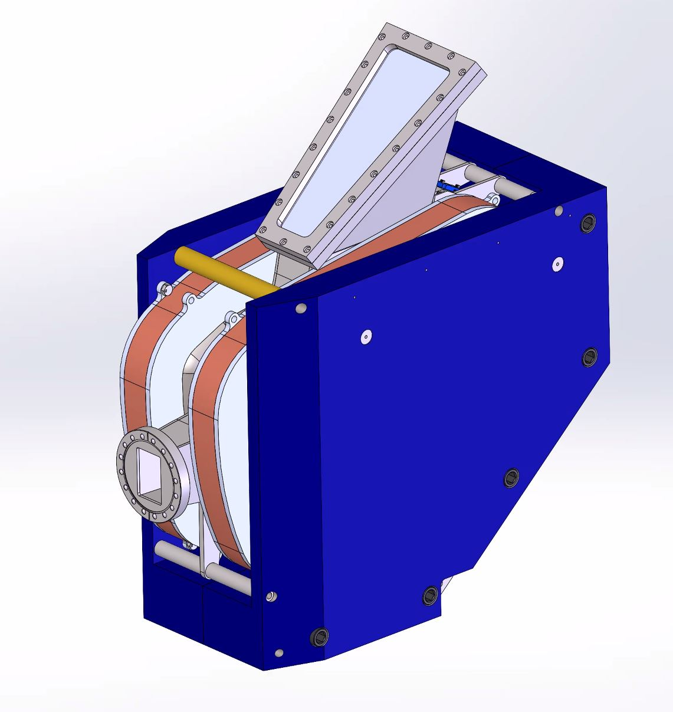
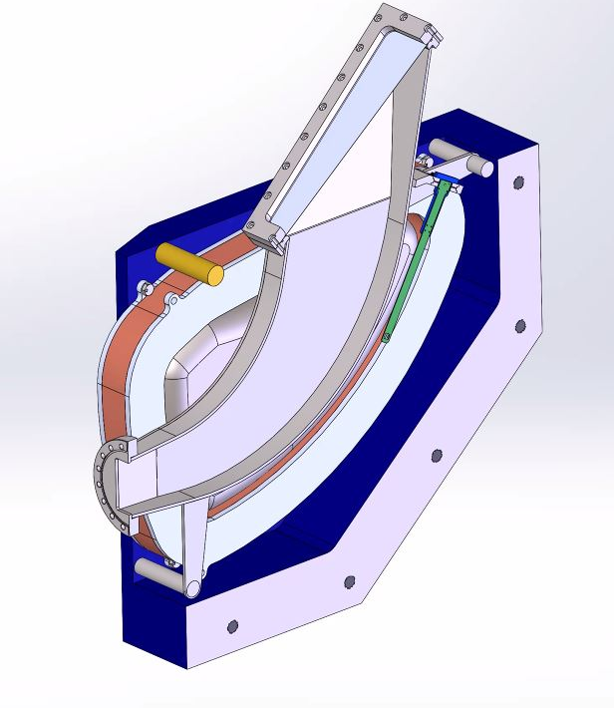
Dipole Magnet Spectrometer

Slide 4
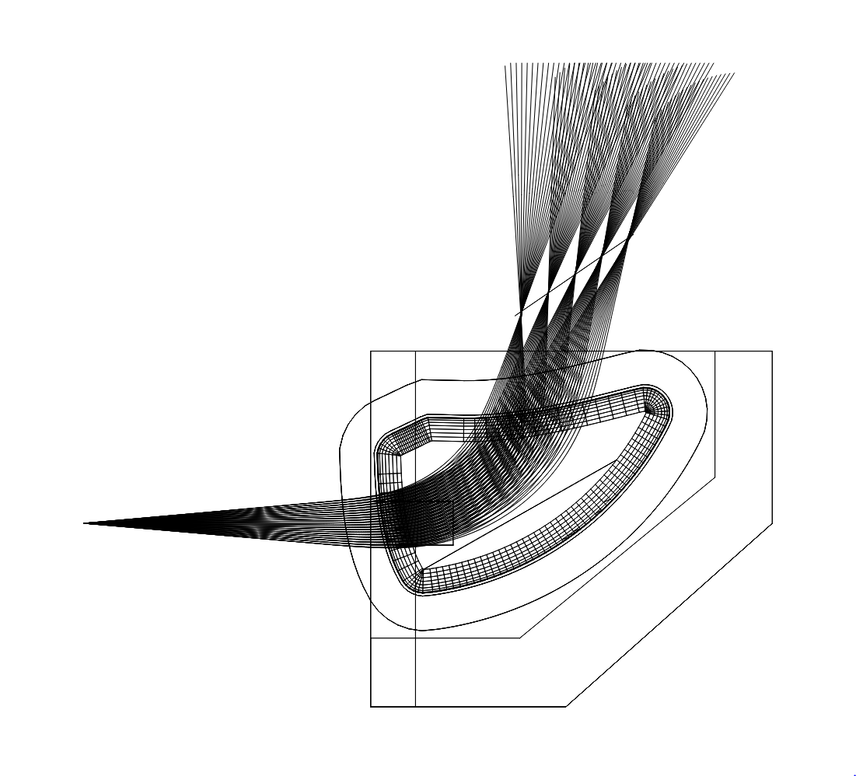
Dipole Magnet Spectrometer
Given: 35 MeV electrons, 80 mm gap, 30 cm bend radius, pole design from Harald.
Field calculated- Use 4 kilogauss in design
NI per coil is 12,725. 25,450 amp turns per magnet.
Ribbon wound coils , potted water-cooling plates.
Current in coils: 132 amps, Resistance of one coil: .120 Ω, Voltage per coil; 15.8V
Power per coil: 2.1 kW. Water cooling. 2 liter/min (.53 gpm), Delta T: 15 C. V=.68 m/s (is in process of changing)
Design iteration in process to match vendor stock and make faster.

Slide 5
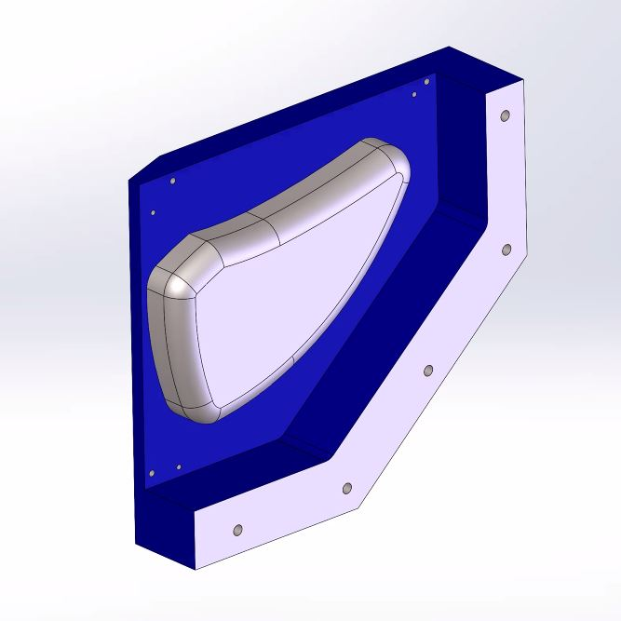
Dipole Magnet Spectrometer

Slide 6
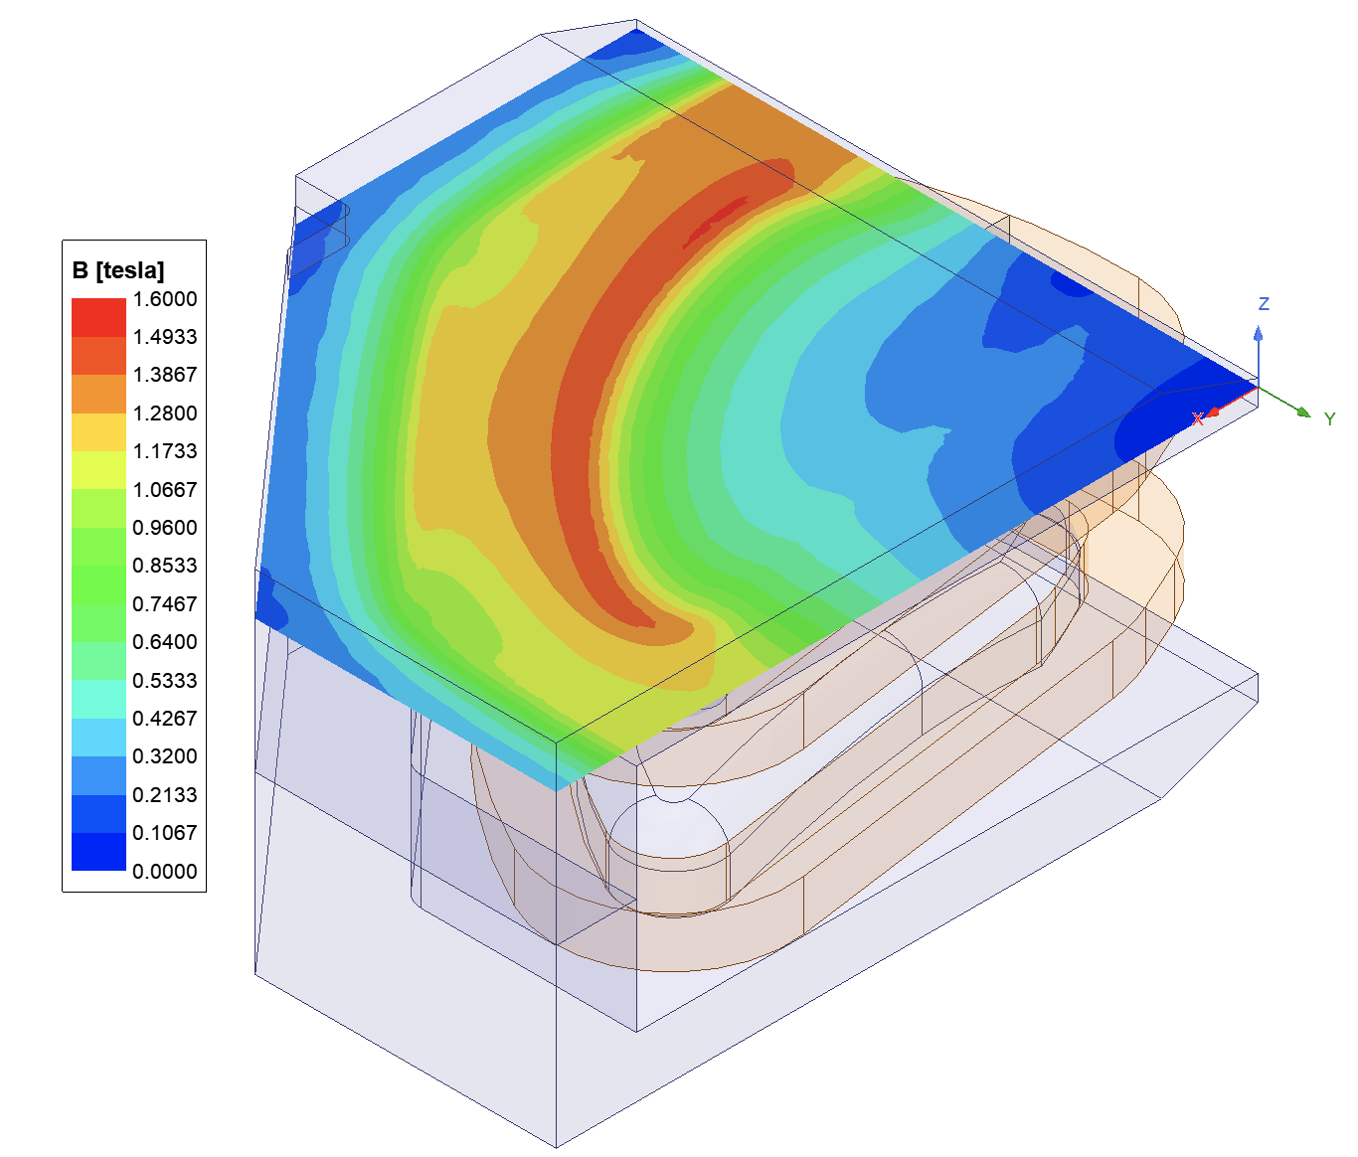
ANSYS Analysis by Xiaqing Li

Slide 7
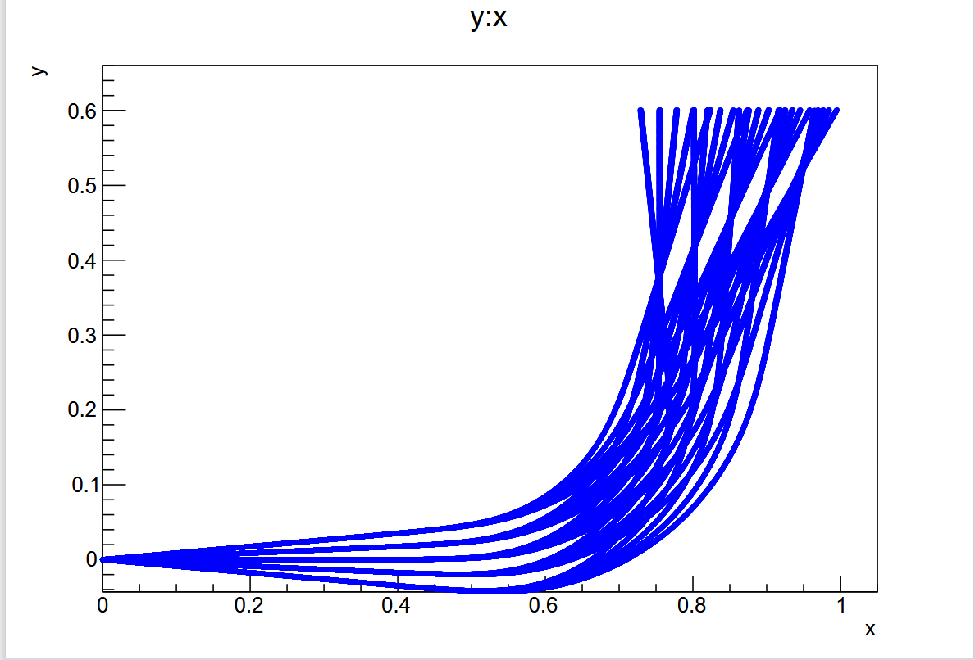
Ray trace by Doug Hasell

Slide 8
Summary
The iteration of the magnet design was required because of extremely long delivery times for hollow core conductor from Luvata. An air cooled version was not possible to reach field in limited space.
The steel yoke was completely redesigned by Chris and I based on feedback from a vendor on how to machine it the fastest. I will explain during my talk the approach we took.
The move to ribbon wound coils was nessessary to make the magnet with vendor in house stock ribbon.
The change in conductor required a change in needed current and it was matched to in house MIT existing Power Ten supplies to save cost and delivery issues. Fine tuning is underway with release of design to vendor by 9 June.
Delivery expected to be much faster based on the design changes. The vendor has the steel, conductor and multiple CNC machines to do this task.
A hall probe from Pyramid is included in the design to monitor field during experiment .
Mass of magnet assembly is 787 kg.
Metric hardware will be used.
Will meet with ARIEL survey group to ensure we have adequate tooling for survey.

