Slide 1
Counting Room, Assembly Space and Office Space
Stephanie Diana Rädel
Accelerator Division

Slide 2
Office Space
There will be NO (additional) Office Space available.

Slide 3
Assembly Space
So far, Kate has a room for testing, down the hall from her office.

Slide 4
Counting Room
Two options

Slide 5
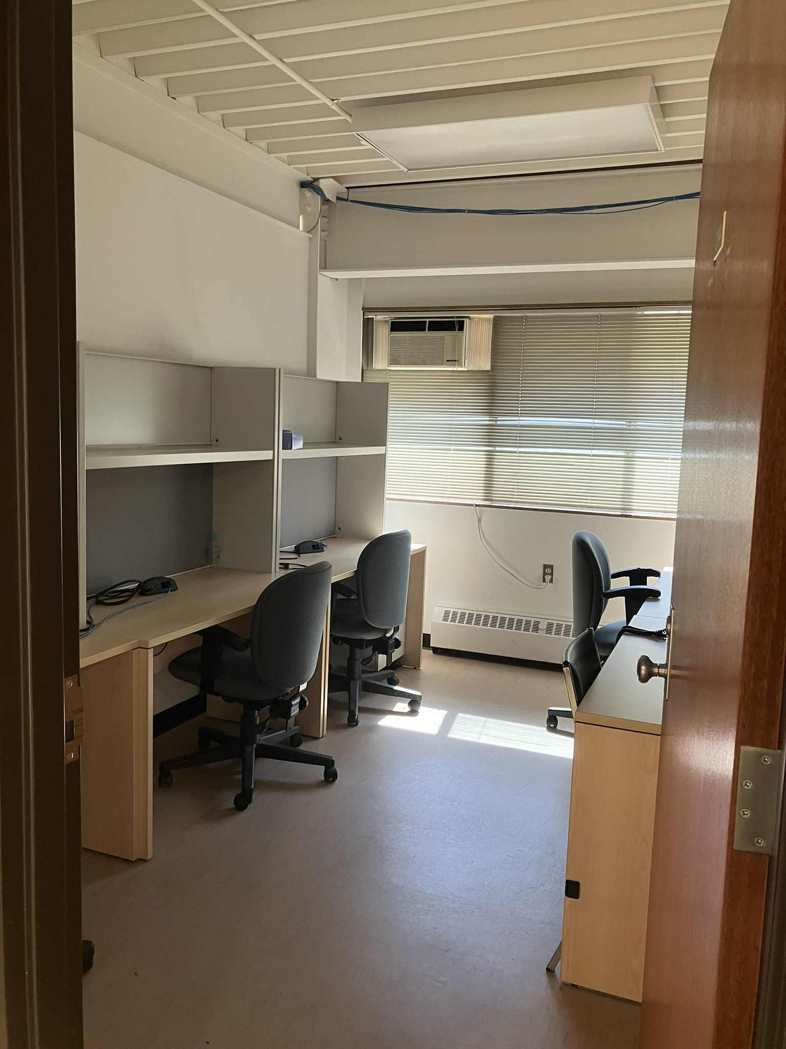
VECC visitor room
Old e-Linac control room

Slide 6
We need more input for the organisation
From when to when?
How many people?
Need for full counting room during experiment? (could be done from anywhere now too)
Commissioning time?

Slide 7
Thank you Merci
www.triumf.ca
Follow us @TRIUMFLab

