Slide 1
Infrastructure: Space, Shielding and Cabling
Stephanie Diana Rädel
Accelerator Division

Slide 2
E-Hall space

Slide 4
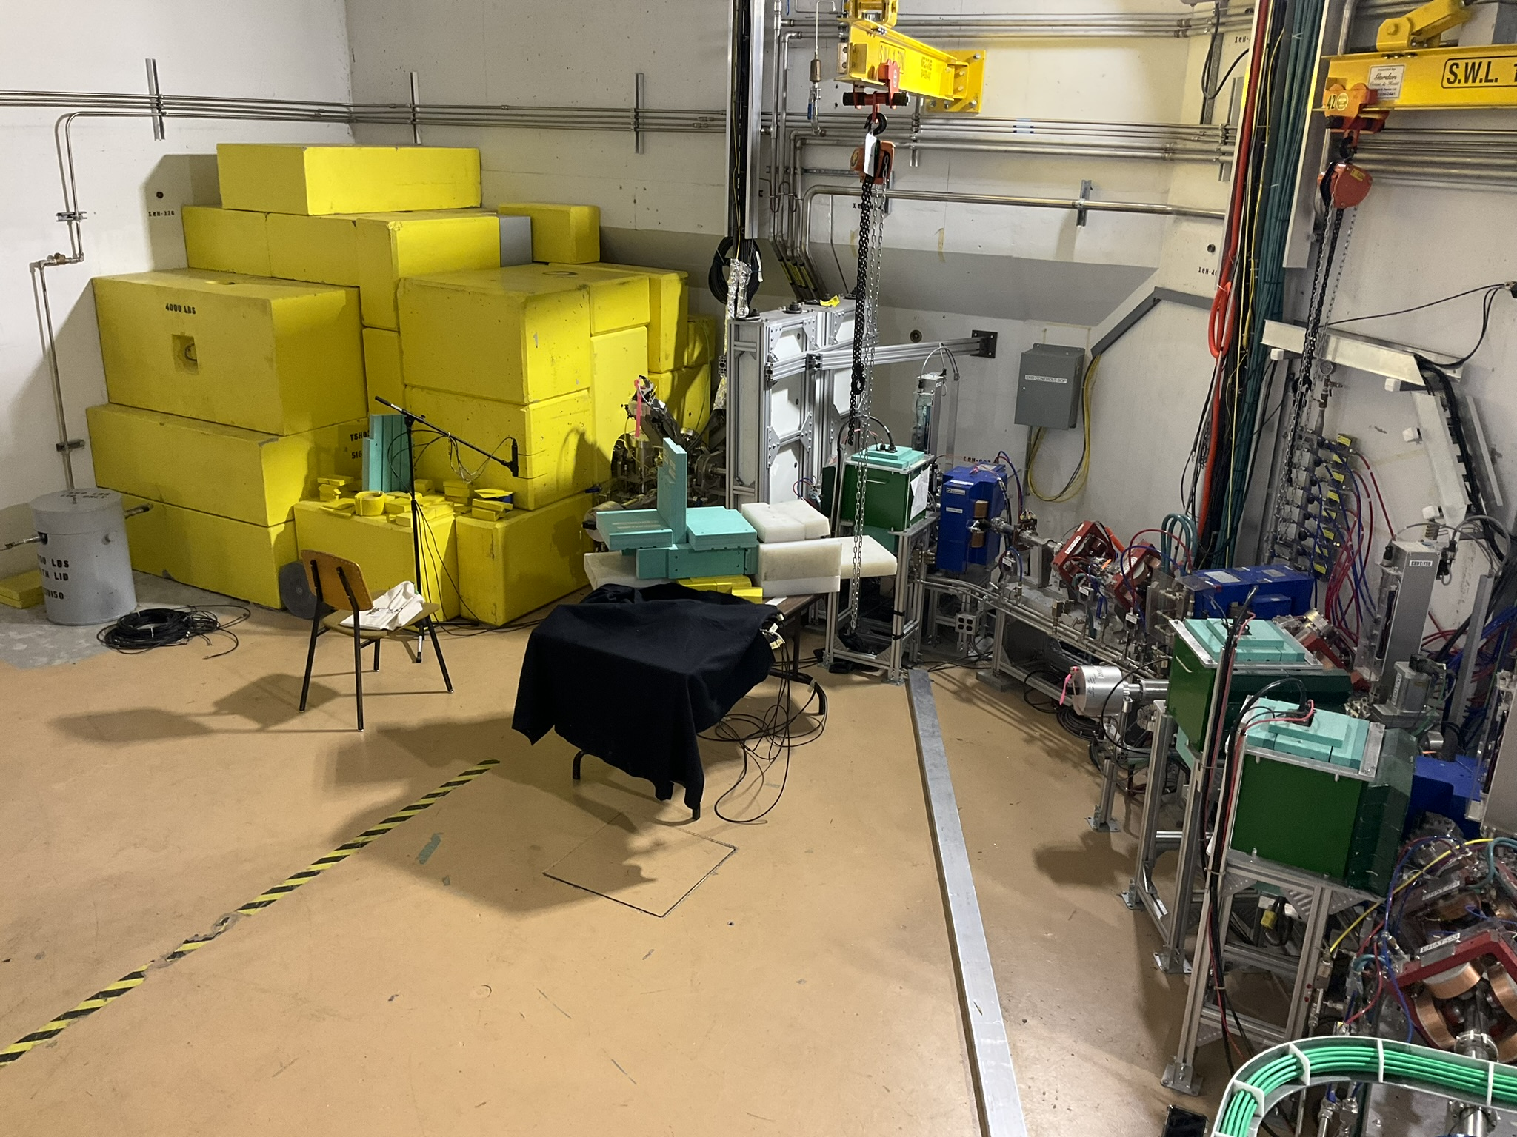
Part of EHDT where DarkLight will be installed

Slide 5
Long Ionization Chamber (LIC)
Protection tray -> can not be moved.
Hatch space
Needs to stay clear
For e-Hall access

Slide 6
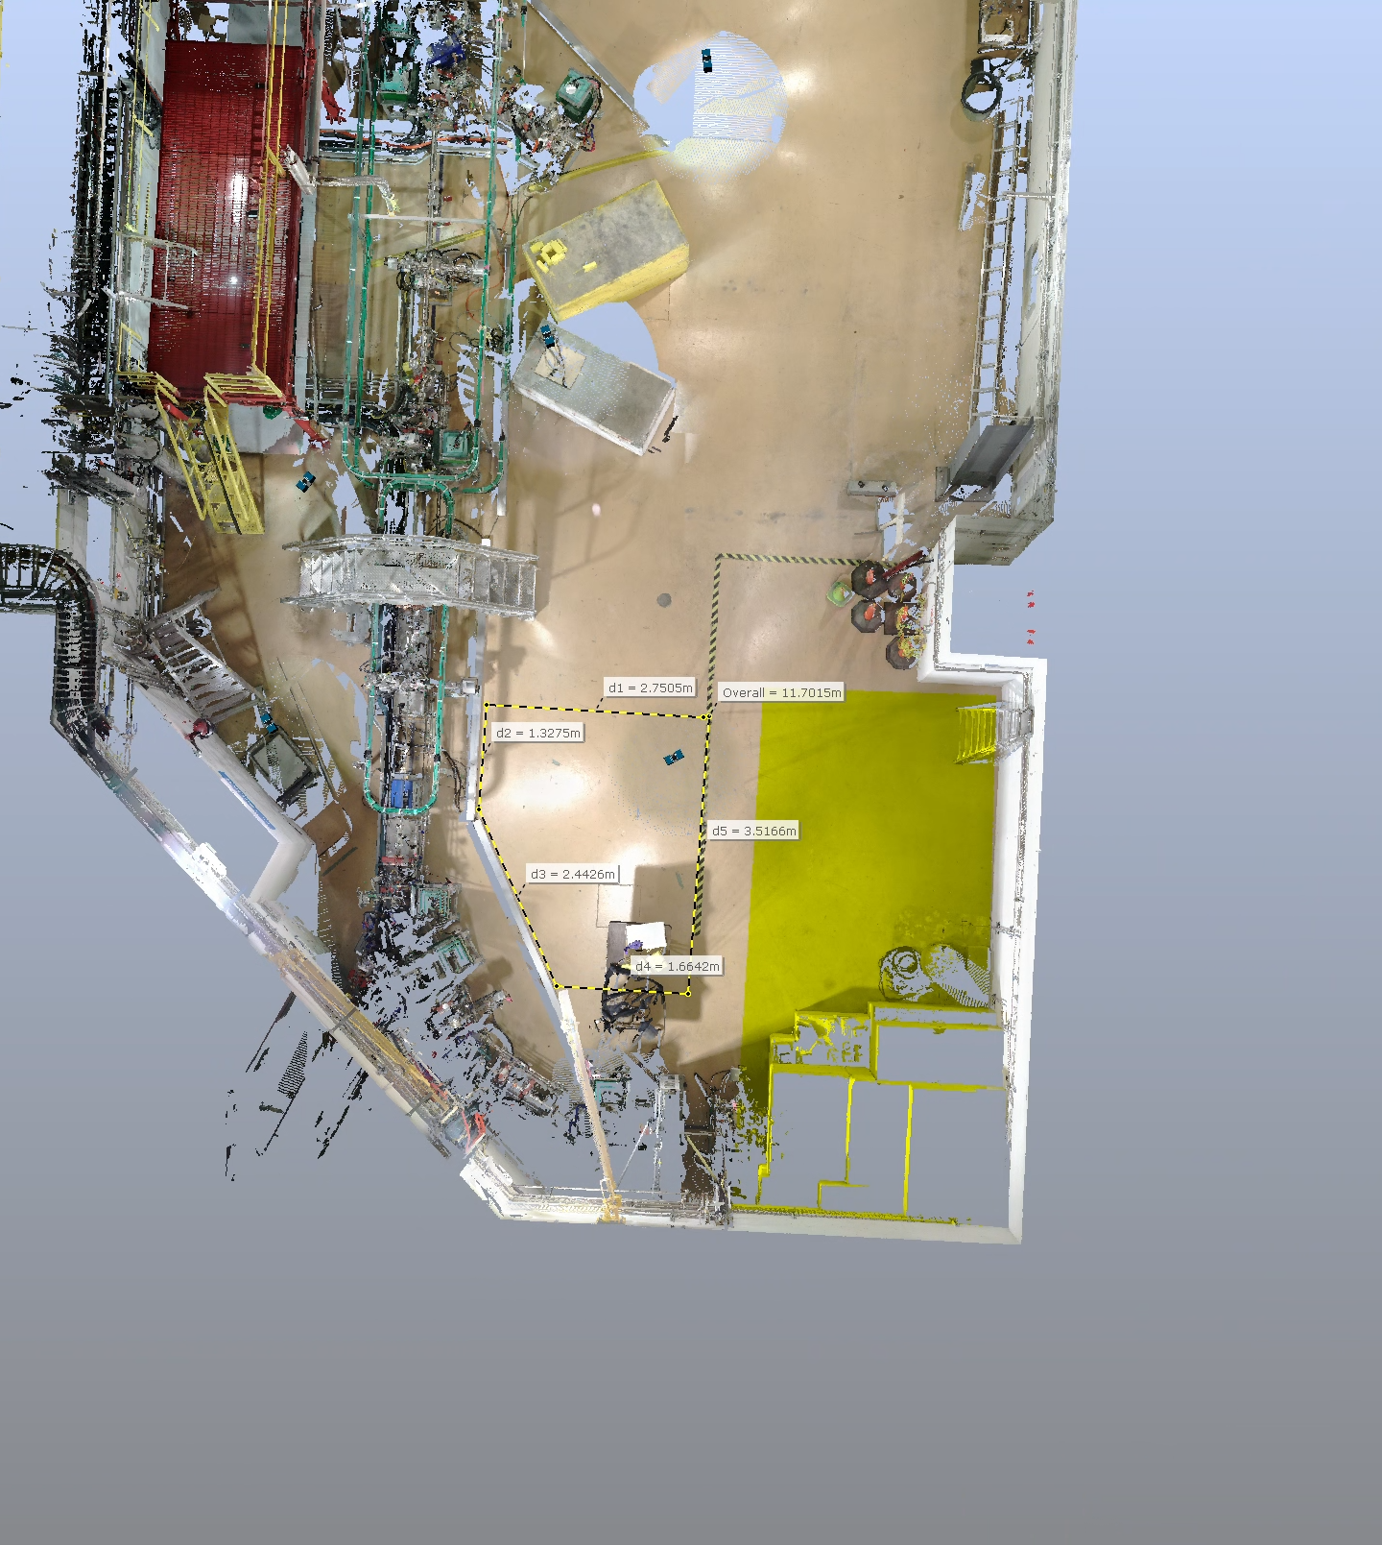
Shielding
LICs
E-Hall top view
Hatch space

Slide 7
Shielding
8’ × 2’
4’ × 2’
Shielded Hut
Position will be challenge to set up
Tristar brick and block will be a good provider of new shielding blocks
Will need a shielding roof
Hatch space
LICs

Slide 8
Shielding
8’ × 2’
4’ × 2’
Shielded Hut
Position will be challenge to set up
Tristar brick and block will be a good provider of new shielding blocks
Will need a shielding roof
Hatch space
LICs

Slide 9
Cabling

Slide 10
Cabling
Cables for different applications
Vacuum
Control and instrumentation => roof
Spectrometers
2 substantial cables for each spectrometer => roof
2 lines for water cooling for each spectrometer => from existing pipes in hall
control cables for Hall probes
GEM detectors
4 HV and 24 HDMI cables to VME crate => shielded hut
4 gas supply and 4 gas return lines => shielded hut
panel with 4 gas flow controls
panel with 4 gas bubblers (TV camera to observe remotely)
exhaust line (N₂ can probably be vented to the hall but Ar:CO₂ might require venting to atmosphere) => gas shack
Trigger Scintillators
Ask Mike => ?

Slide 11
Cabling
Cable trays from EHDT area connect to trays to the e-hall roof.

Slide 12
Plumbing
Gas pipes from the gas shack and water pipes within the hall.

Slide 13
Thank you Merci
www.triumf.ca
Follow us @TRIUMFLab

