Slide 1
DarkLight at ARIEL Scattering and Magnet Chamber, Vacuum system and Target Ladder Presentation

Slide 2
Experiment layout

Slide 3
Experiment Layout Plan view

Slide 4
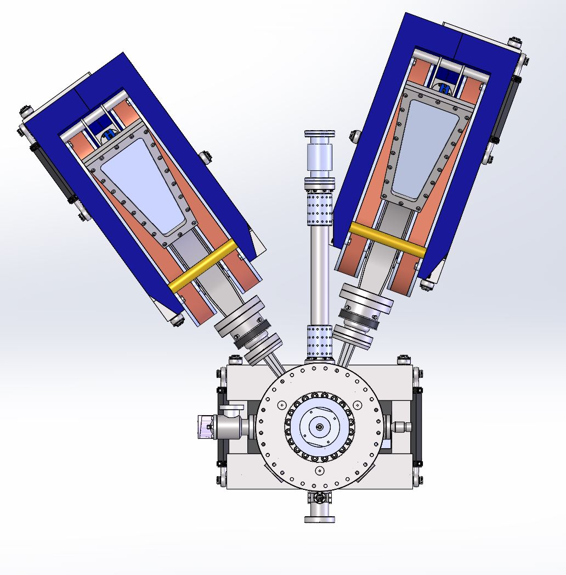
Views with no GEMS

Slide 5
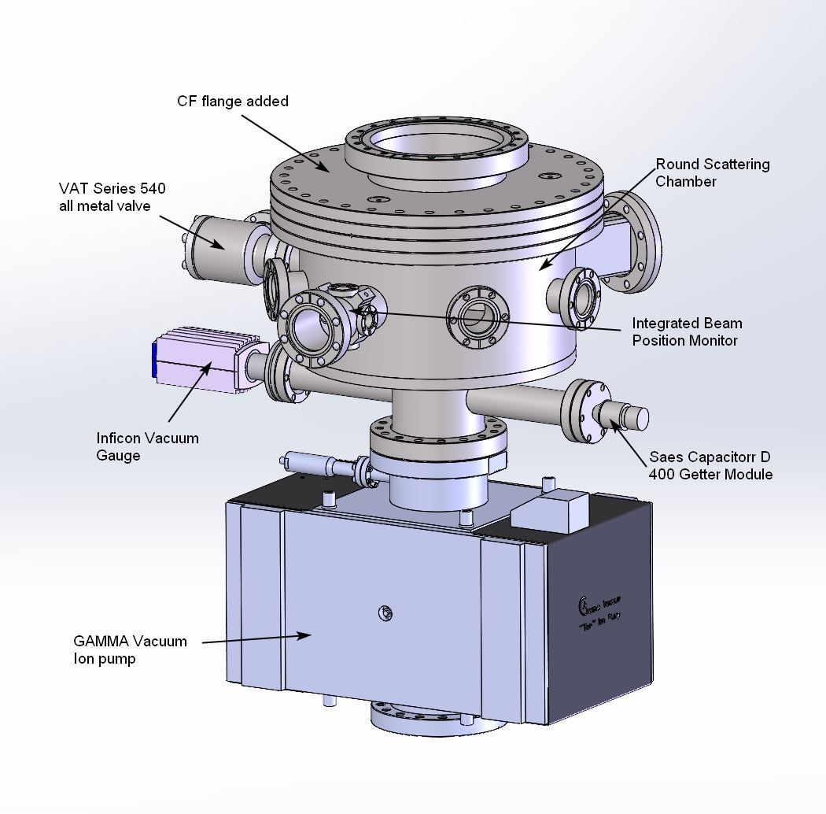
DarkLight Scattering Chamber
New design with a round chamber and conflat flange. This will provide for easier fabrication and assembly. Still working on whether to integrate BPM or fabricate a modified one for experiment.

Slide 6
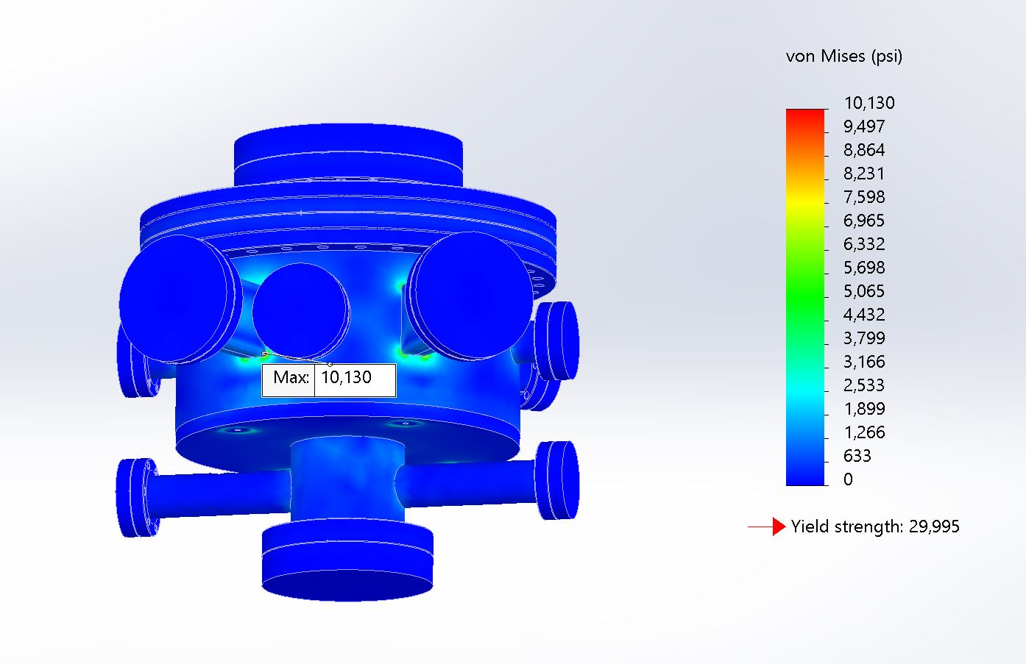
Scattering Chamber Analysis
FEA analysis shows low stress levels with a yield safety factor of 3.
FEA of displacement is also very low (0.001”). No issues with target position when chamber is pumped down.

Slide 7
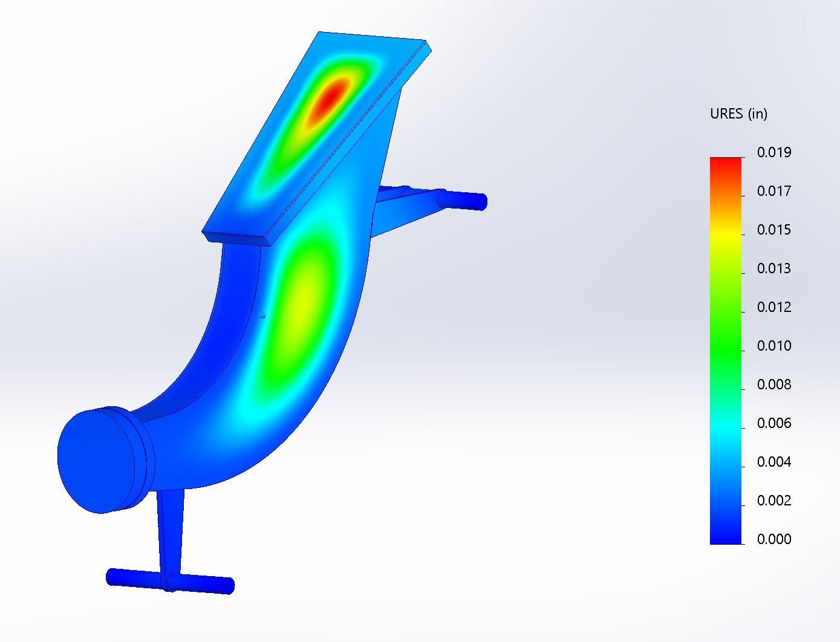
Magnet Chamber Analysis
FEA analysis of Magnet chamber has higher stresses but still almost a factor of 3 safety margin.
Deflection analysis shows less than ½ mm displacement.

Slide 8
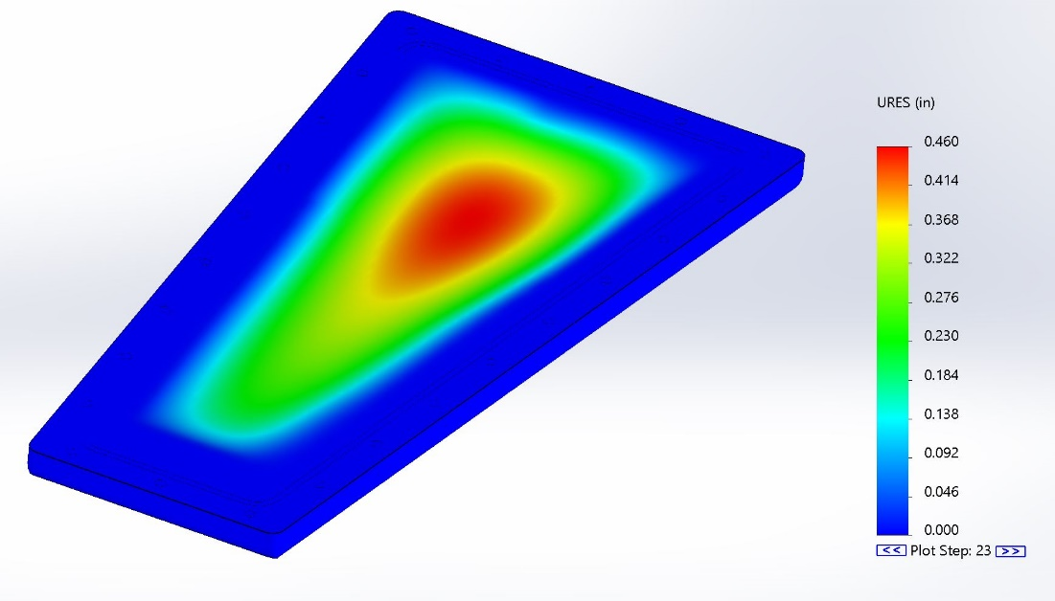
Thin window analysis
Analysis of the thin window shows stress levels very close to ultimate in Solidworks. This is a non-linear analysis and I am pursuing an ANSYS analysis to confirm. I’ve used these windows before so I’m confident they work.
The analysis shows approx. 1/2 inch of displacement which agrees with MIT Bates experience with these windows. Our plan is to hydro test several windows to confirm our experience with similar windows.
In addition there will have to be a pressure relief valve on the chamber to prevent reverse deflection of the window.

Slide 9
Spectrometer Collimators
1” thick Tungsten collimator installed in entrance to each Spectrometer leg.

Slide 10
Summary
All vacuum systems will be thoroughly cleaned and leak checked. All hardware will be vented and silver coated.
If time allows we will assemble the system at Bates and bake it out.
Viewports for viewing the target can be Borosilicate Glass for optical and/or Zinc Selenide for infrared.
We will use standard conflat flanges with copper seals for all connections except the magnet chamber windows.
The window will use small cross section o-rings made from Viton.
We will use a Gamma TiTan CV ion pump with an integrated NEG module producing 500 l/s of pumping. In addition we will add a SAES Capacitorr NEG module.
Total outgassing for chamber and windows is approx. 2 x 10⁻⁶ torr-l/s
Therefore final chamber pressure will be in the low 10⁻⁹ torr.
The target ladder mechanism will be controlled by ARIEL.
We have several ports on the scattering chamber for ARIEL diagnostics.
Supports for the scattering and magnet chambers are standard 6 strut systems that will give 6 degrees of adjustment. Still need to do analysis but this is a system we regularly use for much larger magnets.
Mass of magnet assembly is 787 kg. Mass of scattering chamber, ion pump, and supports is 704 kg.
Metric hardware will be used.
Will meet with ARIEL survey group to ensure we have adequate tooling for survey.

