Slide 1

QCD Thermodynamics
Peter Petreczky
BES program and RHIC
QCD Phase Diagram and EoS
Heavy Flavor probes of sPHENIX @ RHIC, LHC heavy ion program
Bottomonium masses and widths at T>0
Larsen, Meinel, Mukherjee, PP, PLB 800 (20) 135119
Complex potential at T>0
Balla et al (HotQCD), PRD 105 (2022) 054513
Heavy quark diffusion coefficient from lattice QCD
Altenkort, Kaczmarek, Larsen, Mukherjee, PP, Shu, Stenbach (HotQCD), arXiv:2302.08501
USQCD Collaboration meeting MIT, April 20-21, 2023

Slide 2
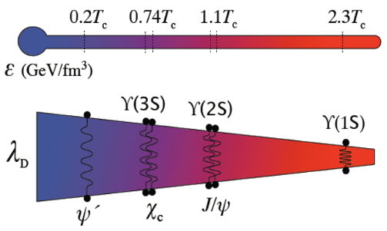
Heavy flavor probes and lattice QCD
From 2015 LRP: understanding the inner workings of QGP by probing different
length scales
RHIC
sPHENIX, STAR+
2023-2025
LHC Runs 3-5
ALICE 2-3, CMS+,ATLAS+,LHC+
2022-2038
White papers for the 2023 LRP:
The Present and Future of QCD, arXiv:2303.02579
Hot QCD White Paper, arXiv:2303.17254
Conveners:
S. Mukherjee
PP
Lattice:
Phenomenology:
In-medium quarkonium masses and widths
Transport models for quarkonium suppression and regeneration
Langevin dynamics of quarkonium
regeneration, open quantum system
Complex potential at T>0
Heavy quark diffusion coefficient
(average momentum transfer to heavy quark)
Collisional energy loss, open
heavy flavor suppression

Slide 3
Meson correlators and spectral functions
Vacuum and in-medium properties as well as dissolution of mesons are encoded in the spectral functions:
Melting is seen as progressive broadening and disappearance of the bound state peaks
Modifications of quarkonium yields in heavy ion collisions
Matsui and Satz, PLB 178 (1986) 416

Slide 4
Strategies to obtain the spectral functions from lattice
Strategy: use EFT to simplify the problem, use appropriately chosen correlation
functions to enhance sensitivity to quantities of interest, constrain the spectral
function by T=0 results
Example: NRQCD using correlation
functions of optimized meson
operators projecting on bottomonium
states of interest
Larsen, Meinel, Mukherjee, PP, PLB 800 (20) 135119
parametrized
as single peak+ tail
constrained at
T=0

Slide 5
Thermal mass shift of bottomonium
Larsen, Meinel, Mukherjee, PP, PLB 800 (20) 135119
No significant thermal mass shift is observed in any of the bottomonium states
contrary to expectations of the potential model with screened potential

Slide 6
Thermal width of bottomonium
Larsen, Meinel, Mukherjee, PP, PLB 800 (20) 135119
Significant thermal width for all bottomonium states that increases with T
Bottomonium states dissolve when thermal width is larger than the level splitting

Slide 7
Quark anti-quark potential at T>0
Conjecture, Matsui and Satz, PLB 178 (86) 416
Extending pNRQCD to T>0: the potential is complex, the real part can have thermal correction
but is not necessarily screened, except when r ~ 1/m_{D} >> 1/T
Weak coupling calculation
Laine, Philipsen, Romatschke, Tassler, JHEP 03 (06) 054
Brambilla, Ghiglieri, PP, Vairo, PRD 78 (08) 014017
Calculate the potential non-perturbatively on the lattice by considering Wislon loops
of size r x 𝞽 at T>0
Rothkopf, Hatsuda, Sasaki, PRL 108 (2012) 162001

Slide 8
Quark anti-quark potential at T>0 from the lattice
Bala et al (HotQCD), PRD 105 (2022) 054513
No color screening !

Slide 9
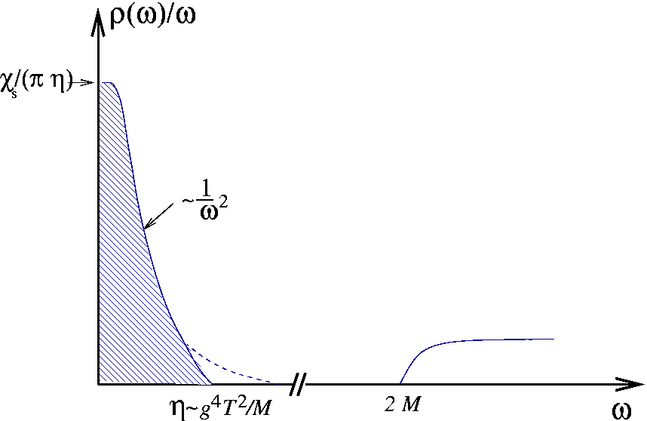
Current-current correlators and heavy quark diffusion coefficient
Momentum diffusion coefficient
PP, Teaney, PRD 72 (2006) 014508
drag constant
Spatial diffusion constant
~ mean free path (weak coupling)
area under the peak ~
heavy quark coefficient ~ width of the peak
For large quark mass the transport peak is very narrow even for strong coupling and its
difficult to reconstruct it accurately from Euclidean correlator calculated on the lattice

Slide 10
Heavy quark diffusion and lattice QCD
Obtain the momentum heavy quark transport coefficient through the force correlator
Can be rigorously derived in Heavy Quark Effective Theory
Casalderrey-Solana, Teaney, PRD 74 (2006) 085012; Caron-Huot, Laine, Moore, JHEP 0904 (’09) 053
Bouttefeux, Laine, JHEP 12 (2020) 150

Slide 11
Extracting momentum diffusion coefficient from the lattice
Challenge 1: obtain precise results for chromo-electric and chromo-magnetic (very noisy)
Noise reduction via multi-level algorithm, applicable to quenched QCD (pure glue plasma)
Noise reduction by gradient flow method (new development !) , also applicable in full QCD
Challenge 2: reconstruct the spectral function from the Euclidean time lattice correlator
use known large
and small energy behavior of the spectral

Slide 12
Extracting momentum diffusion coefficient from the lattice
Symanzik gauge action and
Zeuthen flow
We see small cutoff effects thanks improved actions

Slide 13
Analysis and modeling the chromo-electric correlator
Analysis of the chromo-electric correlator:
Extrapolate the lattice results on the chromo-electric correlator to the continuum limit
Perform the zero flow time extrapolation
Fits to model spectral function:

Slide 14
T=195 MeV:

Slide 15
T=293 MeV:

Slide 16
Heavy quark diffusion coefficient in QCD
Extend the calculations to smaller T and physical quark light quark masses

Slide 17
USQCD proposals
2005-2021 All Type-A proposal focused on EoS and various aspects of QCD phase diagram,
a few Type-B proposals on spectral function
2022-2023 Type-A proposal ”The heavy quark diffusion coefficient in (2+1)-flavor QCD from lattice”
Requested: 28.8 M KNL core hours, 0.22M MI100 GPU hours
Awarded: 16M KNL core hours, 0.175M MI100 GPU hours
2022-2023 Type-A continuation proposal ”The heavy quark diffusion coefficient in (2+1)-flavor QCD from lattice”
Requested: 40.3 M KNL core hours, 0.315M MI100 GPU hours
The generated gauge configurations will be also used to estimate meson spectral
functions and the complex potential at T>0

Slide 18
Lattice QCD and phenomenology of heavy flavor probes
New topical collaboration
In nuclear theory
Ralf Rapp(PI), P. Petreczky,
R. Vogt (co-spokespersons),
S. Bass, X. Dong, Frawley,
Y-J. Lee T. Mehen, S. Mukherjee,
J. Qiu, M. Strickland, I. Vitev
INT program
Heavy Flavor Production in Heavy‐Ion and Elementary Collisions (22-3)
Z. Meziani, P. Petreczky, R. Vogt

Slide 19
Summary
Consistent with analysis of
spatial meson correlators

Slide 20
Back-up: Mass suppressed correction to heavy quark diffusion coefficient
Quenched QCD
Gradient flow + incomplete 1-loop matching
Multi-level algorithm +
non-perturbative matching
via Schrödinger functional
Brambilla, Leino, Mayer-Steudte, PP
(TUMQCD), PRD 107 (2023) 054508
Banerjee, Datta, Laine JHEP 08 (2022) 128
<v²> is taken from PP, EPJC 62 (2009) 85
10-20% correction for bottom quark, ~30% correction for charm quark

Slide 21
Back-up: Bethe-Salpeter amplitude at T>0 and potential model
Larsen, Meinel, Mukherjee, PP, PRD 102 (‘20) 114508
Shi et al, PRD 105 (‘22) 014017
T=334 MeV (filled)
T=151 MeV (open)
potential model
with inverse problem
+
Thermal width
from lattice
+
Machine learning
1S (crosses)
2S (filled)
3S (open)
No color screening

