Slide 1

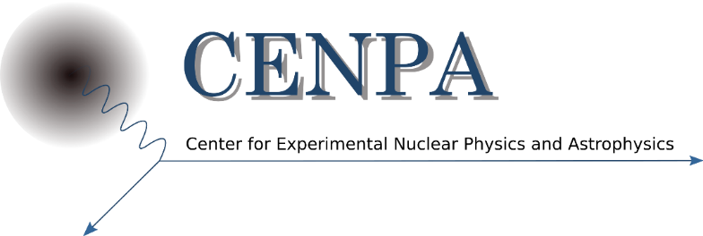
Updates and Perspectives on the Muon g-2 Experiment and SM Comparisons
A theory storm seems to be brewing
David Hertzog, University of Washington
USQCD Meeting
April 21, 2023

Slide 2
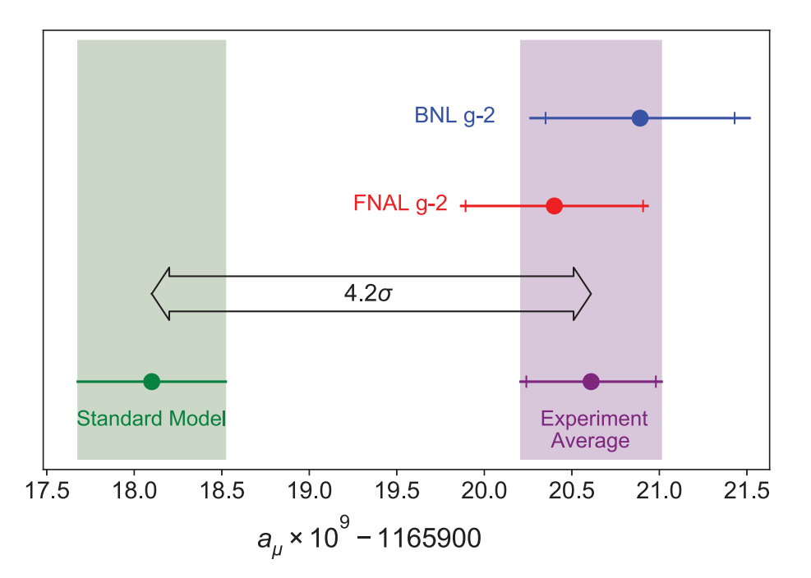
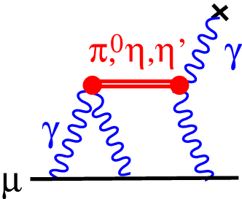
What everybody generally knows…
The 2021 Run1 g-2 result:
  Confirmed the BNL result
  Led to net increase in discrepancy with theory above 4 σ
  Statistical uncertainty: 434 ppb; Systematics: 159 ppb)
  World average uncertainty: 350 ppb
  Represents only 5% of our data set
The g-2 Theory Initiative recommended SM value:
  2020 Compilation from published work only
  HLbL includes data-driven theory and lattice!
  HVP entirely based on data-driven evaluation
  Net uncertainty -- driven by HVP – is 368 ppb
The uncertainty in the SM prediction is dominated by hadronic terms, essentially leading-order hadronic vacuum polarization (HVP)

Slide 3
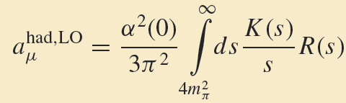
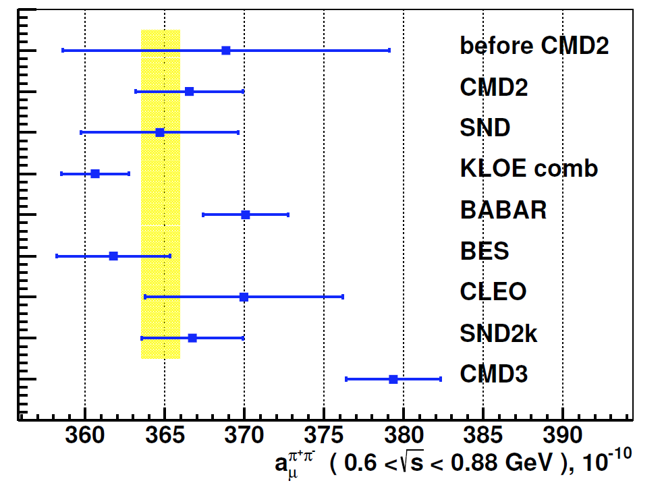
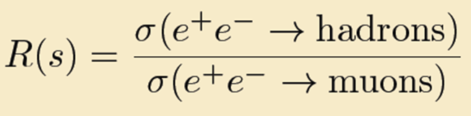
To date: The recommended HVP value from e⁺e⁻ data
π
μ
μ
π
Had VP
ππ region
Here, 8 experiments contribute
We will return to this topic at the end

Slide 4
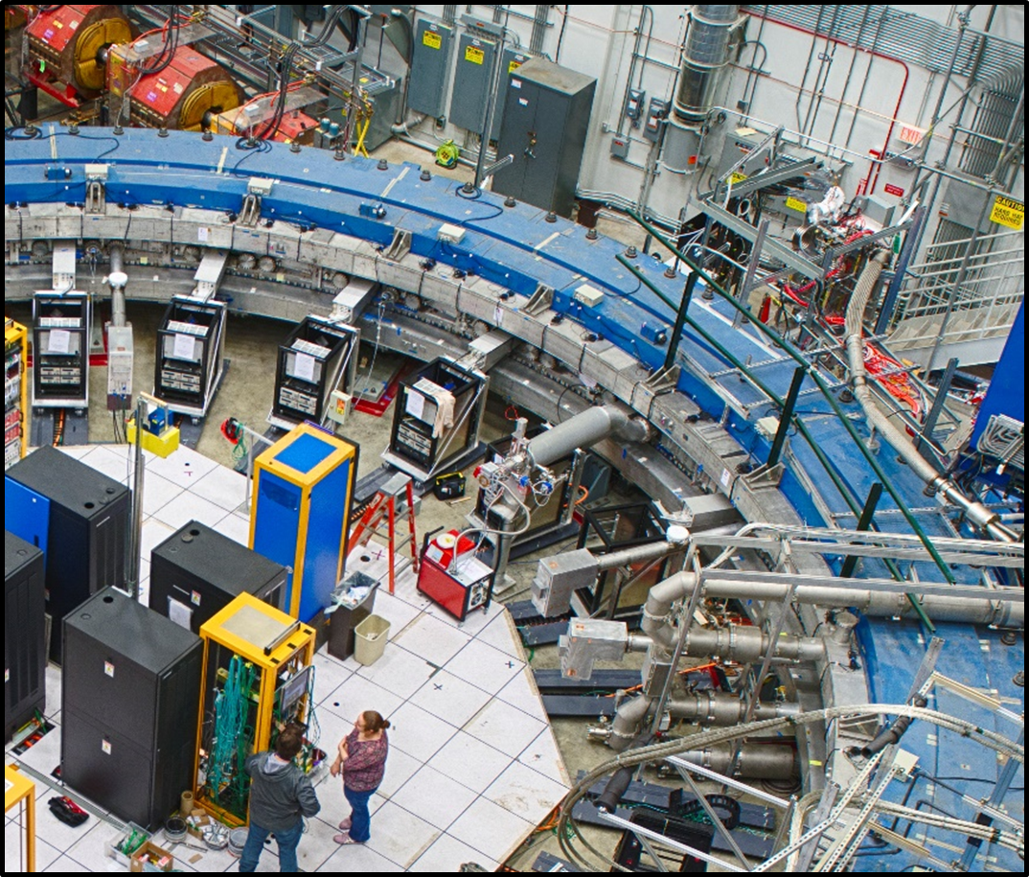

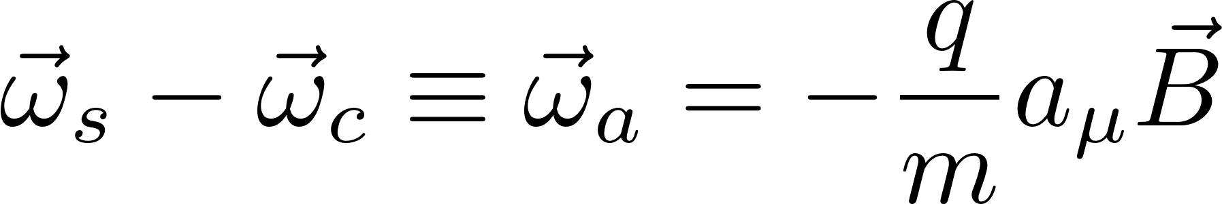
The Fundamental Experimental Principle
e
Momentum
Spin
Determine difference between spin precession frequency and cyclotron frequencies for a muon moving in a magnetic field
Get a_{μ}
Measure these

Slide 5
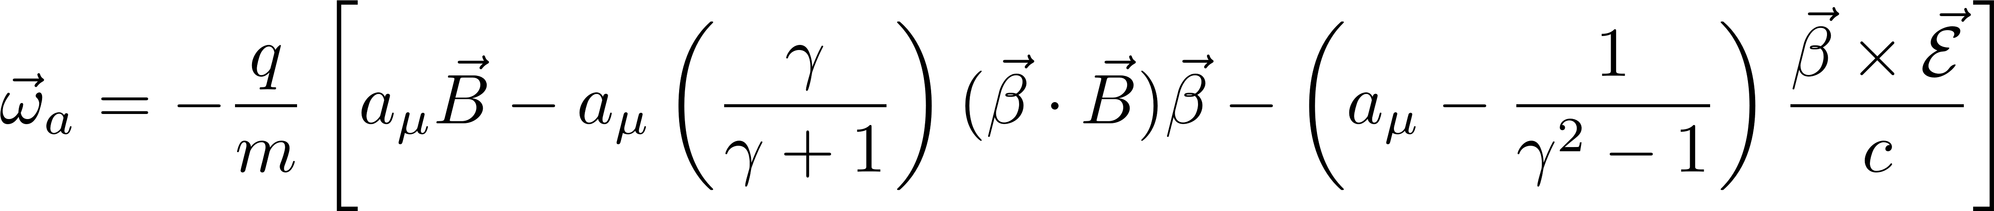
The expression is more complicated when you add in E-field focusing and out of plane oscillations
e
Momentum
Spin
The motion is very nearly planar and the momentum is very nearly the ideal one, but both effects are not perfect and require corrections
0 if “in plane”
Term cancels at 3.094 GeV/c, the “Magic γ”

Slide 6
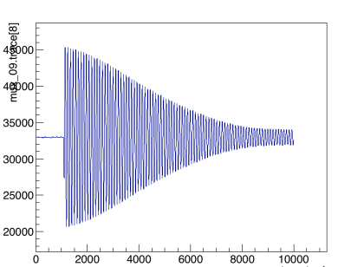
5 miracles permit g-2 to be measured to sub-ppm precision
Polarized muons produced naturally in pion decay
~97% polarized for forward decays
The anomalous spin precession frequency is proportional to (g-2) … not to “g”
~850 easier vs measuring muon precession at rest
The electric holding field does not perturb the spin frequency at the magic momentum
Parity violation encodes the anomalous precession frequency in the e⁺ vs time spectrum
Pulsed proton NMR allows the Field to be measured accurately to sub-100 ppb level
ν π⁺ μ⁺
µ
FID in uniform B

Slide 7
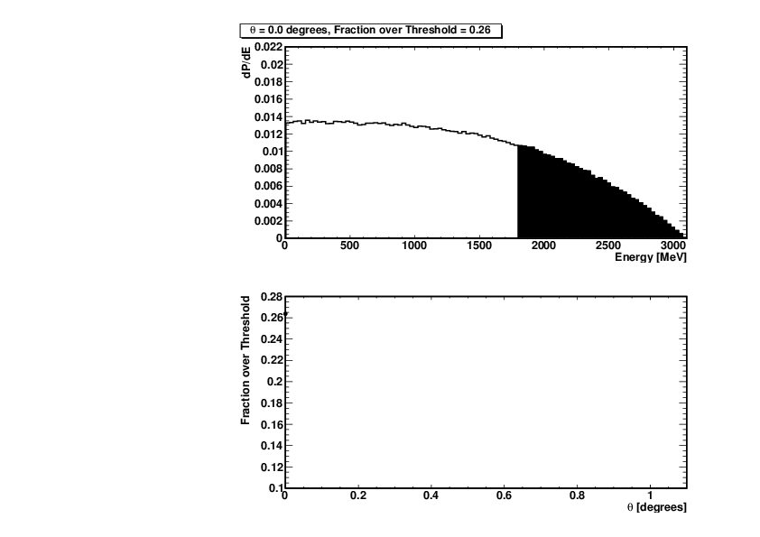
Reminder: the precession frequency is the difference between the spin and cyclotron frequencies
Threshold Energy Cut
Energy in Calorimeters
Phase of Muon Spin

Slide 8
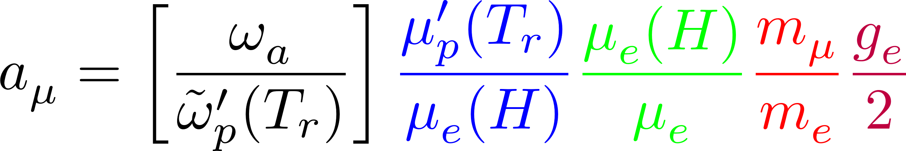
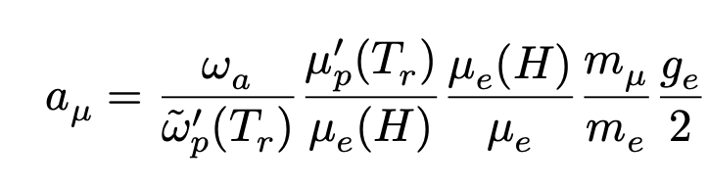
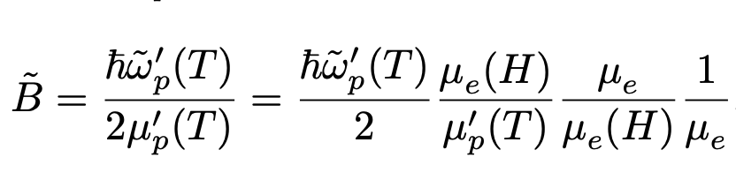

a_{μ} is obtained from 2 frequency measurements we make
… and well-known fundamental factors from others
We measure these 2 frequencies
$$′$$
Known to 22 ppb from muonium hyperfine splitting
Measured to 10.5 ppb at T = 34.7℃
Metrologia 13, 179 (1977)
Phys. Rev. Lett. 82, 711 (1999)
Rev. Mod. Phys. 88 035009 (2016)
Bound-state QED (exact)
Measured to 0.28 ppt
Phys. Rev. A 83, 052122 (2011)

Slide 9
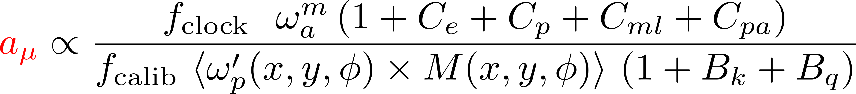
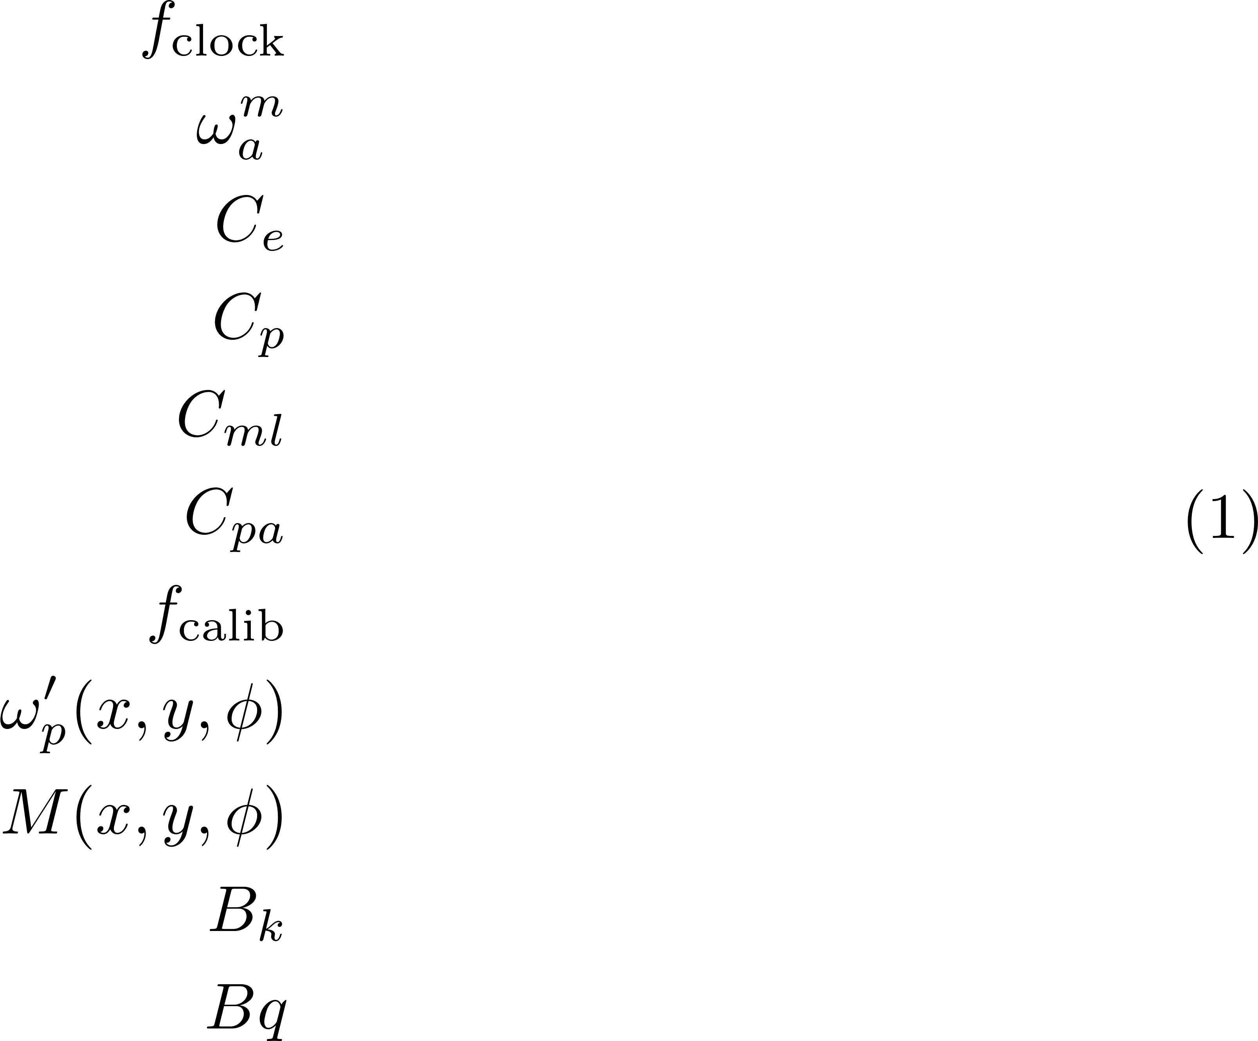
The “ω_{a}/ω_{p}” ratio is expanded to include important correction factors that are evaluated by teams
Blinded clock
Measured precession frequency
Electric field correction
Pitch correction
Muon loss correction
Phase-acceptance correction
Absolute magnetic field calibration
Field tracking multipole distribution
Muon weighted multipole distributed
Transient field from the eddy current in kicker
Transient field from the quad charging

Slide 10
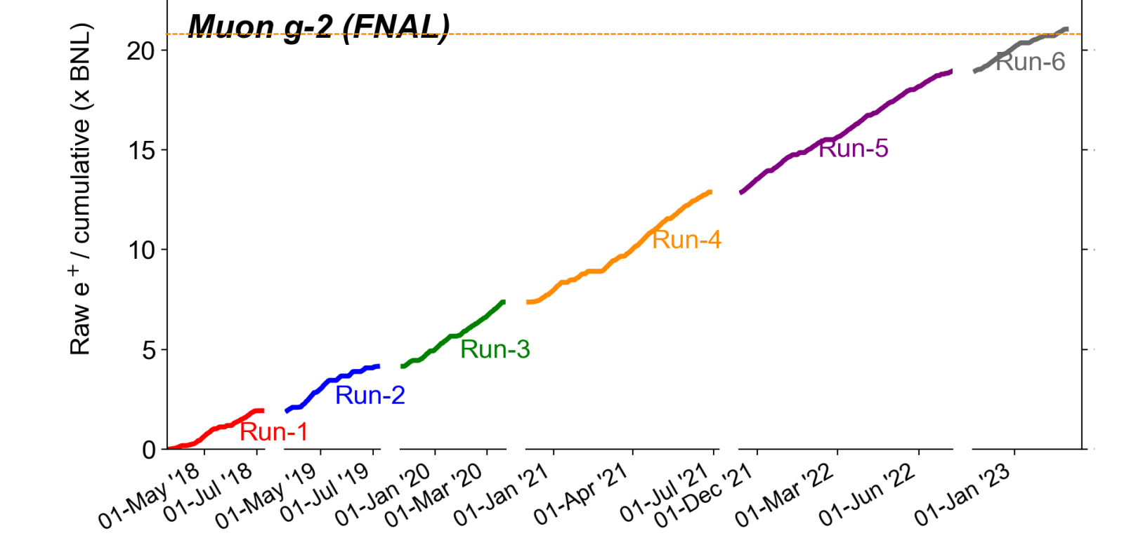
Data collected met proposal goals … “21 BNLs”
Chugging its way through production
Next release, very soon
Published

Slide 11
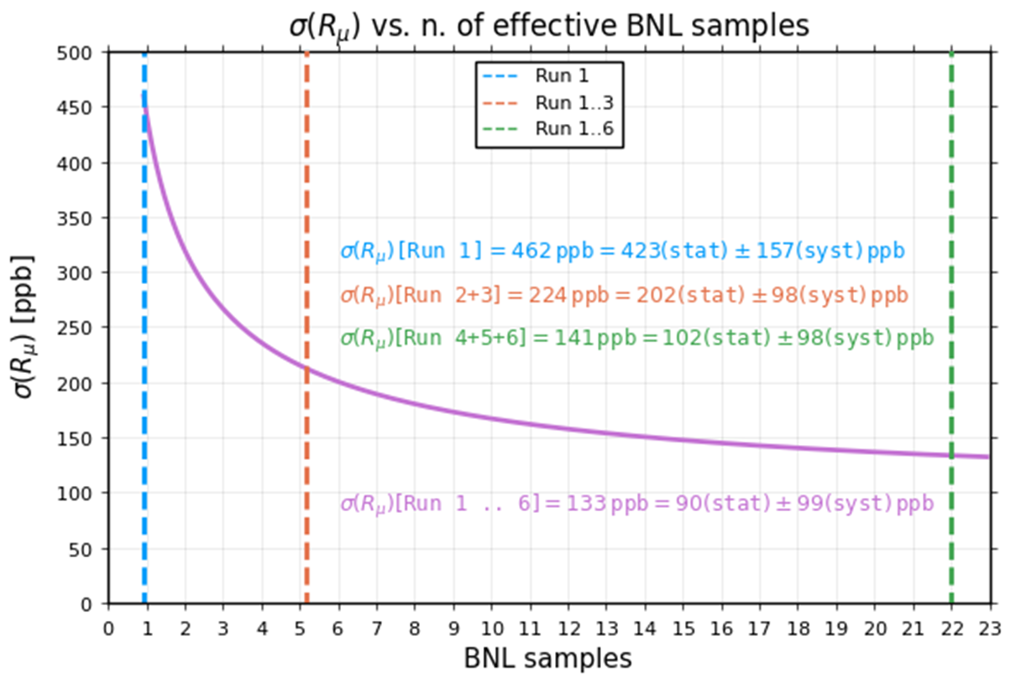
Original Goals and Where we are trending *
Final precision: δa_{μ} = 140 ppb
  Statistics 100 ppb
  Precession systematics 70 ppb
  Field systematics 70 ppb
  Not thought of then 0 ppb ☺
  Trending toward: δa_{μ} = <140 ppb (slightly)
  Statistics <100 ppb
  Precession systematics <<70 ppb
  Field systematics <<70 ppb
  Not thought of then ~50? ppb (my guess)
*Warning: until we look at the data, we can’t be sure about final systematics, so this is just a good guess
~133 ppb
We are here now

Slide 12
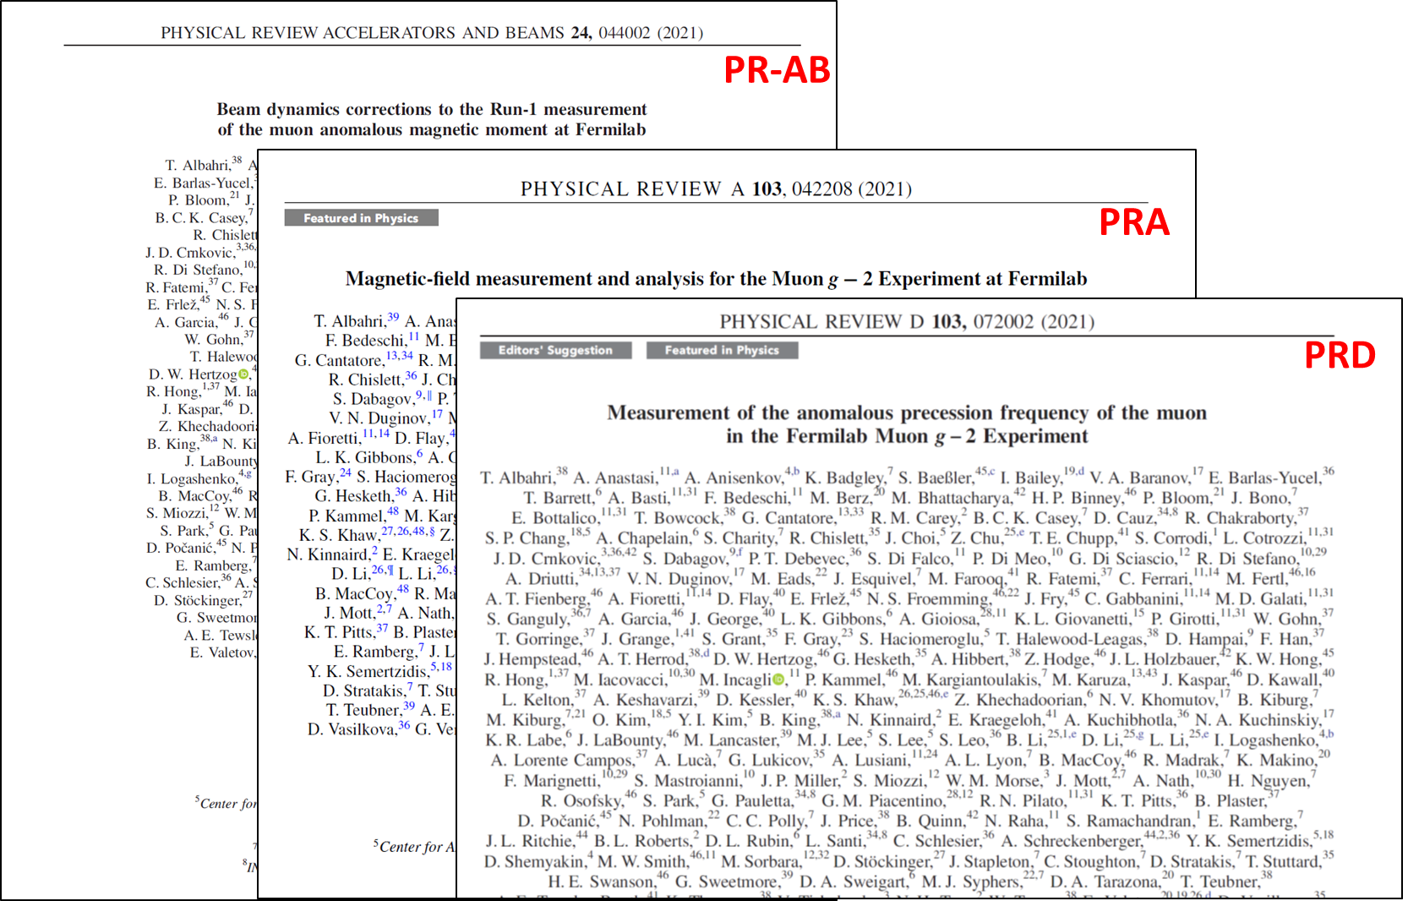
Toward the Run-2/3 Release …
It’s a lot of data, taken in 2019 and 2020 …until the Covid shutdown
Many improvements leading to final “ideal” conditions only at end of Run3
  Fixed bad HV resistors that caused major systematic in Run1
  Ring and Hall temp stabilized; significant for magnet and detector stability
  Muon kicker gradually upgraded to center beam & minimize CBO amplitudes (see later)
2021 Long Papers from Run1
Beam Dynamics Corrections vs Run1
Magnetic Field Status vs Run1
Muon Precession Frequency Status vs Run1

Slide 13
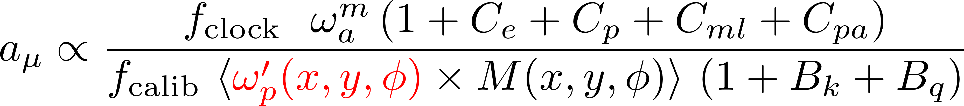
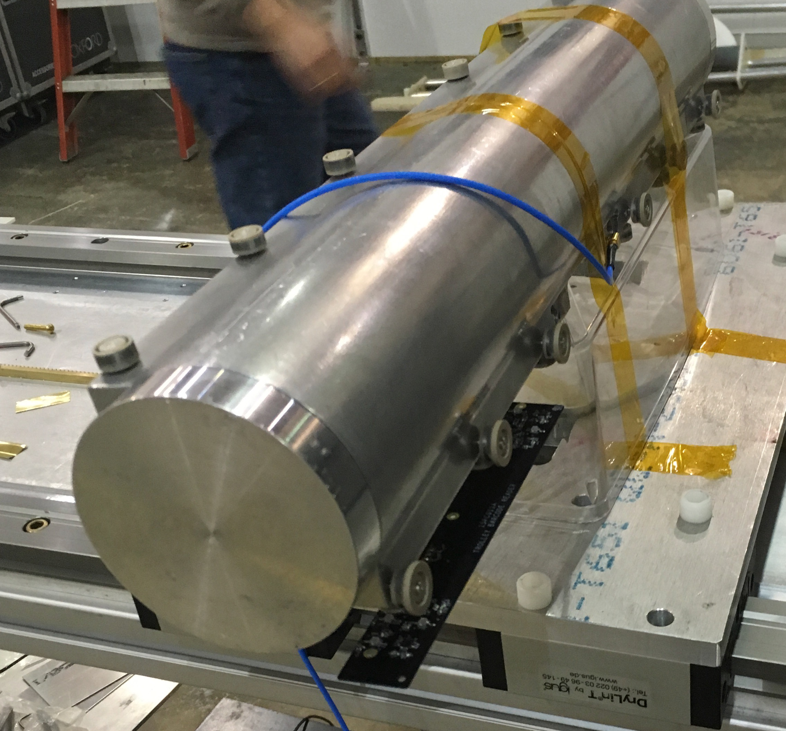
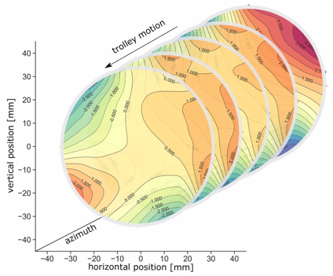
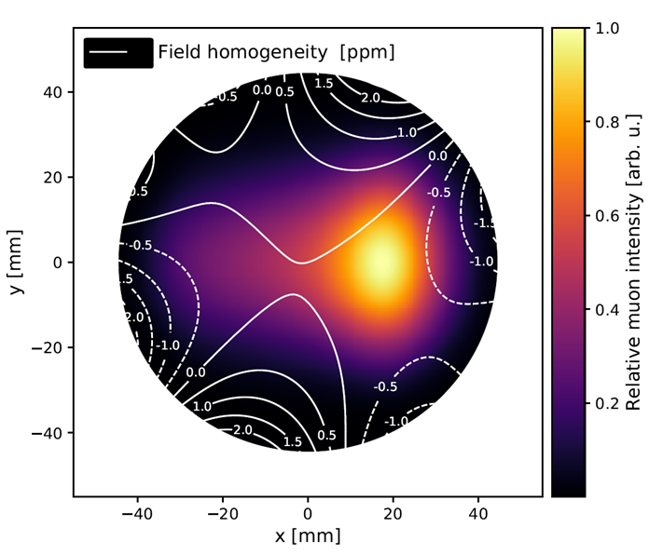
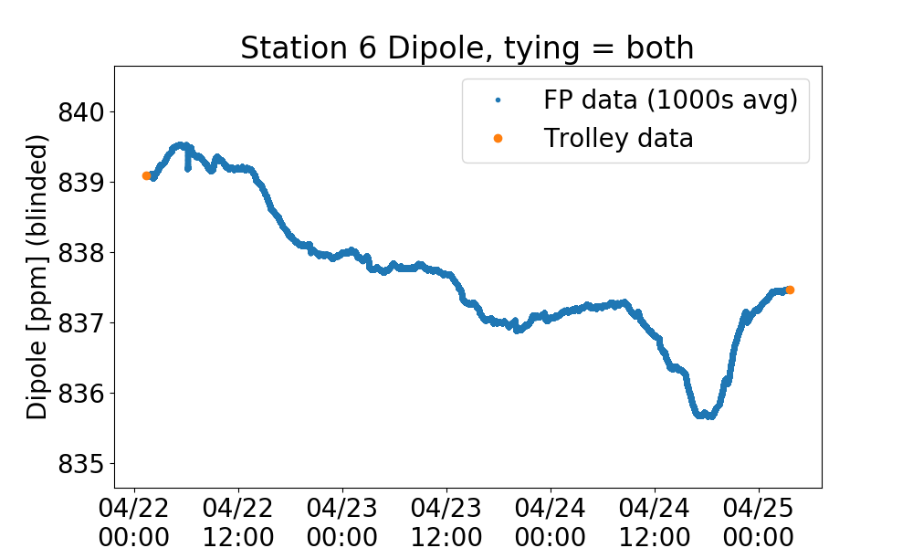
Measure the field moments vs time
17-element Trolley maps full azimuth every few days (muons not present)
378 Fixed probes monitor between trolley runs (during muon data collection)
Field map is interpolated between trolley runs using fixed probe information
Fold with Muon Spatial Distribution
Sequence of field 2D field slices as trolley moves
Fixed probes

Slide 14
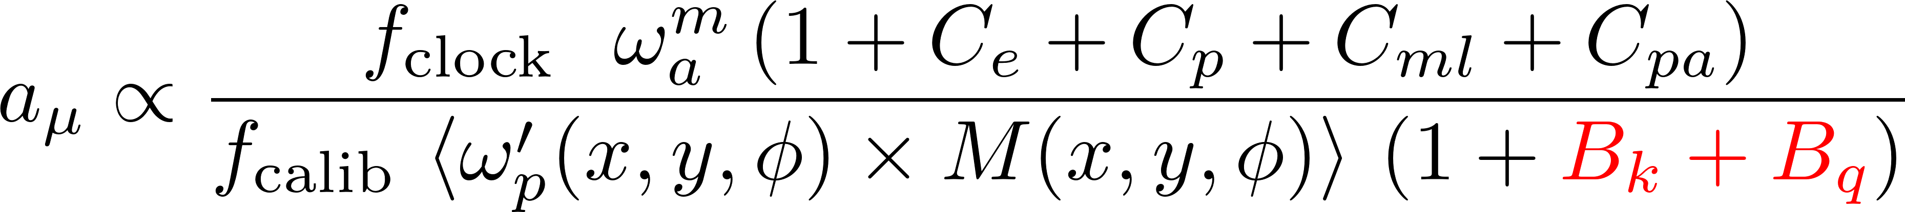
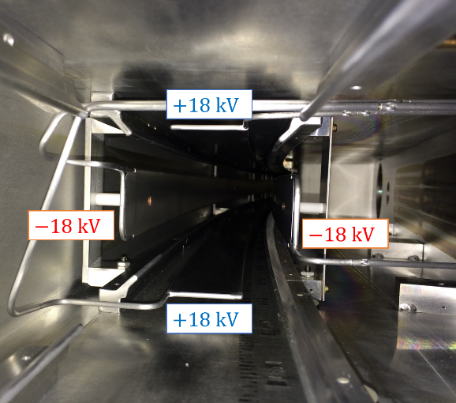
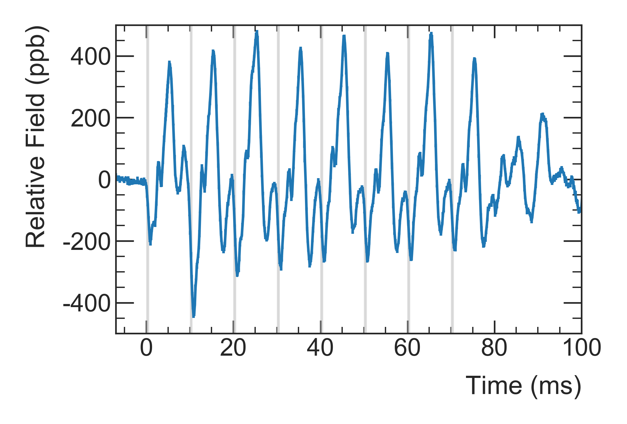
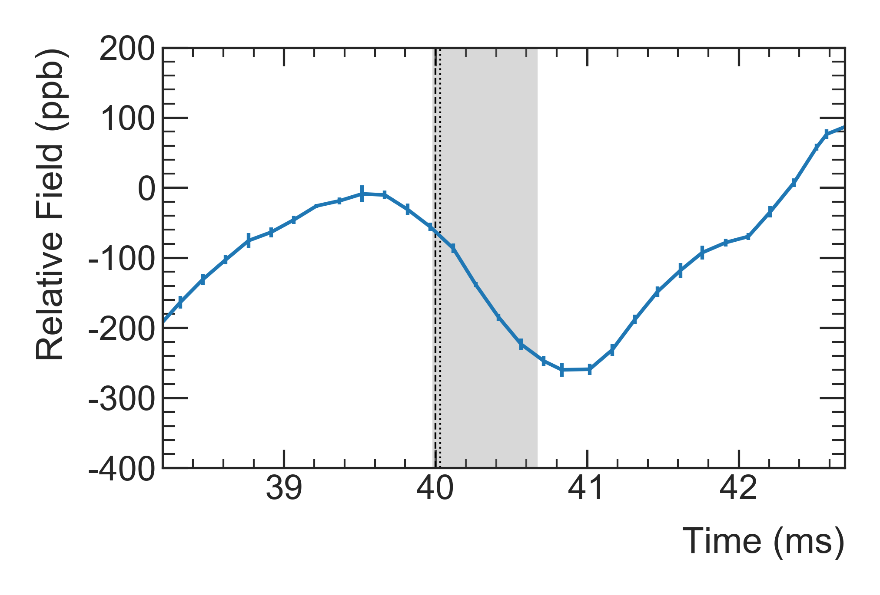
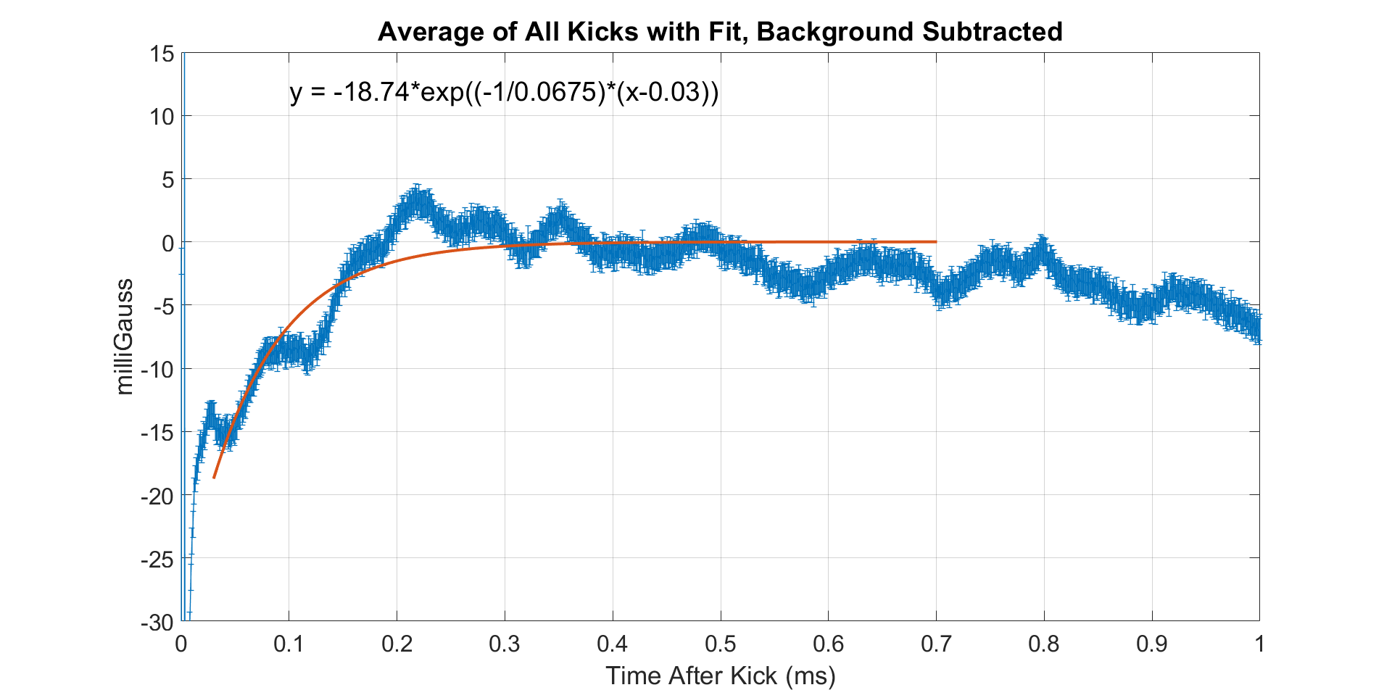




Two transient effects perturbed B within the kicker and quadrupole plates at injection
Quads pulsed on every fill
induces mechanical vibrations
oscillating B field
Net effect was small, but… complicated!
$$B_{q}=−17 ppb, δ_{B_{q}}=92 ppb$$
$$B_{q}=−xx ppb, δ_{B_{q}}=\sim 21 ppb$$
Zoom
Run 2/3 -PRELIMNARY
Kickers fire on every fill
induces small Eddy currents
We measured with custom magnetometers based on the Faraday effect
μ in ring
1 spot in 1 fill
$$B_{k}=−27 ppb, δ_{B_{k}}=37 ppb$$
$$B_{k}=−22 ppb, δ_{B_{k}}=13 ppb$$
Run 2/3 -PRELIMNARY

Slide 15
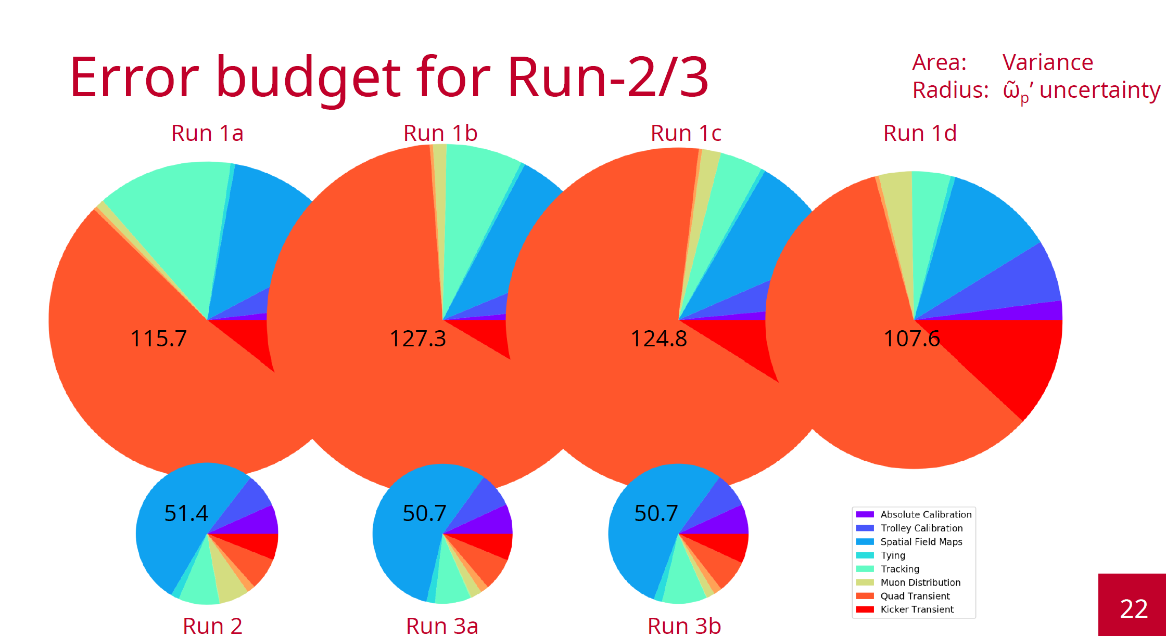
Fresh update from Field Team
Largest uncertainties were transients, now understood much better
René Reimann for the field team

Slide 16
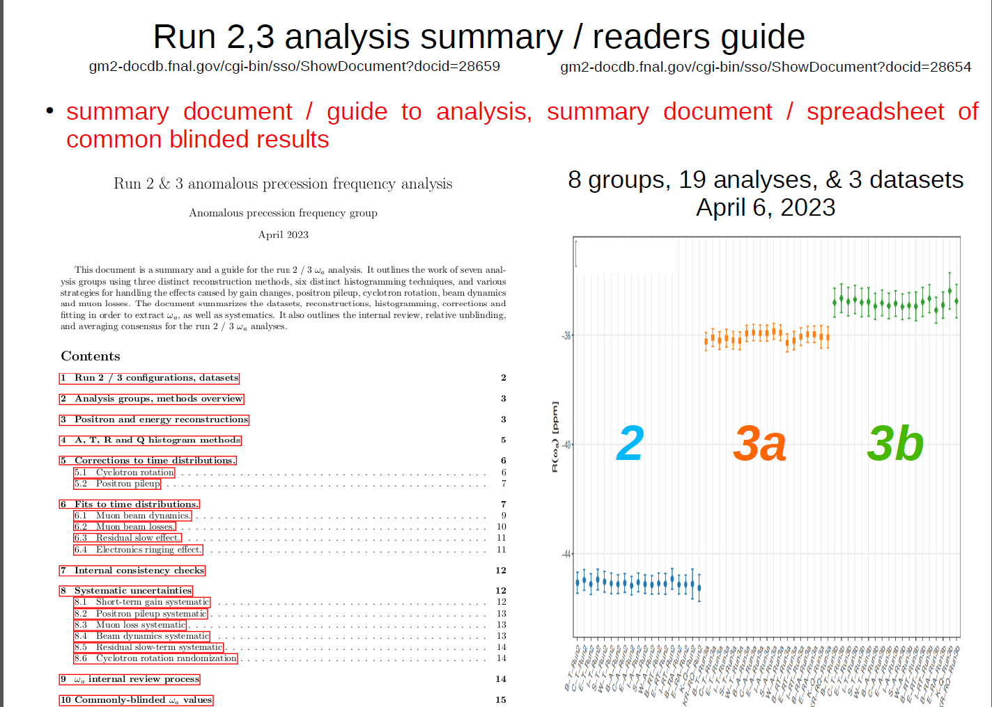
Precession frequency… 19 analyses x 3 runs periods = 57 ω_{a} !
Enormous work in final Review stages…
Note, various blinding factors and no magnetic field denominator here so don’t compare different colors to one another
Tim Gorringe, ω_{a} Analysis Co-Lead

Slide 17
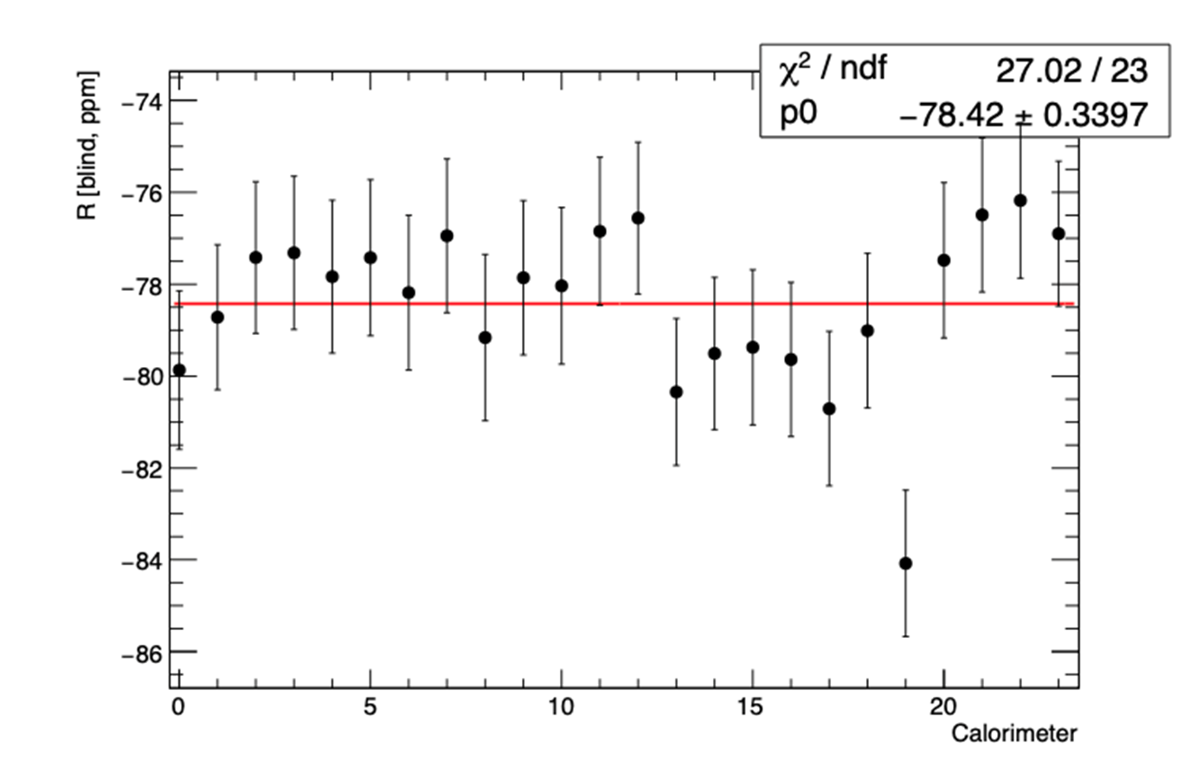
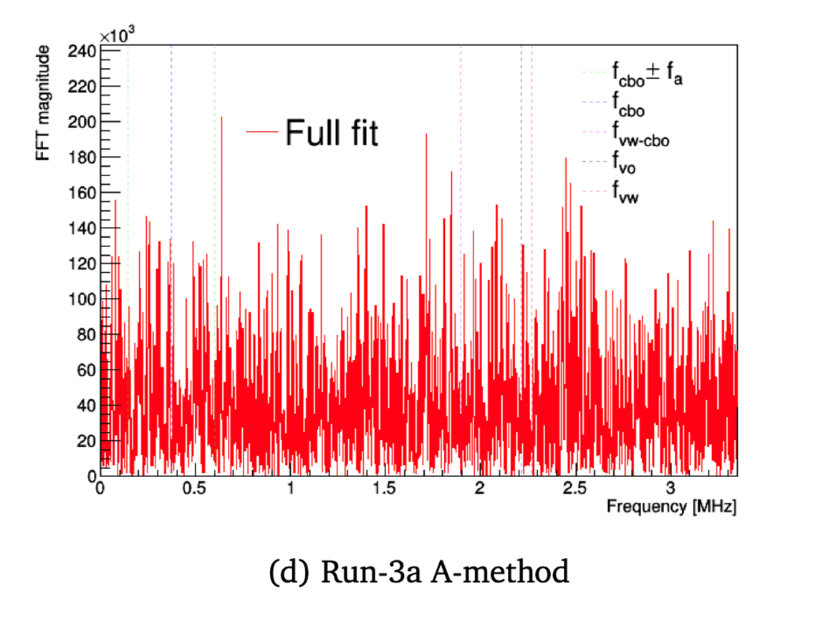
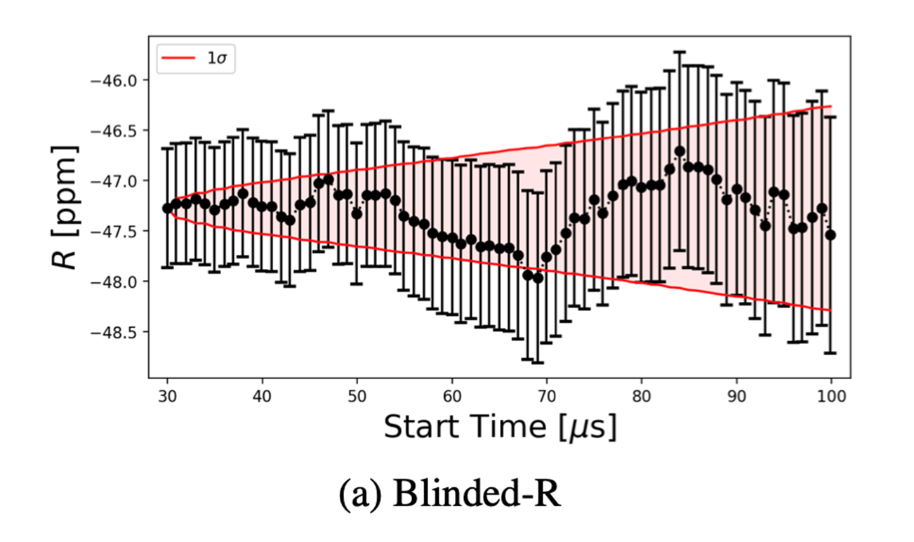
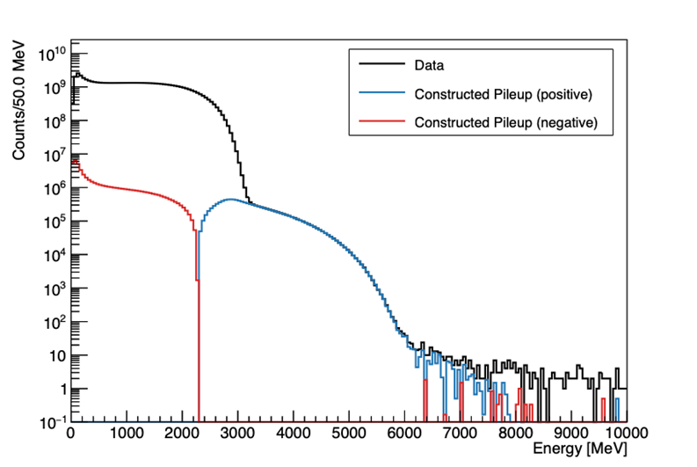
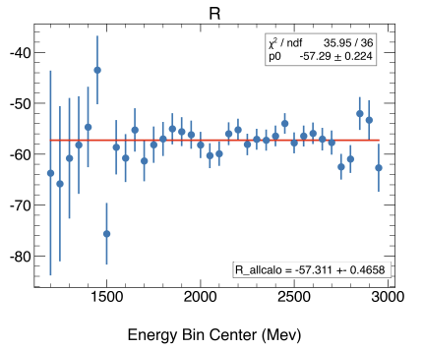
Overall message: Results are consistent and are supported by many quality control checks
ω_{a} vs Start of Fit in Fill
ω_{a} vs Calorimeter
Residuals of FFT
Etc, millions more…
Match of raw Energy spectrum and Pileup Correction
ω_{a} vs Energy Bin

Slide 18
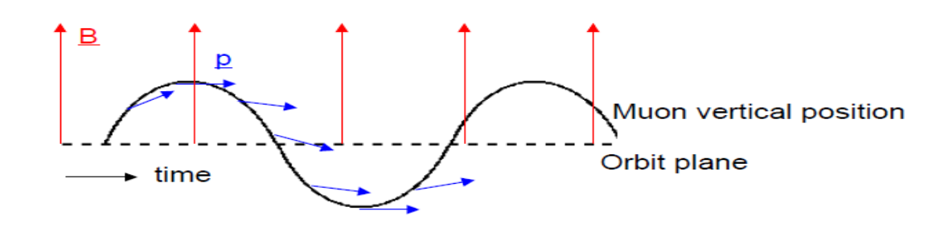
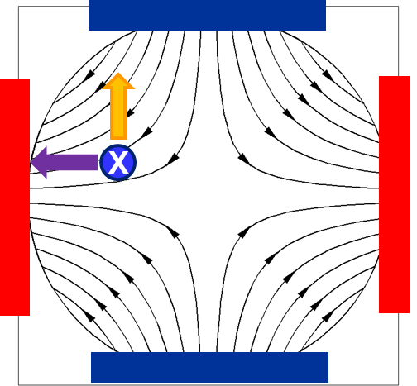
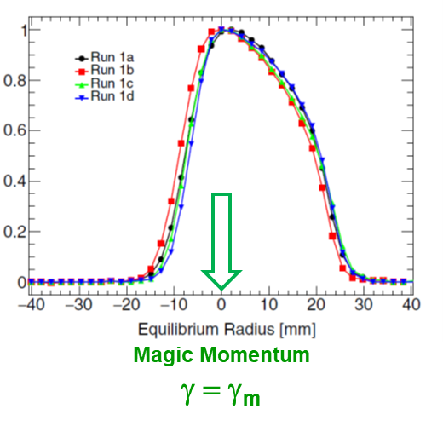
Beam Dynamics Corrections to measured ω_{a}
Because the Run1 bad resistors were replaced,
  C_{ml} “muon loss” are now negligible
  C_{pa} “phase-acceptance” was largest, but now much smaller
C_{dd} “differential decay” newly evaluated, but a small entry
C_{p} “pitch” -- no difficulties; evaluated by 2 teams
C_{E} “Electric Field” --
  largest correction so investigating if anything couples to it
  uncertainty being carefully evaluated with new hardware and software special efforts

Slide 19
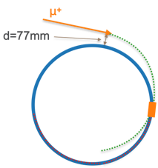
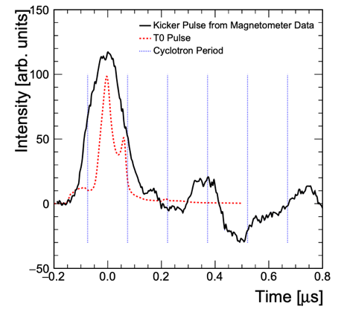
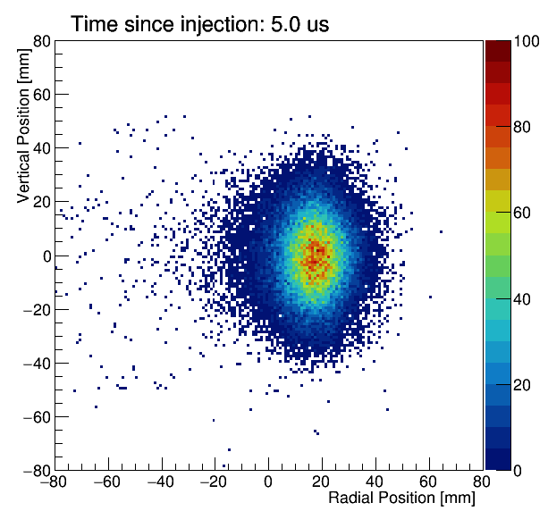
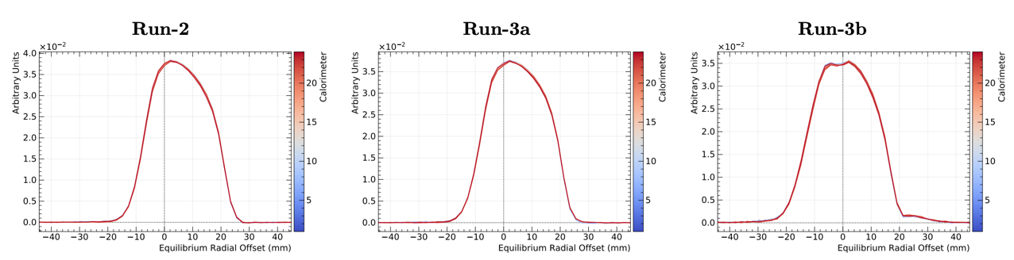
Major post Run 1 improvements – kicker strength
R1: Kickers did not center beam
Negative impacts
  Larger CBO amplitude
  Muons live in less uniform B field
  Off-center → off-momentum → large C_{e} correction
Major upgrade campaign completed by end of Run 3

Slide 20
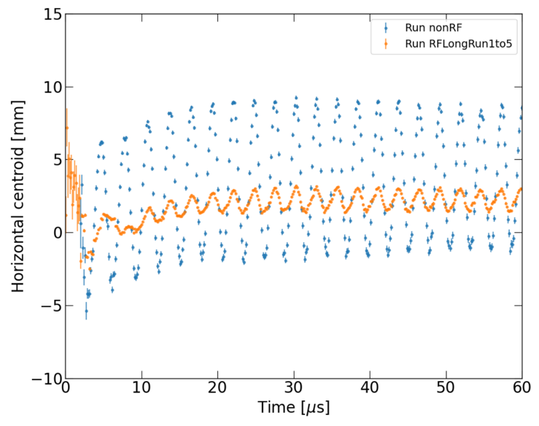
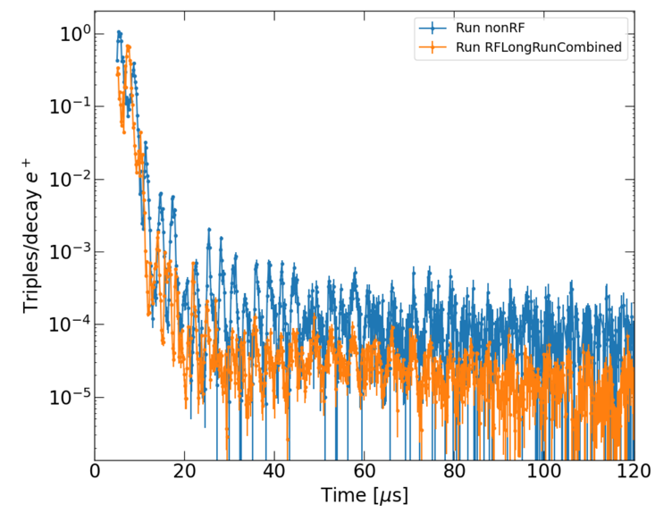
RF system deployed in Run 5 to damp CBO, reduce muon losses during storage
CBO Without RF
Muon Loss Without RF
CBO With RF
Muon Loss With RF
Implemented active RF system in Run 5 (first time in any g-2 storage ring)
Turns on for first few microseconds to damp CBO
Will make fitting time-dependent precession distribution easier

Slide 21
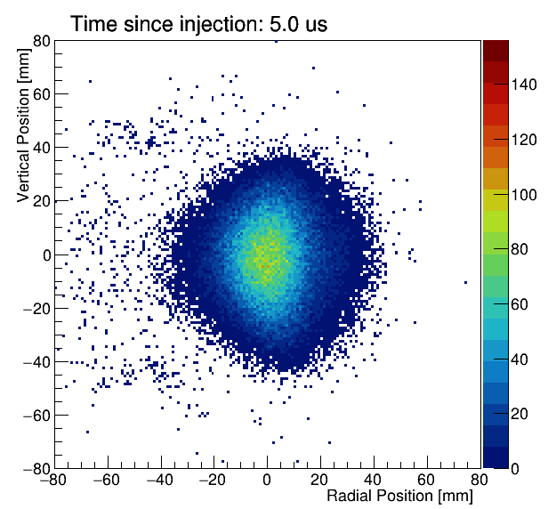
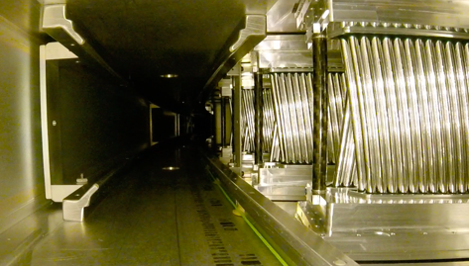
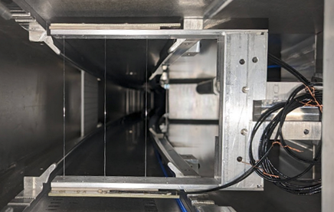
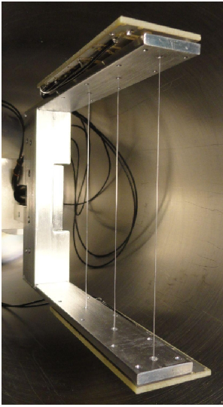
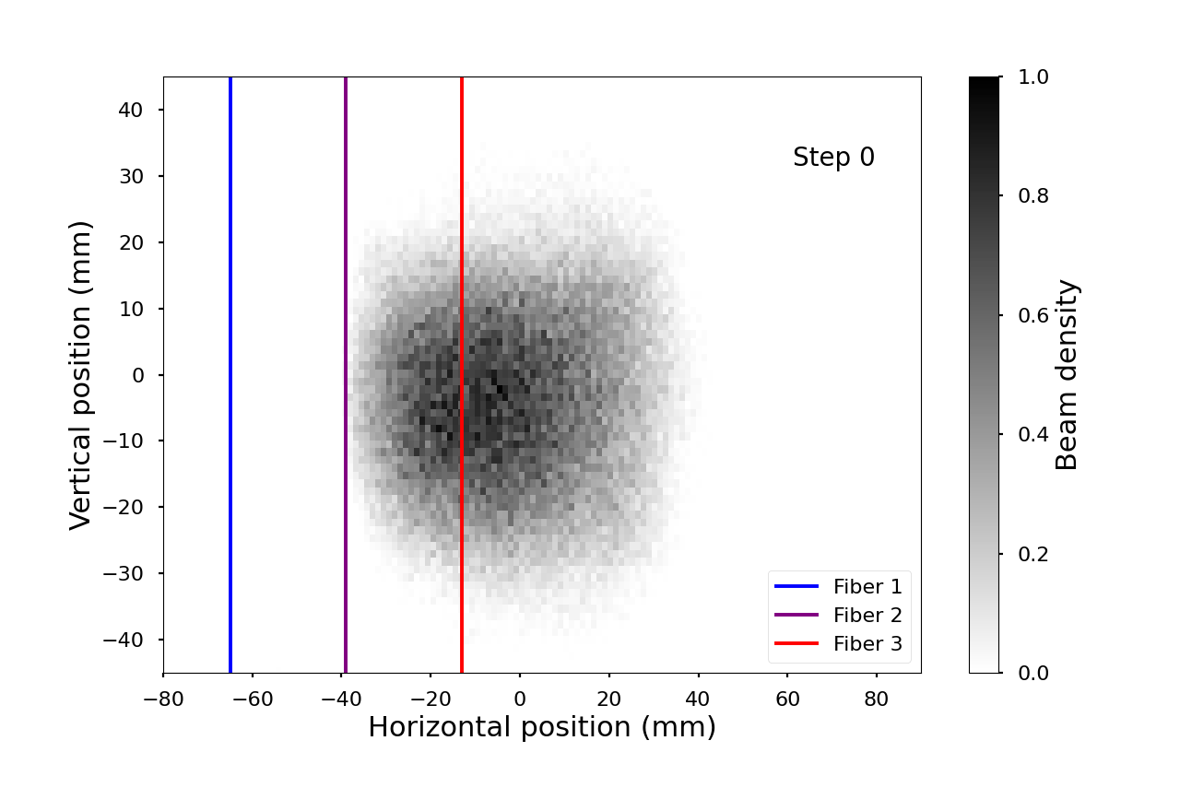

We’ve recently added a new beam imaging tool that directly observes the stored muons with minimum perturbation for the first time
A precision scan is made
The “indirect” view from tracked decay positrons
250 μm fibers, too thin to see, so I overlaid with blue lines
Preliminary analysis
Profile at 180°

Slide 22

Plans for Release of Run 2/3
All ω_{a} measurements are now relatively unblinded;
  6 pre-selected methods have the greatest sensitivity and independence; the will be averaged to provide the best and most robust result
    2 Recons; 2 Asymmetry Weighted Fits; 2 Ratio-Asymmetry Fits
The magnetic field analysis is very mature and thoroughly reviewed
The various “Beam Dynamics” corrections are nearly complete
After documents are blessed, we will vote to unblind.
Public release follows within a few weeks

Slide 23



Now back to the SM and why you are important!!
[F. Ignatov et al, arXiv:2302.08834]
The CMD-3 “February Surprise”
  e⁺e⁻ → π⁺π⁻ in important low-energy regime disagrees with all other results by many σ !
  Questions arise:
    What might they have wrong?
    How rigorously were results vetted?
    Did older exeriments miss something big and common?
  After lengthy seminar/panel discussion, nothing is at all obviosly wrong on new or older result and methods.
  This is a big PUZZLE that must get resolved, …
Might look like this if confirmed

Slide 24

The experimental landscape will improve …
Ongoing work in experimental inputs
BaBar: new analysis of large ππ data set with better detector
KLOE: new analysis of 7x larger ππ set
SND: new results for ππ channel
BESIII: new results for ππ channel and πππ
Belle II: promising greater statistics than BaBar or KLOE and similar or better systematics for low-energy cross sections
See Aida El-Khadra’s P5 presentation, March 2024 for lots of details on the g-2 Theory Initiative and the recent lattice efforts related to HVP

Slide 25




And finally, the lattice … eventually the most precise HVP method?
Not yet included in the Theory Initiative recommendation.
The 2021 BMW HVP publication is an impressive, sub-percent calculation. The result is closer to experiment
Since then, quite a buzz among groups trying to reconcile and find common areas to compare
Biggest problem is short- and long-distance extrapolations that are needed for such a diagram
  Step 1: “Intermediate” Euclidian Window
Looks consistent

Slide 26
… and, then ?
We are all excited to see the next g-2 result with ~½ the uncertainty
But, to what SM value can we compare it to this time?
  A) The “recommended” 2020 Theory Initiative value remains a standard (for now)
  B) But, they and we know, the situation is dynamic and could greatly change
    Need Confirmed Lattice Calculations. This is imperative.
    The Lattice could take us to 0.1% !! and even push for next-generation measurements
    The CMD-3 result is a true outlier right now, but that does not imply it is wrong. Fortunately a lot of new data is being analyzed so we have a “wait and see” situation
“Discovery” takes time.
  We do not know the final implications of our measurements of g-2.
  We can only control the quality of the effort and analysis.

