Slide 1
MIT Bates HPRCF Overview

Slide 2
MIT Bates High Performance Computer Center
The MIT-Bates High Performance Research Computing Facility service center was established in Fall 2009 within LNS. The HPRCF consists of 70 water-cooled racks and one air-cooled rack for computers, with each rack providing 12 kW of cooling. The HPRCF was connected to the main campus by a 10 Gb/s fiber optic link. IS&T upgraded this link to 100 Gb/s in the fall of 2015. In the last year IS&T installed a second 100 Gb/s line as backup.
The facility currently hosts computers for several groups in LNS (primarily CMS Tier-2 computing, also computers for lattice QCD), EAPS climate modeling, Condensed Matter Theory, Chemical Engineering, Civil and Environmental Engineering, and MIT Sea Grant. Currently all racks are in use but there are several racks with space being used by dead, underpowered, or obsolete systems. We are in the process of addressing this issue.
As of July 1, 2014, MIT covers power and network costs, as well as support of the infrastructure (cooling water system, electrical distribution, etc.). The operating budget is set by LNS and Bates management in consultation with the HPRCF users. Infrastructure support is provided by 0.6 FTE of MIT-Bates technicians and 0.15 FTE of a infrastructure administrator, along with 1 FTE of a local system administrator (Michael Tiernan) to handle support issues. Expenses also include service contracts for the chiller for the water system and the two UPS systems (fiber optic network and 10 racks of essential user computers), and funds for minor equipment and supplies (replacement rack fans, chemicals for the water system, etc.).

Slide 3
MIT Bates High Performance Computer Center
In MIT FY 2015, VPR equipment replacement funds were used to replace a server lift to assist in loading computers into the racks. We purchased a spare pump for the water system in MIT FY 2018, using accumulated funds in the HPRCF account. The two existing pumps alternate running for one month at a time and have now been running for seven years. When the operating pump fails, the other pump picks up the load so there is no down time.
UPS Battery replacement was done in 2022.
Bates is looking at how to provide power during outages. Investigating UPS alternatives and adding a generator to accept full HPRCF load. It’s unclear if funds will be available.
MIT has allocated funds to replace the current chiller. Bates has hired a consultant to facilitate this effort. We hope to order a new one within 4-6 weeks. Current lead time is 6-12 months.
The typical lifetime for most of the infrastructure equipment for the HPRCF (rack heat exchangers, chiller, UPS, etc.) is approximately 10 years. This was consistent with the planned 10 year lifetime of the facility (2009-2019). Maintenance effort has increased in recent years and we anticipate that we will have more equipment failures as we extend beyond the 10-year mark. In the coming year, we will be examining facility operation beyond 2023 and the implications to the users and budget.

Slide 4
Power and Equipment Outages
The Bates HPRCF has 24/7 technical coverage for power and equipment outages.
During working hours staff has procedures to address various failures immediately.
Off hours there is a guard with a call procedure to alert the necessary people to address the failure.
Currently, alerted staff then contact users with instructions that are dependent on the type of failure.
In the last year Bates has started a program to have technicians committed for call-ins on weekends and holidays.
The HPRCF has spare parts for common and predicted equipment failures. In particular equipment related to the rack cooling units and a spare cooling pump for the facility.
The HPRCF cooling system water is regularly tested and chemicals adjusted accordingly.

Slide 5
Current Usage Map

Slide 6
Some choices for solutions to computing needs.
Do it yourself.
Pay for an external Co-Lo
Install at the Bates facility
●
Find a place for it. (Too noisy for your office.)
Buy a rack.
Buy/Obtain special networking connections for chosen location. Provide cooling.
Provide appropriate power needs. Select & Purchase a UPS for the system.
Do hardware troubleshooting yourself.
Secure room containing server(s).
Provide access control. Designate people to respond during “off hours”.
Train a subset of them again next semester?
Purchase spares & replacement
parts. (i.e. Lead Acid Battery for UPS.)
Secure and inventory spare parts.
●
Go through the selection process of all the various service providers.
Some access requires 24hr
notice. Most limited to weekday work hours.
Costs based on “U” or per rack. General duty personnel are
unskilled workers. Provided as “hands & eyes” assistance.
All access is “escorted” and in some cases, charged for. (You
can't go in and hack away troubleshooting at your leisure.)
Various locations around the state are available.
YOU monitor everything about your system. You have to notice if
it breaks or shows a warning light.
●
Rack space provided by MIT at no cost to user.
MIT IS&T available for network configuration and/or connection. Personnel are skilled workers in the fields.
Power conditioned and provided at each rack.
Access is controlled. After hours guard on duty 365/yr.
Access is 24/7 with reasonable notice after hours.
Bates personnel include experienced electricians and technicians as well as system level trained people.
The entire MIT technical infrastructure is accessible 24/7 for support of projects and solutions to problems.
●
●
●
●
●
●
●
●
●
●
●
●
●
●
●
●
●
●
●
●
●
●
●
●
●

Slide 7
Infrastructure and some of the things we do regularly...
●
Regularly accept palettes of systems “drop shipped” from vendors at loading dock. Unpack and install these systems.
●
Install rails, power cables, network cables, label, test and then dispose of packaging.
Routinely walk through the DC, when a warning light is seen, contact can be made with the customer's designated contact for correction.
Personnel have training such as Dell's required for onsite warranty replacement. Onsite shipping/receiving department for warranty returns, etc.
We're 35 mins from Campus.
Regular visitors can, with training, be permitted 24/7 access without escorts. Racks supported by large onsite UPS are available for master servers.
Maintenance of infrastructure is done by Bates personnel independent of users of data center.
Space is available for maintenance of spare parts and inventory. Meeting rooms.
Conference space.
●
●
●
●
●
●
●
●
●
●
●

Slide 8
HPRCF Back Cooling Doors

Slide 9
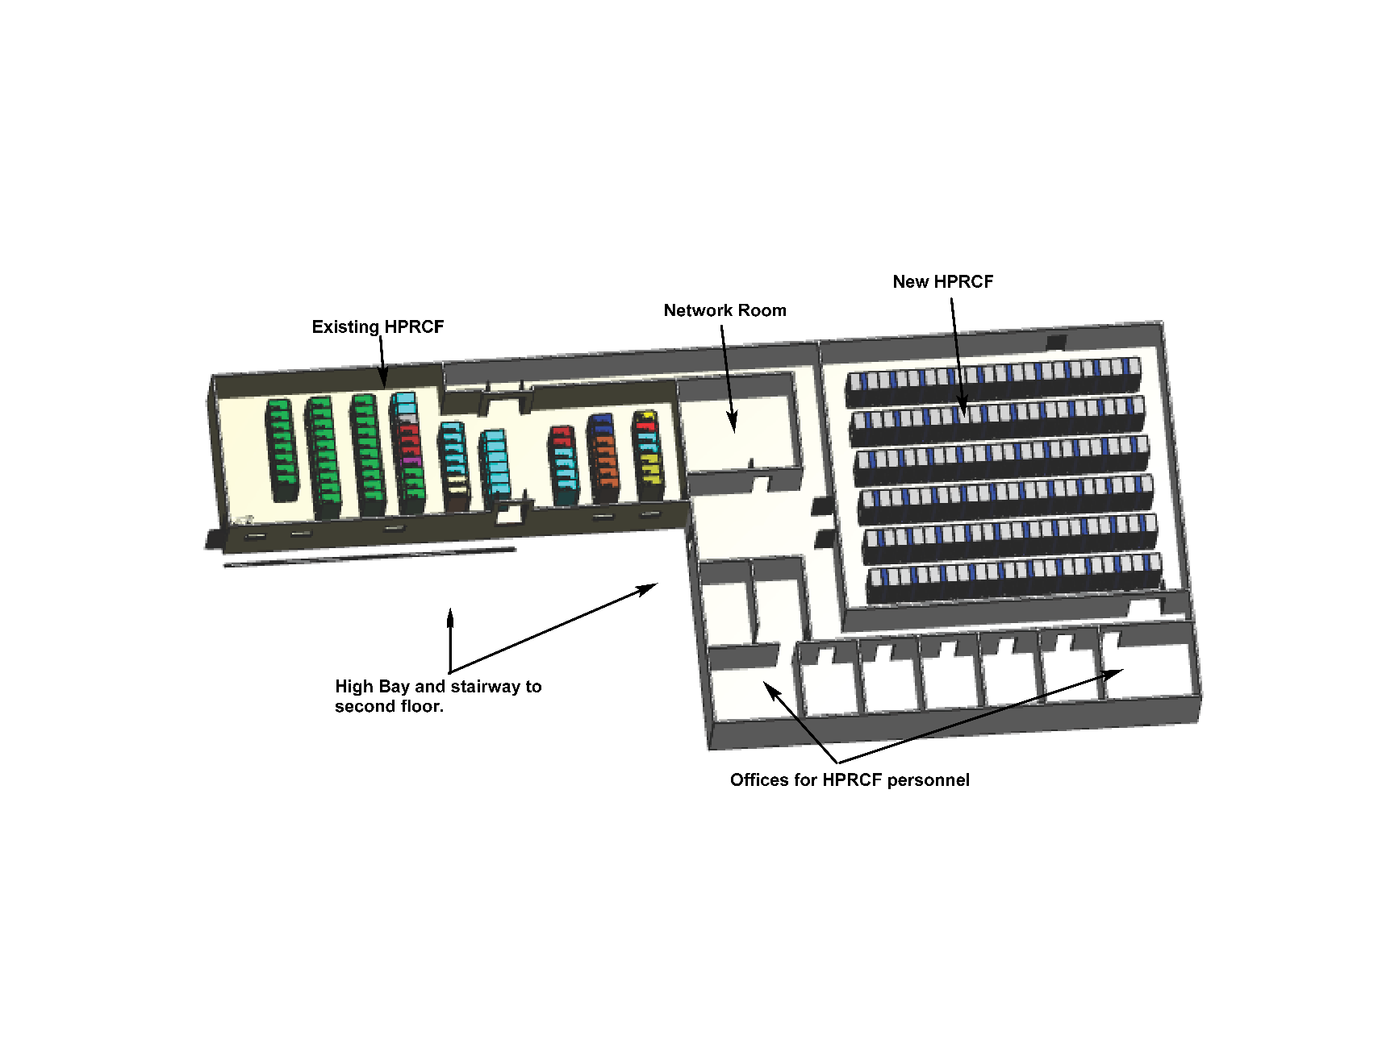
Proposed HPRCF 2 currently being investigated
HPRCF 2 would occupy space adjacent to the current facility.
HPRCF 2 will utilize much higher power capacity racks (30-50 KW/rack).
It will also have full backup power for the facility.

