Slide 1

APPLY & AFFORD / OUR ADMISSIONS PROCESS
Notes:
Slide 19) OUR ADMISSIONS PROCESS
Pictured: Killian Court, the picturesque grass lawn in front of the Great Dome that’s an iconic MIT picture spot. Big, campus-wide celebrations happen here, like commencement in the spring or the annual water war during Residential Exploration in the fall.
We talk about our admissions process as selecting a 1,100 person team to climb a metaphorical mountain together. We need people who have the stamina, training, and motivation for the difficult journey ahead. We want people who will support, surprise, challenge, and inspire each other—especially when the going gets tough.
Practically speaking, our admissions process is holistic, which means we look at each applicant as a full person: who you are and how you’ll contribute to the MIT community. You’re not just a list of grades, test scores, and extracurriculars. We’ll always evaluate your application by looking at your individual context, taking into account the opportunities and resources available to you.
So all this is to say: there isn’t a “perfect” MIT applicant. We’re looking for people who will thrive at MIT socially, academically, creatively, and otherwise. And we’re looking for people for whom MIT is a good fit for them.

Slide 2
APPLY & AFFORD / Holistic admissions
Scores are one tool we use to help us in admissions. And yes, your grades and test scores (especially your grades) are important. But what ultimately really matters to us is who you are, what qualities you bring to the table.
We want people who are academically curious and passionate, people who will bring their various talents to our schools and share them with others, people who will be good roommates, good mentors, good friends.
We do not admit test scores. We admit people.

Slide 3
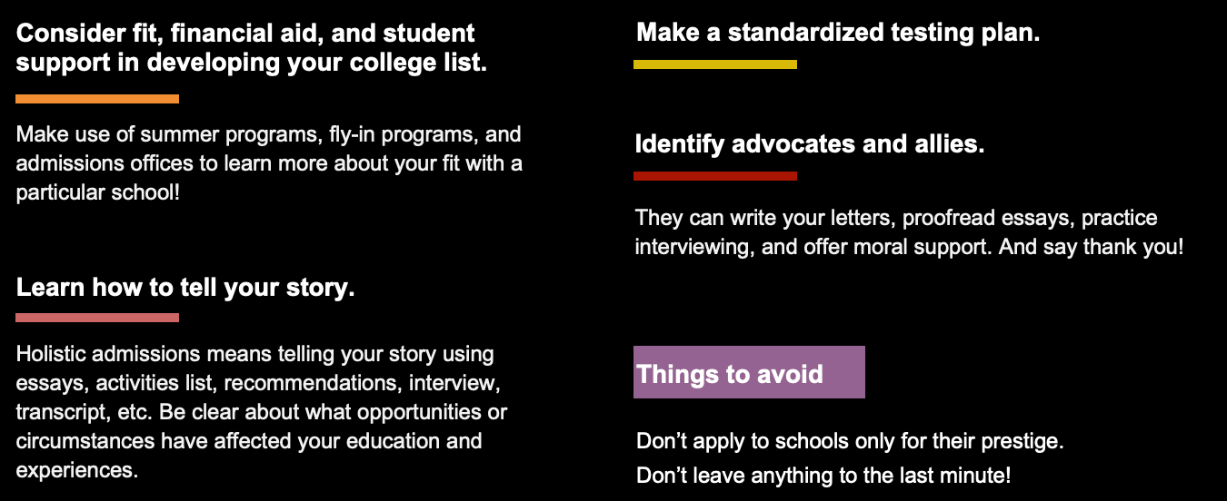
APPLY & AFFORD / Application advice

Slide 4
APPLY & AFFORD / THE MIT APPLICATION
THE MIT APPLICATION
Essays, activities, awards, etc.
Recommendations
Transcript
SAT or ACT (superscore)
Interview
LEARN MORE
mitadmissions.org/apply
Notes:
Slide 20) THE MIT APPLICATION
To help us in this search, we have our own, independent application. This isn’t to make your lives harder, but we designed it thoughtfully to help us identify students who will be a great match for MIT.
The bulk of the application is fill-in-the-blank questions to let you tell us your story in your own words:
There’s space for up to 4 activities with a brief description, anything from sports, to leadership activities, to helping with elder care at home.
There’s also space for work experience, like a part-time job at a grocery store, or summer activities, whether that’s a summer program or working on a weird personal project.
We want you to brag about yourself, so there are spaces for awards and honors you’ve received.
And we have short essay prompts (with word limits of 100 to 225 words depending on the question) to talk about who you are and what you value.
We ask for two recommendations to learn how your teachers see you, your hard work, and your contributions to your classroom community:
We strongly recommend 1 from a Math or Science instructor, and 1 from a Humanities, Arts, or Social Sciences instructor – to match the two core academic GIRs.
We ask for a transcript to see your academic interests and strengths:
We have more information on our website about what classes well-matched students have taken in high school, but generally we’re looking to see whether you’ve challenged yourself academically in the areas that interest you – which, for a lot of MIT applicants, includes strong math and science preparation.
You don’t need to have spotless grades, and you don’t need to max out every AP class. We understand that you’re a human with a limited amount of time, and that different students have access to different coursework.
We do require standardized tests, and there’s a whole blog post from our Dean of Admissions Stu Schmill about the thought and data that went into this decision:
All applicants need to self-report SAT or ACT scores (the SAT essay section and ACT writing section are not required).
If you’ve been using English for fewer than 5 years or don’t speak English at home or in school, we recommend reporting scores from one of the following exams, like the TOEFL (Test of English as a Foreign Language) or Duolingo English Test (DET).
And, finally, the interview is optional and is conducted by our alumni volunteers, called Educational Counselors, or ECs :
Some of them are here in the room today, if they could raise their hands and wave!
Once a student has submitted their MIT Application, they will be contacted by an EC, if one is available, to set up an interview. If there isn’t an EC available, it won’t be held against them.
Slide 21) WHEN TO APPLY
We have two application cycles with virtually no difference in admission rates.
Early Action, or EA , has a November 1st application deadline. You’ll receive a decision in mid-December.
For EA, scores taken through early November test dates are accepted – you should self-report them in your applicant status portal as soon as they become available.
To clarify some College Admissions jargon: unlike schools that have “Early Decision,” MIT’s “Early Action” is non-binding. Basically, this means that if you get admitted in either of our cycles, you don’t HAVE to come to MIT. You can still weigh your options, apply to other schools, and make an educated decision about where to enroll that works for you and your family. Early Action is often for people who are super excited about MIT, or who want information sooner about their decision as they’re going about their college search process.
Regular Action, or RA , has a January 4th application deadline. You’ll receive a decision in mid-March.
For RA, scores taken through December test dates are accepted.
I also want to remind you that passionate people are everywhere, not just at MIT, so any one college decision won’t make or break your academic journey, it’s just one possible future of many.
pronounced by saying the letters: E-A
pronounced by saying the letters: R-A
pronunciation: TOE-fl
pronounced by saying the letters: E-C

Slide 5

APPLY & AFFORD / Financial Aid PROCESS

Slide 6

APPLY & AFFORD / AFFORDING MIT
AFFORDING MIT
MIT is one of only seven U.S. colleges that practices need-blind admissions, offers need-based aid, and meets full demonstrated need for all undergraduate students. We are committed to making the cost of an MIT education affordable!
ESTIMATE YOUR COST
mitadmissions.org/afford
Notes:
Slide 22) AFFORDING MIT
We also know that finances play a big role in the college search and decision-making process for most families. College is expensive, and MIT has financial aid policies in place to try and make sure that the cost of attendance is affordable for every student who is admitted — including domestic, international, transfer, and undocumented students. We want people who are a good match for MIT, regardless of what they can pay.
There are three key terms that inform how we think about financial aid:
Need-blind aid means that no student will be disadvantaged in the admissions process because of their financial need. In other words, as admissions officers, we don’t see your family’s financial documents or know how much it will cost you to come to MIT.
Need-based aid means that the financial aid offer you receive from MIT is solely based on your family’s financial circumstances. Getting into MIT means that you’re exceptional in so many ways, so there are no merit or athletic scholarships.
And full demonstrated need basically means, “the amount of financial aid we estimate your family needs in order to afford MIT, based on the information you provided.” Some of MIT’s need analysis is based on standard calculations, and some of it considers individual circumstances. If you’re concerned about affording MIT after seeing your financial aid award, you can reach out to your financial aid counselor and may be asked to submit an appeal to gather more information.
As a ballpark figure, for the 2021-2022 academic year, the average annual price paid by a student who received financial aid was $19,599 – and that includes things like tuition, fees, housing, and dining. 58% of full-time undergraduates received need-based aid, and 33% had their tuition fully covered.
The best thing you can do to get an idea of how much MIT will cost is use the tools we have available online at mitadmissions.org/afford. In fact, no matter what colleges you’re considering, they should have at least one cost estimator tool to help you crunch some numbers!

Slide 7
APPLY & AFFORD / Applying FOR AID
APPLYING FOR AID
Early Action: November 30**
Regular Action: February 15
You’ll need: CSS Profile, parental tax returns or income documentation (submitted through IDOC), and FAFSA**
**Only for US Citizens
Notes:
Slide 23) APPLYING FOR AID
Both Early Action and Regular Action application deadlines also have financial aid deadlines – but, don’t worry, the Student Financial Services office is flexible if you need extra time.
How to apply
Applying for financial aid can be complicated, so we have broken it down to make it a bit easier. Before we can decide what your financial aid award looks like, we need to know what your financial situation is. To do this, we use two documents that paint us a detailed picture of what kind of aid you’ll need to be able to attend MIT affordably.
Two steps to apply for aid.
CSS Profile: a tool provided by the College Board that we use to determine if you qualify for a need-based MIT Scholarship
Parental tax returns or income documentation: your parents’ tax returns or income documentation must be submitted through the College Board’s secure IDOC platform. If your parents live outside the U.S., please provide the tax return from that country, along with a translation to English if applicable.
International students are considered for aid using the same process that we use for all applicants. We are committed to meeting 100% of demonstrated financial need for international students just as we are for domestic students.
The CSS Profile is a tool provided by the College Board. We use it to determine if you qualify for a need-based MIT Scholarship.
For the application, you will need the following:
Your parents’ 2022 income tax returns or wage statements
Any other records of money earned
Current bank account balances
Records of investments
Records of untaxed income
If your parents are separated or divorced, each parent will need to complete their own CSS Profile application.
Parental tax returns or income documentation
After submitting the CSS Profile, you will need to submit your parents’ tax returns or income documentation to the College Board’s secure Institutional Documentation Service (IDOC) for processing.
If your parents live outside the U.S., please provide the tax return from that country, along with a translation to English if applicable.
If your parents are separated or divorced, you will need both parents’ income documentation.
You must submit all documents directly to IDOC. We are not able to accept anything sent directly to MIT.
Please note: It can take up to two weeks for the tax returns to be received by MIT.
For undocumented and DACA students, your financial aid award will only include an MIT Scholarship, which is considered a grant that does not need to be repaid. It will not include any expectation that you work⁠01 or take out any loans.
As a reminder, I am an admissions counselor, not a financial aid counselor! So if you want more information about the financial aid application process, or an example award with a breakdown of costs and expected contributions, visit the MIT Student Financial Services website at sfs.mit.edu.
pronounced by reading the letters: C-S-S
pronunciation: eye-doc
pronunciation: FAFF-suh

Slide 8

Q&A
mitadmissions.org
sfs.mit.edu
admissions@mit.edu
Notes:
SLIDE 24) Q&A
Pictured: Another angle of The Alchemist, by the Spanish visual artist Jaume Plensa. It sits in front of the Student Center, or Stud for short.
That’s the end of my official presentation, but you can visit our website – mitadmissions.org – for even more information, including detailed guidance about our application process and student blogs that showcase their real experiences at MIT.
We have [10 minutes] set aside to answer any questions, and I want to set some expectations to make the most of this time:
If you raise your hand, please make sure your questions are helpful for the whole room to hear.
If you have specific or personal questions, or if I don’t get to yours, you can:
Check out mitadmissions.org, like I mentioned
Visit sfs.mit.edu for financial aid information
Email admissions@mit.edu, which is staffed by our office
Or chat with one of our Educational Counselors as you leave this central meeting
[Open up Q&A]
[After Q&A, set expectations for clearing out the room, e.g. Thank you all for coming! As a reminder, we need to leave this venue within the next 15 or 30 minutes.]
pronunciation: JOW-ma

