Slide 1
Geant4 Monte Carlo Simulation
Cameron Ekeman

Slide 2
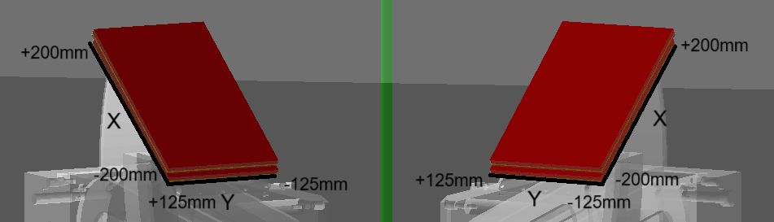
Current Geometry/Coordinate System
Unless specified, the data shown is from the previous geometry of the spectrometers before the shrinking of the window. The magnetic field file and GEM position have been updated to the newest versions.
The coordinate system used as output for the GEMs is shown below:
Electron Side
Positron Side

Slide 3
Background Rates from Elastic Scattering - Method
Electrons are generated at a kinetic energy of 30MeV and are directed down the window of each spectrometer.
The electrons are given a random in-plane angle of ±1.5º and an out of plane angle of ±5º relative to the center of the spectrometer window.
Hits are recorded at the location of the first step in the GEM’s sensitive volume.
A particle sometimes is directed back and records an additional hit on the GEM.
Secondaries created within the GEM are not recorded.

Slide 4
Background Rates from Elastic Scattering - Results
100,000,000 event runs. The top row has the back of the vacuum chamber fully lined with PEEK, the bottom row has the middle section removed.
 | Events Electron Side | Events Positron Side | Hits Electron Side | Hits Positron Side
Full PEEK | 220863 (0.22%) | 1509 (0.0015%) | 231154 | 1600
Middle PEEK Removed | 62748 (0.063%) | 4051 (0.00405%) | 68712 | 4449

Slide 5
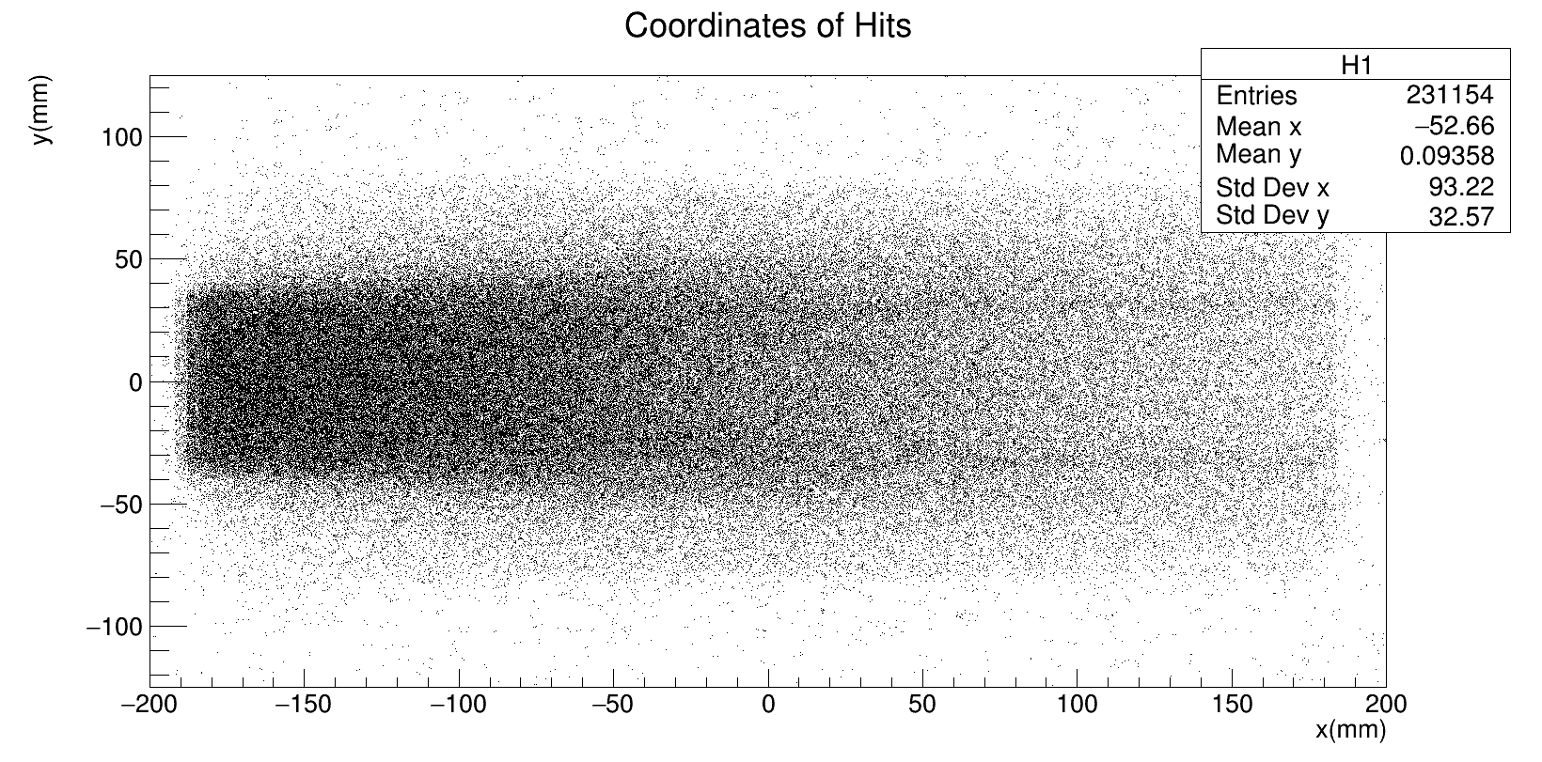
Hit Coordinates (Full PEEK) Electron Side
Approximate Area for ±20% Nominal Momentum

Slide 6
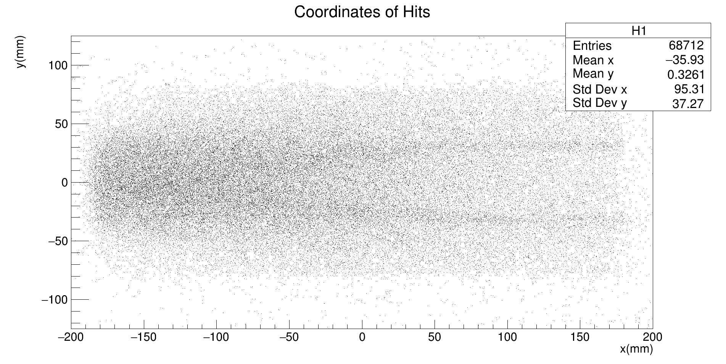
Hit Coordinates (Partial PEEK) Electron Side
Approximate Area for ±20% Nominal Momentum

Slide 7
Validation Studies - Method
Electrons and Positrons are generated at or near the nominal momentum for the magnetic field.
The particles are given a random in-plane angle of ±1.5º and an out of plane angle of ±5º relative to the center of the spectrometer window.
Hits are recorded at the location of the first step in the GEM’s sensitive volume.
A particle sometimes is directed back but this additional hit is no longer recorded.
Secondaries created within the GEM are not recorded.

Slide 8
Effect of the Aluminum Vacuum Window
In the old geometry used in these simulations, the aluminum window on the chamber is 0.1mm thick.
When measuring the precision of the focal plane, the aluminum caused significant scattering compared to when the window was omitted.

Slide 13
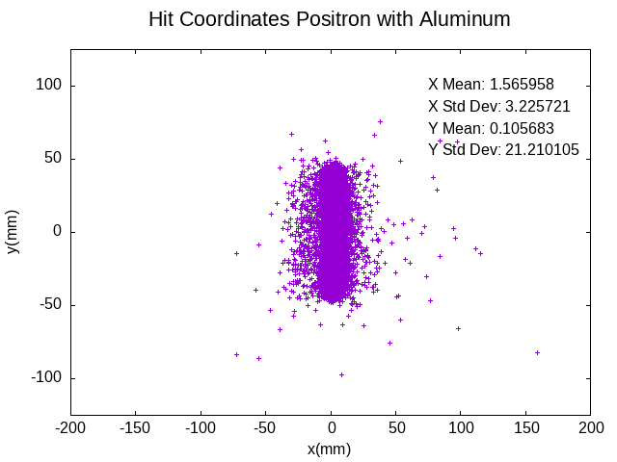
New Geometry Scattering

Slide 14
Focal Plane Analysis - Method
In order to get an accurate measurement of the focal plane, the aluminum window had to be removed temporarily.
Particles were sent into the spectrometers using the same method as before, except at 0.8, 0.9, 1.0, 1.1, and 1.2 times the nominal momentum for each side.
100,000 events were run for each momentum.
Again, secondaries generated in the GEMs were not recorded.

Slide 23
Next Steps
Implement new geometry and run background studies.
Put in scintillators (import from MUSE)
Digitize the GEM and scintillator outputs to accurately measure the effect of secondaries.

