Slide 1

Design by Jordan Lang
Welcome to MIT
Christoph Paus
March 25, 2024
Participants: 208

Slide 2
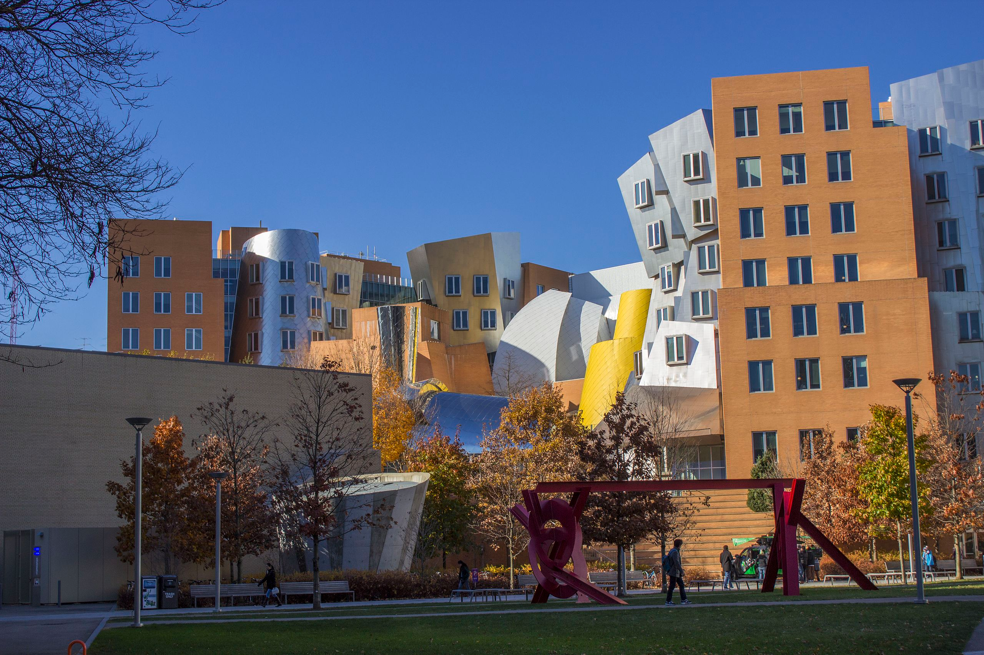
MIT Supports: ‘eduroam’
otherwise
‘MIT GUEST’

Slide 3
Iconic View of MIT The Stata Center
and our venue
A Frank Gehry building

Slide 4
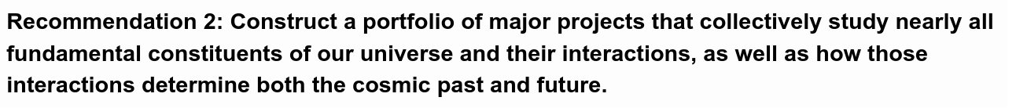
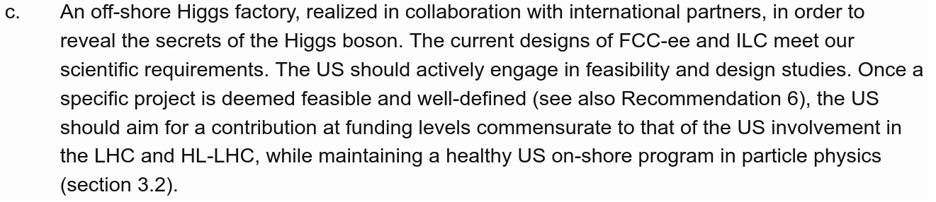
From the 2023 P5 report*
<snip>
<snip>
* 2023 P5 report

Slide 5
Goals for the Workshop
P5 report – offshore Higgs factory
  US must make a strong impact on the Higgs factory
Build up an active US FCC community
  Accelerator development essential to help FCC-ee design
  But detectors are the key for the physics
  Develop our own ideas about the physics focus of a detector
    What is the way to optimize a detector?
    Given a physics goal, where do we spend the money?
  Make sure we can ask for R&D funding in a coherent fashion
Synergy with linear collider folks very important
  Plenary session today, invited plenty of people

Slide 6
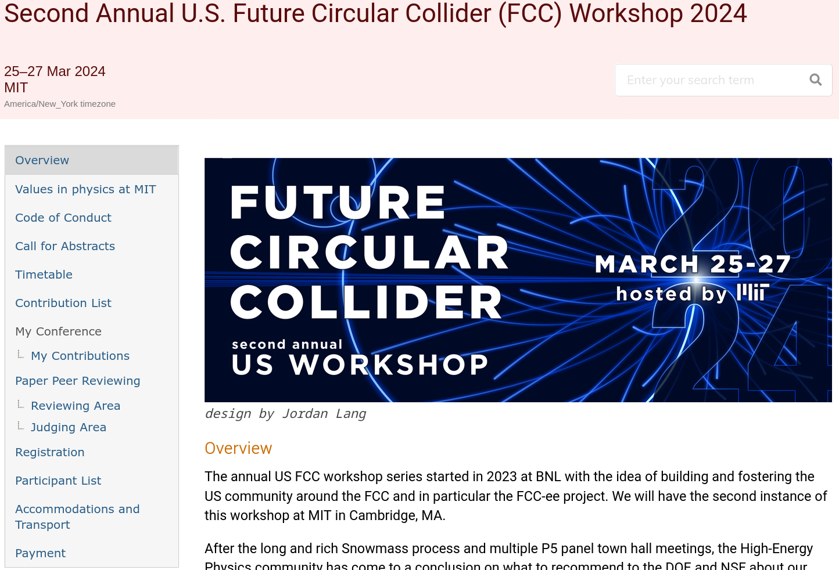
Overview

Slide 7

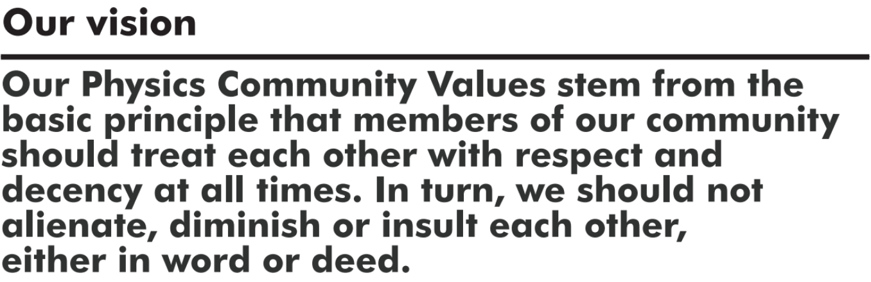
Values in Physics at MIT

Slide 8

Values in Physics at MIT

Slide 9

Code of Conduct*
* Adapted from the APS

Slide 10
Code of Conduct*
We want everybody to have
a positive and constructive
experience at the workshop.
* Adapted from the APS

Slide 11
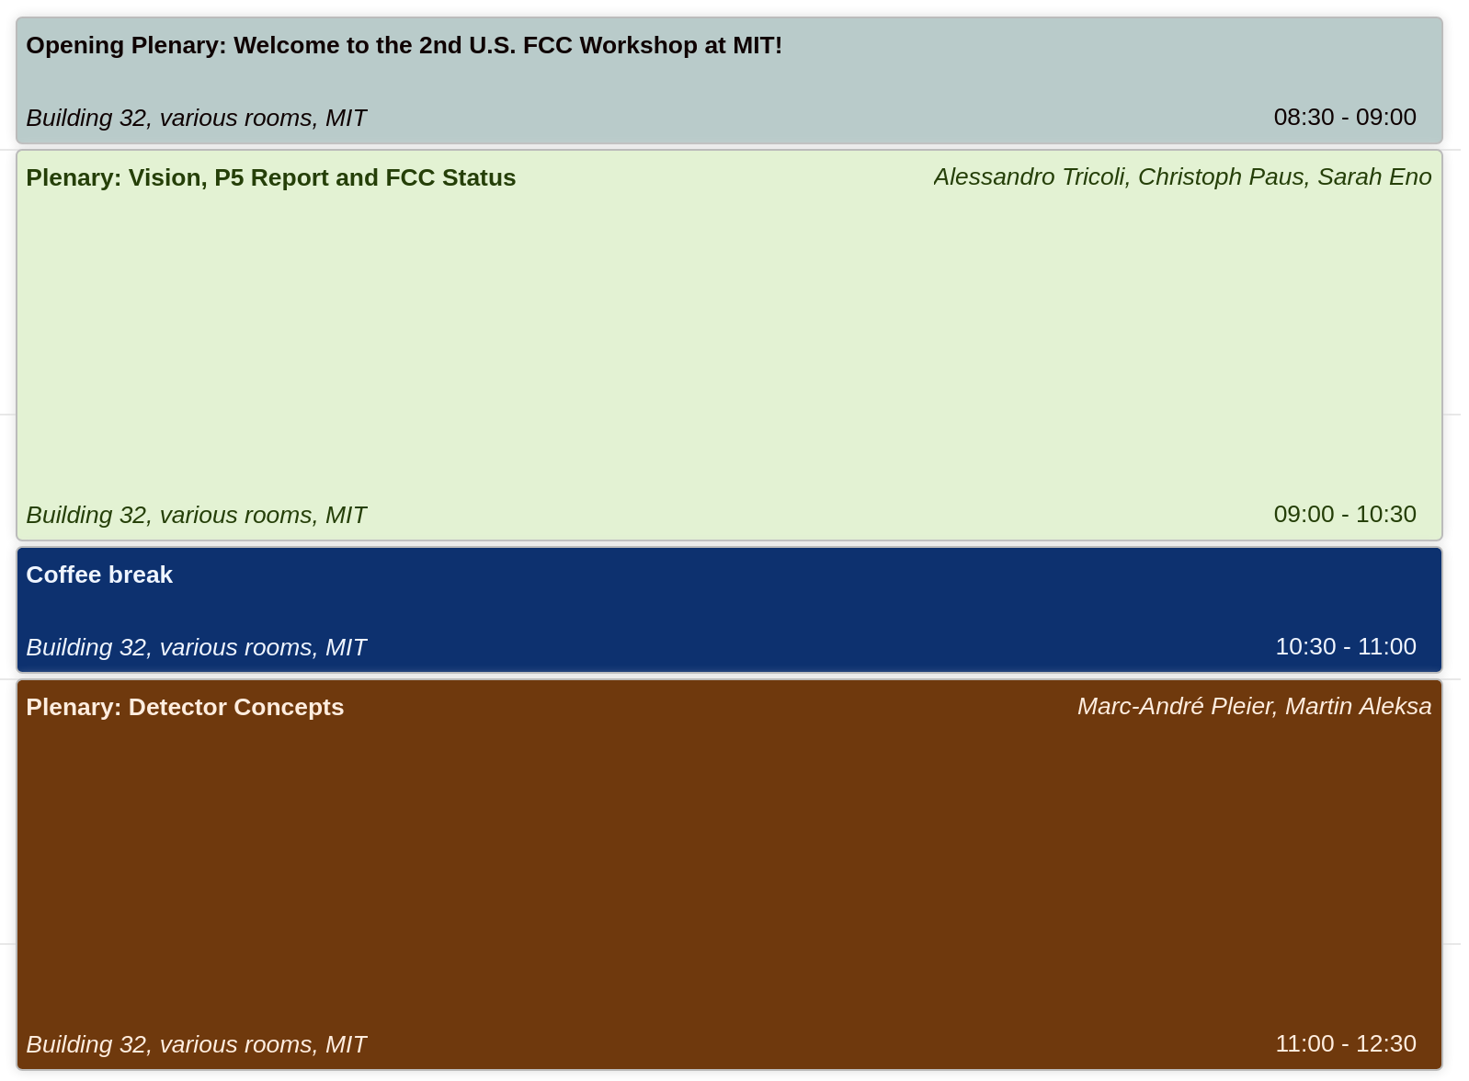
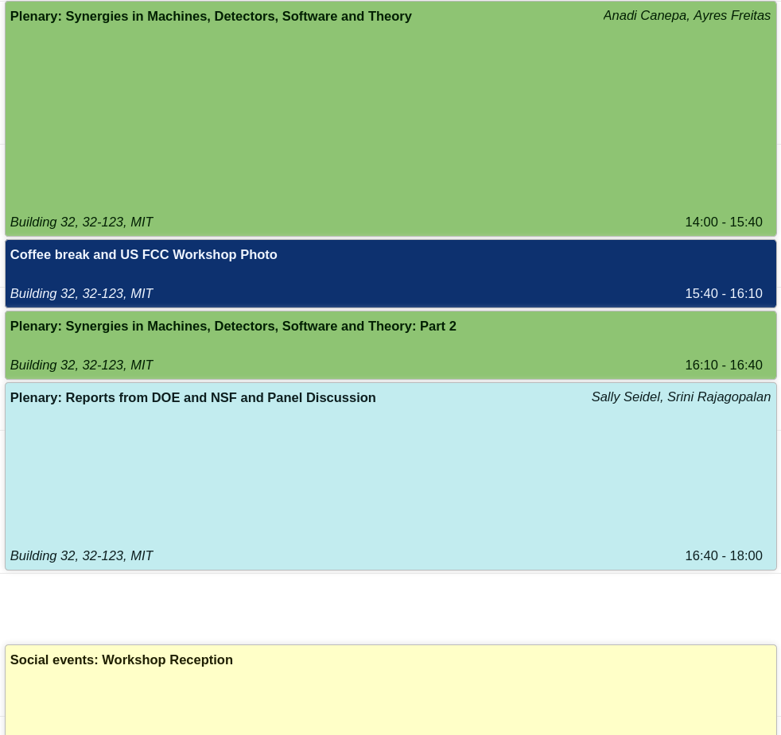
Agenda – Monday
Afternoon
Workshop Photo
Morning

Slide 12
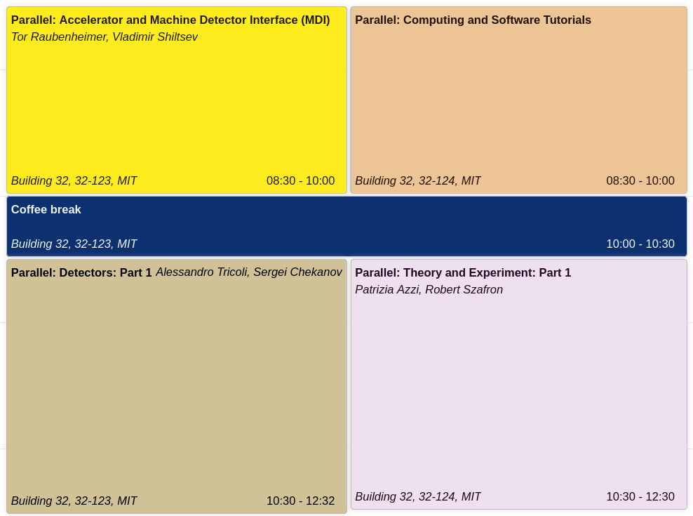
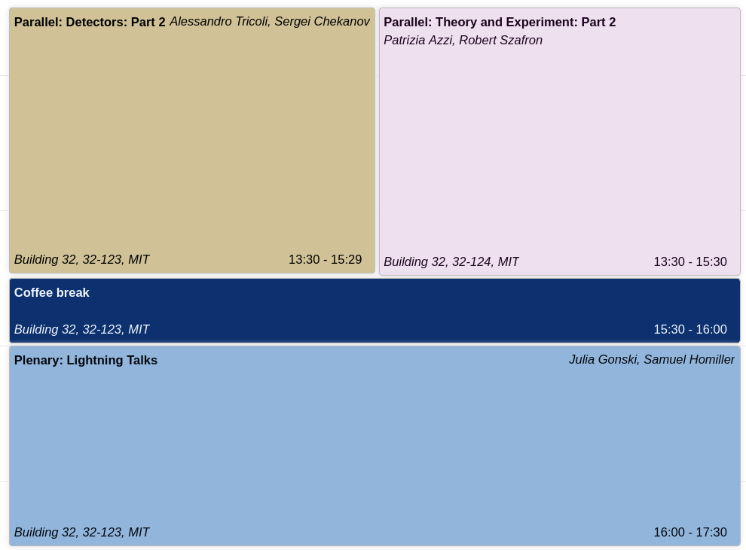
Agenda – Tuesday
Afternoon
Morning
→ Conference Dinner

Slide 13
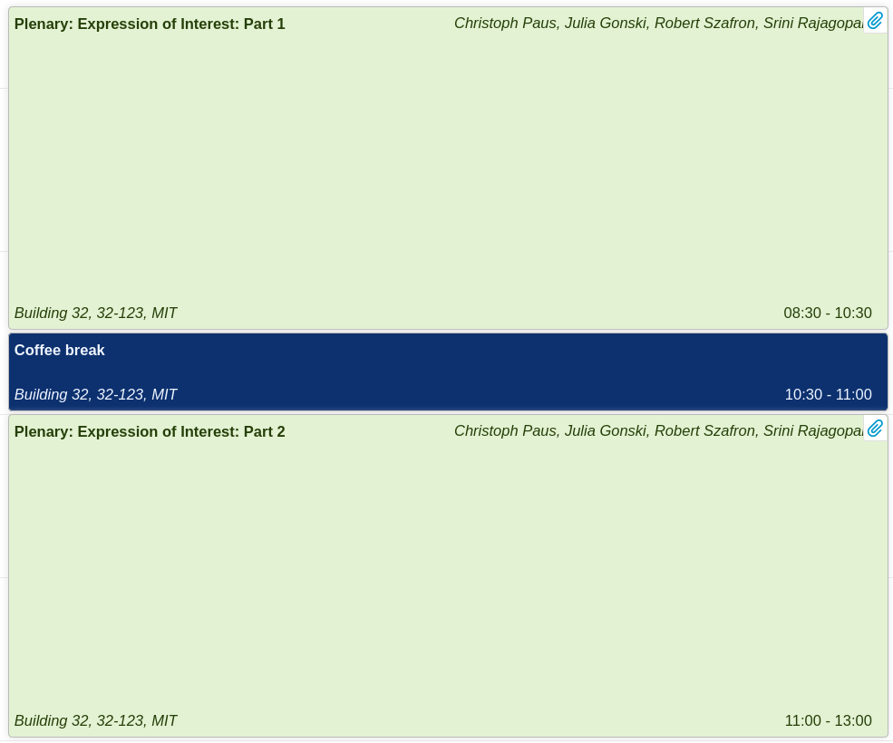
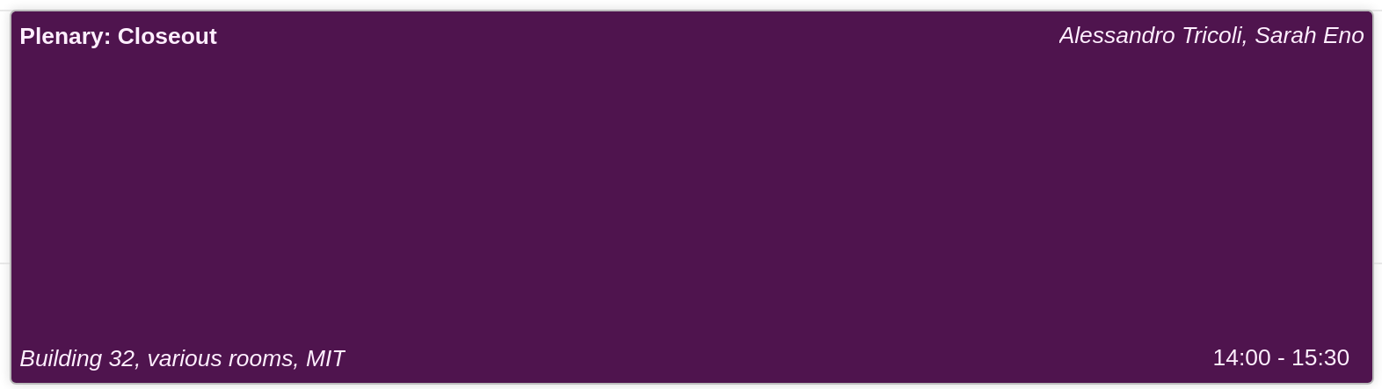
Agenda – Wednesday
Morning
Afternoon

Slide 14
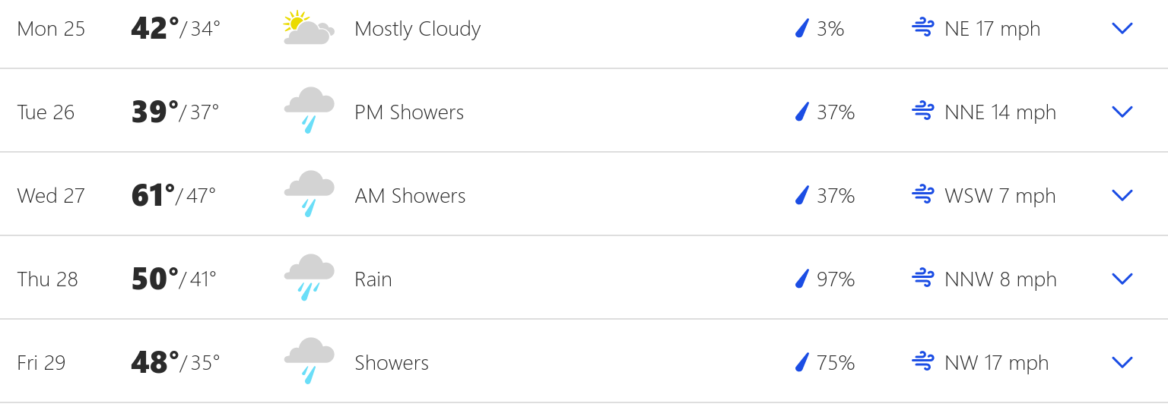
Weather in Boston...
Comments from the locals ...
  At least we have a chance of sun for the workshop photo
  The cold has made a comeback but …
  Fairly standard weather in Cambridge this time of the year

Slide 15
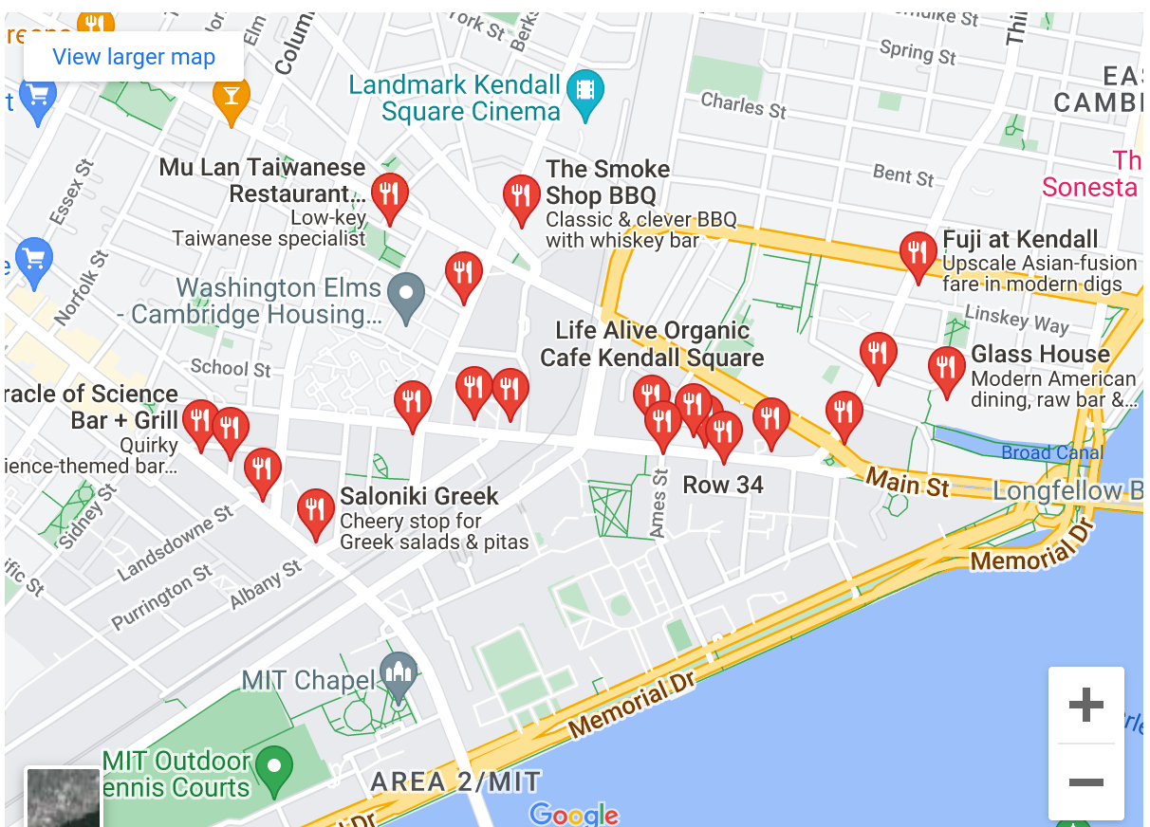
Where to eat?
We serve in breaks
  coffee/tea
  bakery/snacks
Lunch favorites
  Stata center (easiest)
  Al’s Cafe (subs)
  Cava (middle east ‘Chipotle’)
  Saloniki (greek)
  Beantown Taqueria (Taco Tuesday)
  Chipotle
What also works
  .. just use your phone as usual
32-123
MIT Web site
https://web.mit.edu/visitmit/where-eat/

Slide 16
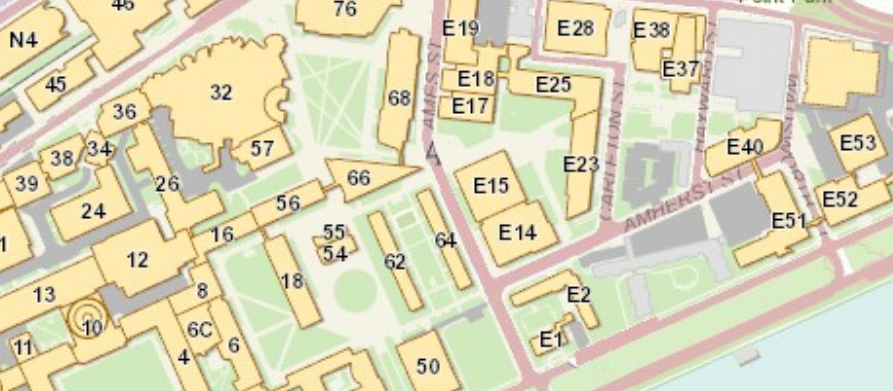
Reception / Dinner
32-123 /124
Conference Venue
34-401 A/B (4th floor)
E52 Samberg Center
Reception
Monday 6:30-8:30pm
Conference Dinner
Tuesday 7-9pm

Slide 17
Zoom and Indico
Zoom connections
32-123 Big room -- Plenary/Parallel room:
https://mit.zoom.us/j/94405507633?pwd=WHNySGNXN0h3ZU9UeC9OdnZwaDdGUT09
Password: 511786
32-124 Smaller room -- Parallel only:
https://mit.zoom.us/j/95307472672?pwd=cXhHeHFtZ3ozcS9mZTEvcldhaUJidz09
password: 558789
Indico and slides
  We project from a fixed laptop, please upload your slides at least one hour before your talk!
  PDF files are by far most reliable
  To upload: make a local (MIT) indico account with your email as used in submitting your abstract (your standard email)
  Trouble? email session conveners or fcc-help@mit.edu

Slide 18
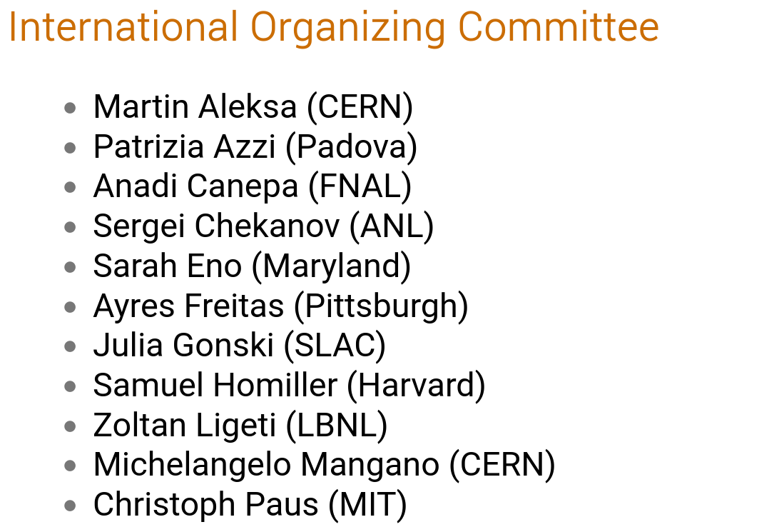
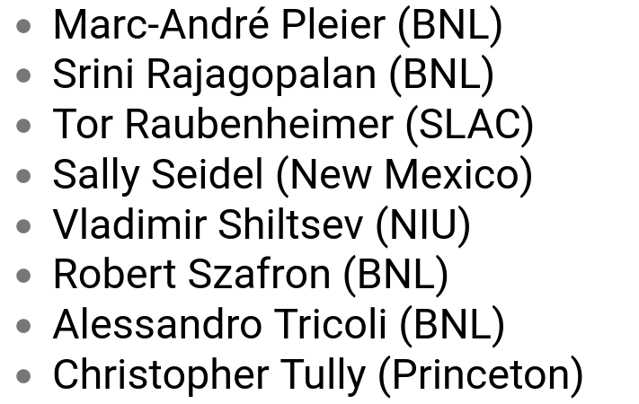

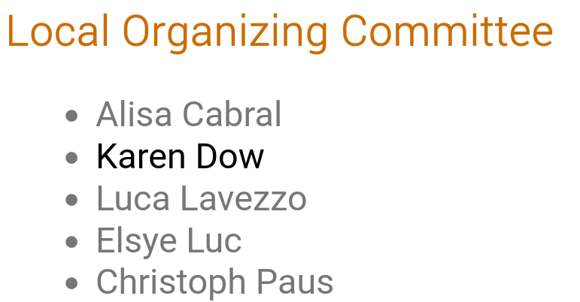
Thank you!
To DOE/BNL, the MIT Physics Department and the Lab for Nuclear Science for funding support

