Slide 1
The IDEA detector concept
Paolo Giacomelli
INFN Bologna
These projects have received funding from the European Union’s Horizon Europe Research and Innovation programme under Grant Agreements No. 101004761 (AIDAinnova), 101057511 (EURO-LABS).

Slide 2
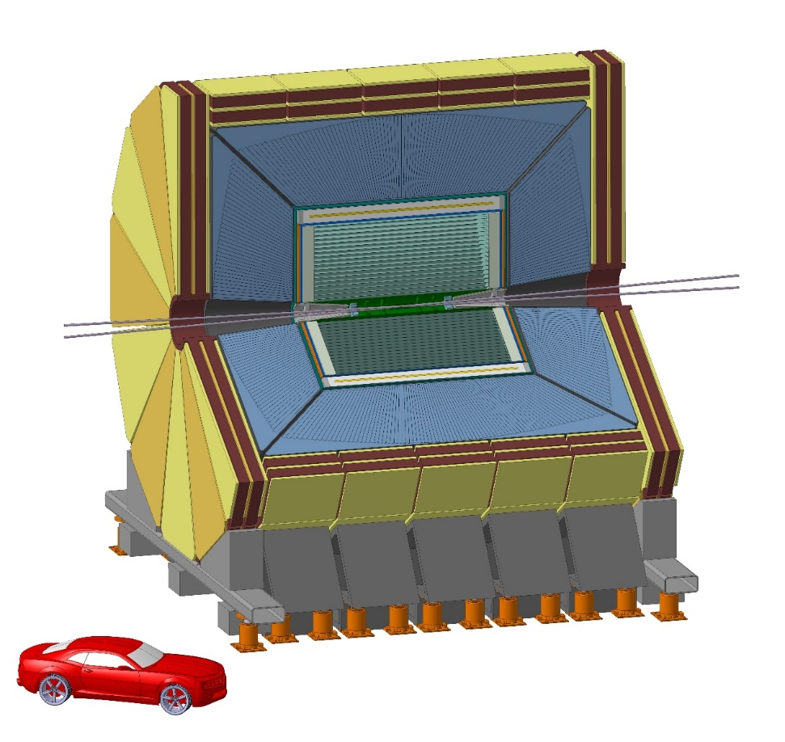
The IDEA detector concept
New, innovative, possibly more cost-effective concept
Silicon vertex detector
Short-drift, ultra-light wire chamber
Dual-readout calorimeter
Thin and light solenoid coil inside calorimeter system
Small magnet ⇒ small yoke
Muon system made of 3 layers of μ−RWELL detectors in the return yoke
https://pos.sissa.it/390/
IDEA concept (proposed in FCC CDR)
Innovative Detector for e⁺e⁻ Accelerator
Acknowledgments
I need to thank many colleagues, in particular:
F. Bedeschi

Slide 3
IDEA detector layout
Beam pipe: R∼1.0 cm
Vertex:
5 MAPS layers
R = 1.37-31.5 cm
Drift Chamber: 112 layers
4 m long, R = 35-200 cm
Outer Silicon wrapper:
Si strips
Superconducting solenoid coil:
2 T, R ∼ 2.1-2.4 m
0.74 X0, 0.16 λ @ 90°
Preshower: ∼1 X0
Dual-Readout Calorimeter:
2m / 7 λint
Yoke + Muon chambers

Slide 4
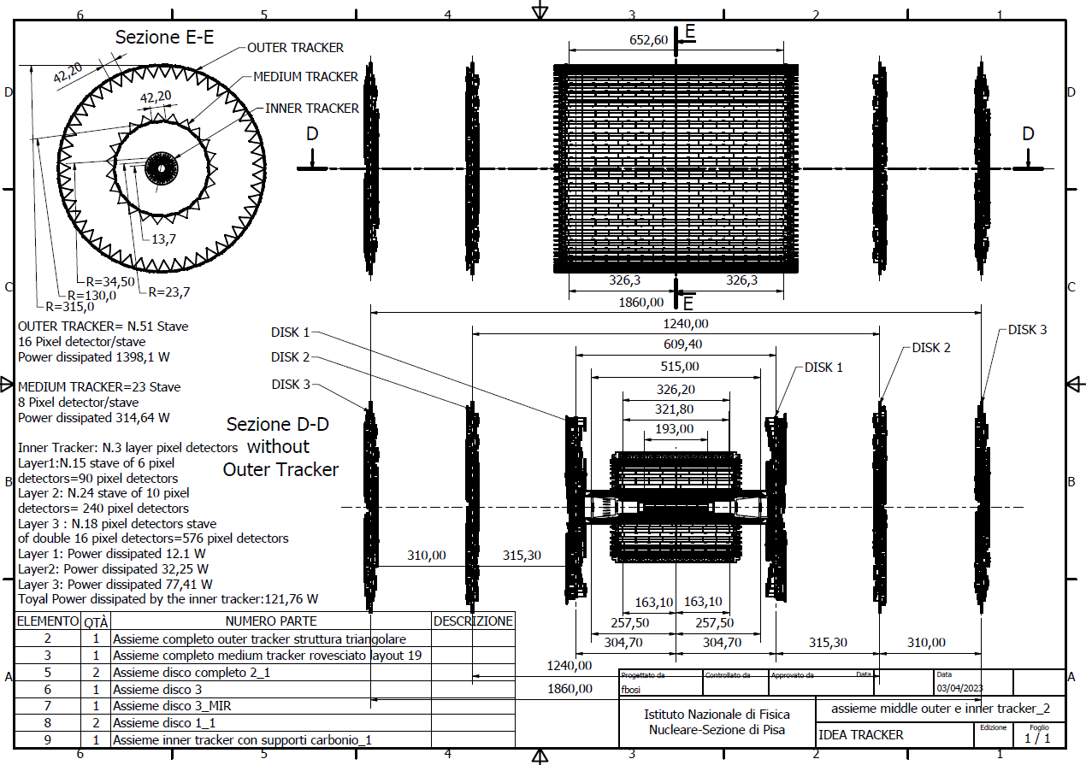
Vertex detector: IDEA
Mid-term review vertex detector overall layout
Outer vertex tracker:
Modules of $50×150µm^{2}$ pixel size
Intermediate barrel at 13 cm radius (improved reconstruction for$p_{T}>40MeVtracks$)
Outer barrel at 31.5 cm radius
3 disks per side
Inner Vertex detector:
Modules of $25×25µm^{2}$ pixel size
3 barrel layers at
13.7, 22.7 and 34.8 mm radius
F. Palla

Slide 5
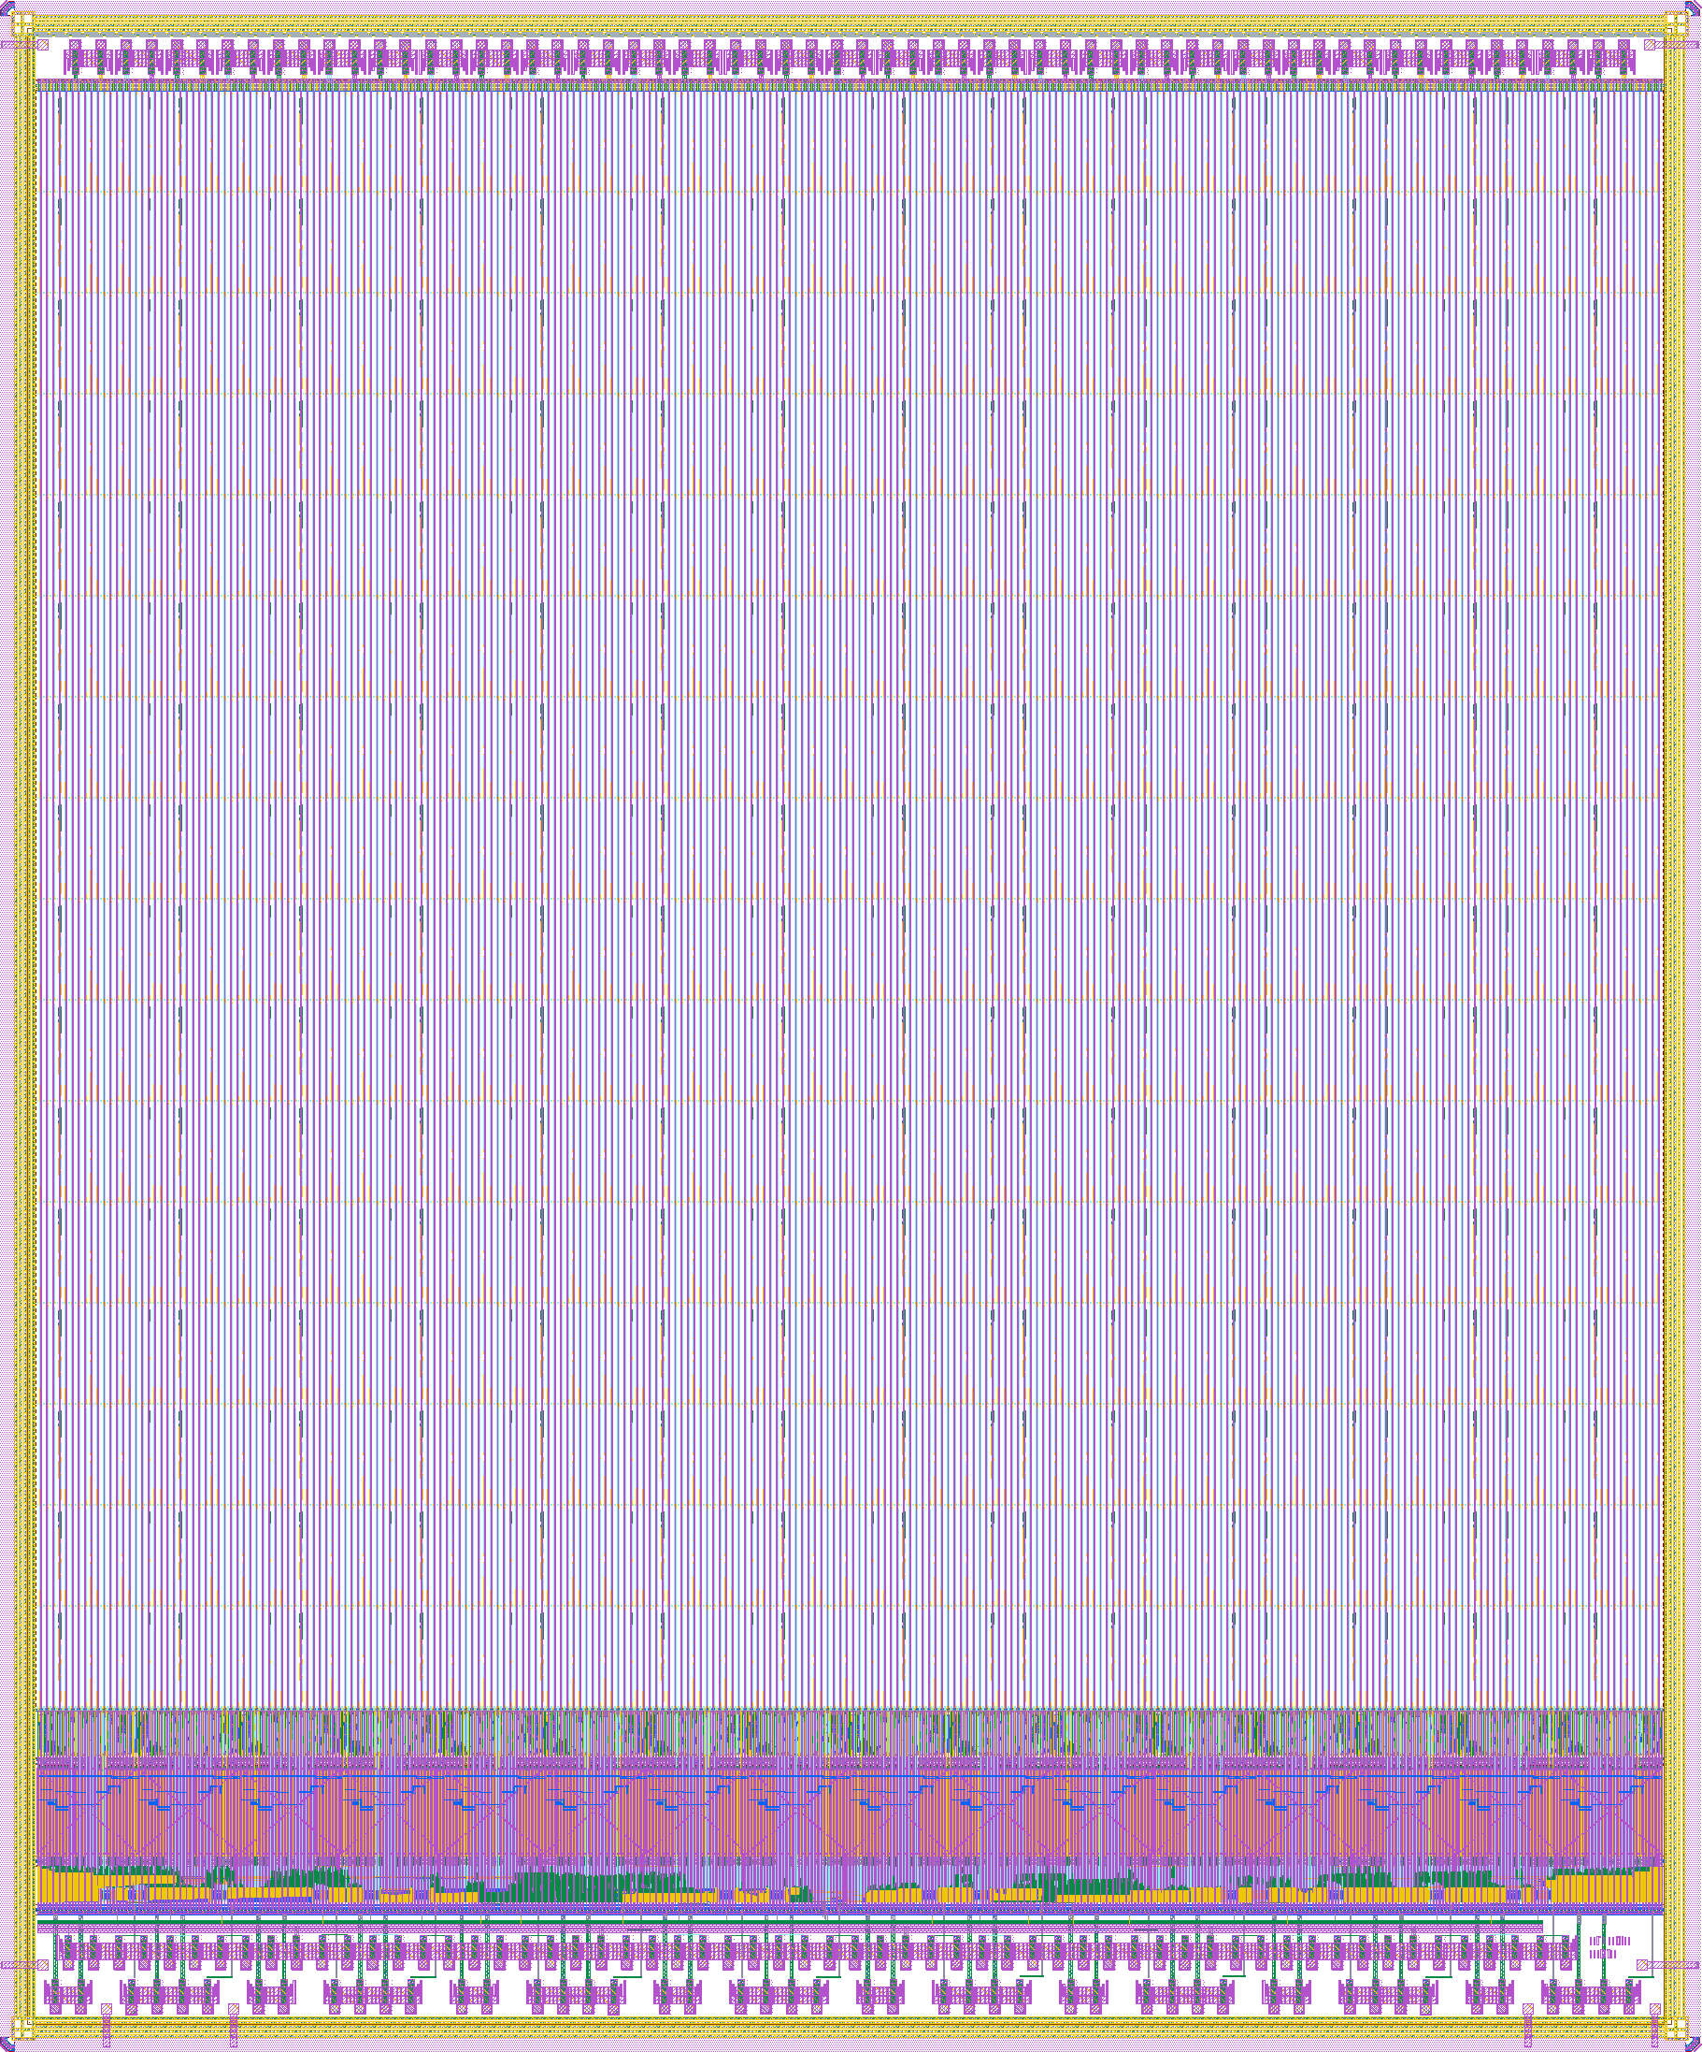
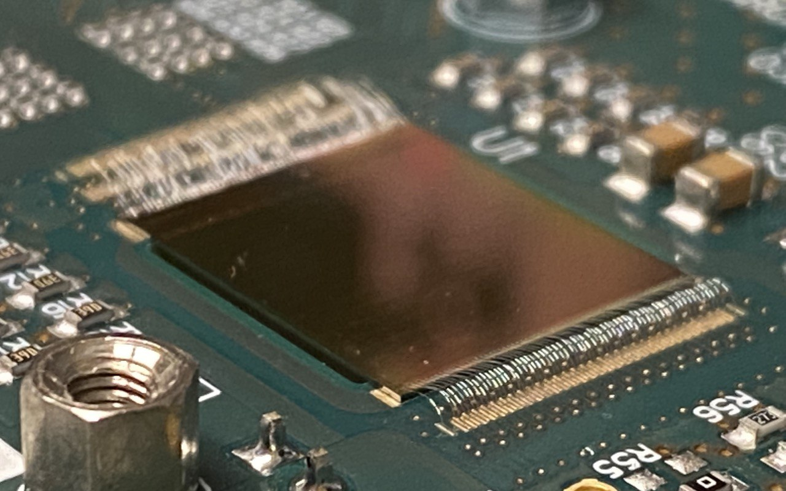
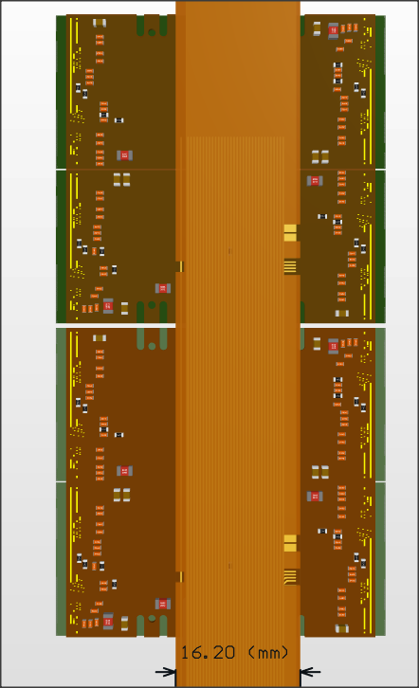
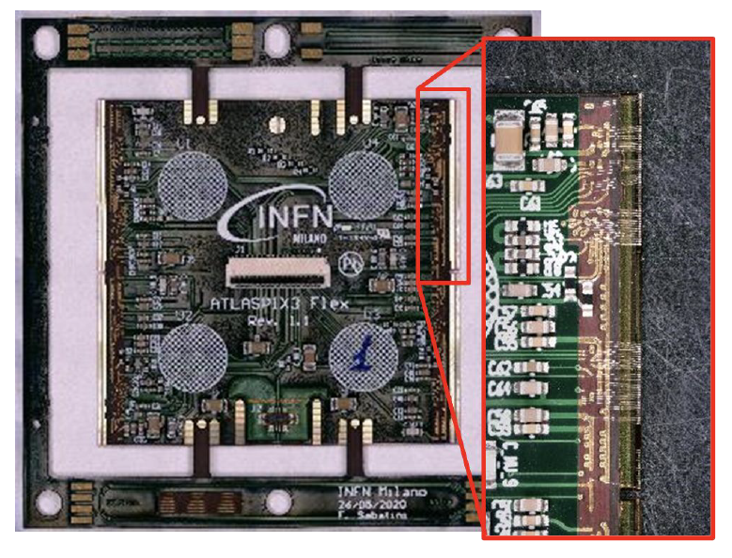
Vertex detector: IDEA
Depleted Monolithic Active Pixel Detectors
Inner Vertex (ARCADIA based):
Lfoundry 110 nm process
50 µm thick
Dimensions: $8.4×32mm^{2}$
Power density 30 mW/cm²
100 MHz/cm²
Outer Vertex and disks (ATLASPIX3 based)
TSI 180 nm process
50 µm thick
Module dimensions: $42.2×40.6mm^{2}$
Power density 170 mW/cm²
Up to 1.28 Gb/s downlink
Power
Data IN/OUT
HV
See talk by F. Palla for more details on the vertex tracker
F. Palla

Slide 6
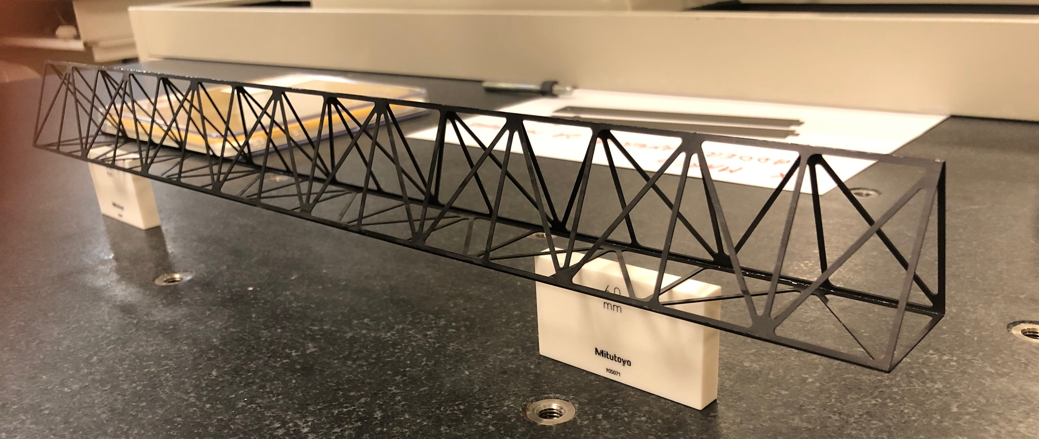
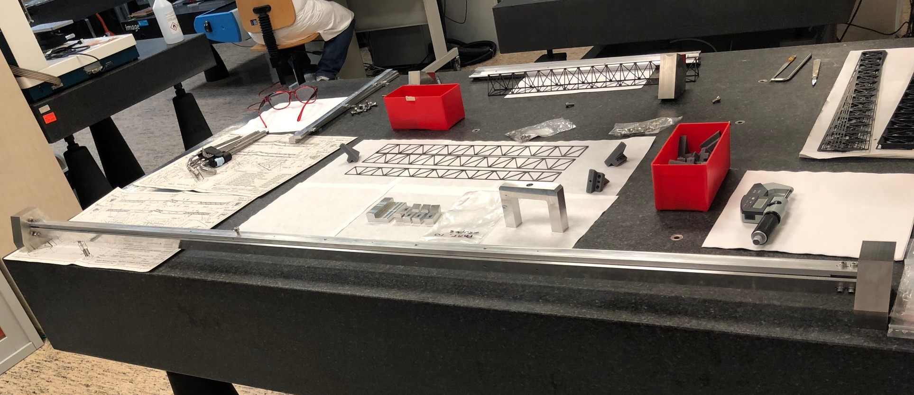
Vertex detector mechanical integration
Vertex design based on:
ARCADIA inner 3 layers
Air cooled
AtlasPix3 outer 2 layers/disks
Liquid cooled
Outer layer
Layer 1

Slide 7
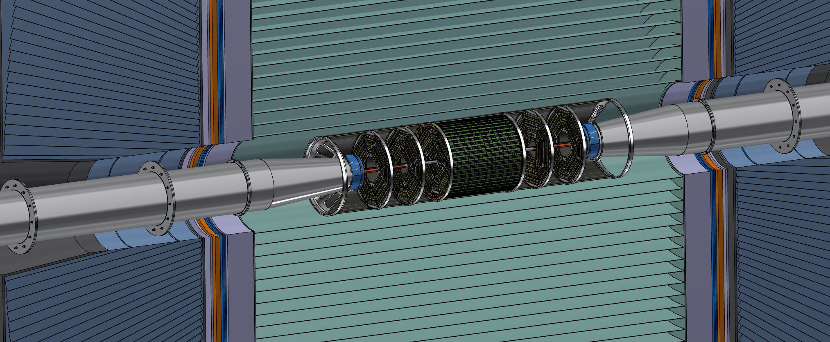
Vertex detector: IDEA
General integration
F. Palla

Slide 8
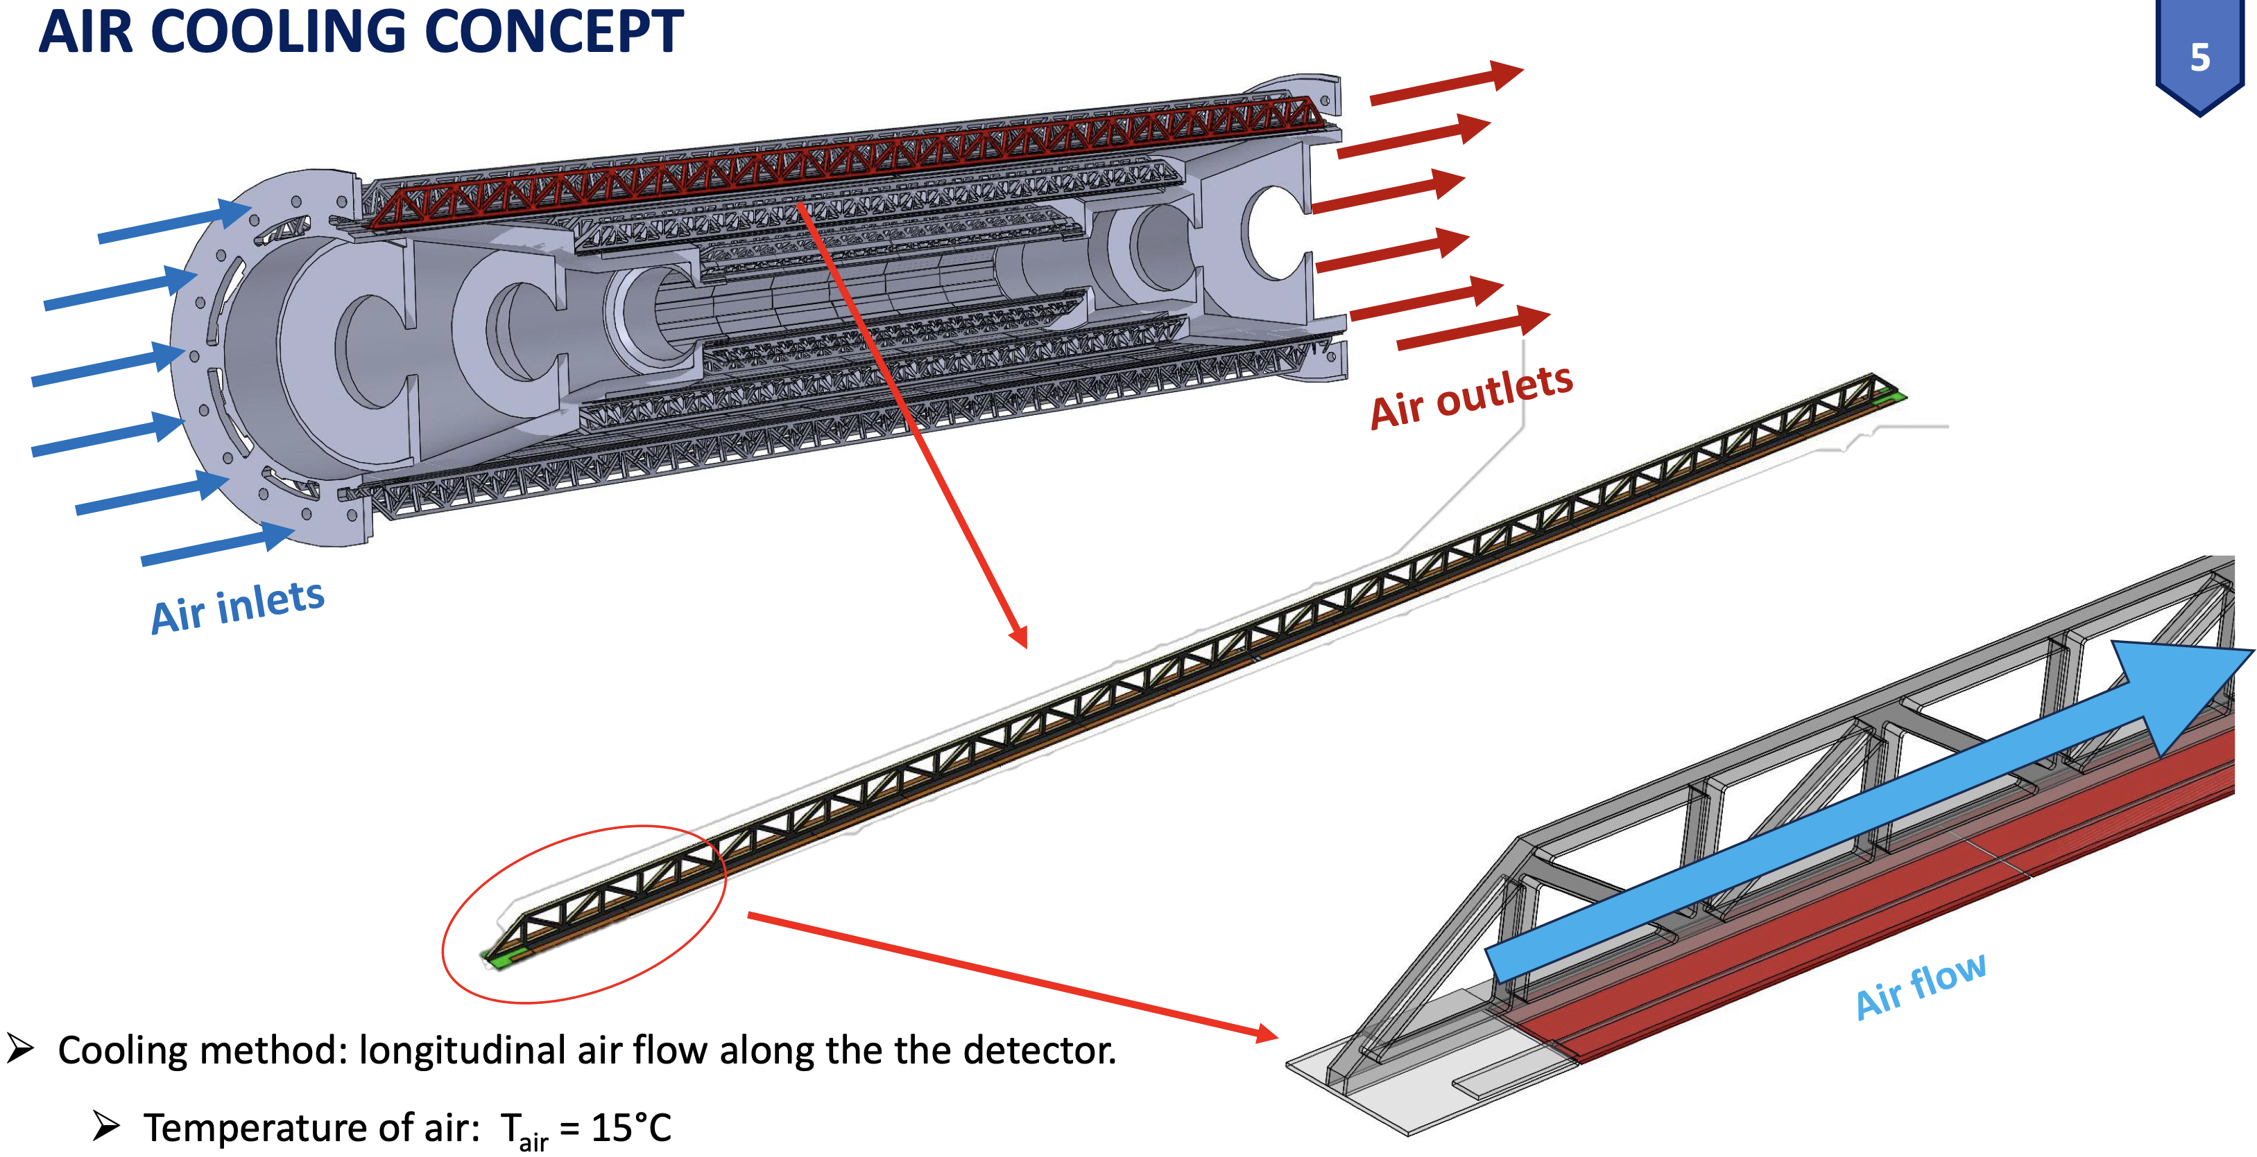
Vertex detector: IDEA
C. Turrioni

Slide 9
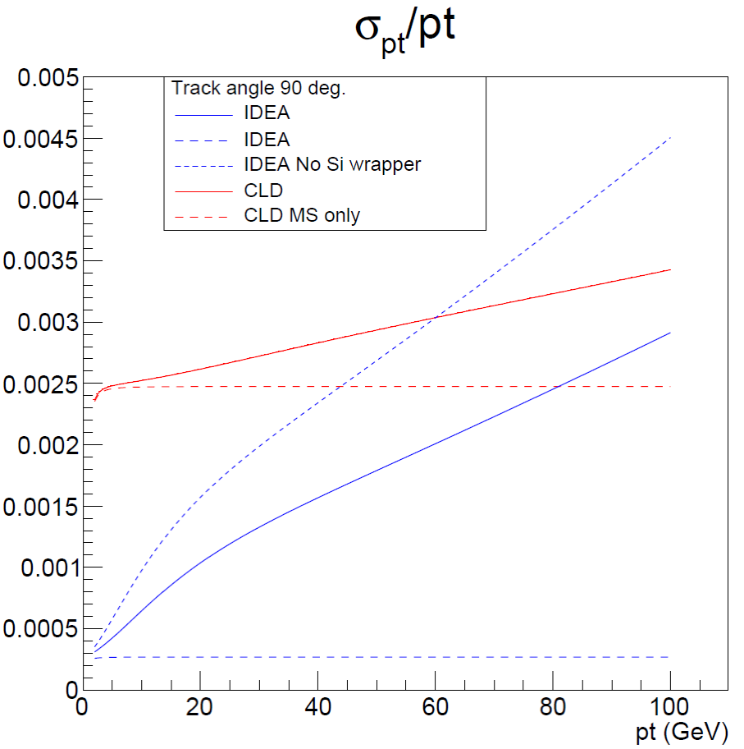
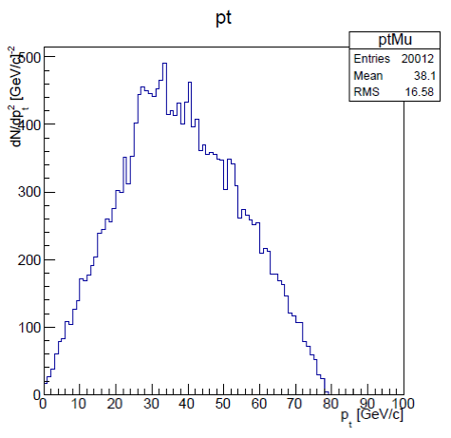
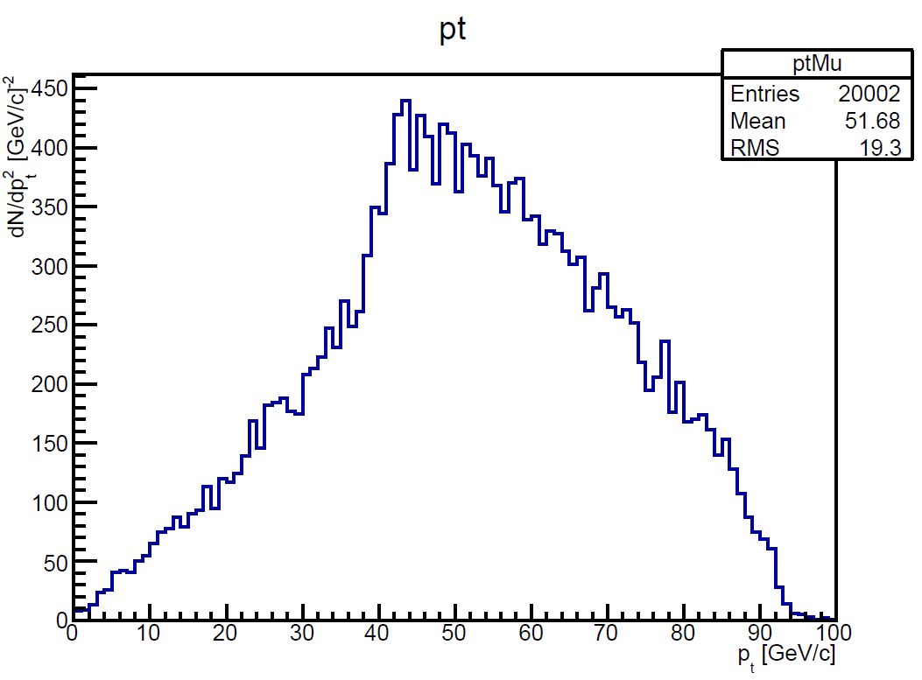
Momentum measurement
Z or H decay muons in ZH events have rather low pt
Transparency more important than asymptotic resolution
MS only
ZH (H→μμ)
Muon pt
ZH (H→μμ)
Muon pt
ZH (Z→μμ)
Muon pt
90 degree

Slide 10
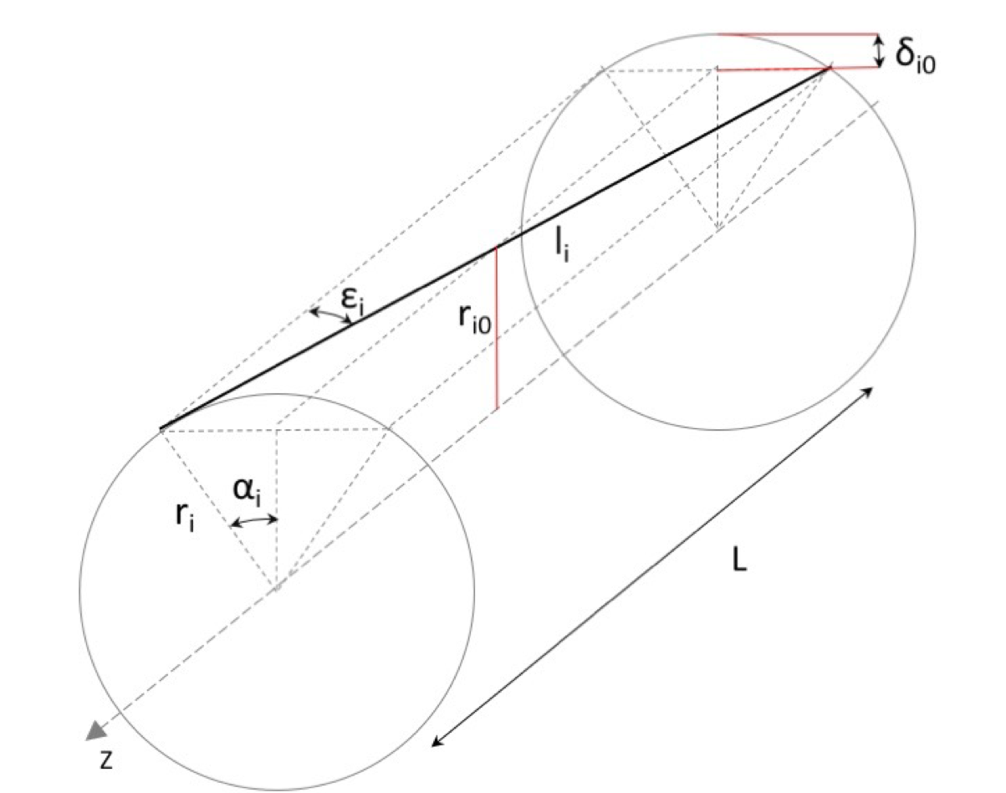
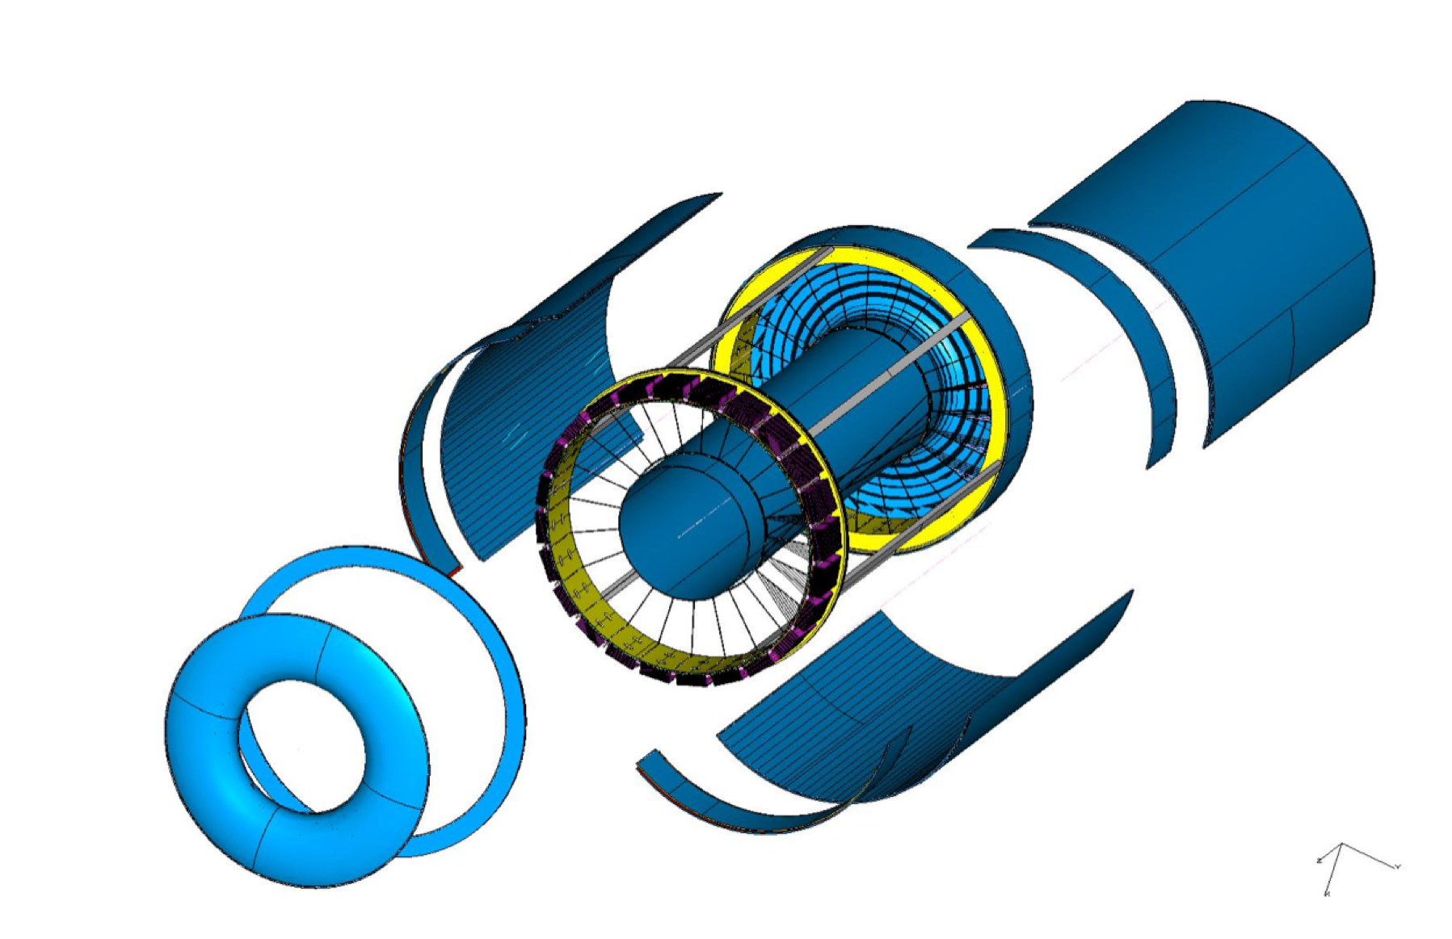
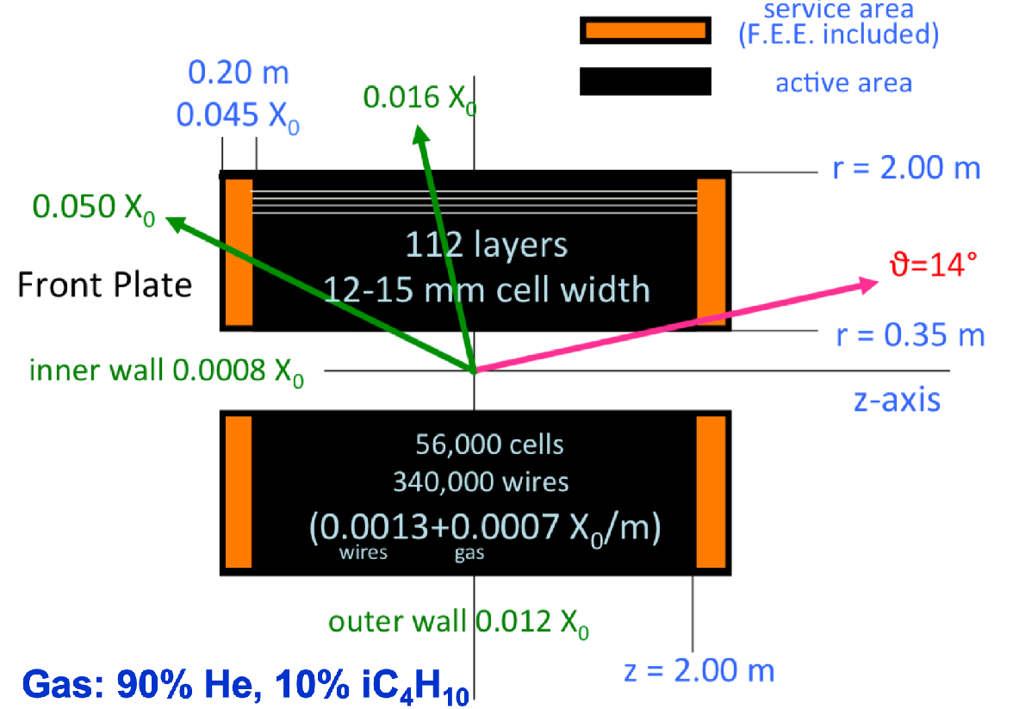
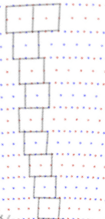
Drift chamber
IDEA: Extremely transparent Drift Chamber
Gas: 90% He – 10% iC₄H₁₀
Radius 0.35 – 2.00 m
Total thickness: 1.6% of X₀ at 90º
All stereo wires (56448 cells, 343968 wires)
Tungsten wires dominant contribution
112 layers for each 15º azimuthal sector
max drift time: 350 ns
L = 4m
IDEA DC

Slide 11
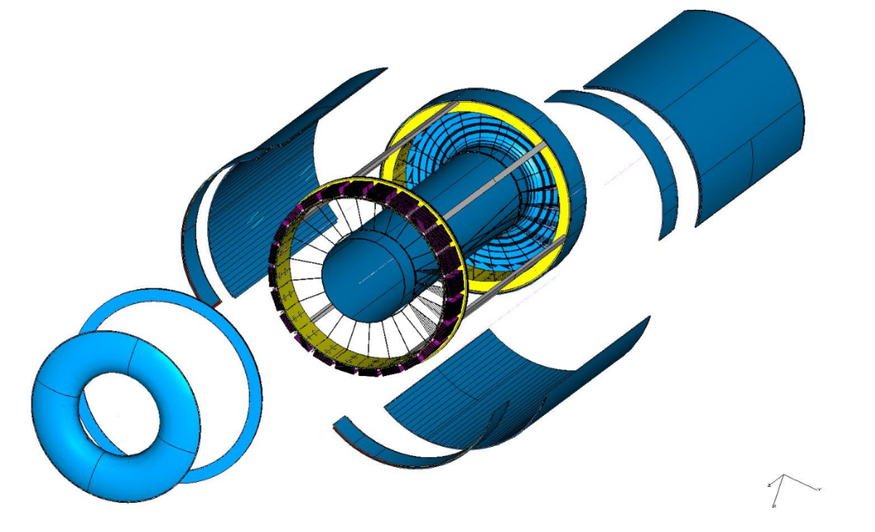
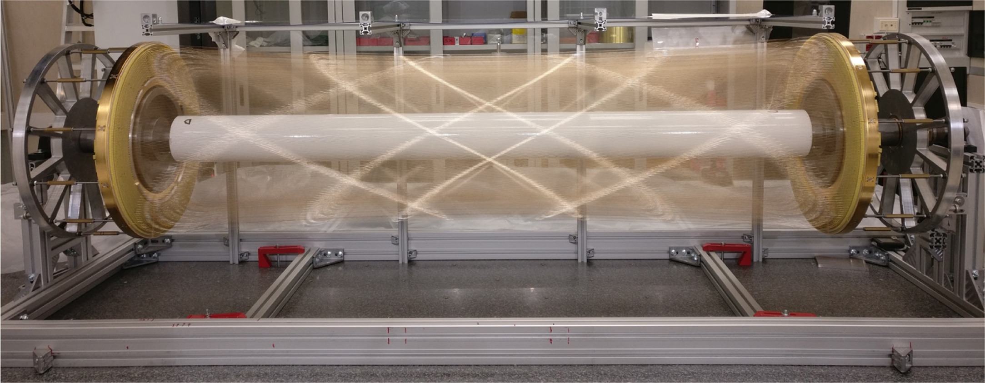
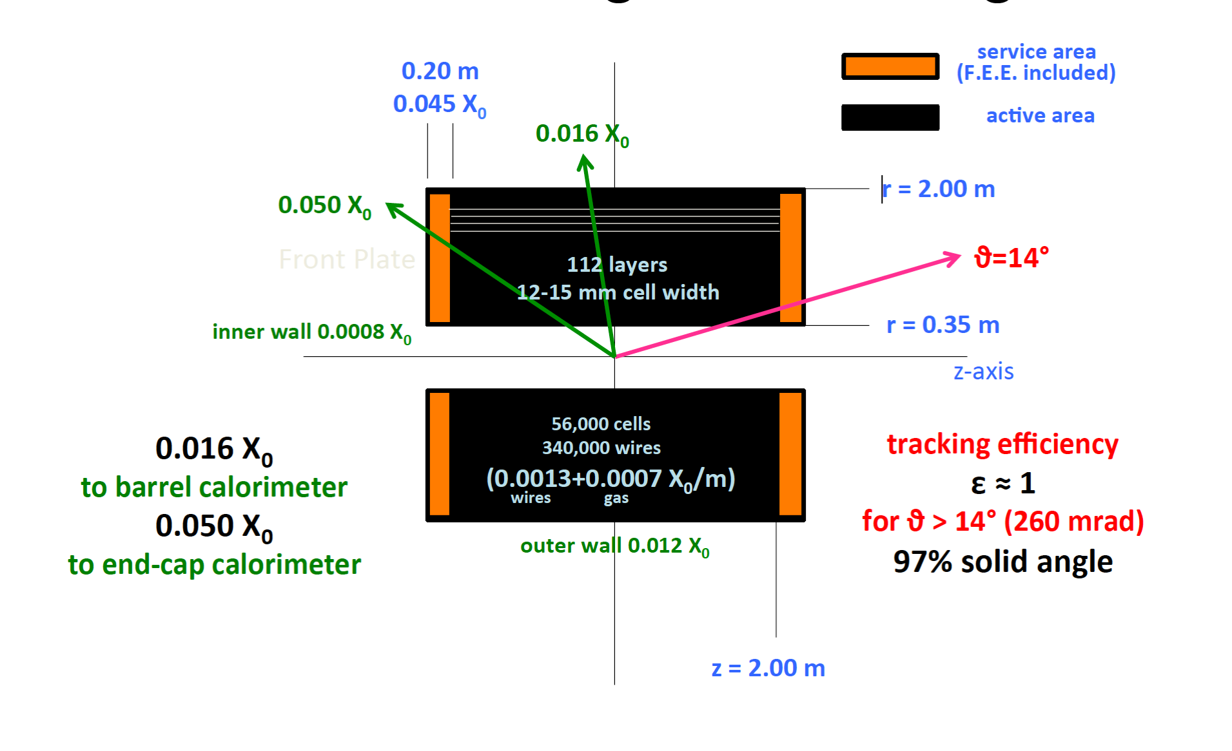
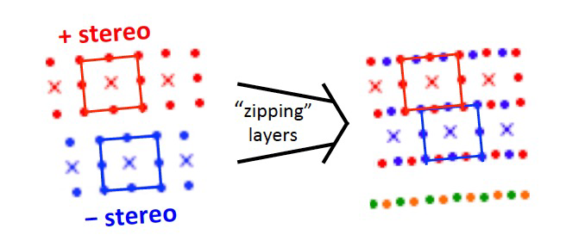
Drift chamber
90% He - 10% C₄H₁₀ – All stereo – σ ~ 100 μm
Small cells, max drift time ~ 350 ns
Wire Cage
Gas envelope
Based on MEG2 experience
Based on MEG2 experience

Slide 12
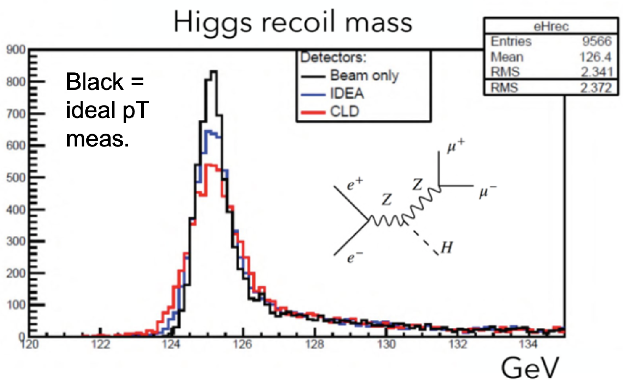
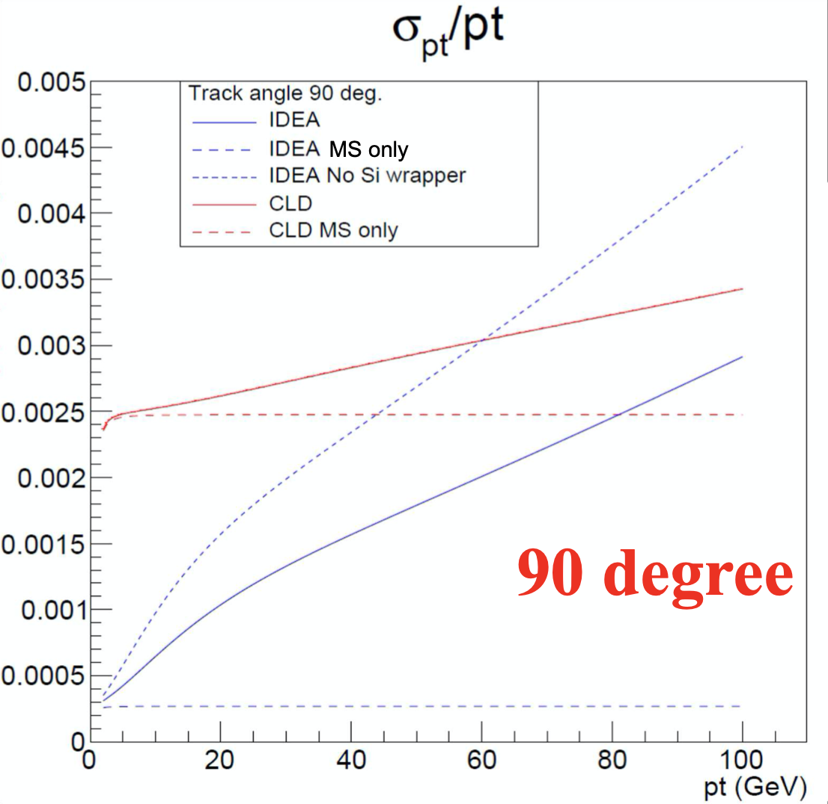
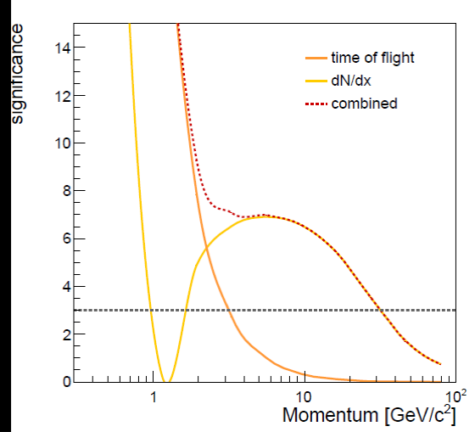
Drift chamber
In general, tracks have rather low momenta (p_{T} ≲ 50 GeV)
Transparency more relevant than asymptotic resolution
Drift chamber (gaseous tracker) advantages
Extremely transparent: minimal multiple scattering and secondary interactions
Continuous tracking: reconstruction of far-detached vertices (K⁰_{S} , Λ, BSM, LLPs)
Outstanding Particle separation via dE/dx or cluster counting (dN/dx)
>3σ K/π separation up to ~35 GeV
dN/dx from Garfield++

Slide 13
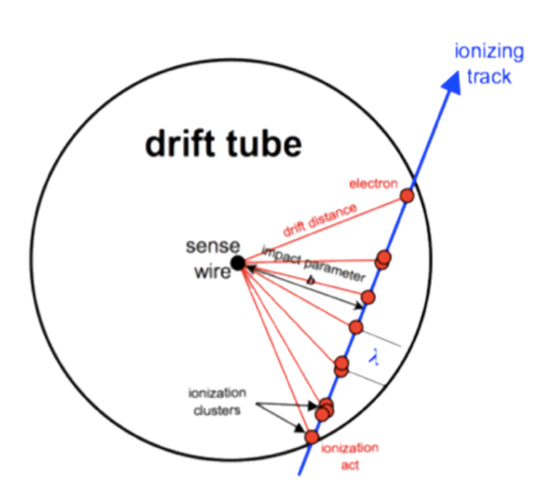
Cluster counting
Cluster counting 2x better than dE/dx
Poisson vs . Landau → no large tails
Sample signal few GHz → on detector electronics R&D
Test beam data 2022

Slide 14
Drift chamber future plans
Complete mapping of dN/dx data in all relevant βγ regions (few years)
Understand details of cluster counting performance
Build large mechanical prototype (few years)
Build full length functioning prototype with few cells (few years)
Develop on-detector cluster counting electronics (few years)
Towards a drift chamber TDR

Slide 15
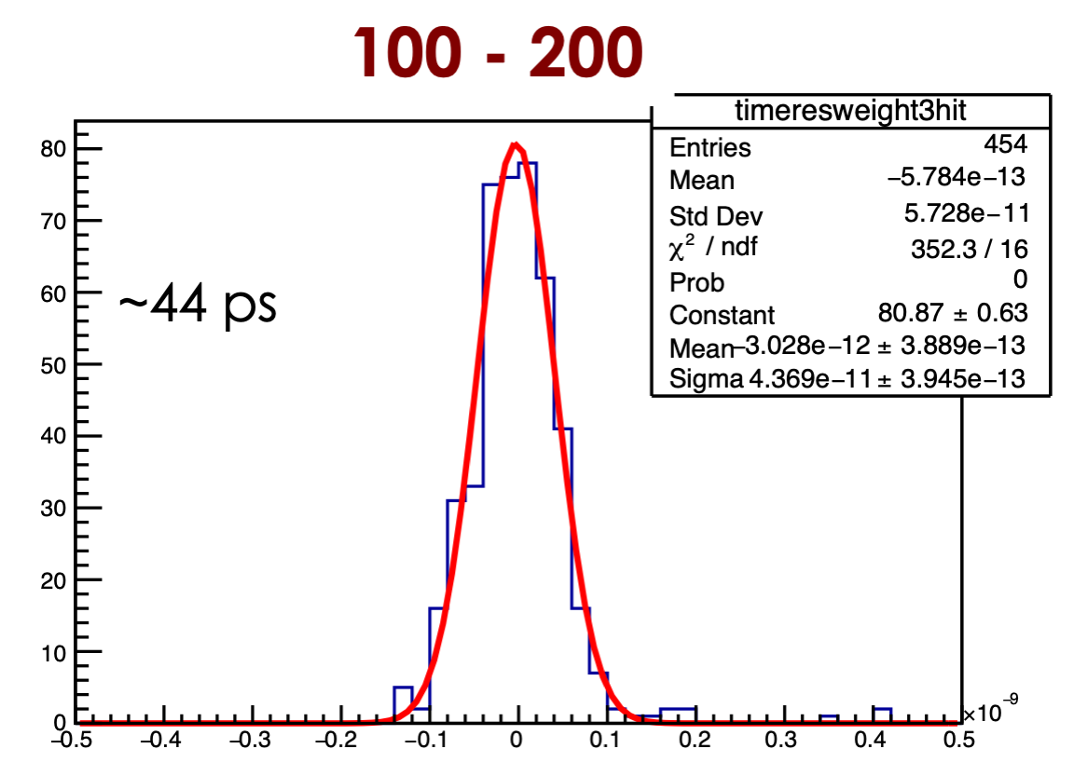
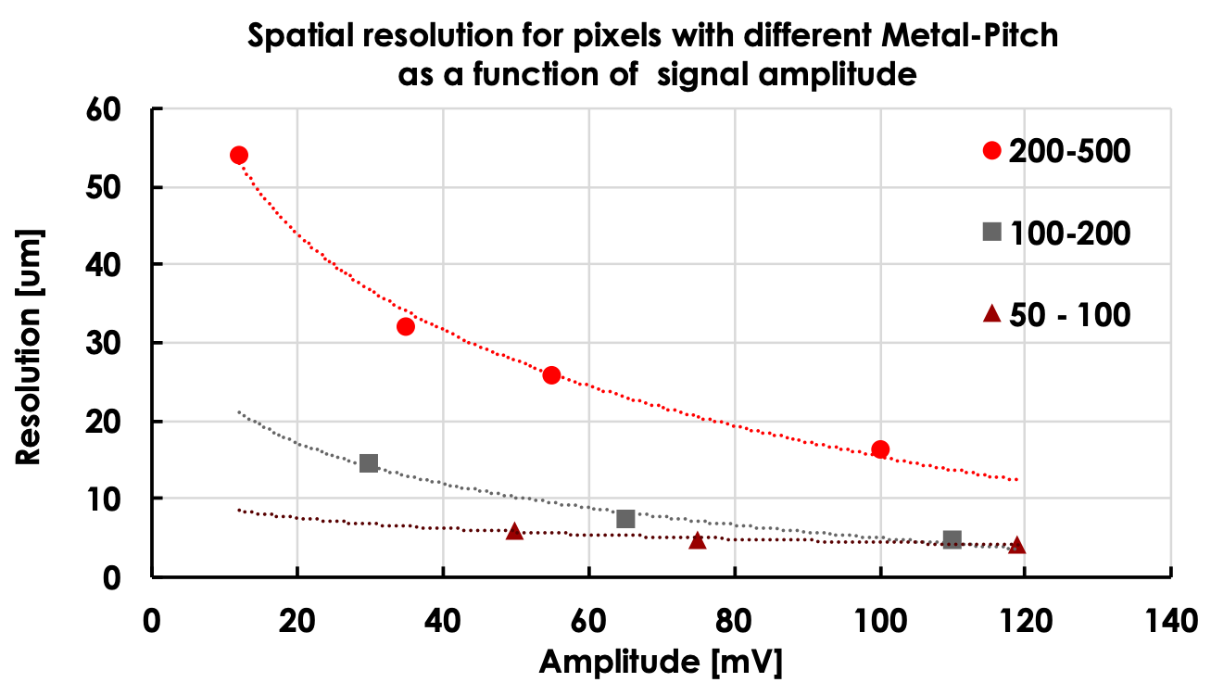
Resistive LGAD
Recent new activity with INFN-GE/(TO)
Match time and position resolution
Very attractive option for timing in Si wrapper region
Cost reduction is major area of R&D
Some “fast” devices also prototyped by Arcadia group

Slide 16
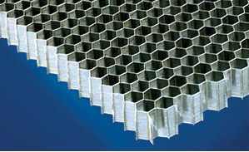
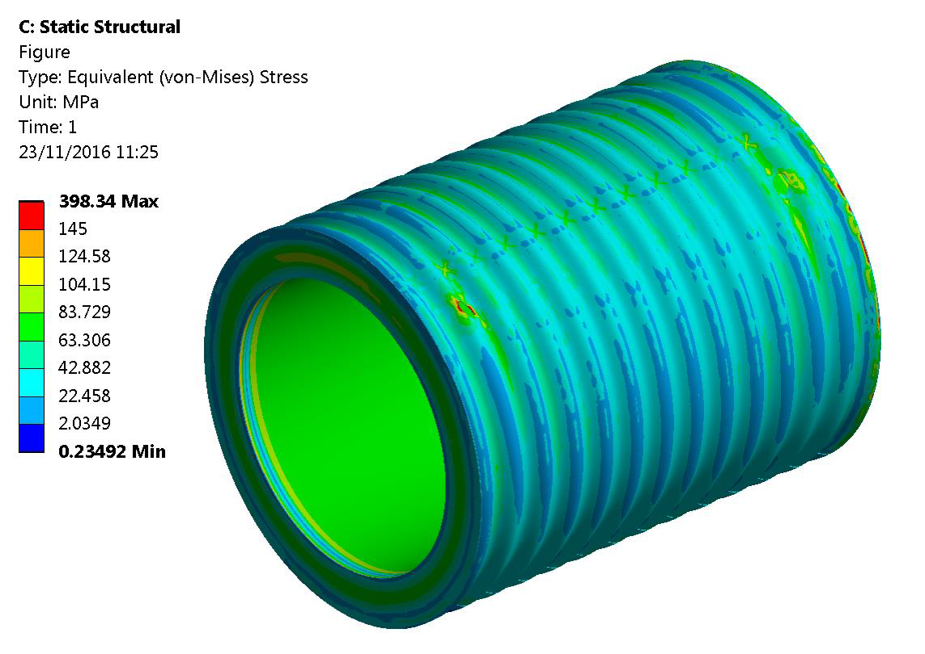
Superconducting solenoid
Ultra light 2 T solenoid:
Radial envelope 30 cm
Single layer self-supporting winding (20 kA)
Cold mass: X₀ = 0.46, λ = 0.09
Vacuum vessel (25 mm Al): X₀ = 0.28
Can improve with new technology
Corrugated plate: X₀ = 0.11
Honeycomb: X₀ = 0.04
Courtesy of H. TenKate
Interest from Genova (in synergy with DUNE) on alternative superconducting magnets like MgB2

Slide 17
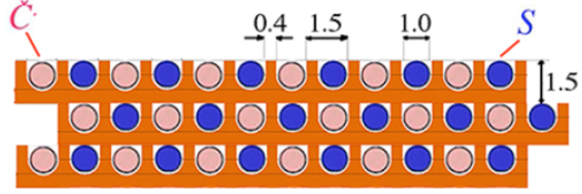
Dual Readout Calorimetry
Alternate
Cherenkov fibers
Scintillating fibers
~2m long capillaries
Measure simultaneously:
Scintillation signal (S)
Cherenkov signal (Q)
Calibrate both signals with e⁻
Unfold event by event f_{em} to obtain corrected energy
Newer DR calorimeter
( bucatini calorimeter)
$$S=E[f_{em}+(h/e)_{S}(1-f_{em})]$$
$$C=E[f_{em}+(h/e)_{C}(1-f_{em})]$$
$$E=\frac{S-χC}{1-χ}$$
with:
$$χ=\frac{1-(h/e)_{S}}{1-(h/e)_{C}}$$

Slide 18
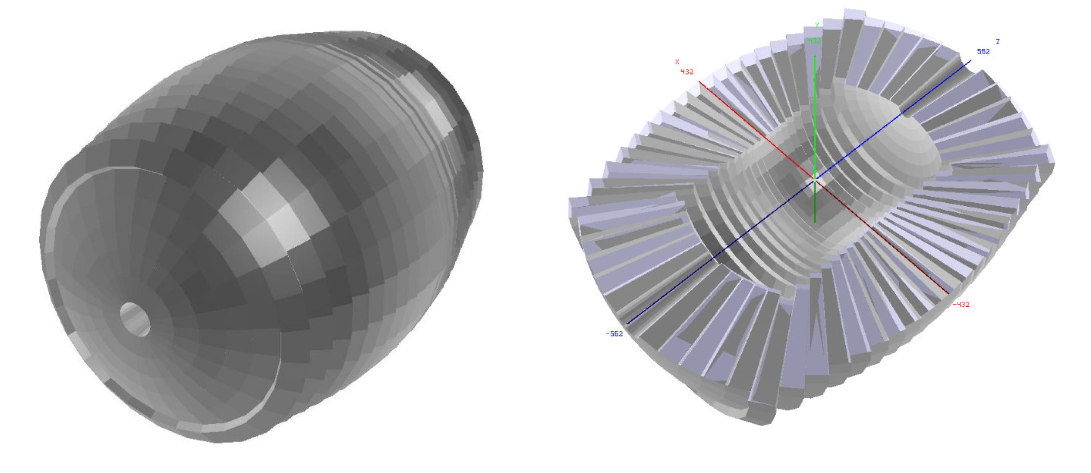
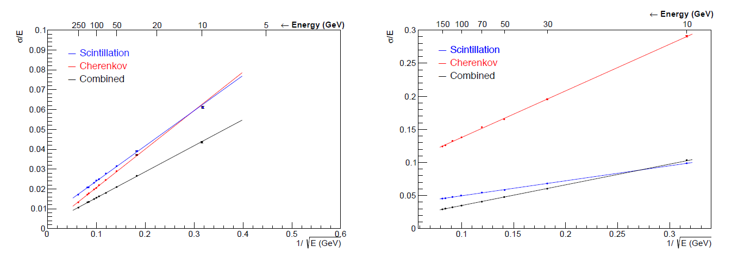
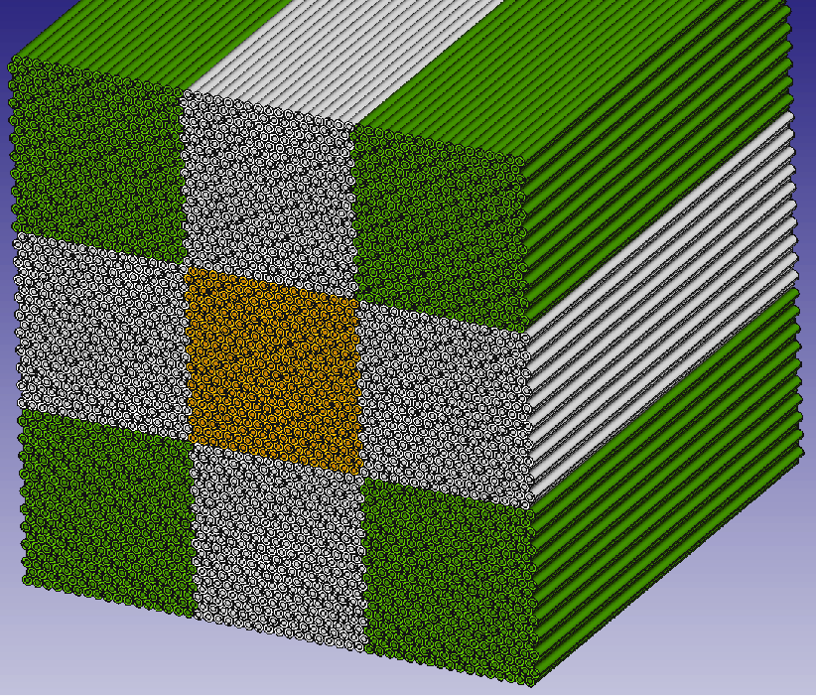
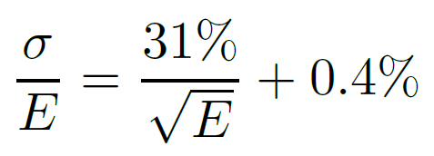
Dual Readout Calorimeter
Full GEANT4 implementation of the DR calorimeter
HAD
EM

Slide 19
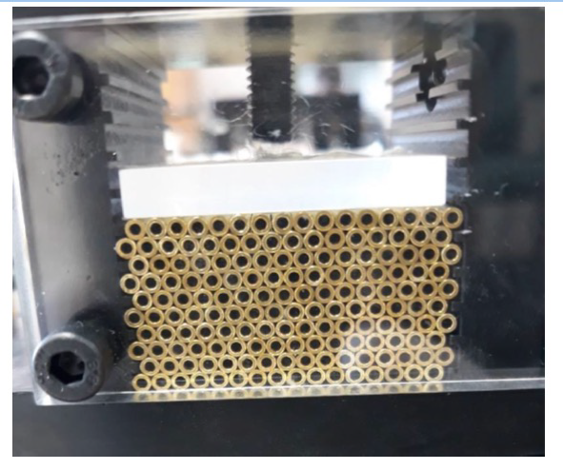
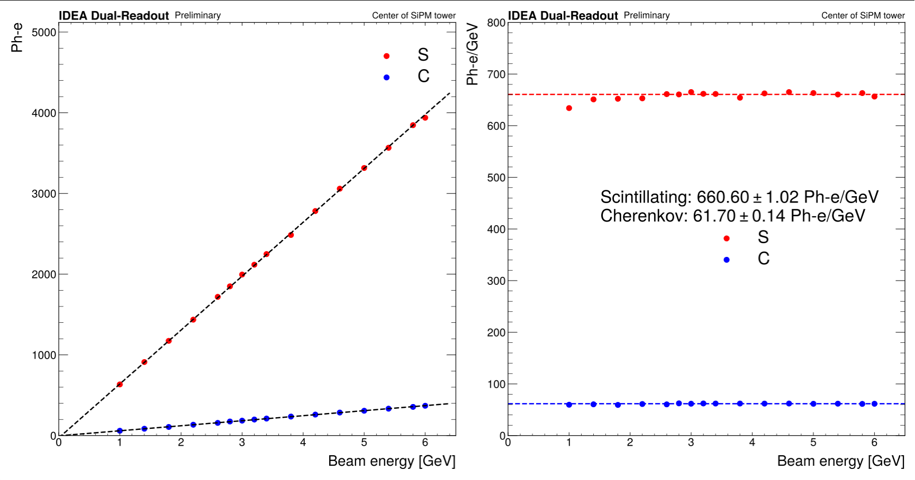
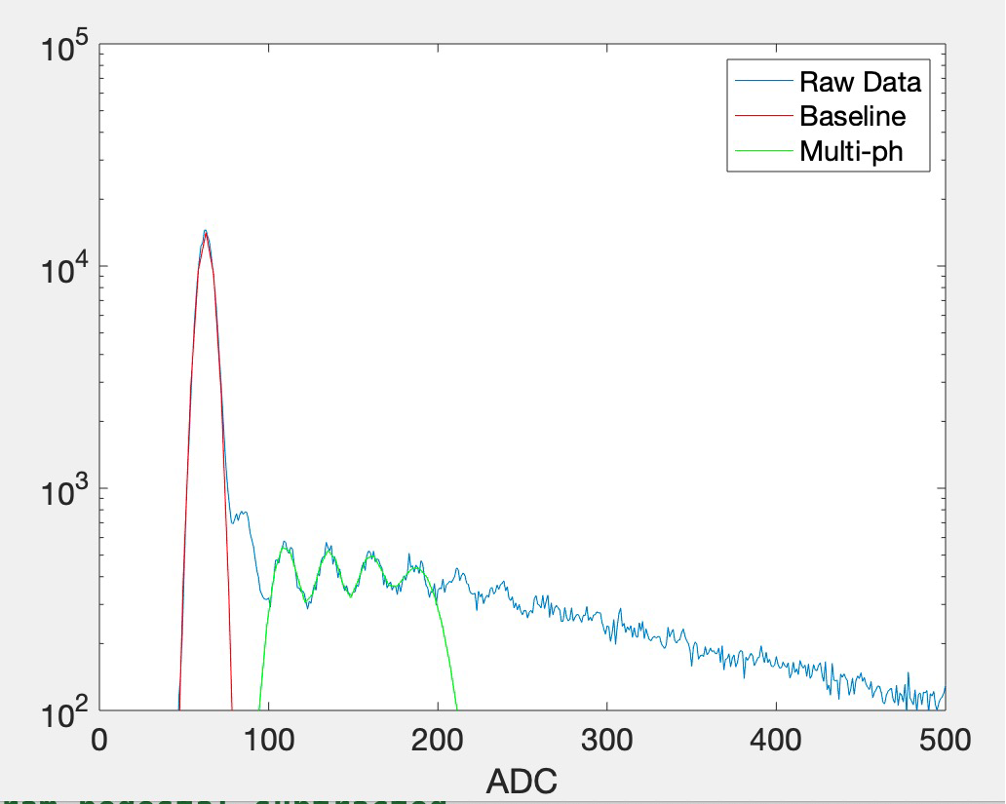
DR calorimeter
International collaboration:
TTU (USA), Sussex (UK), several universities (Korea – 2 M$/5 yr), Chile
Princeton, Maryland (USA), CERN for crystal extension
EM prototype built and tested on beams (DESY/CERN)
Absolute calibration in ph.e

Slide 20
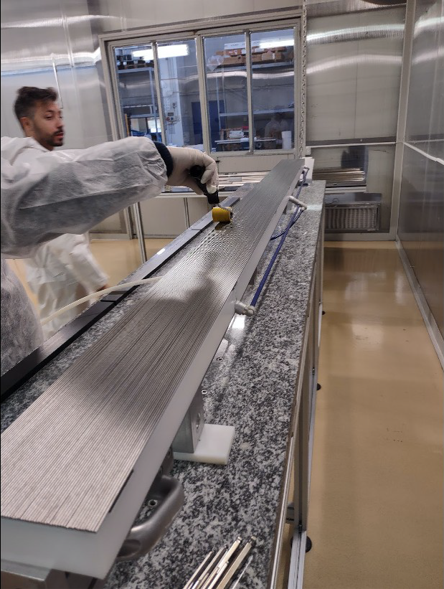
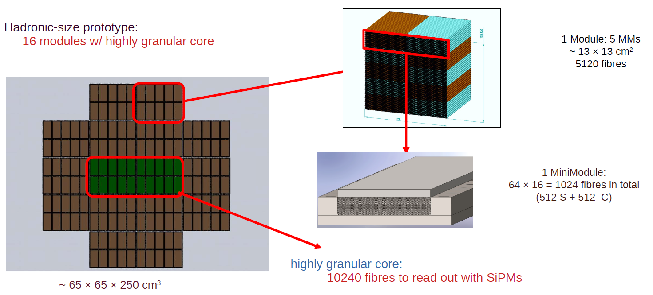
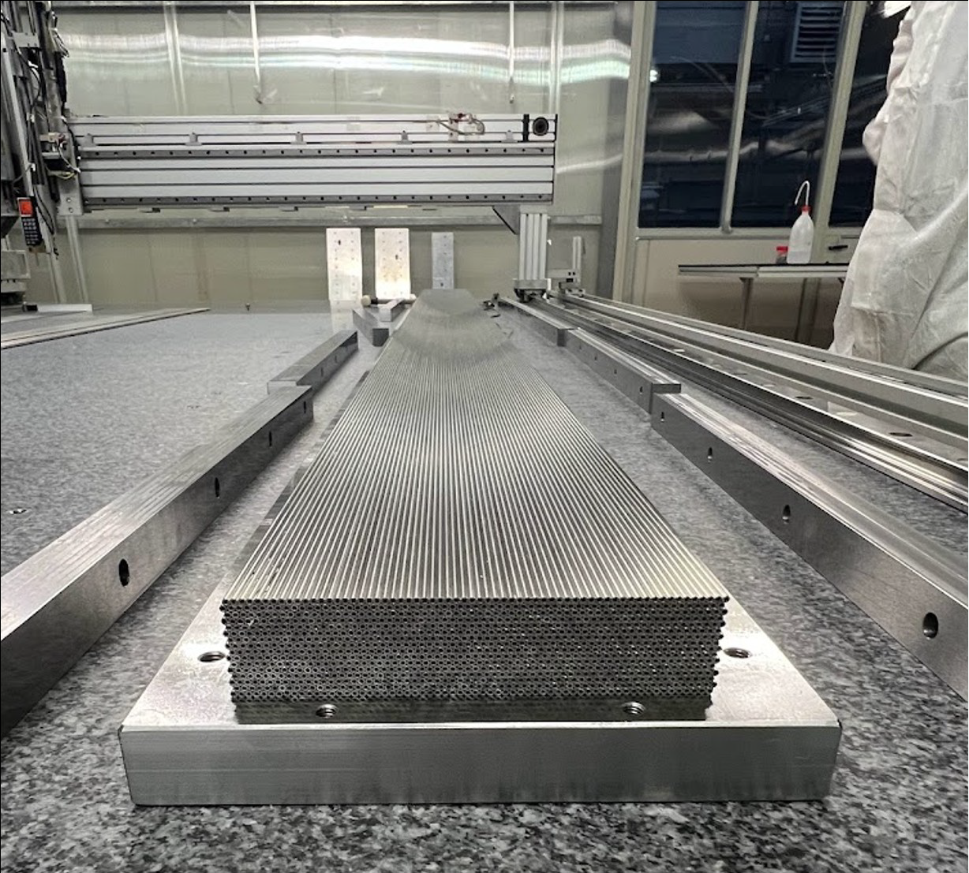
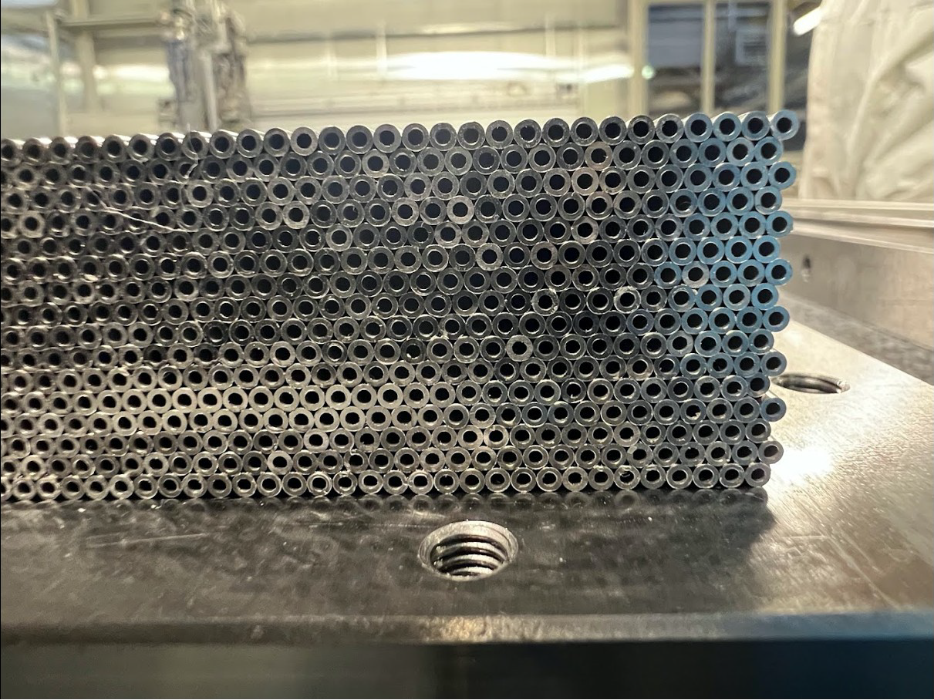
DR calorimeter
Full containment hadronic prototype in progress
Hidra2 call INFN CSN5

Slide 21
Dual readout future plans
Complete construction/test of Hidra2 prototype (one year)
Demonstrate resolution with full containment
Develop scalable readout electronics (few years)
Optimize metal matrix mechanics for large production (few years)
Develop mechanical model of full system with services (few years)
Towards a DR calorimeter TDR

Slide 22
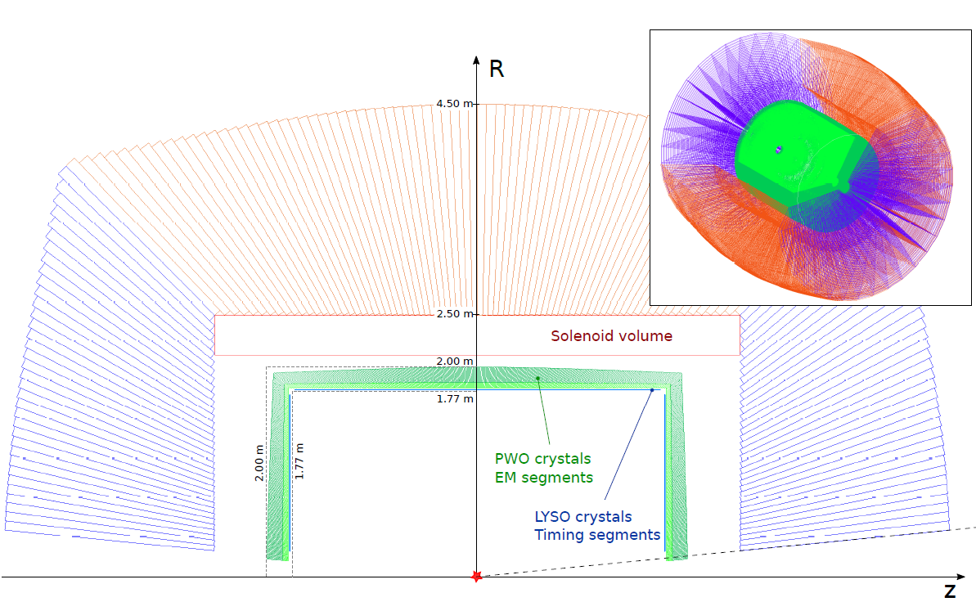
Crystal option

Slide 23
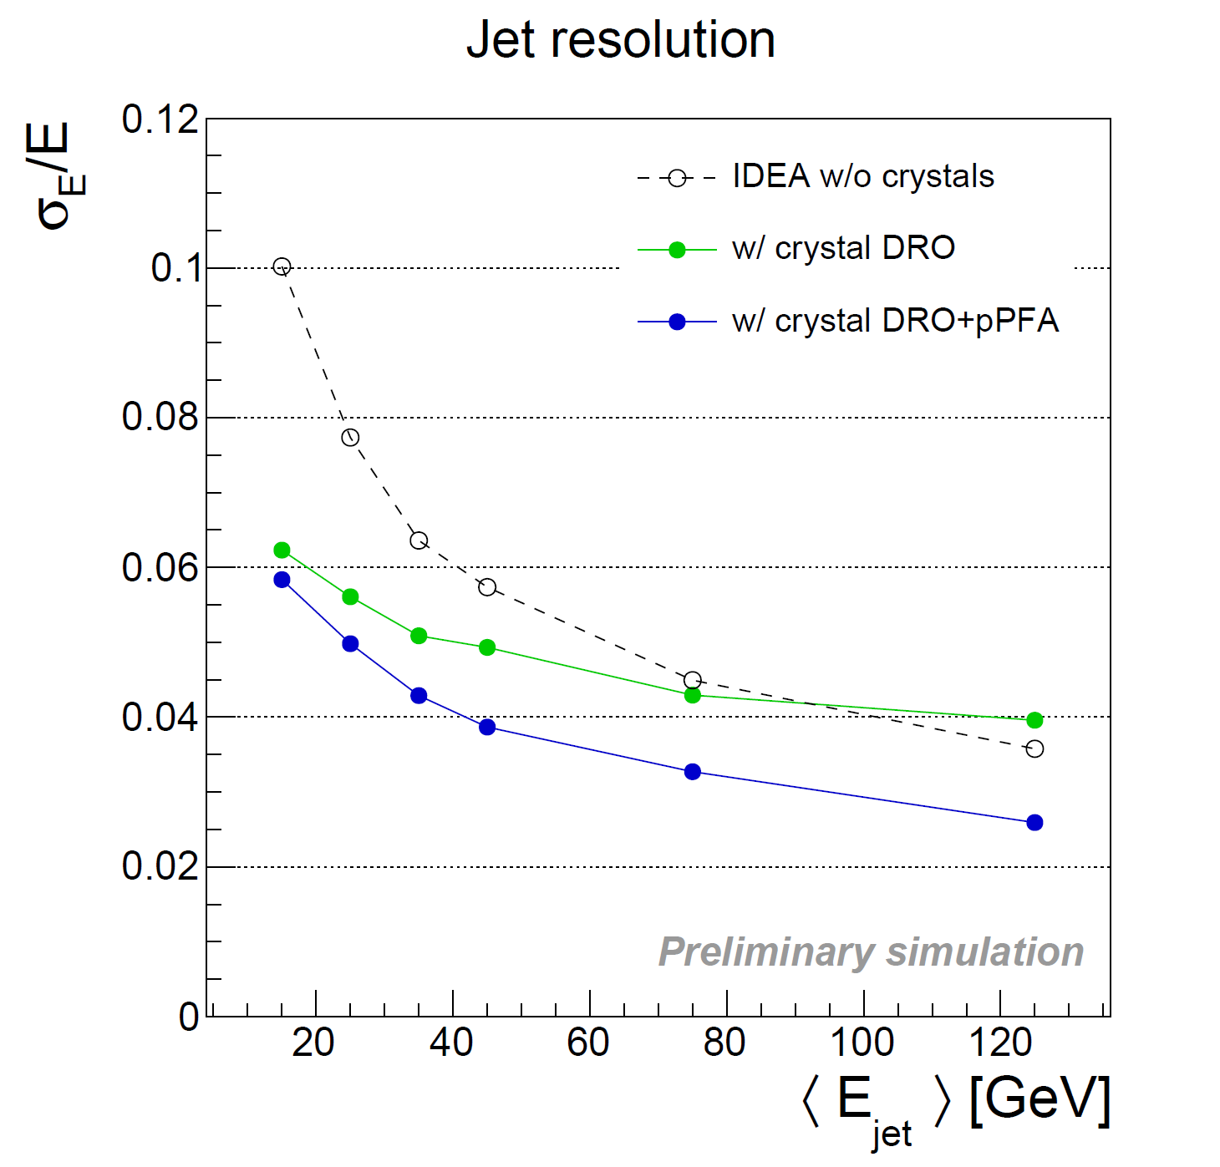
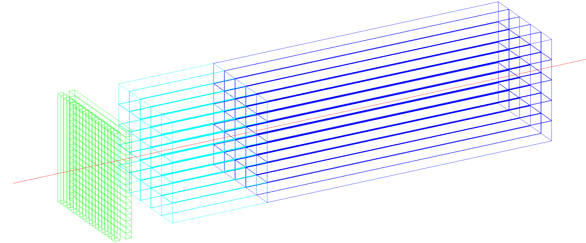
Crystal option
~20 cm PbWO₄
s_{EM} ≈ 3%/$\sqrt{E}$
DR w. filters
Timing layer
LYSO 20-30 ps
PF for jets
ECAL layer:
PbWO crystals
front segment 5 cm (~5.4 X₀)
rear segment for core shower
(15 cm ~16.3 X₀)
10x10x200 mm³ of crystal
5x5 mm² SiPMs (10-15 um)
1x1x5 cm³
PbWO
1x1x15 cm³
PbWO

Slide 24
Crystal option future plans
Optimize crystal choice (few years)
Develop scalable readout electronics (few years)
Re-optimize fiber DR calorimeter (few years)
Develop mechanical model of full system with services (few years)
Towards an EM calorimeter TDR

Slide 25
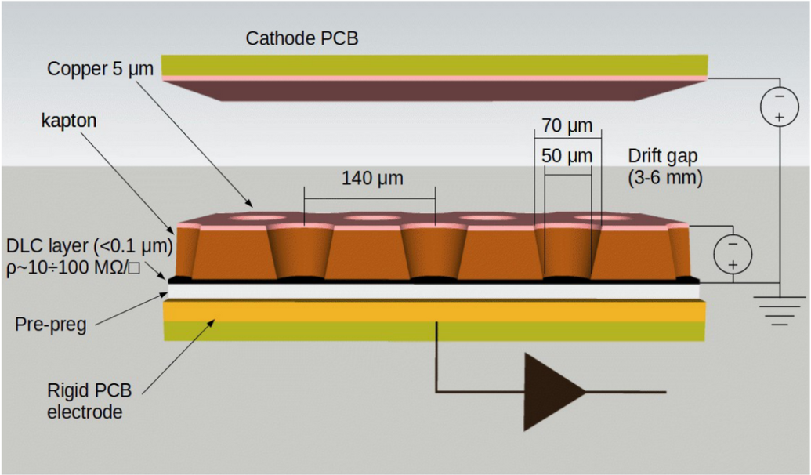
μ-RWELL technology
The μ-RWELL is composed of only two elements:
μ-RWELL_PCB
drift/cathode PCB defining the gas gap
μ-RWELL_PCB = amplification-stage ⊕ resistive stage ⊕ readout PCB
μ-RWELL operation:
A charged particle ionises the gas between the two detector elements
Primary electrons drift towards the μ-RWELL_PCB (anode) where they are multiplied, while ions drift to the cathode
The signal is induced capacitively, through the DLC layer, to the readout PCB
HV is applied between the Anode and Cathode PCB electrodes
HV is also applied to the copper layer on the top of the kapton foil, providing the amplification field
LNF
BOLOGNA
FERRARA
TORINO
(*) G. Bencivenni et al., “The micro-Resistive WELL detector: a compact spark-protected single amplification-stage MPGD”, 2015_JINST_10_P02008)

Slide 26
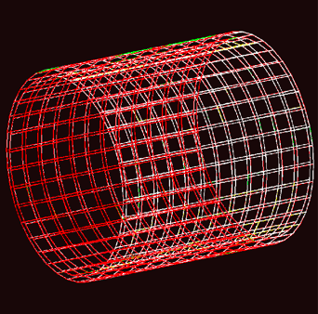
Preshower and muon detector
Preshower Detector
Muon Detector
High resolution after the magnet
to improve π±/e± and 2γ separation
Identify muons and search for LLPs
Efficiency > 98%
Space Resolution < 100 μm
Mass production
Optimization of FEE channels/cost
Efficiency > 98%
Space Resolution < 400 μm
Mass production
Optimization of FEE channels/cost
Barrel Preshower
Endcap Preshower
Detector technology: µ-RWELL
50x50 cm² 2D tiles to cover more than 1650 m²
Preshower
pitch = 0.4 mm
FEE capacitance = 70 pF
1.3 million channels
Muon
pitch = 1.2 mm
FEE capacitance = 220 pF
5 million channels
Similar design for the Muon detector
Similar design for the Muon detector

Slide 27
Ongoing R&D
Click here for more R&D information

Slide 28
ARCADIA MD3 test
3 engineering runs with:
full-scale DMAPS
sensor R&D (monolithic FD-strips and readout, fast sensors with gain layer)
High rate capability (100 MHz/cm²) architecture on a scalable 512x512 pixel matrix (25 μm pitch) MD3 Main Demonstrator chip:
measured 30 mW/cm² at full-speed (16 data Tx active) and 10 mW/cm² on low-rate mode (1 data Tx active)
Main Demonstrator
MD3
Matrix: 1,28 x 1,28 cm2
Cosmic ray data
110 nm CMOS CIS technology, high-resistivity bulk, operated in full depletion mode

Slide 29
Silicon detectors: ATLASPix3
Based on ATLASPIX3 R&D
50x50 μm²
Up to 1.28 Gb/s downlink
TSI 180 nm process
132 columns of 372 pixels
Active length (r-phi x z)
18.6 mm x 19.8 mm
Module is made of 2x2 chips
Power goal 100 mW/cm² (175 now)

Slide 30
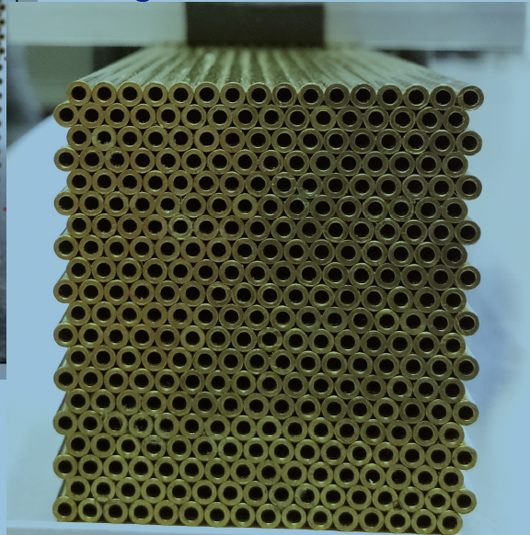
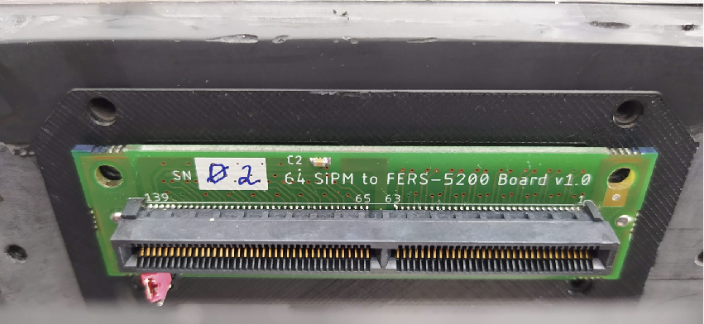
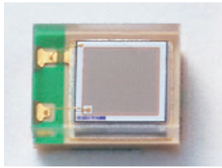
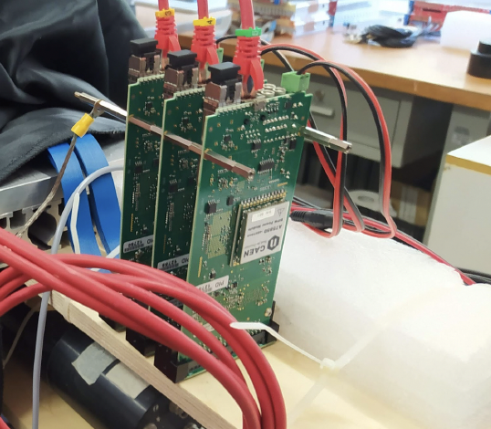
2020 Dual Readout prototype
Full prototype - 9 towers
Single tower
Electromagnetic dimensions of 10x10x100 cm³
“Bucatini calorimeter”
9 towers containing 16x20 capillaries (160 C and 160 S)
Capillary tube with outer diameter of 2 mm and inner diameter of 1.1 mm 1-mm-thick fibers
Front end board
housing 64 SiPM
Fiber guiding system
Hamamatsu SiPM: S14160-1315
PS Cell size: 15 μm
Readout Boards CAEN A5202

Slide 31
Crystal ECAL with DR calorimeter
M. Lucchini

Slide 32
Crystal ECAL with DR calorimeter
Event display
crystals + IDEA w/o DRO
crystals + IDEA w/ DRO
crystals + IDEA w/ DRO + pPFA
Sensible improvement in jet resolution using dual-readout information combined
with a particle flow approach → 3-4% for jet energies above 50 GeV
M. Lucchini

Slide 33
μ-RWELL: Test beam 2021
H8 Test beam 11/2021
New μ-RWELL prototypes with 40 cm long strips
a) Design optimization:
- different HV filter applied
b) Detector characterization
- HV scan at 0°
- HV scan at different angles and drift field
strips
7 μ-RWELL prototypes with resistivity varying between
10 and 80 MOhm/£
will allow to define best resistivity for final 50x50 cm² detector
1- Signal shape
(cluster charge, cluster size)
2 - Detector performance
(efficiency, space resolution)
beam
LNF
BOLOGNA
FERRARA
TORINO

Slide 34
Muon and pre-shower future plans
Complete test of large 2D chamber design (50x50 cm²) (this year)
Complete readout electronics based on TIGER chip (next years)
Develop chamber production plan with industry (few years)
Develop plan for layout on detector with services (few years)
Towards a Muon/pre-shower TDR

Slide 35
Status of Simulation of IDEA concept
FASTSIM Delphes IDEA card used for performance studies FCCSW
Very sophisticated compared to default.
Latest additions: Vertexing, LLP, PID, dN/dx, dE/dx
FULLSIM: standalone GEANT4 description
Fully integrated geometry
Output hits and reco tracks converted to EDM4HEP
Ready for PFlow development and other reconstruction frameworks/algorithms (ACTS, Pandora etc) in FCCSW

Slide 36
Some considerations
The IDEA detector concept was originally conceived by several Italian groups
Clearly if this detector will be built, it will have to be by a large international collaboration
US could provide a fundamental contribution to several areas:
Silicon detectors: silicon sensors, readout electronics, mechanics
Wire chamber: lots of expertise available in the US
DR calorimeter, and in particular the EM crystal DR calorimeter: lots of past experience from CMS, etc.
Other areas (Simulation, DAQ&Trigger, software, etc.) ...
There are already collaborations FNAL/Padova on ARCADia and CalVision on DR calorimetry

Slide 37
Some more considerations
The IDEA detector is also well represented in the largest EU-funded project on detectors R&D for particle physics: AIDAinnova
AIDAinnova ends on 31/03/2025 but is actively looking at a new call to continue its activities: IDEA would be again largely present and financed, there is space for collaboration with US groups
US groups can participate in another EU-funded project that provides Transnational Access to test beams and irradiation facilities in more than 40 European Research Infrastructures, EURO-LABS
EURO-LABS allows up to 20% of its funding to go to non-EU research groups
We have excellent connections with AIDAinnova and EURO-LABS (P.G. is the PI of both projects...)

Slide 38
Conclusions
FCC-ee will be a fascinating machine, allowing to achieve unprecedented precision on EW measurements and Higgs couplings
The IDEA detector concept could be an excellent choice for one of the IPs
Very good momentum measurement
Outstanding PID with cluster counting from the drift chamber
Excellent calorimetry
Precise and efficient muon detector
Very appealing upgrade options! (DR EM crystal calorimeter, LGADs for the Si wrapper)
Need for significant R&D in the next 4-5 years
A lot of ongoing activities on all IDEA sub-detectors
Profiting from several national funding schemes, EU projects, etc.
INFN was central in all these R&D activities and started many of them
Now several international colleagues have joined these efforts
Lots of possibilities for US colleagues to join IDEA and help on all these developments!!

Slide 39
Backup

Slide 40
Vertex inner barrel
A. Ilg

Slide 41
Vertex outer barrel
A. Ilg

