Slide 1
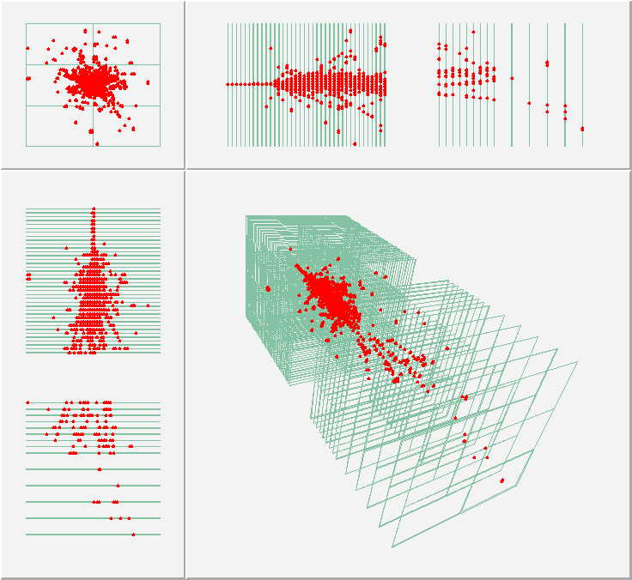
High Segmentation, Radiation-Hard Calorimetry Options for FCC
¹ University of Iowa, Iowa City, USA
² Beykent University, Istanbul, Turkey
³ Turkish Accelerator and Radiation Laboratory, Ankara, Turkey
Second Annual U.S. Future Circular Collider (FCC) Workshop 2024
25 - 27 Mar, 2024
Y. Onel¹, B. Bilki^{1,2,3}

Slide 2
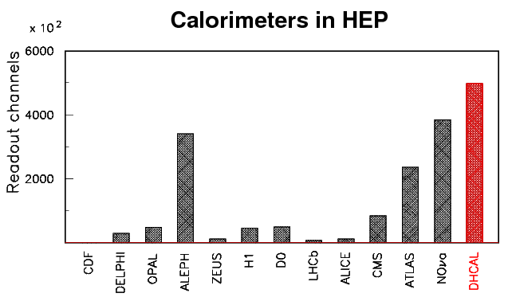
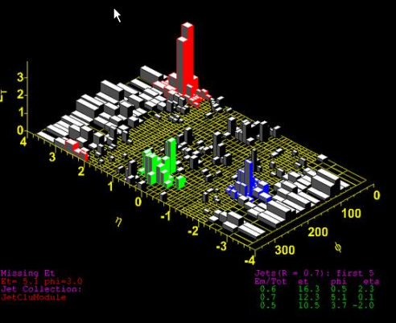
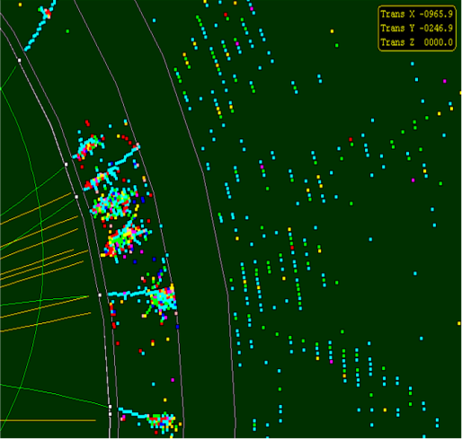
Trend in Calorimetry
Particle Flow Algorithms (PFAs)
Attempt to measure the energy/momentum of each particle with the detector subsystem providing the best resolution
Tower geometry
Energy is integrated over
large volumes into single
channels
Readout typically with
high resolution
Individual particles in a
hadronic jet not resolved
Imaging calorimetry
Large number of calorimeter
readout channels (~10⁷)
Option to minimize
resolution on individual
channels
Particles in a jet are
measured individually
Maximum exploitation of precise tracking measurement
Large radius and length to separate the particles
Large magnetic field for high precision momentum measurement
“no” material in front of calorimeters (stay inside coil)
Small Moliere radius of calorimeters to minimize shower overlap
High granularity of calorimeters to separate overlapping showers
Emphasis on tracking capabilities of calorimeters
E_{T}

Slide 3
Digital Hadron Calorimetry

Slide 4
Resistive Plate Chambers (RPCs)
Development of the
Digital Hadron Calorimeter
Develop a tracking Hadron Calorimeter
Implement digital readout (1-bit) to maximize the number of readout channels
Place the front-end electronics in the detector
The active medium should:
Be planar and scalable to large sizes
Not necessarily be proportional (only yes/no for the traversing particle)
Be easy to construct, robust, reliable, easy to operate, …
Gas: Tetrafluorethane (R134A) : Isobutane : Sulfurhexafluoride (SF₆) with the following ratios 94.5 : 5.0 : 0.5
High Voltage: 6.3 kV (nominal)
Average efficiency: 96 %
Average pad multiplicity: 1.6
Resistive Plate Chambers

Slide 5
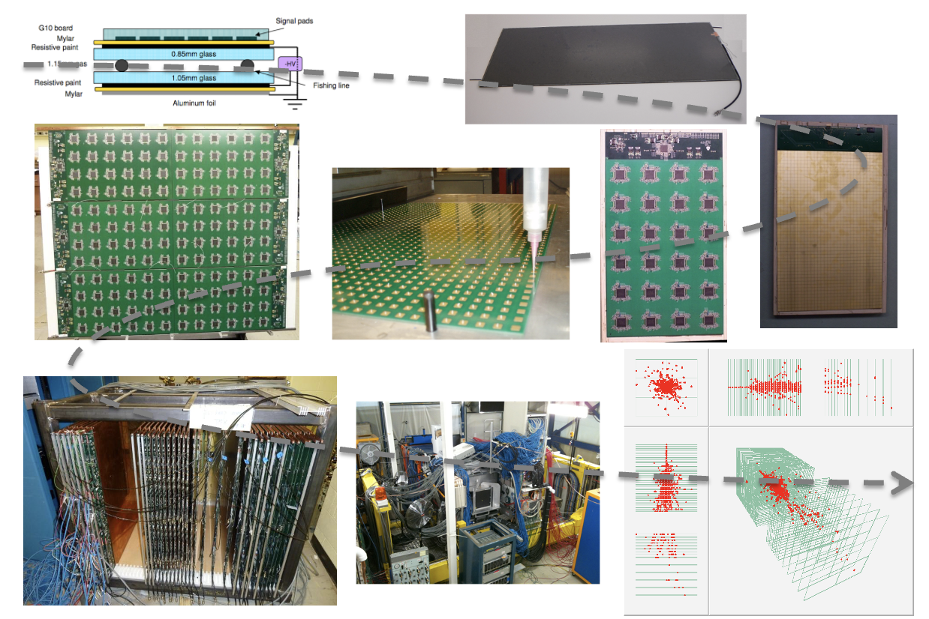
The DHCAL Prototype
Description
Hadronic sampling calorimeter
Designed for future electron-positron collider (ILC)
54 active layers (~1 m²)
Resistive Plate Chambers with 1 x 1 cm² pads
→ ~500,000 readout channels
Electronic readout
1 – bit (digital)
Tests at FNAL
with Iron absorber in 2010 – 2011
with no absorber in 2011
Tests at CERN
with Tungsten absorber in 2012

Slide 6
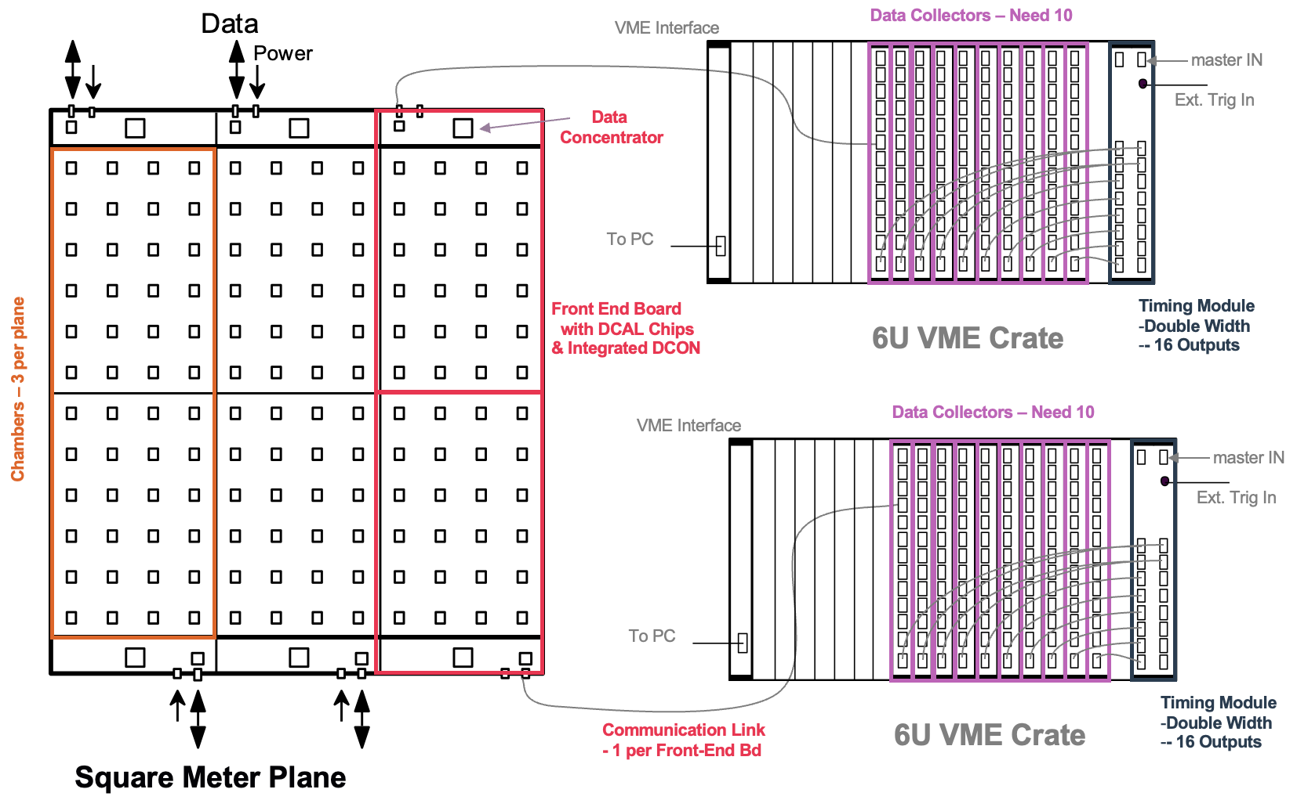
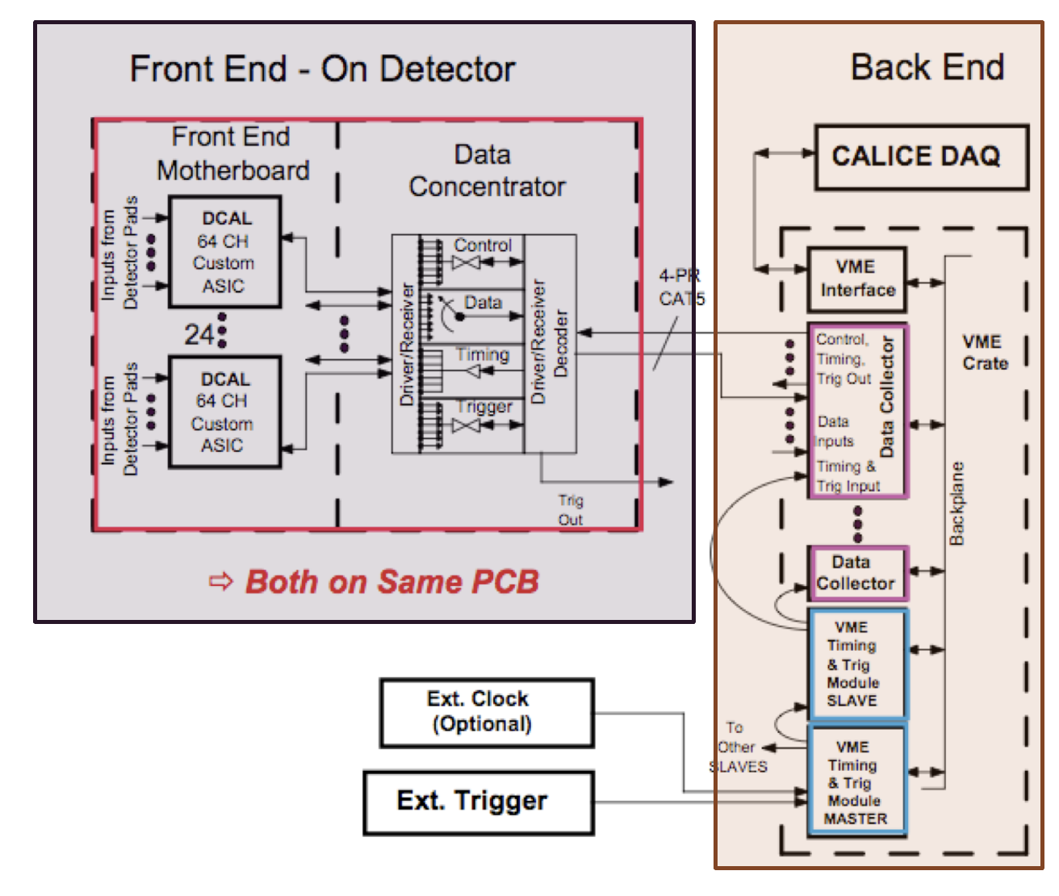
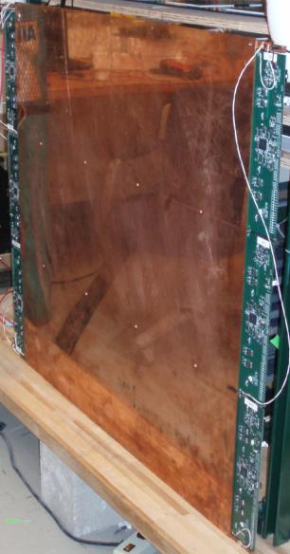
Readout Electronics Overview
Cassette Assembly
- Cassette is compressed horizontally with a set of 4 (Badminton) strings
- Strings are tensioned to ~20 lbs each
- ~45 minutes/cassette

Slide 7
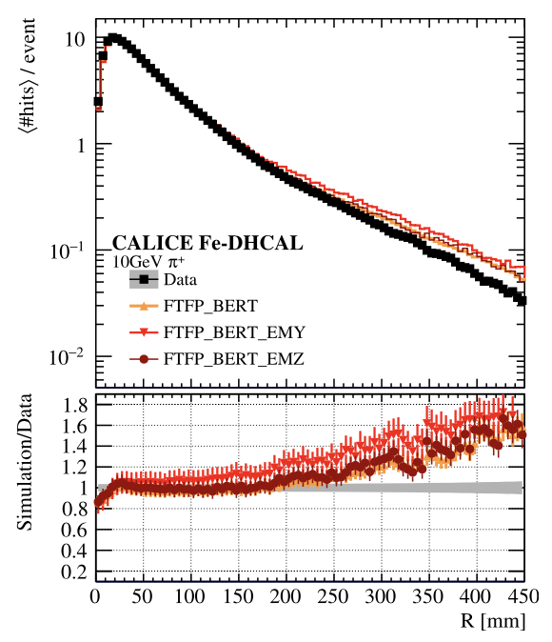
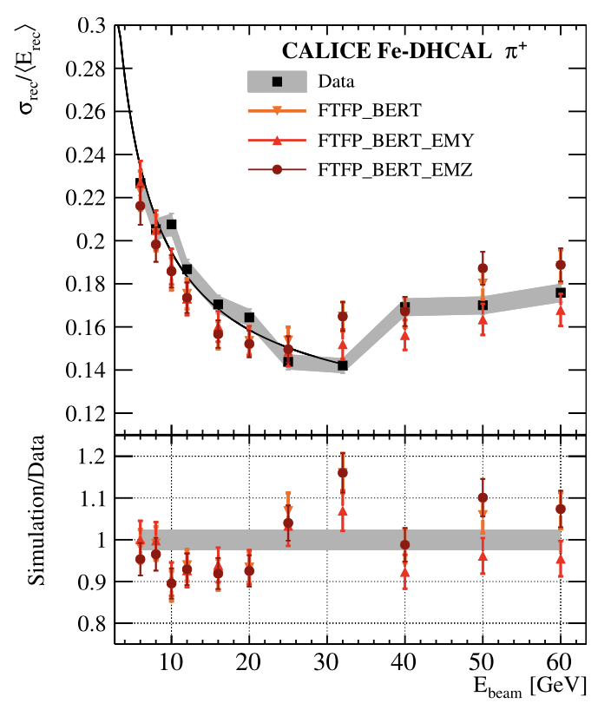
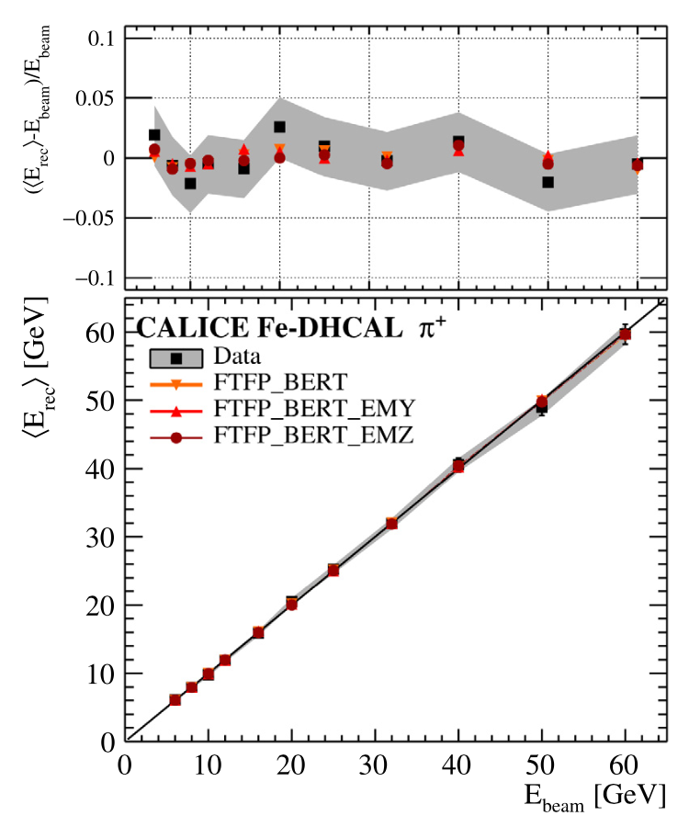
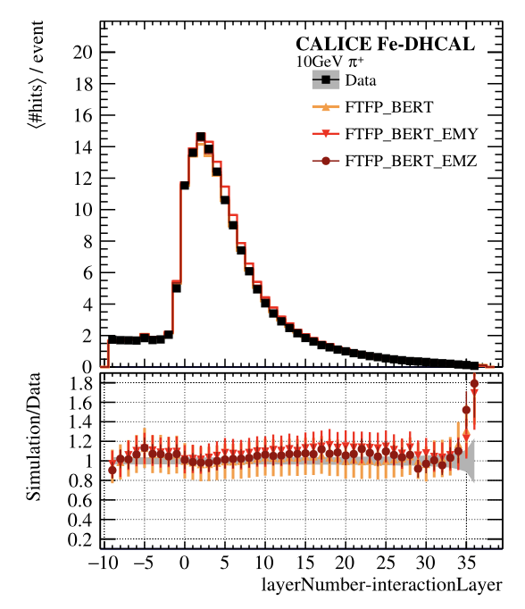
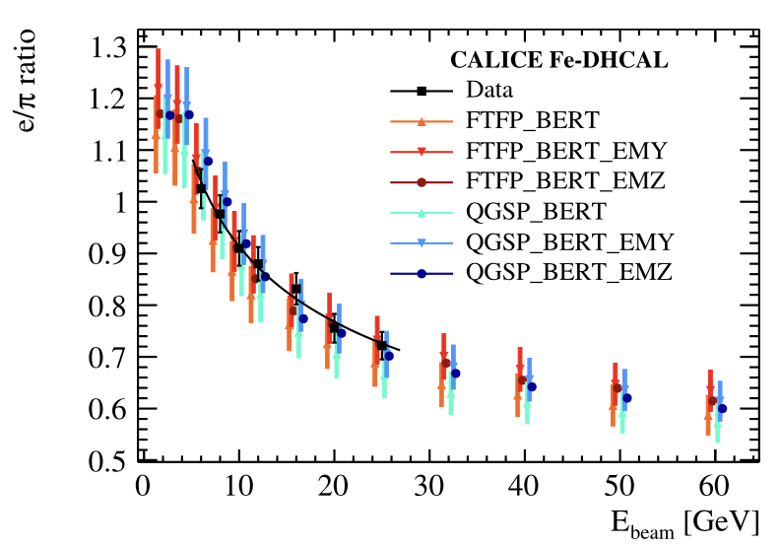
Fe-DHCAL at Fermilab
$$\frac{σ}{E}=\frac{\left(51.5±1.5\right)\%}{\sqrt{E}}⨁\left(10.6±0.5\right)\%$$
M. Chefdeville, et.al., Nucl. Instr. And Meth. A 939, 89, 2019

Slide 8
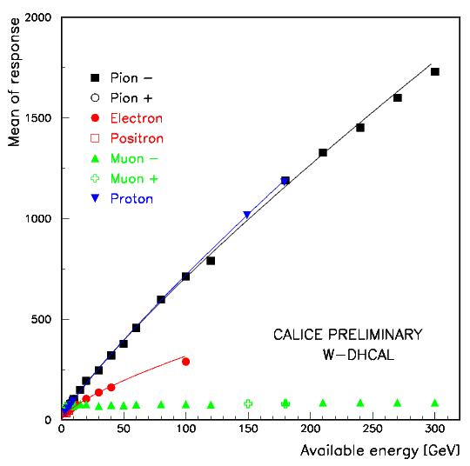
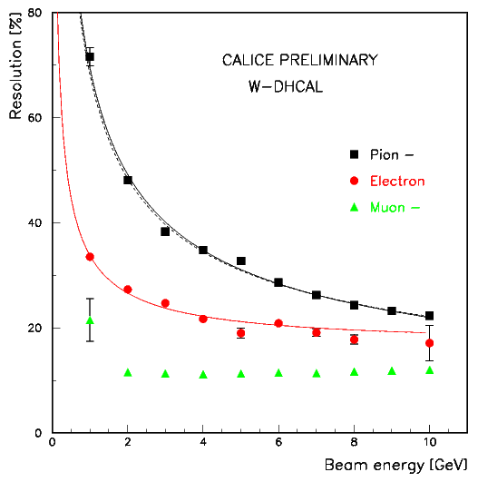
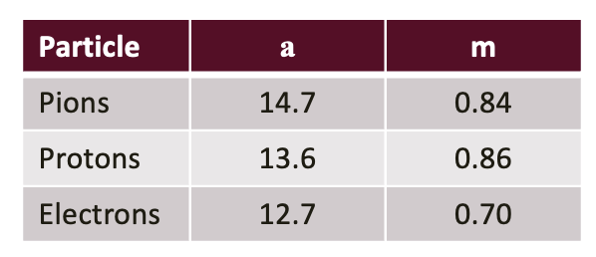
W-DHCAL at CERN – Combined PS and SPS Measurements
W-DHCAL with 1 x 1 cm²
Highly over-compensating compared to the Fe-DHCAL for the entire energy range.

Slide 9
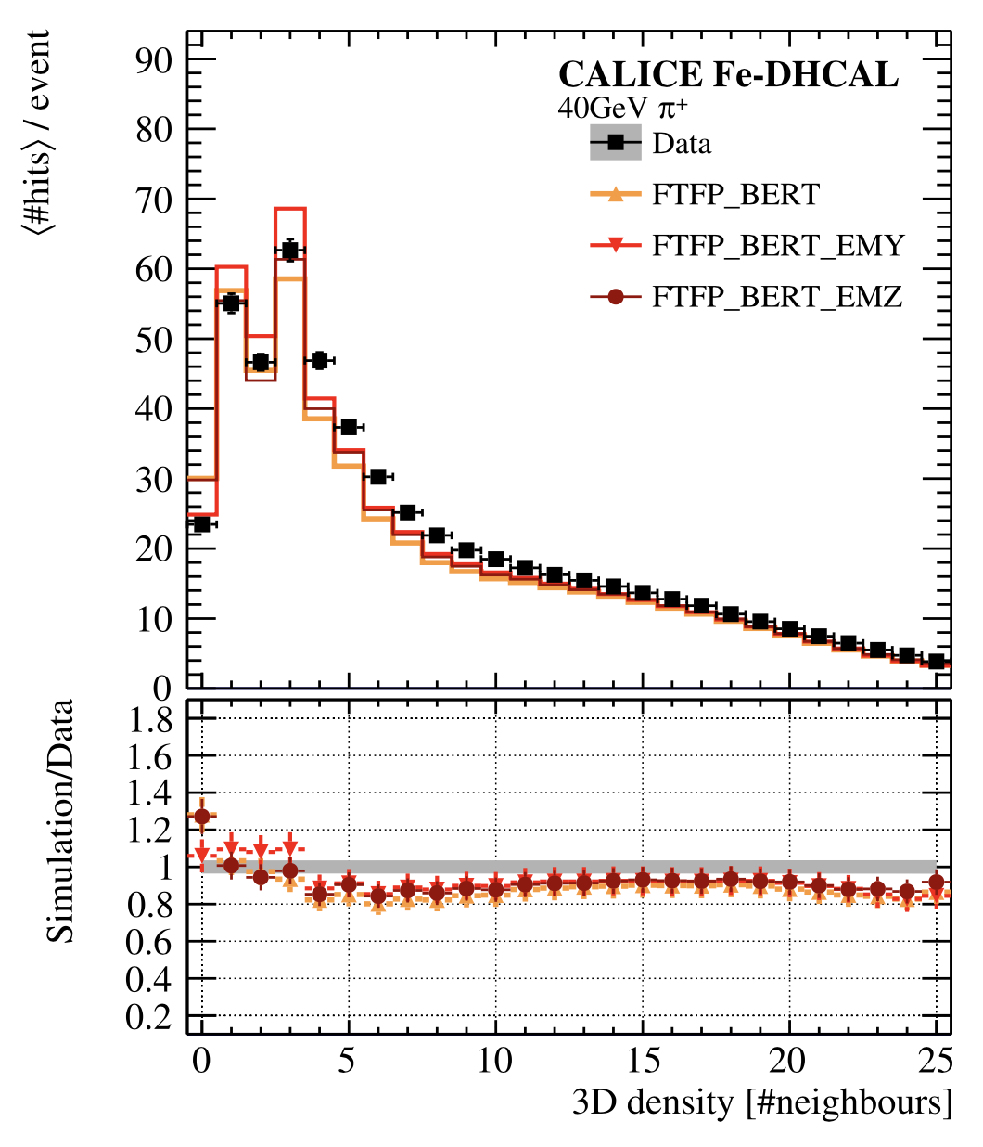
Simulation of the DHCAL Response
is particularly challenging
shows significant improvements in newer versions of Geant4 and EM physics packages
Involves several interconnected steps:
The primary ionization locations in the gas gaps of the RPCs are obtained from Geant4.
The ionization charges are sampled from the distribution obtained with the analog readout of a DHCAL RPC.
A dedicated software called RPCSim was developed to distribute the generated charge over the pads, apply the threshold and reconstruct the hits.
3D density of hits for 40 GeV π⁺ showers in the DHCAL with iron absorbers (Fe-DHCAL)
The disagreements are at the very fine level of detail which is not available in conventional calorimeters. ➔ Work ongoing.

Slide 10
Recent Hardware Developments
For
Digital Hadron Calorimetry

Slide 11
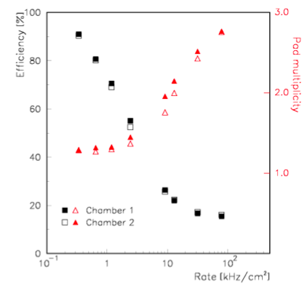
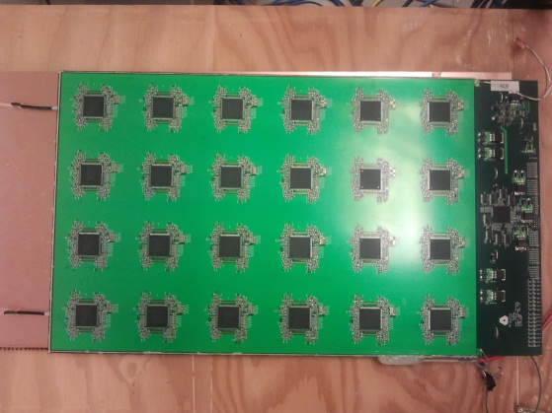
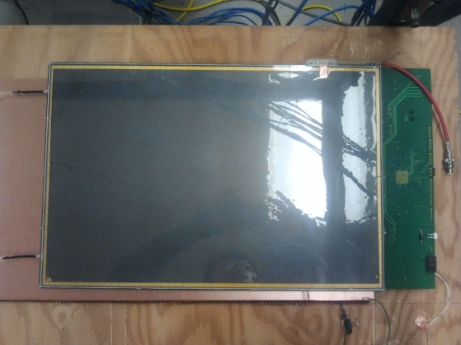
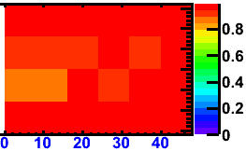
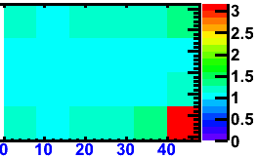
1-glass RPCs
Offers many advantages
Pad multiplicity close to one
→ easier to calibrate
Better position resolution
→ if smaller pads are desired
Thinner
→ t = t_{chamber} + t_{readout} = 2.4 + ~1.5 mm
→ saves on cost
Higher rate capability
→ roughly a factor of 2
Status
Built several large chambers
Tests with cosmic rays very successful
→ chambers ran for months without problems
Both efficiency and pad multiplicity look good
Good performance in the test beam
Efficiency
Pad multiplicity
B. Bilki, et.al., JINST 5, P05003, 2015
cm
cm
Notes:
65

Slide 12
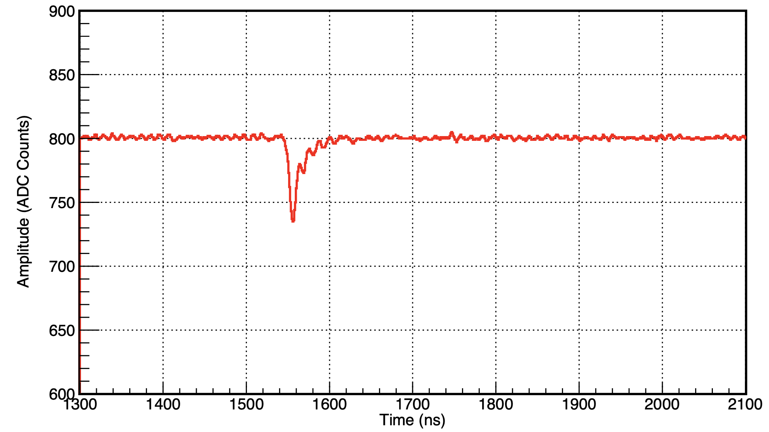
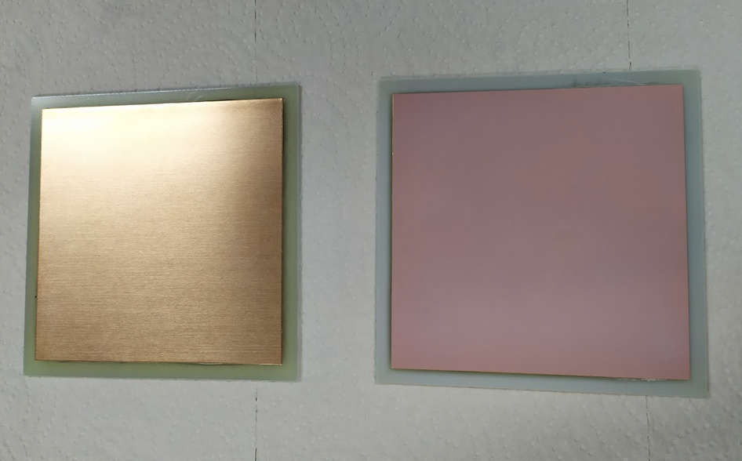
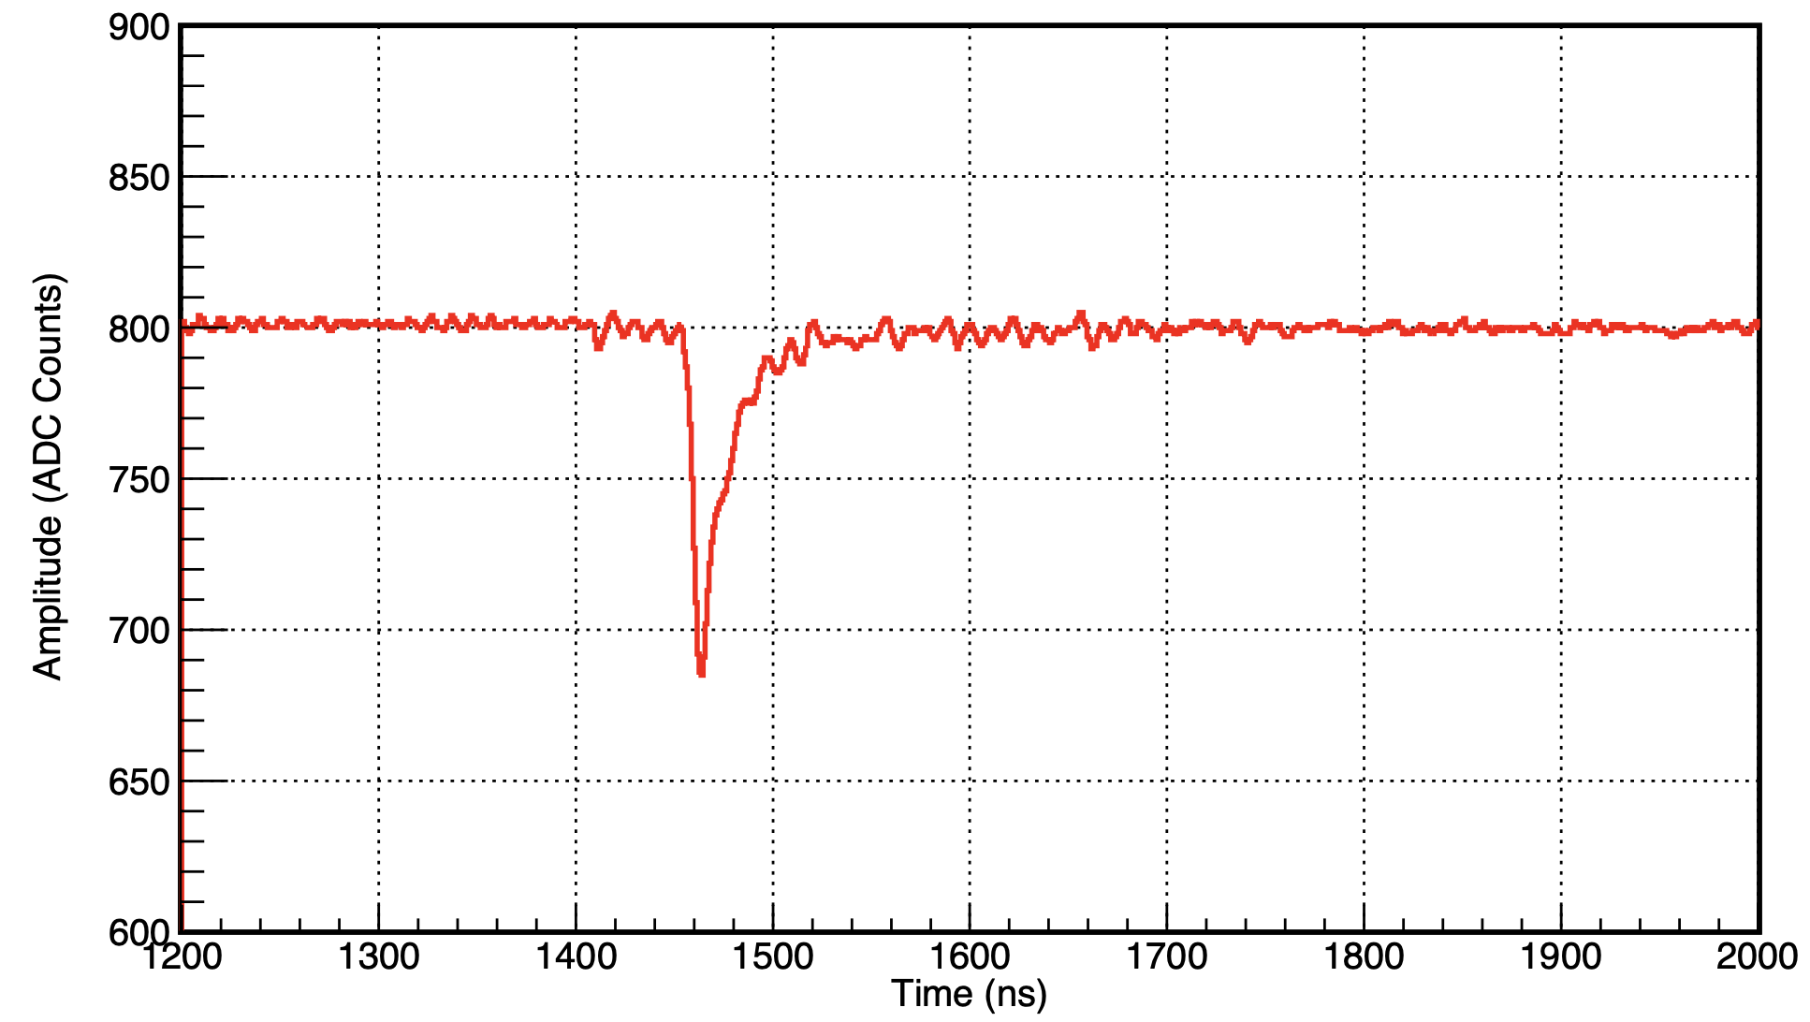
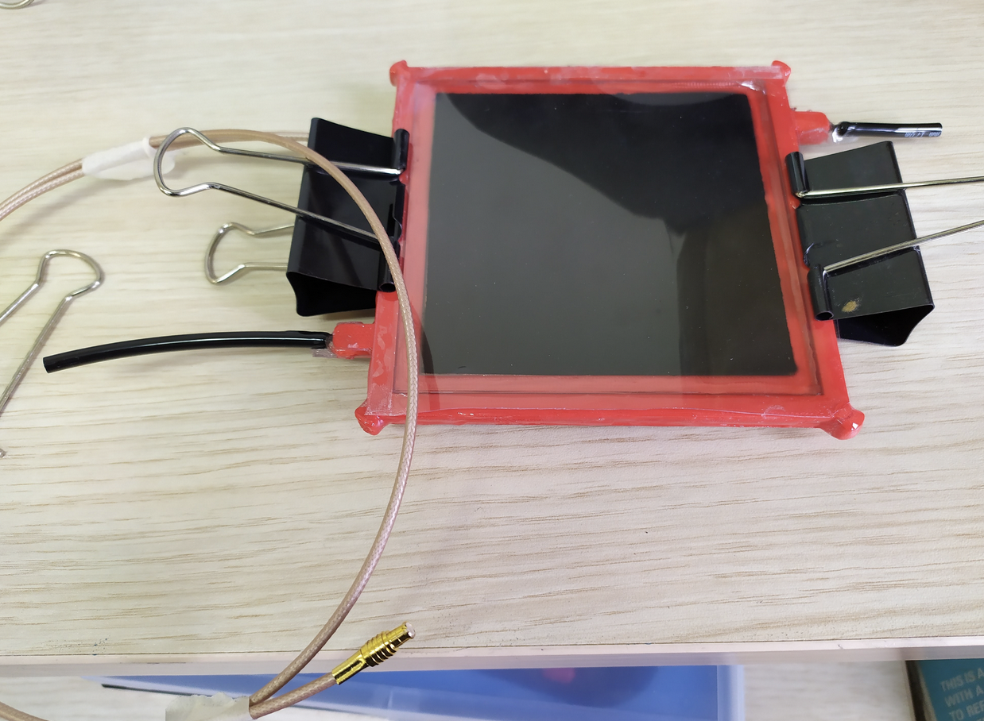
Development of Hybrid RPCs
Cosmic muon response
Probing a hybrid readout where part of the electron multiplication is transferred to a thin film of high secondary emission yield material coated on the readout pad with the purpose of reducing/removing gas flow and enabling the utilization of alternative gases.
Built several 10 cm x 10 cm chambers with single pad readout.
Coating of Al₂O₃ made with magnetron sputtering.
Coating of TiO₂ made with airbrushing after dissolving TiO₂ in ethanol.
7.7 kV
7.8 kV

Slide 13
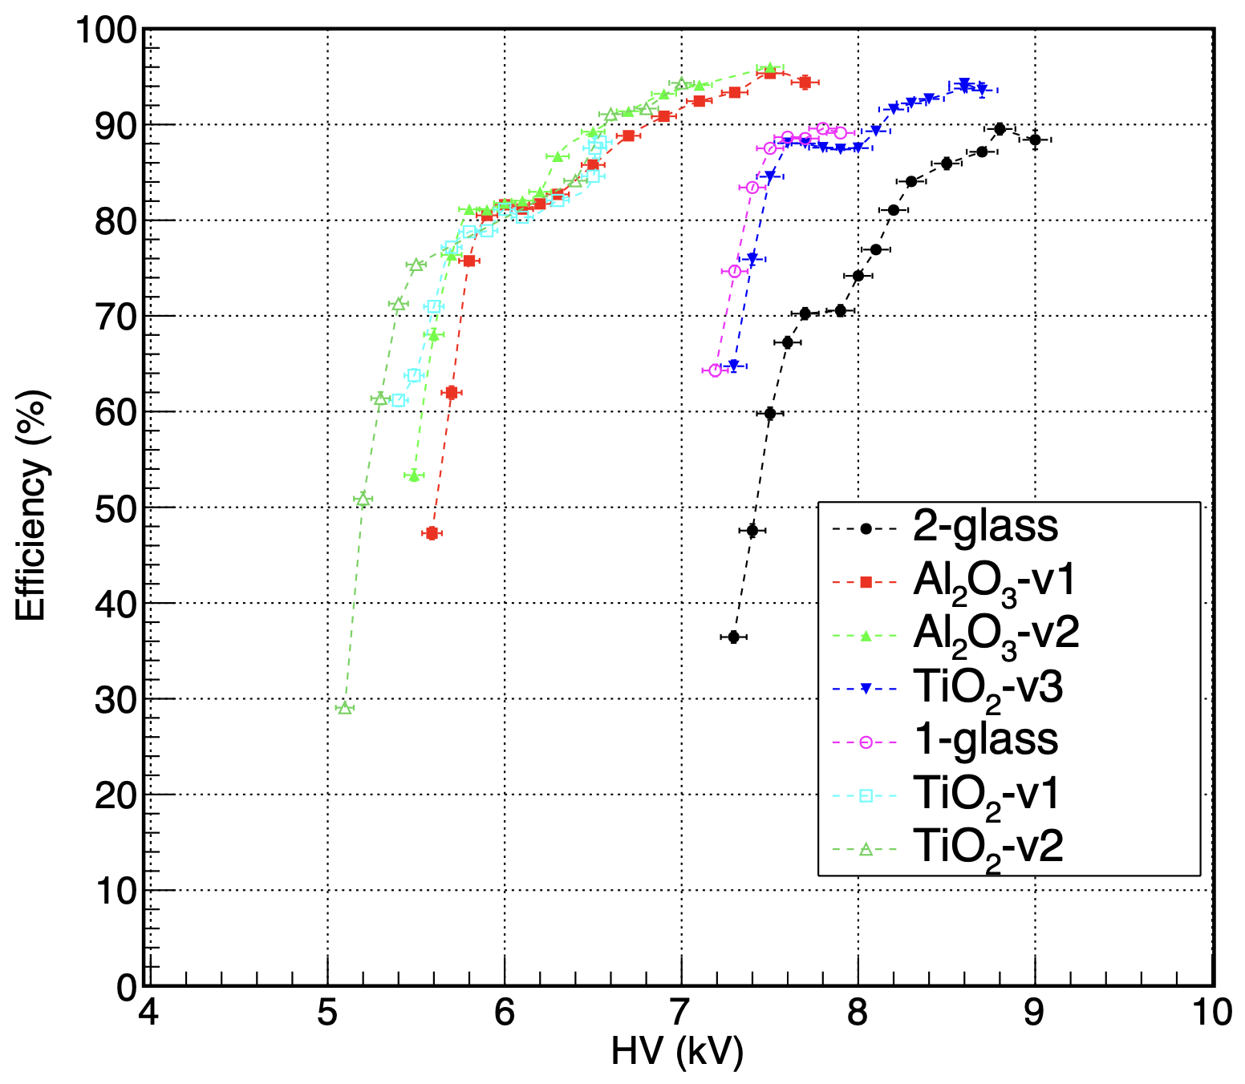
Tests of First-Generation Hybrid RPCs
We tested the first-generation hybrid RPCs as well as the standard 1-glass and 2-glass RPCs at Fermilab test beam. The lateral size of the chambers was 10 cm x 10 cm, the gas gap was 1.3 mm and the gas mixture was the DHCAL RPC gas mixture R134A : Isobutane : SF₆ ; 94.5 : 5.0 : 0.5 at 2-3 cc/min flow rate (lower than the nominal 5 cc/min).
Chambers tested and their 90% efficiency crossing HV:
2-glass RPC (8.5 kV)
1-glass RPC (7.5 kV)
500 nm Al₂O₃ (v1) (6.5 kV)
350 nm Al₂O₃ (v2) (6.5 kV)
1 mg/cm² TiO₂ (v1) (6.5 kV)
0.5 mg/cm² TiO₂ (v2) (6.5 kV)
0.15 mg/cm² TiO₂ (v3) (7.5 kV)
Very Preliminary
The charge multiplication in the secondary emission layer is qualitatively validated.
Efficient if charge > 300 fC

Slide 14
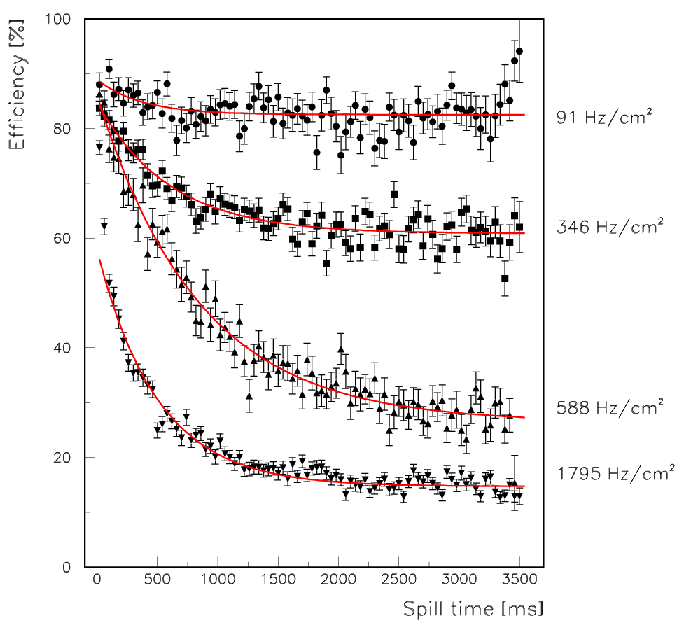
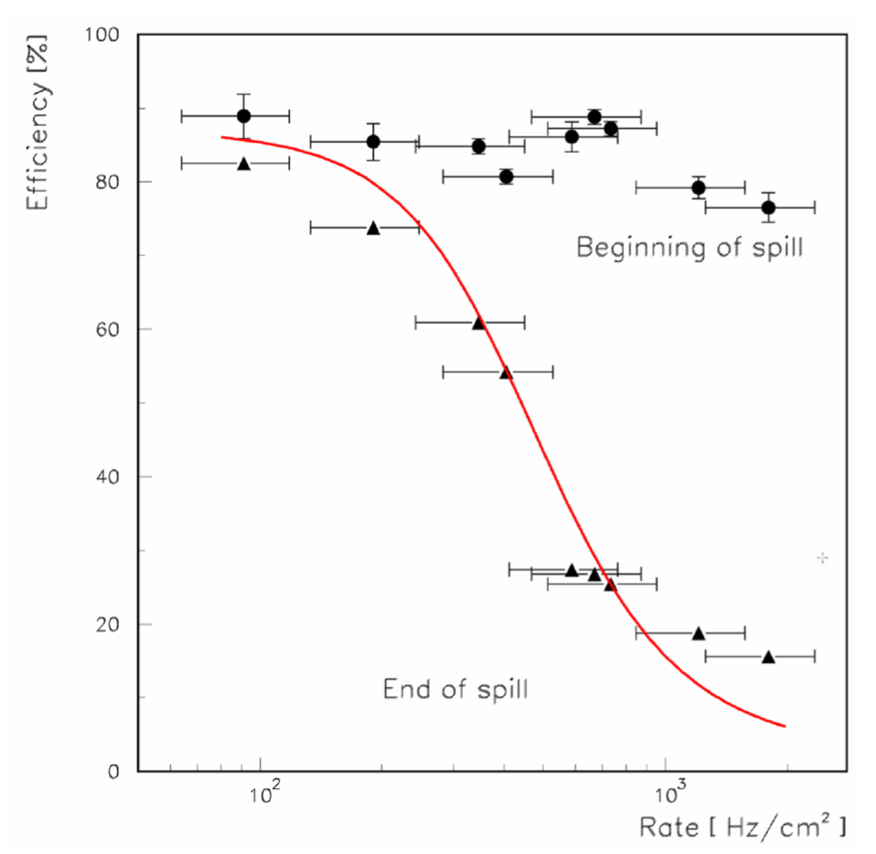
Rate capability of RPCs
Measurements of efficiency
With 120 GeV protons
In Fermilab test beam
Rate limitation
NOT a dead time
But a loss of efficiency
Theoretical curves
Excellent description of effect
Rate capability depends on
The bulk resistivity R_{bulk} of the resistive plates
Lower bulk resistivity → higher rate capability
B.Bilki et al., JINST 4 P06003, 2009

Slide 15
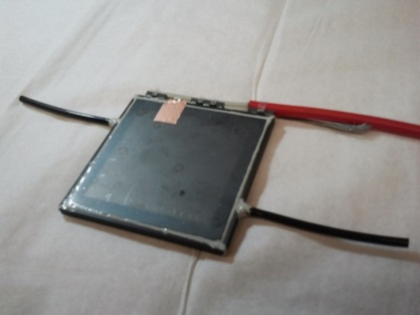
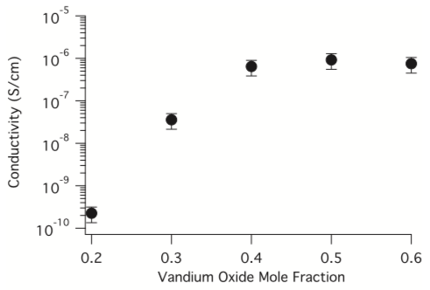
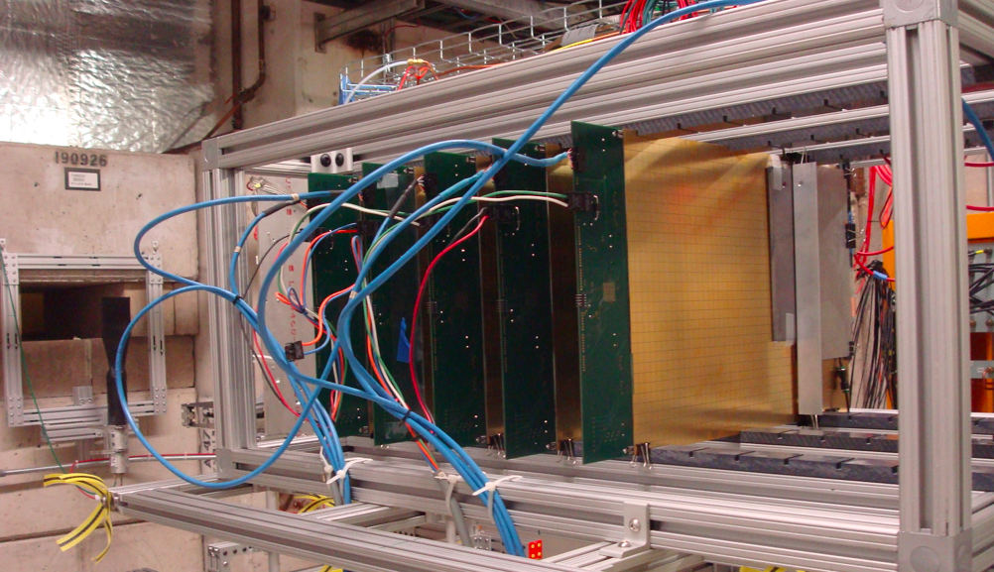
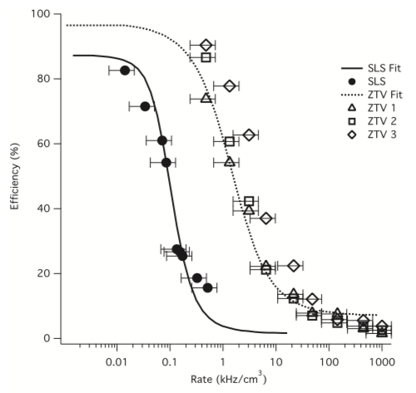
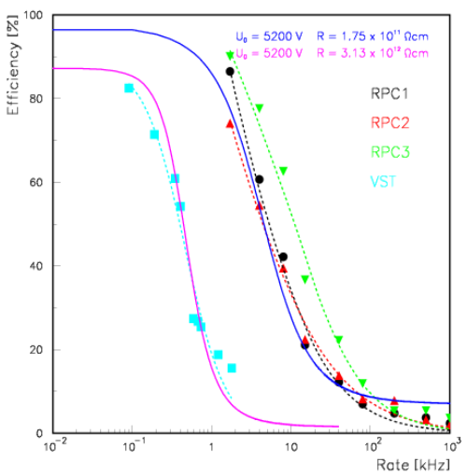
Development of semi-conductive glass
Co-operation with COE college (Iowa)
Vanadium based glass
Resistivity tunable
SLS: Soda lime silicate
ZTV: Zinc tellurium vanadate
N. Johnson et al., Int. J. Appl. Glass Sci. 6, 26, 2015

Slide 16
Further Development of High-Rate RPCs
M. Affatigato et al., JINST 10 P10037, 2015
Soda-lime
Soda-lime
Schott
2-glass RPCs with standard glass The chambers were built with two standard soda-lime float glass plates with a thickness of 1.1 mm each. The gas gap was 1.2 mm. The chambers were 20 x 20 cm² in size.
1-glass RPCs with standard glass The chambers were built with one standard soda-lime float glass plate with a thickness of 1.15 mm. The gas gap was also 1.15 mm. The size of the chamber was dictated by the size of the readout board, i.e. 32 x 48 cm². With only one glass plate the gas volume is defined by the glass plate and the anode board. Thus, the readout pads are located directly in the gas volume.
2-glass RPCs with semi-conductive glass These chambers utilize semi-conductive glass with a bulk resistivity several orders of magnitude smaller than standard soda-lime float glass. The glass, model S8900, is available from Schott Glass Technologies Inc. The gas gap of these chambers was also 1.15 mm and the area of the chambers measured 20 x 20 cm². With 1.4 mm thickness, the glass plates were somewhat thicker than for the other designs.

Slide 17
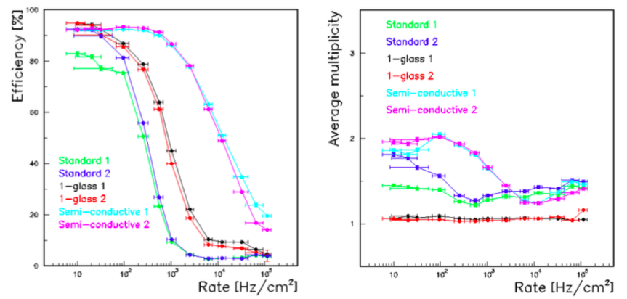
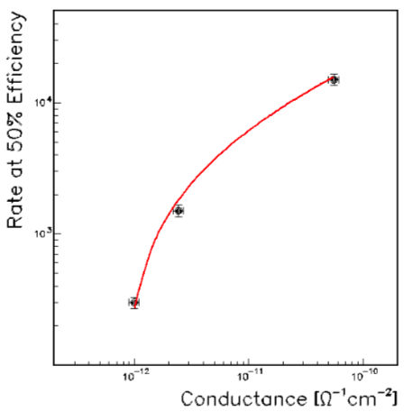
Further Development of High-Rate RPCs
I_{50%}=a+bH+cH³
where H = 1/ log₁₀(G), where G is the conductance per area of the glass plates; and a, b, and c are free parameters.
a = 1.7x10⁵, b = 3.2x10⁶ and c=-1.7x10⁸.

Slide 18
Secondary Emission Calorimetry

Slide 19
Why Secondary Emission Ionization Calorimeters?
Secondary Emission (SE) signal: Generated with SE surfaces inside electromagnetic/hadronic showers:
SE yield δ: Scales with particle momentum
SE e⁻: 3 < δ <100, per 0.05 <e⁻<100 keV (material dependent)
δ ~ 0.05 - 0.1 SE e⁻ per MIP
SE Calorimetry: Radiation-Hard + Fast
a) Metal-Oxide SE PMT Dynodes survive > 100 GRad
b) SE Beam Monitors survive 10²⁰ MIPs/cm²
Expect ~ 60-240 SE e⁻ per 100 GeV pion shower w/ MIPs alone
BUT in an SE calorimeter module, SE e⁻ will be amplified exactly like photoelectrons in the PMTs.

Slide 20
SE Sensor Options - 1

Slide 21
SE Sensor Options - 2

Slide 22
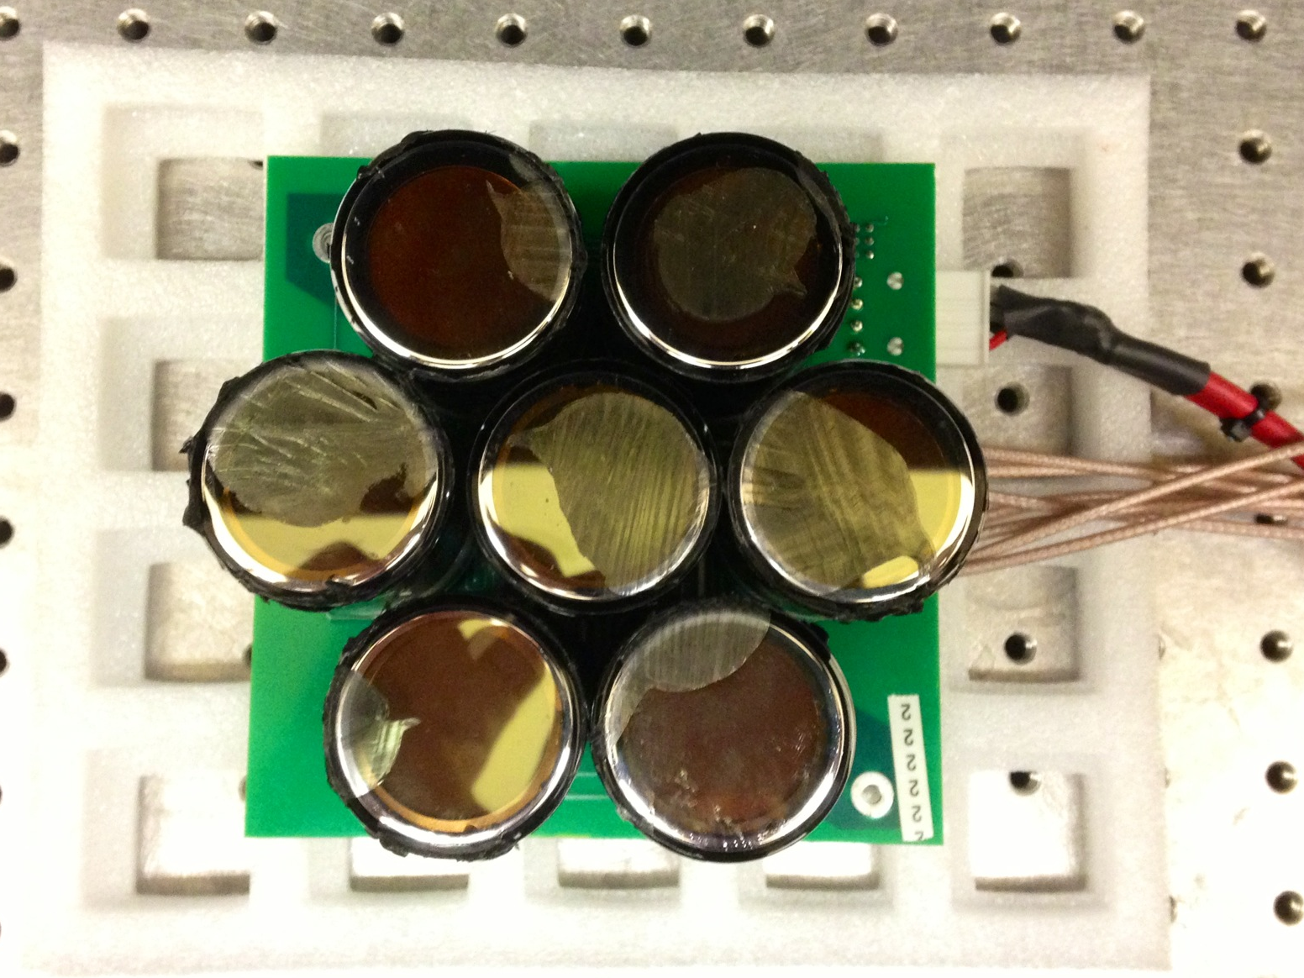
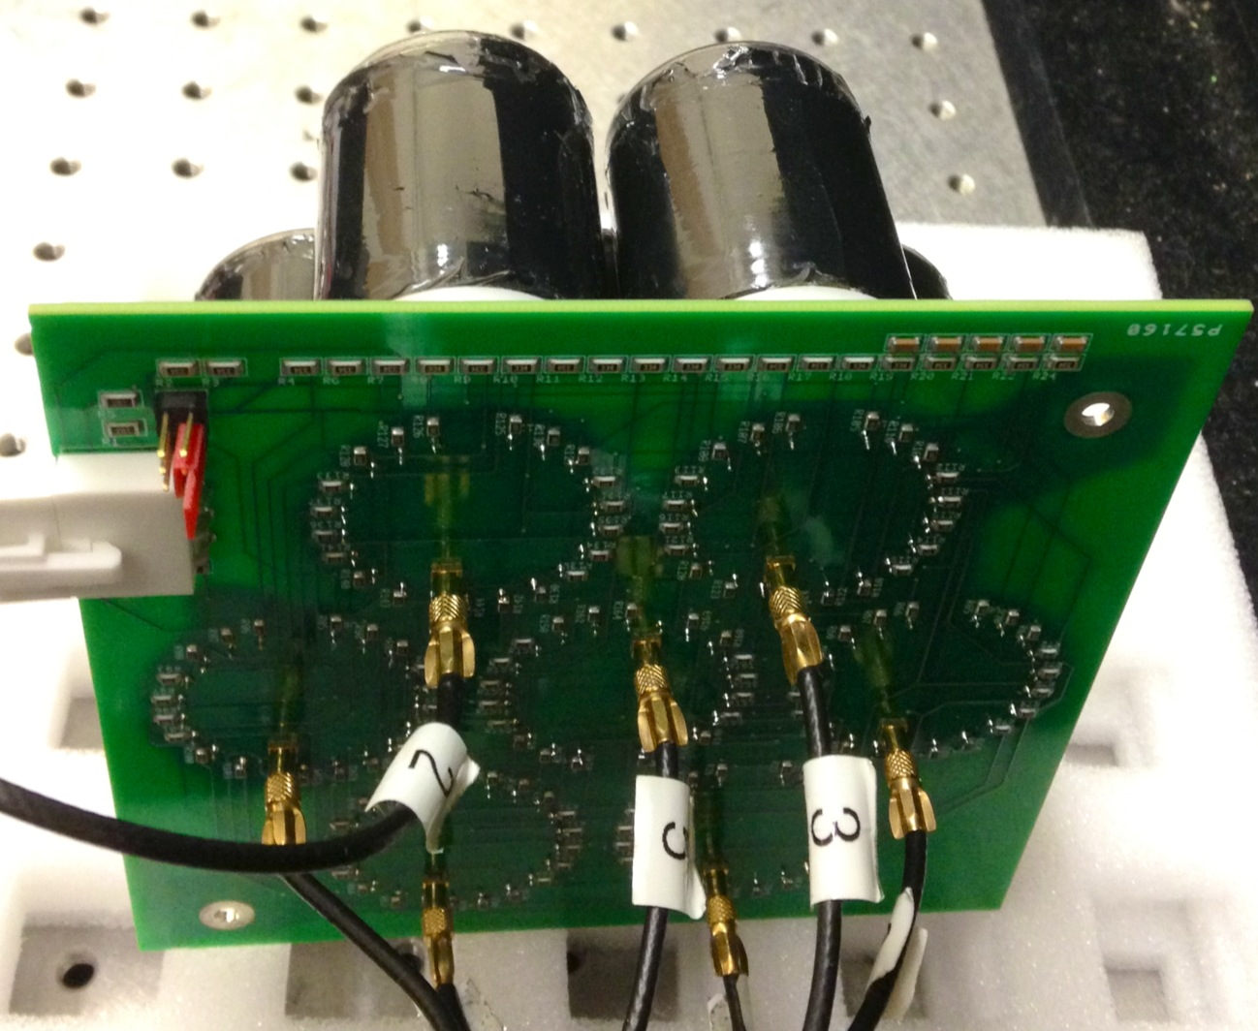
Construction of SE Modules
SE modules with 7 Hamamatsu R7761 19 stage mesh dynode PMTs were constructed. The baseboards were designed to provide three operation modes:
Normal divider (photomultiplier) mode
Cathode – first dynode shorted mode
Floating cathode mode
The default operation mode for the SE module was the cathode - first dynode shorted mode (B-C bridge) with an average gain of 6-9⨉10⁵.
E. Tiras, et.al., JINST 11 P10004, 2016

Slide 23
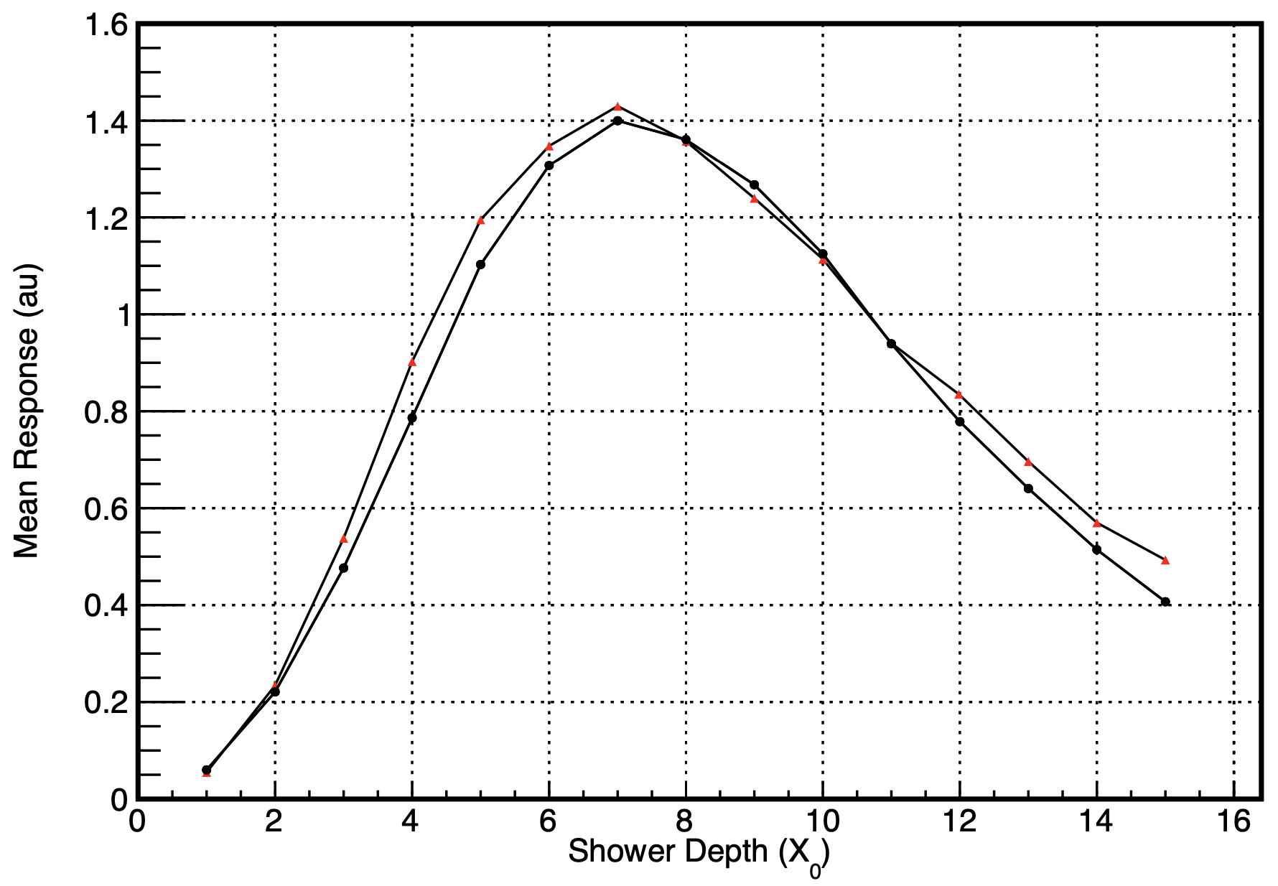
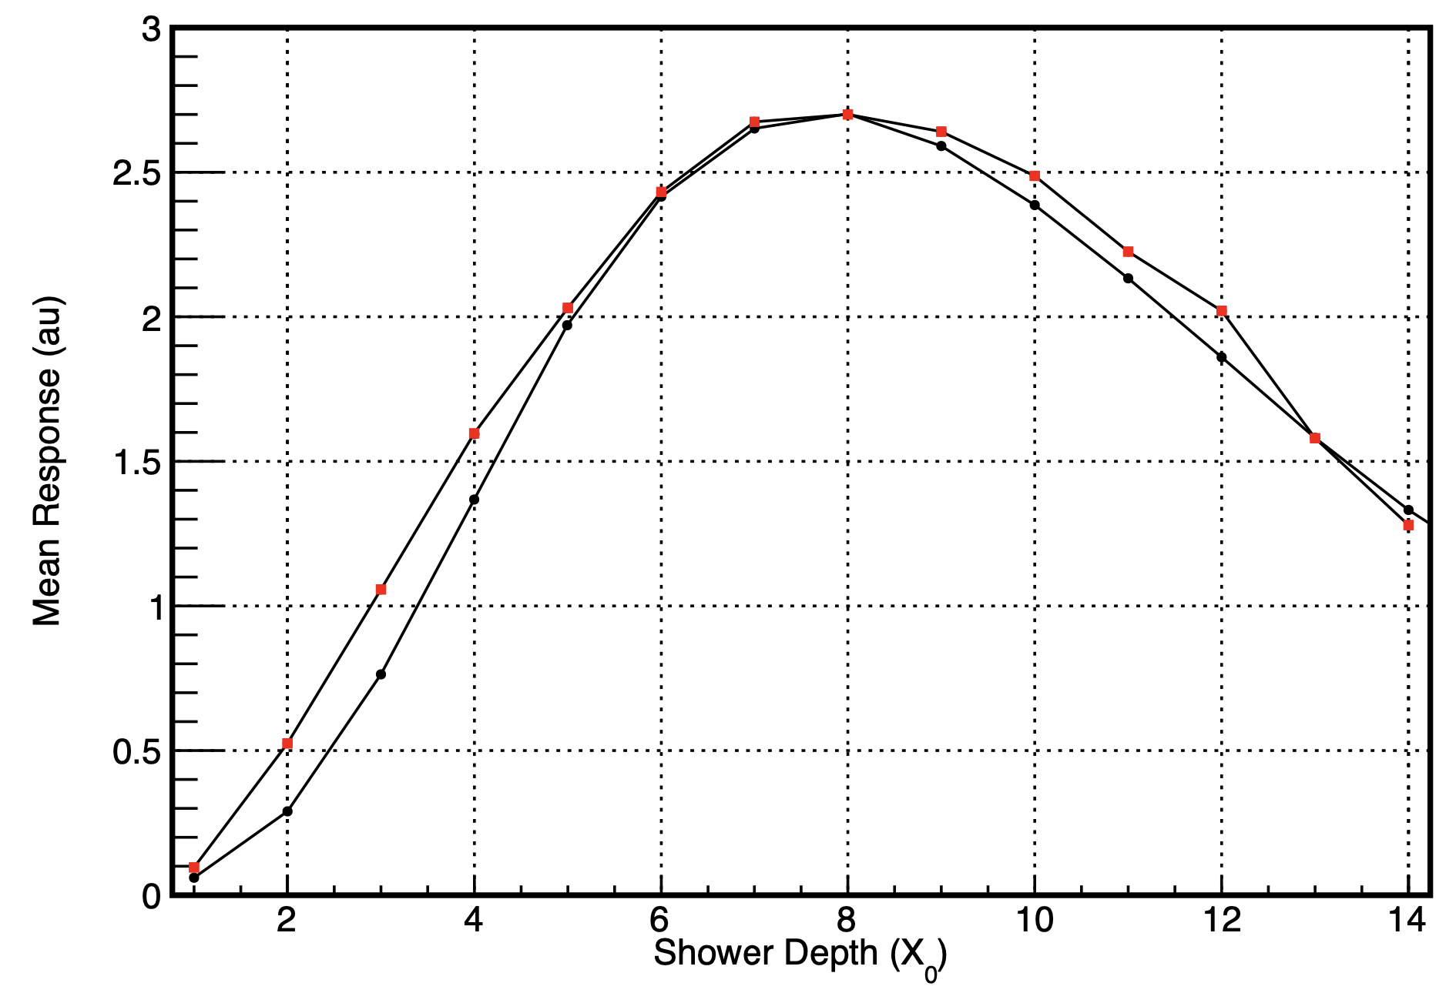
Tests of SE Modules
The SE modules were tested at FTBF with 8 GeV and 16 GeV positrons. The lateral coverage of the modules does not allow an effective measurement of the shower development with steel absorbers. The measurements were taken with the central sensor and up to 16 3 cm ⨉ 3 cm ⨉ 0.35 cm tungsten absorbers. MC matching is still under development.
8 GeV positrons
Data
16 GeV positrons
Data
MC
MC
The results validate the principle of SE calorimetry.

Slide 24
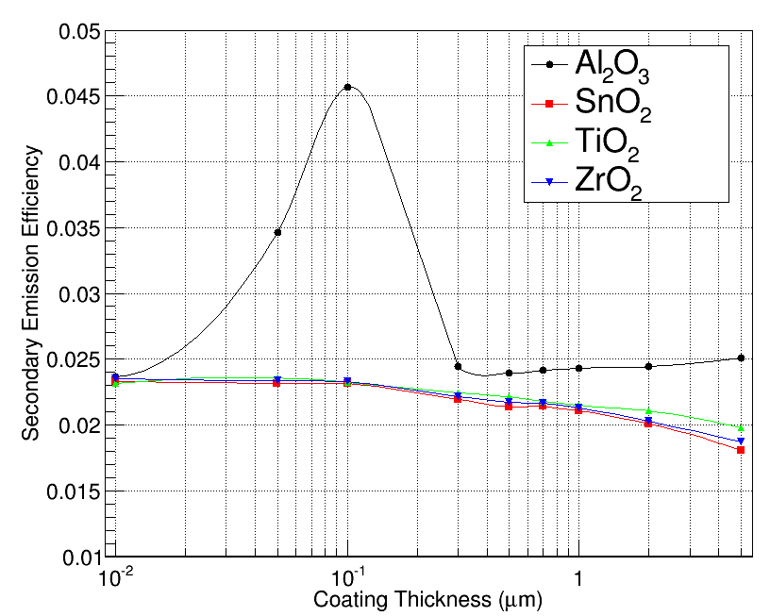
Enhancement of Secondary Electron Emission
The cathode and the dynodes of the SE sensors can be made by coating the mesh copper foils with secondary emitters like Al₂O₃, SnO₂, TiO₂ or ZrO₂. The coating can be done with magnetron sputtering with the simplest options being Al₂O₃ and TiO₂.
Average secondary electron emission efficiency was calculated for various thicknesses of Al₂O₃, SnO₂, TiO₂ and ZrO₂ with 4 GeV muons (MIP).
The best performance was predicted to be with 100 nm thick Al₂O₃.

Slide 25
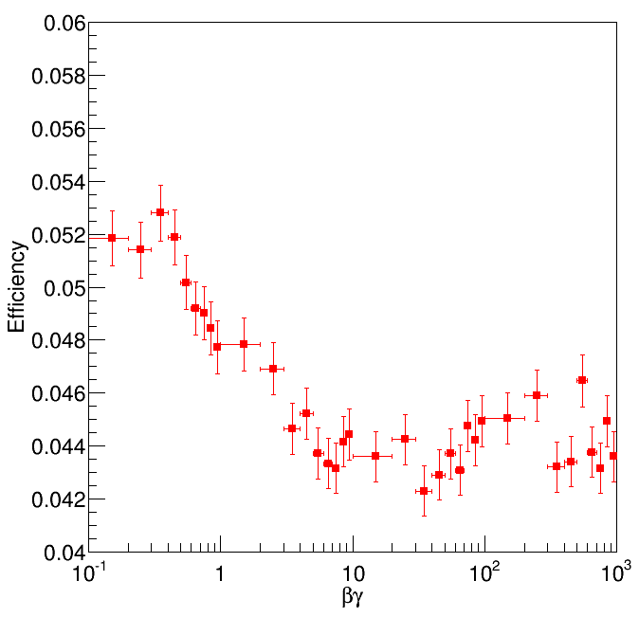
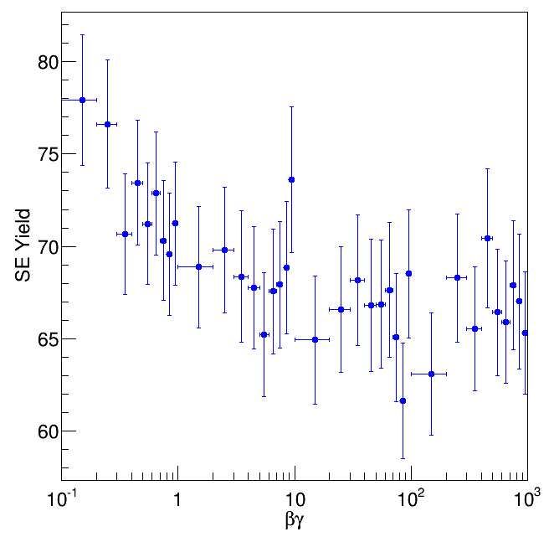
Enhancement of Secondary Electron Emission
The secondary electron emission efficiency and the e⁻ yield of the 100-nm Al₂O₃ coated copper cathode/dynode was simulated as a function of the βγ of the traversing particle (muon). The minimum ionization occurs around βγ of 40 which corresponds to roughly 4 GeV of muon energy. The average secondary electron yield is around 68.

Slide 26
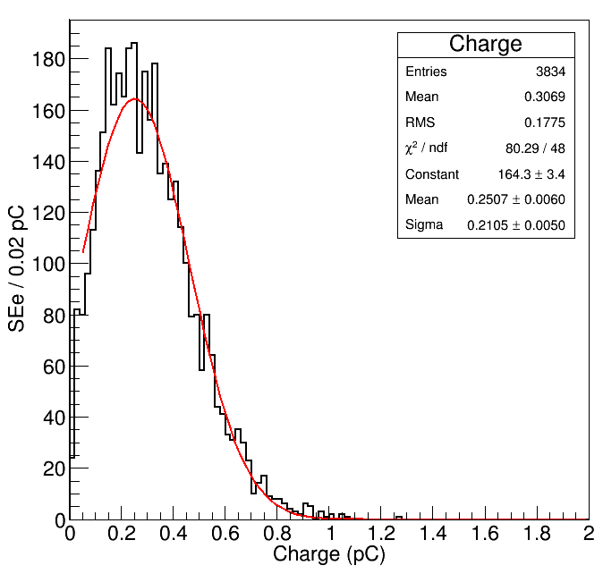
Projection to a Full-Scale SE Sensor
The mesh structure made by holes of size between 10 and 100 microns and hole spacing of 50 – 100 microns.
150 microns distance between the dynode layers.
Vacuum housing (no dramatic vacuum requirements).
Start with a 9-stage multiplication.
Figure shows the charge spectrum for a 9-stage secondary emission device for a minimum ionizing particle that is efficient at the cathode. With an average of 300 fC, the signal can be recorded with commercial oscilloscopes.
12 and 15 stage SE sensors are also practical.

Slide 27
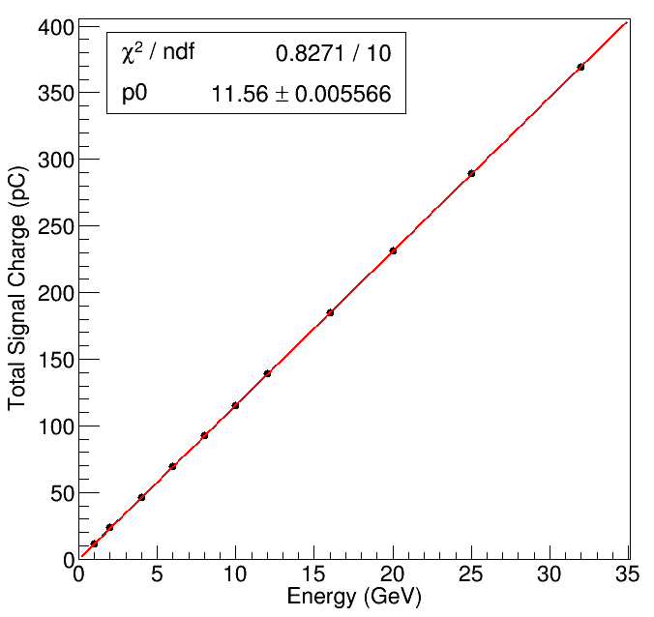
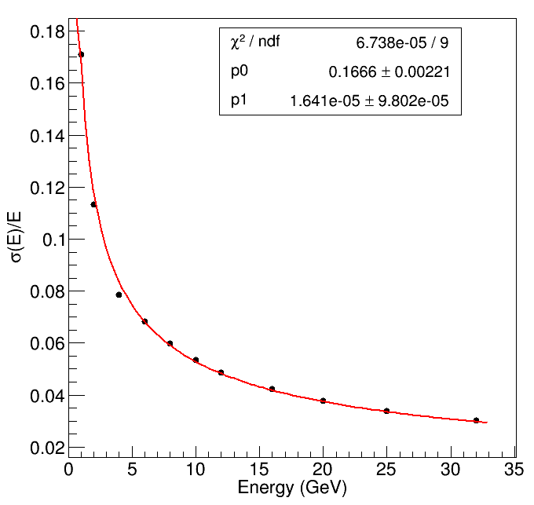
Projection to a Full-Scale SE Calorimeter
The electromagnetic response of an SE calorimeter prototype with 16 active layers interleaved with 1 X₀ tungsten absorbers is also simulated. The SE sensor is the previously described 9-stage SE device.
The detector response is linear in the energy range of 1-32 GeV and the electromagnetic energy resolution is obtained as ${16.7\%}/{\sqrt{E}}$ with a negligible constant term.

Slide 28
Construction of Dedicated SE Sensors
The construction requirements for an SE Sensor Module are much easier than a PMT, since:
The entire final assembly can be done in air. Dynodes used as particle detectors in Mass Spectrometers or in beam monitors cycle to air repeatedly.
The thin film deposition procedure and the handling of the coated SE layer are not as delicate procedures as for the photocathodes.
The SE module is sealed by normal vacuum techniques.
The vacuum necessary is 100 times higher than that needed for a PMT photocathode.
The modules envisioned are compact, high gain, high speed, exceptionally radiation damage resistant, rugged, and cost effective, and can be fabricated in arbitrary tileable shapes. The SE sensor module anodes can be segmented transversely to sizes appropriate to reconstruct electromagnetic cores with high precision.

Slide 29
Conclusions – Digital Hadron Calorimetry
The first Digital Hadron Calorimeter was built and tested successfully. By construction, the DHCAL was the first large-scale calorimeter prototype with embedded front-end electronics, digital readout, pad readout of RPCs and extremely fine segmentation.
Fine segmentation allows the study of electromagnetic and hadronic interactions with unprecedented level of spatial detail, and the utilization of various techniques not implemented in the community so far (software compensation, leakage correction, …). The level of detail also introduces challenges in the simulation of the response.
The novel 1-glass chamber design offers a number of advantages over the traditional two-plate design: an average pad multiplicity close to unity, a reduced overall thickness, a simplified construction procedure and an improvement in rate capability by a factor of 2.
Raising the overall conductance per unit area of the glass plates will enhance the rate capability and increase the range of particle rates for which the chambers retain their full particle detection efficiency.
By developing the hybrid RPCs, the heavy requirements on gases are planned to be relaxed by shifting part of the electron multiplication in the gas layer to materials with high secondary electron multiplication capability coated on the anode surface of 1-glass RPCs.

Slide 30
Conclusions – Secondary Emission Calorimetry
Secondary emission calorimetry is a feasible option particularly for electromagnetic calorimetry in high radiation environments, as well as other implementations such as beam loss monitors and Compton polarimeters.
The construction of the sensor modules is simple. The envisaged modules are compact, robust and cost effective.
The preliminary tests validate the idea and suggest a full-scale SE calorimeter prototype.
Highly segmented readout for imaging calorimetry is possible.

Slide 31
References
B. Bilki, et.al., Calibration of a digital hadron calorimeter with muons, JINST 3 , P05001, 2008.
B. Bilki, et.al., Measurement of positron showers with a digital hadron calorimeter, JINST 4, P04006, 2009.
B. Bilki, et.al., Measurement of the rate capability of Resistive Plate Chambers, JINST 4, P06003, 2009.
B. Bilki, et.al., Hadron showers in a digital hadron calorimeter, JINST 4, P10008, 2009.
Q. Zhang, et.al., Environmental dependence of the performance of resistive plate chambers, JINST 5, P02007, 2010.
J. Repond, Analysis of DHCAL Muon Data, CALICE Analysis Notes, CAN-030, CAN-030A, 2011.
L. Xia, CALICE DHCAL Noise Analysis, CALICE Analysis Note, CAN-031, 2011.
B. Bilki, DHCAL Response to Positrons and Pions , CALICE Analysis Note, CAN-032, 2011.
J. Repond, Analysis of Tungsten-DHCAL Data from the CERN Test Beam, CALICE Analysis Note, CAN-039, 2012.
B. Bilki, The DHCAL Results from Fermilab Beam Tests: Calibration, CALICE Analysis Note, CAN-042, 2013.
B. Bilki, et.al., Tests of a novel design of Resistive Plate Chambers, JINST 10, P05003, 2015.
M. Affatigato, et.al., Measurements of the rate capability of various Resistive Plate Chambers, JINST 10, P10037, 2015.
N. Johnson, et.al., Electronically Conductive Vanadate Glasses for Resistive Plate Chamber Particle Detectors, International Journal Of Applied Glass Science, 6, 26, 2015.
B. Freund, et.al., DHCAL with minimal absorber: measurements with positrons, JINST 11, P05008, 2016.
C. Adams, et.al., Design, construction and commissioning of the Digital Hadron Calorimeter — DHCAL, JINST 11, P07007, 2016.
M. Chefdeville, et.al., Analysis of testbeam data of the highly granular RPC-steel CALICE digital hadron calorimeter and validation of Geant4 Monte Carlo models, Nucl. Instr. And Meth. A 939, 89, 2019.
M. Tosun et.al., Development of hybrid resistive plate chambers, Nucl. Instrum. And Meth. A 1054, 168448, 2023.
E. Tiras et.al., Characterization of photomultiplier tubes in a novel operation mode for Secondary Emission Ionization Calorimetry, JINST 11, P10004, 2016.
B. Bilki et.al., Secondary Emission Calorimetry, Instruments, 6 48, 2022.

