Slide 1
FCC-ee Higgs CP Study
Nicholas Pinto (JHU), Andrei Gritsan (JHU), Jan Eysermans (MIT), Valdis Slokenbergs (JHU)
Second Annual U.S. Future Circular Collider (FCC) Workshop
26 March 2024

Slide 2
Outline:
Overview of Past Studies
Current Study:
Selection and Efficiency
Results
MELA
Reweighting in the FCC Framework
Future Avenues

Slide 3
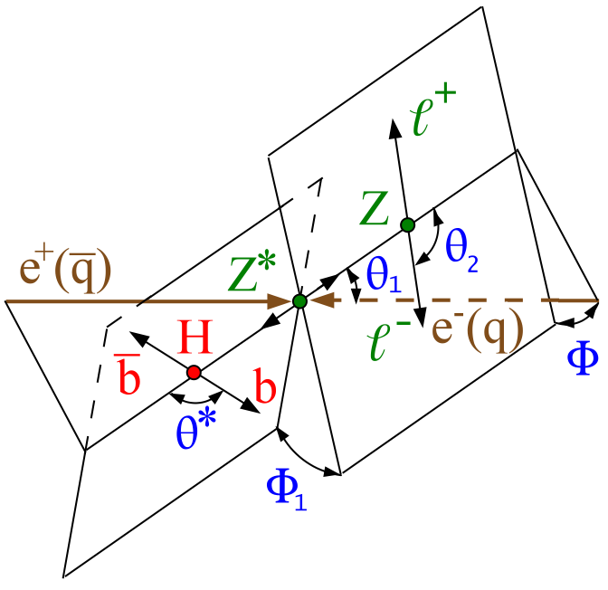
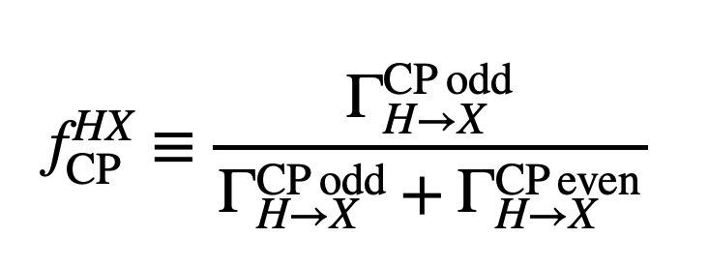
Past Studies: Snowmass 2013
arXiv:1309.4819
$$0^{+}$$
$$0^{−}$$
$$f_{CP}^{VH}=0.5,φ=\frac{π}{2}$$
$$f_{CP}^{VH}=0.5$$
$$e^{−}$$
$$H$$
$$Z^{∗}$$
$$e^{+}$$
$$Z$$
Notes:
Note to self, do I need these?

Slide 4
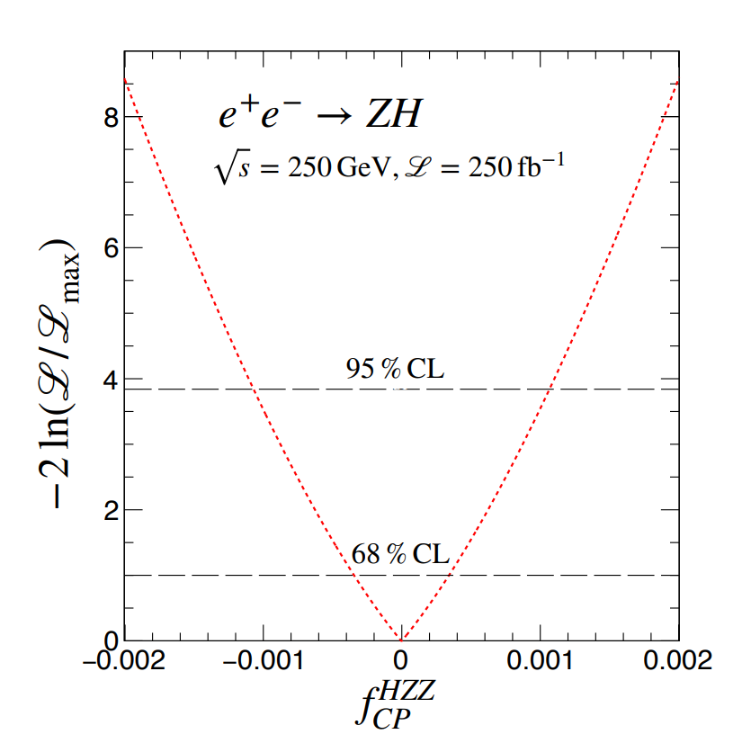
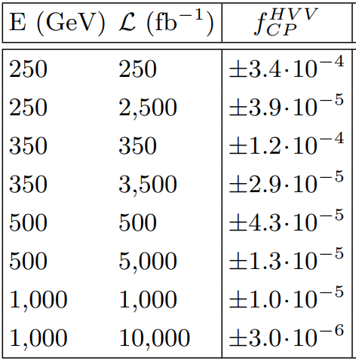
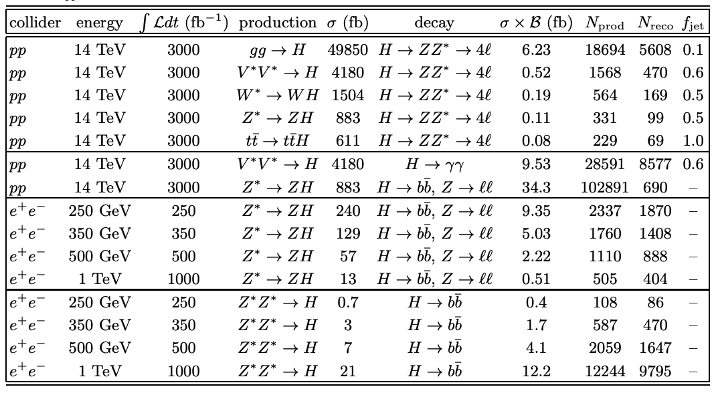
Past Studies: Snowmass 2022
arXiv:2205.07715
Signal: $e^{+}e^{−}→ZH,Z→ll \left(7.7\%\right), H→b\overline{b} (58\%).$Background: $e^{+}e^{−}→ZZ→ll b\overline{b}$, $N_{reco, Background}$ ~ 1/10th of signal,
Z mass, angles input to combine (template fit), $f_{CP}^{HVV}$ returned at 68% CL.
4+ different samples (SM Signal, BSM Signal, Background, SM/BSM Interference) used to produce fits.

Slide 5
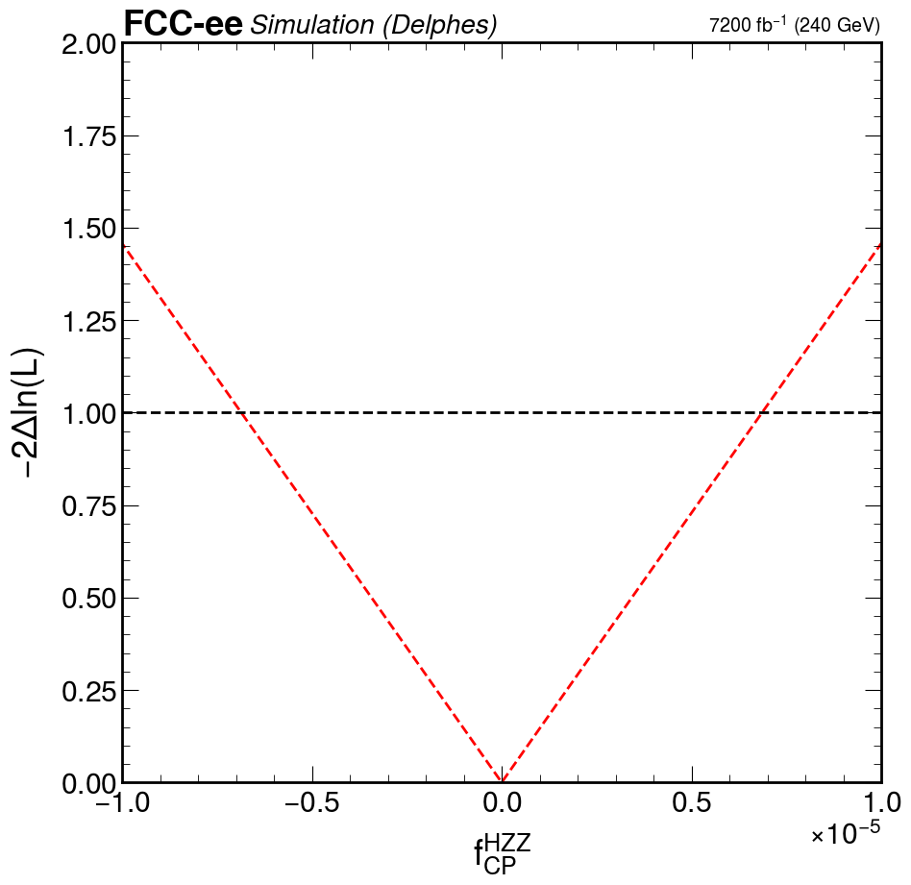
Overview of Current Study:
Target: ee $⟶$ ZH, H $⟶$X (recoil), Z $⟶μμ$ (3.4%)
Detector simulation uses DELPHES fast sim.
Template fit made from angular distributions.
Uses Reco data, FCC signal yield and luminosity.
Additional fit w/ Snowmass luminosity used as a comparison.
Broader range of backgrounds used:
Primarily WW, ZZ, Z/$γ^{∗}$

Slide 6
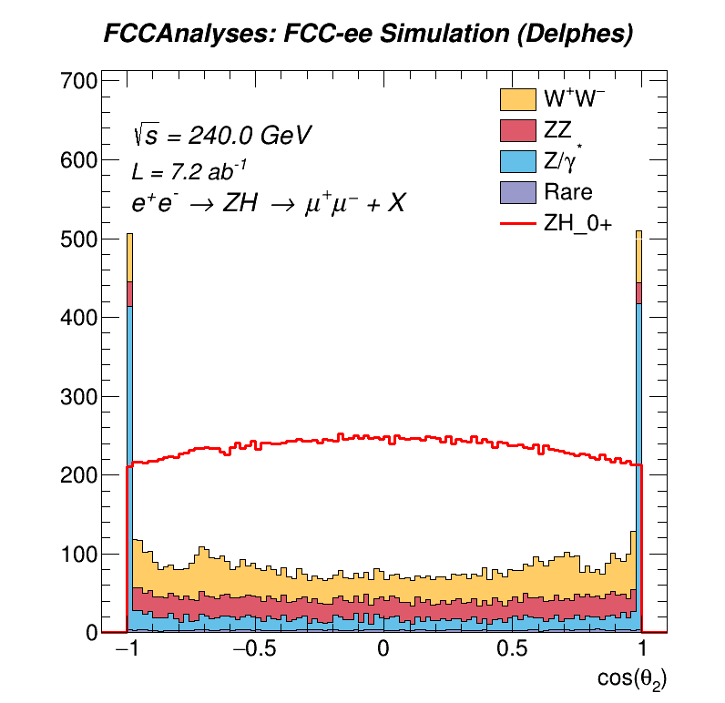
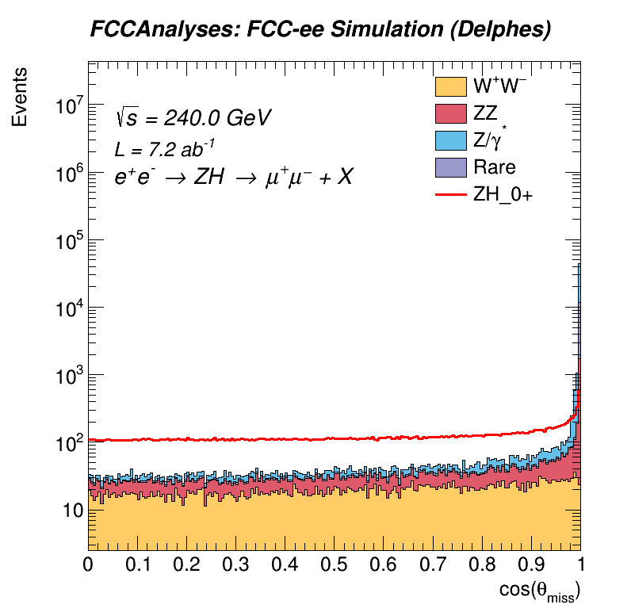
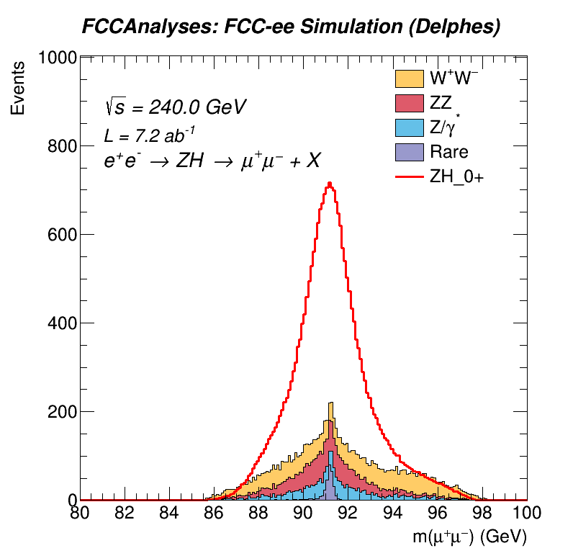
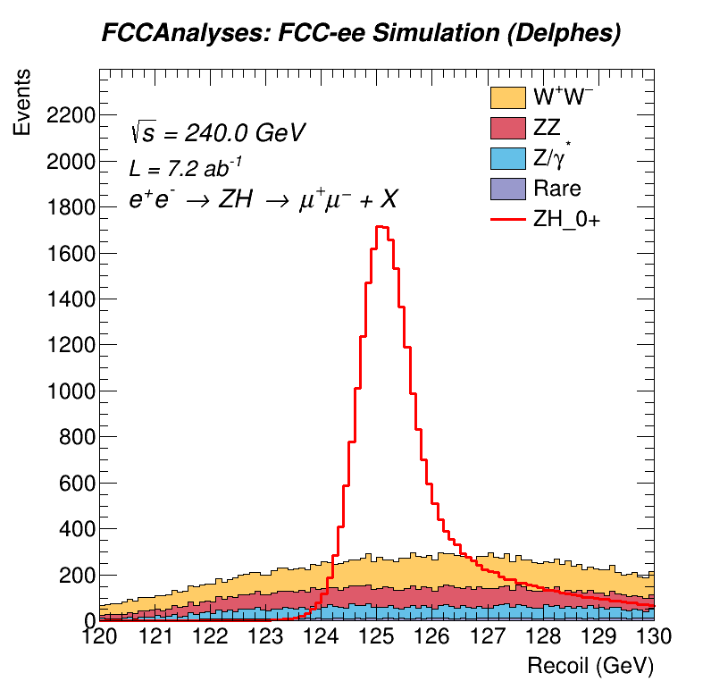
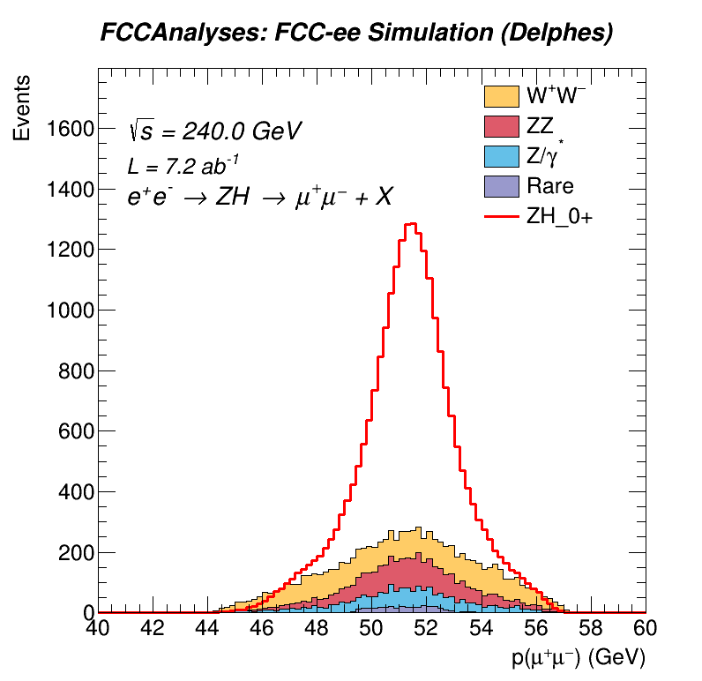
Current Selection: N-1 Plots:

Slide 7
Selection: Behavior of $\operatorname{Cos}{θ_{2}}$ Endpoints:
$\operatorname{Cos}{θ_{2} }$is the angle between muon and recoil direction.
”Bullhorns” appear at the extrema of $\operatorname{Cos}{θ_{2} }$in $e^{+}e^{−}→τ^{+}τ^{−}$

Slide 8
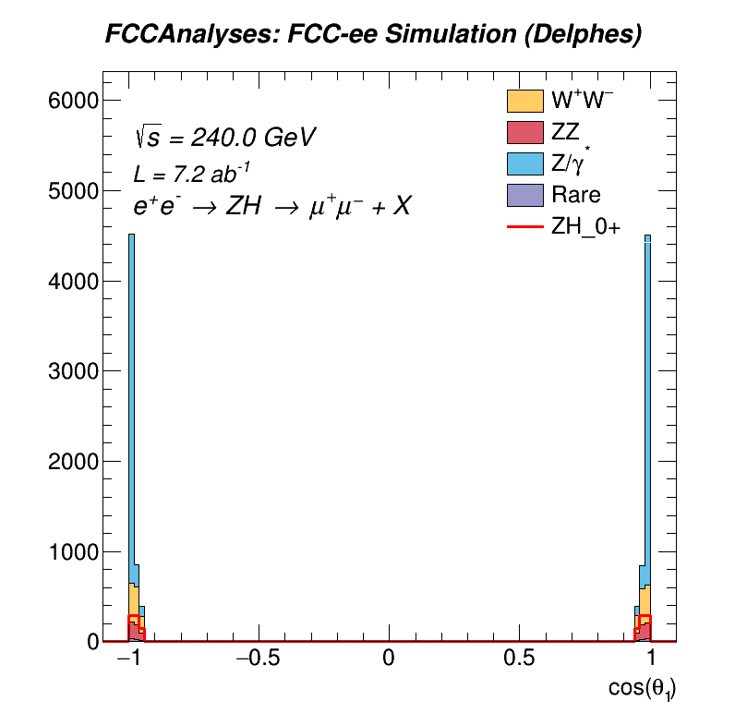
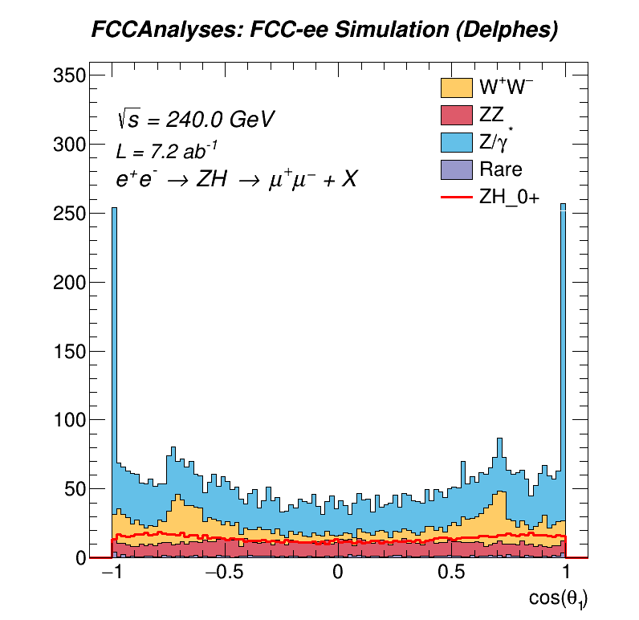
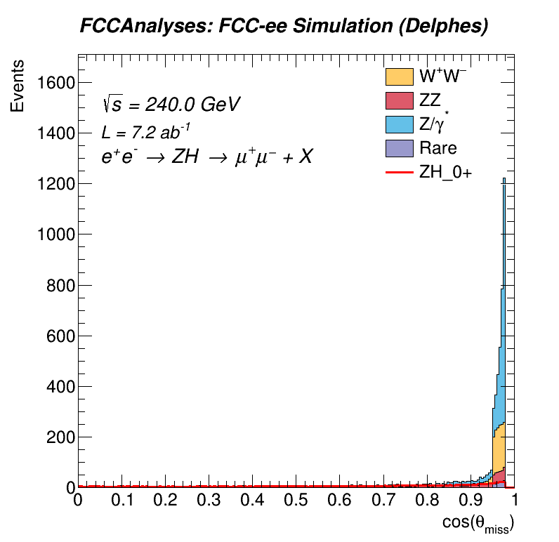
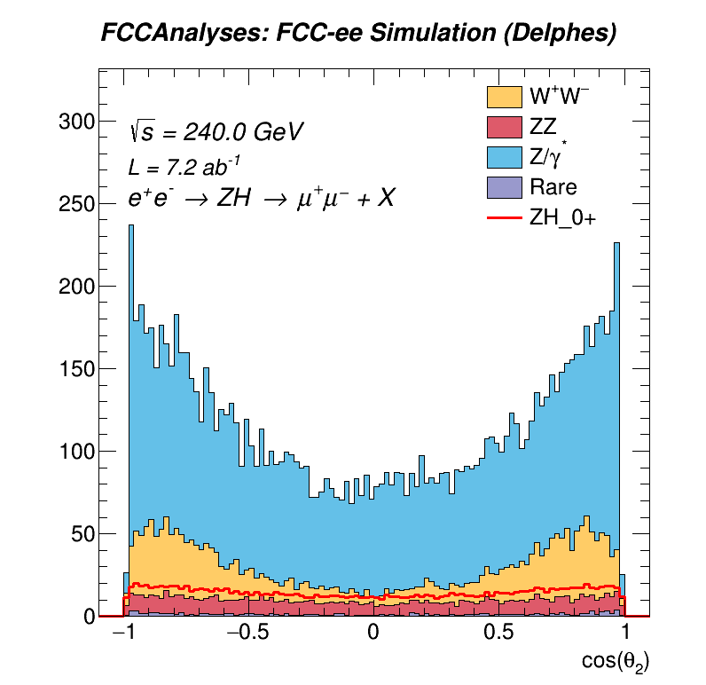
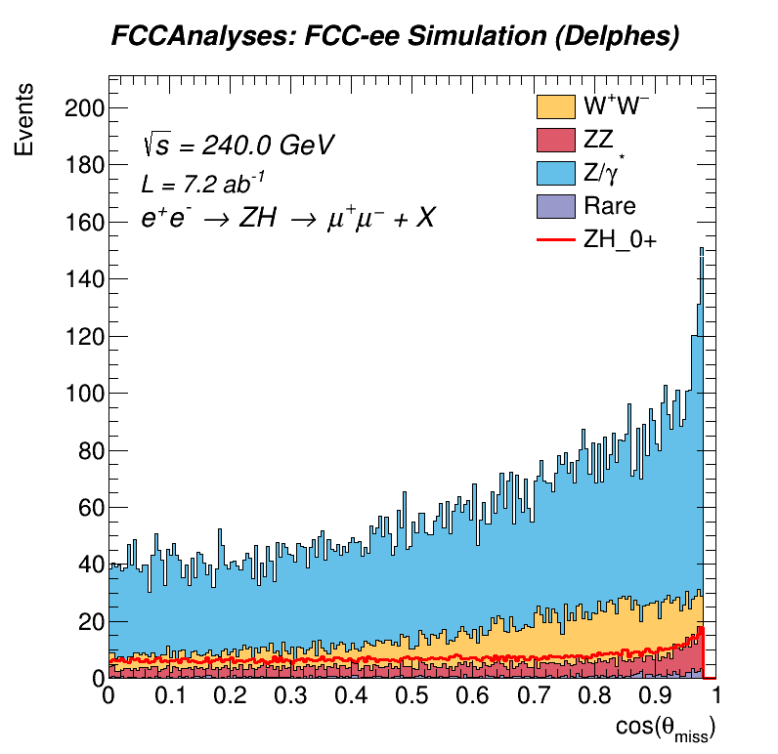
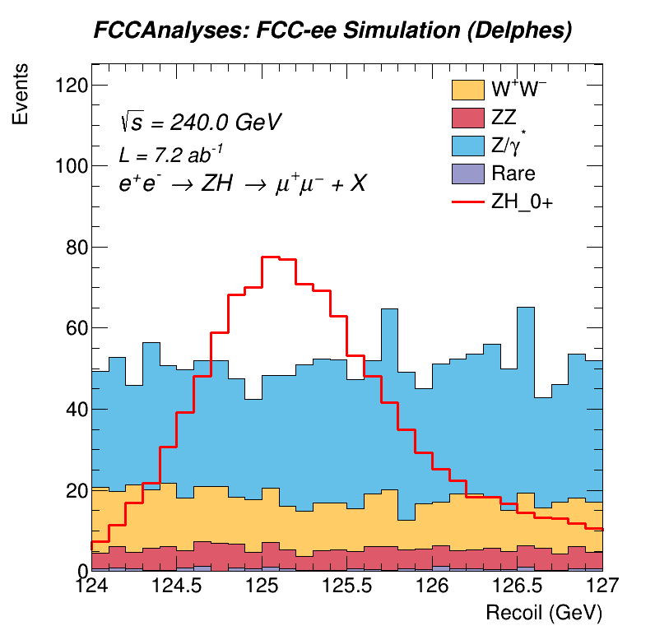
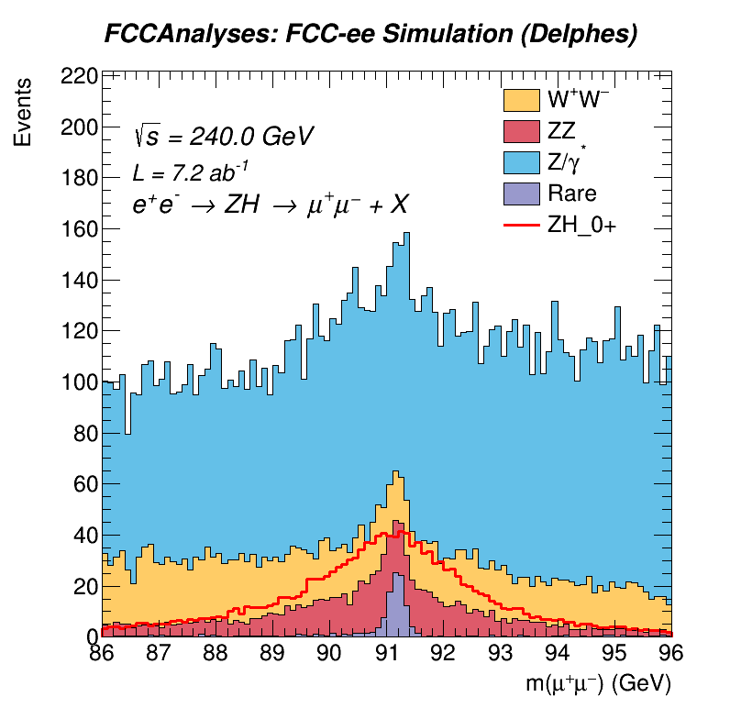
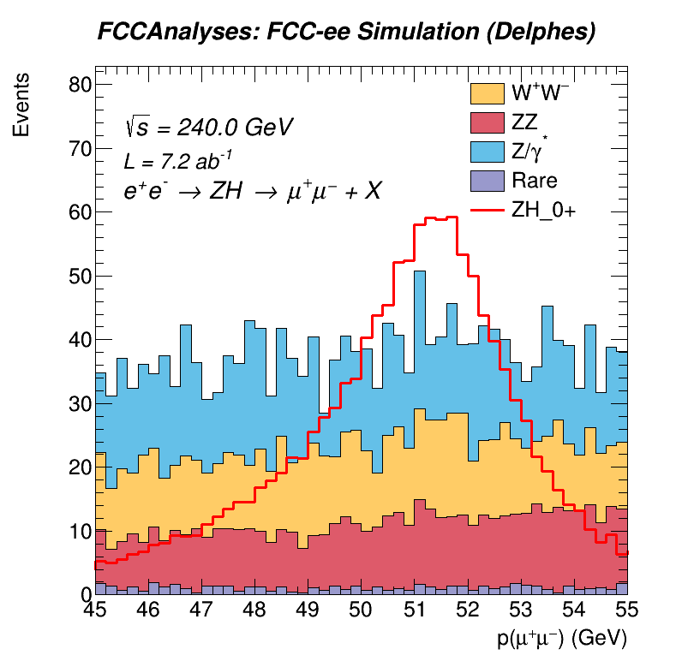
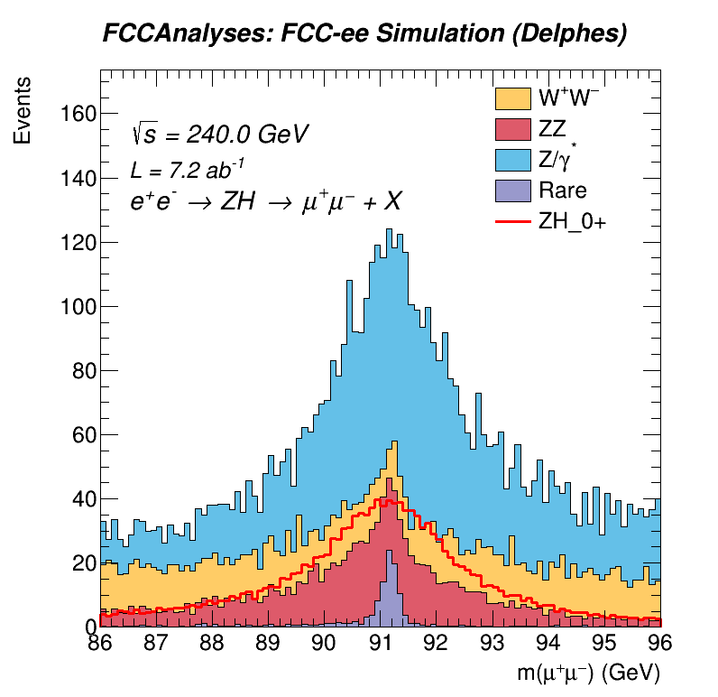
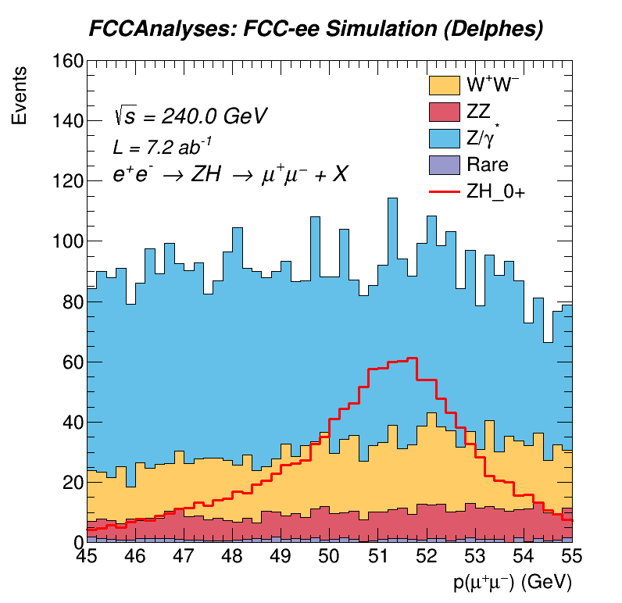
$Events at Cos{θ_{2}}$Endpoints and Correlations to Other Observables:

Slide 9
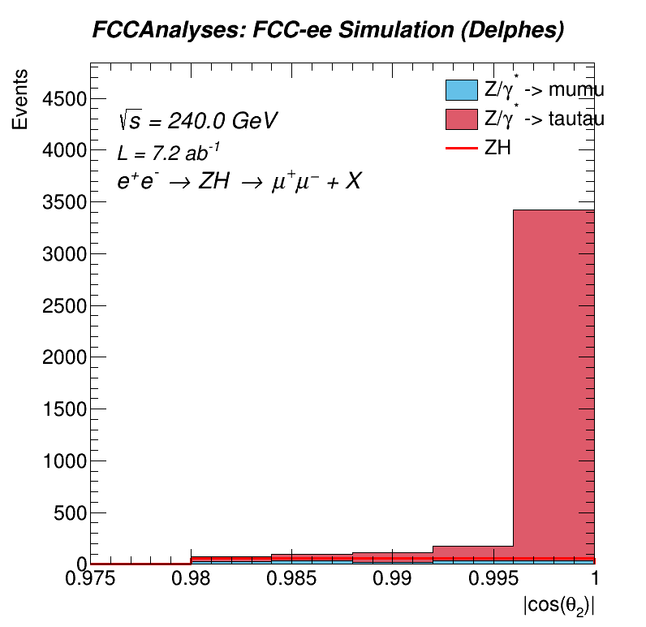
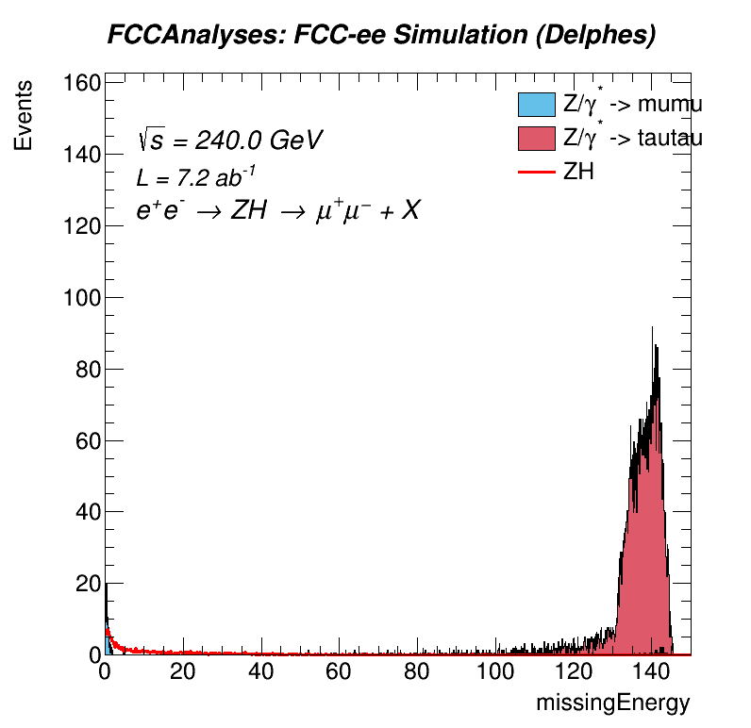
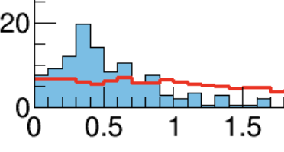
$\operatorname{Cos}{θ_{2}}$ of Z/$γ$* $⟶μμ$and $ττ$:
$μμ$ events are clustered near 0 missing energy.
Horns are nearly all from $ττ$ events. No events in the bins below 0.98.
Missing energy from $τ$ decays into neutrinos.

Slide 10
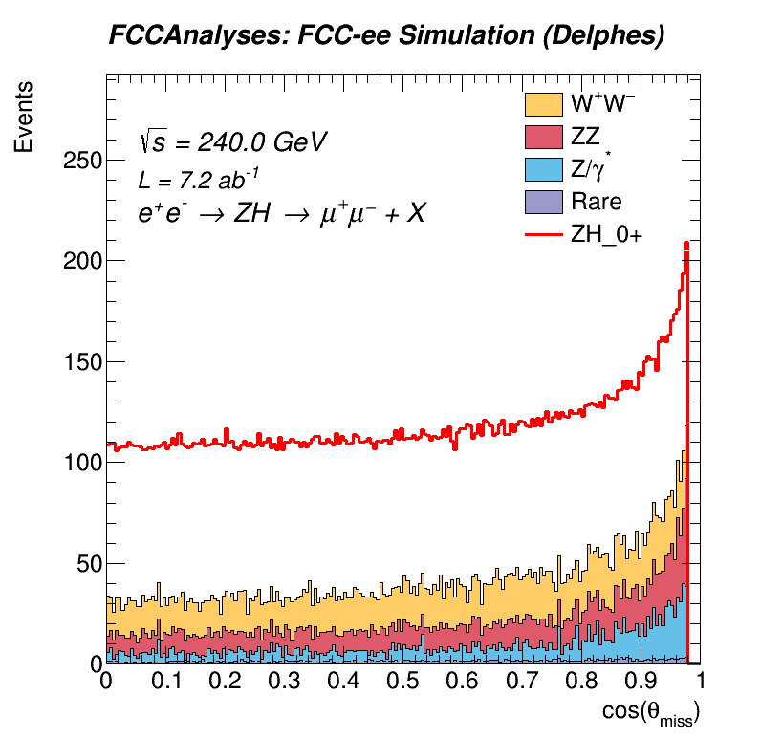
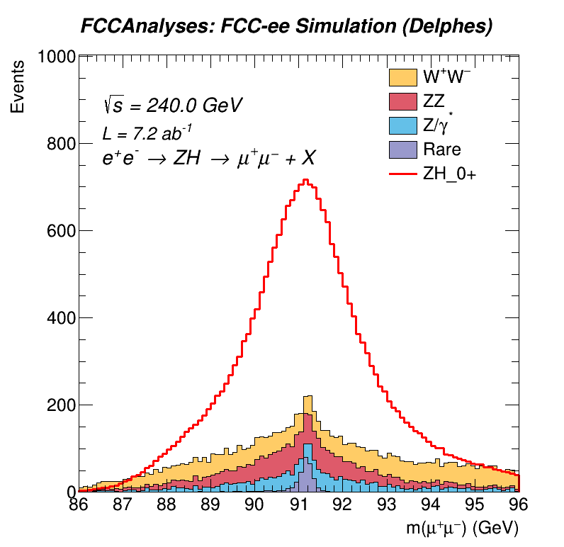
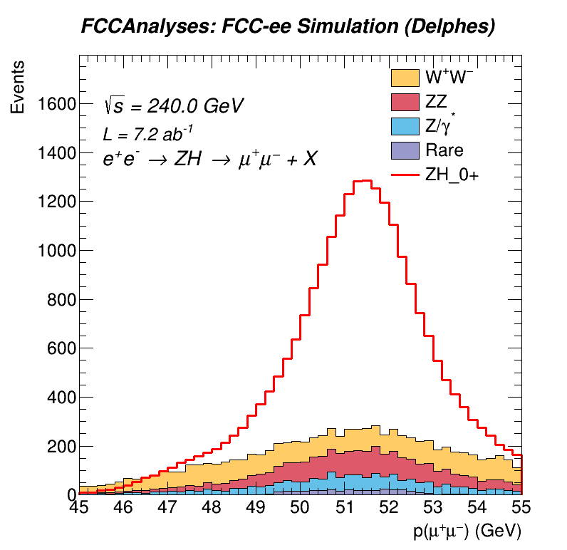
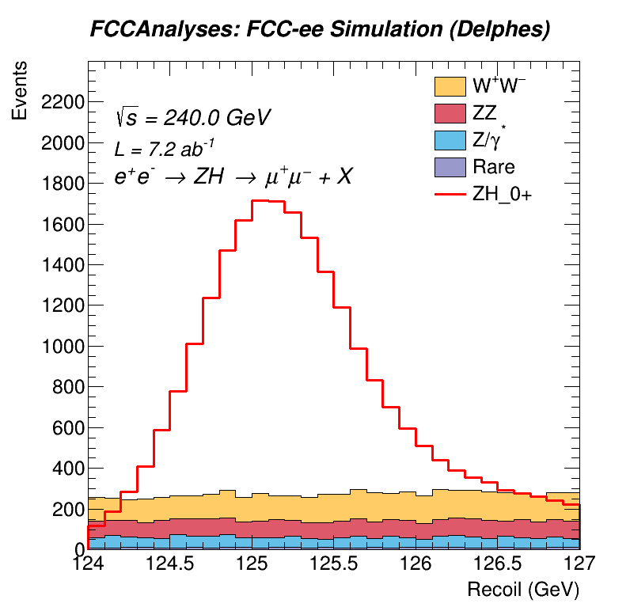
All Cuts Made:

Slide 11
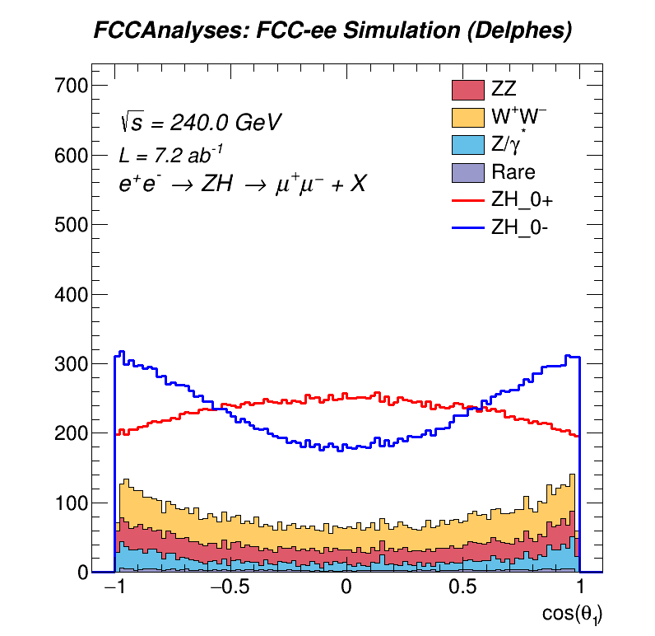
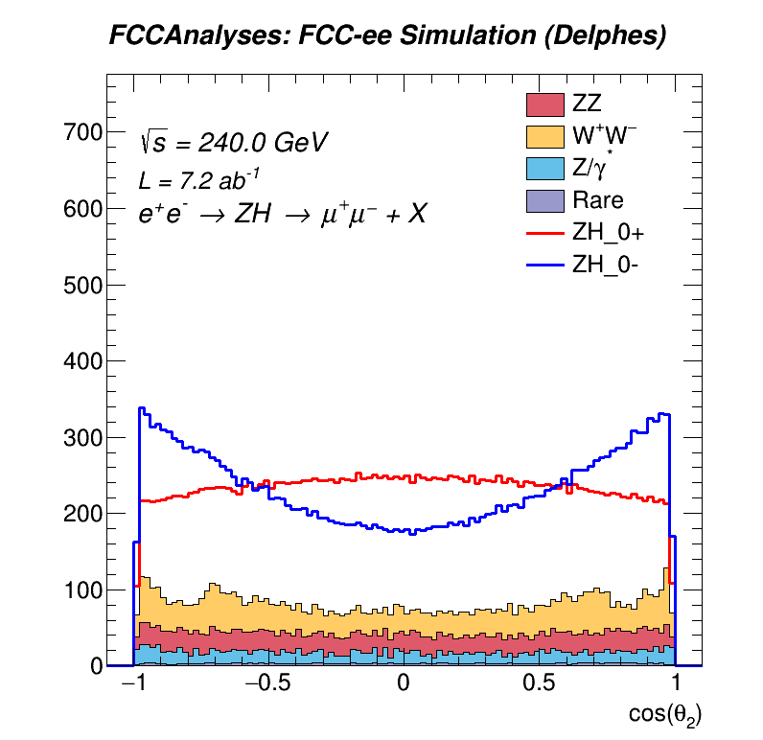
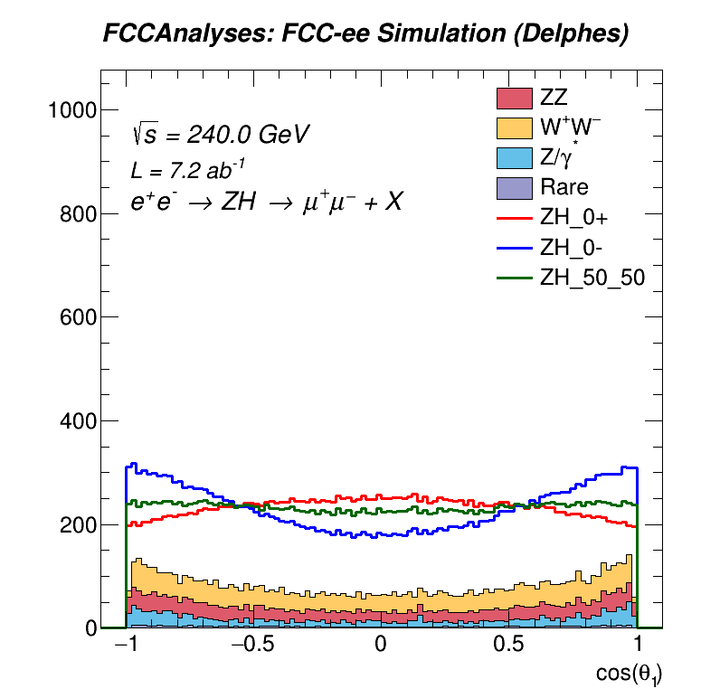
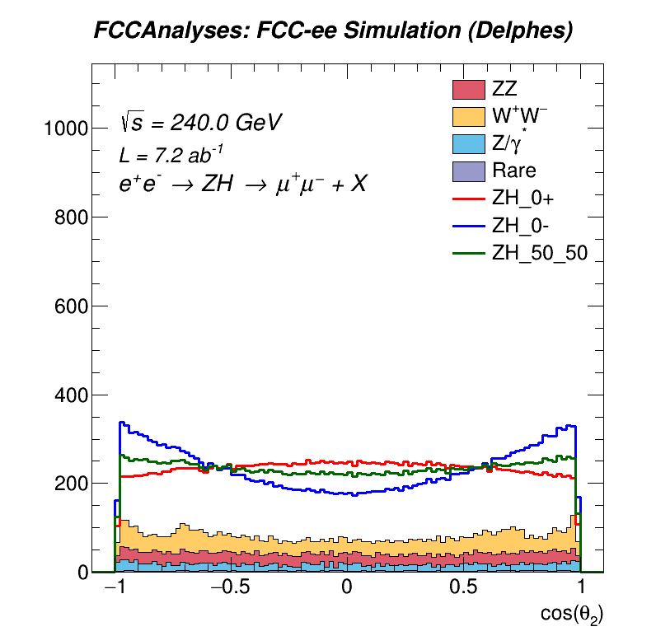
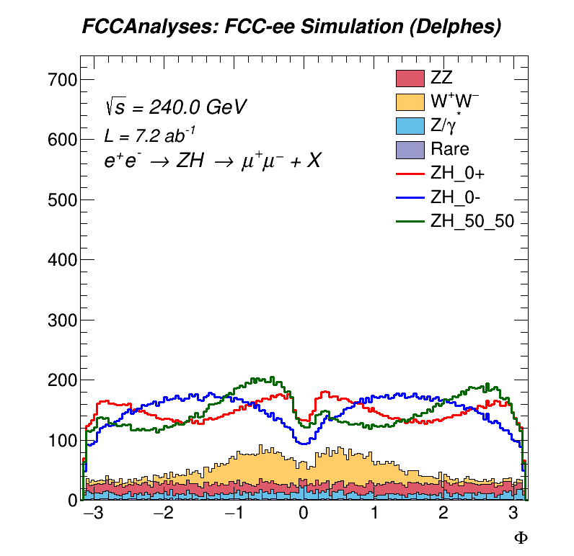
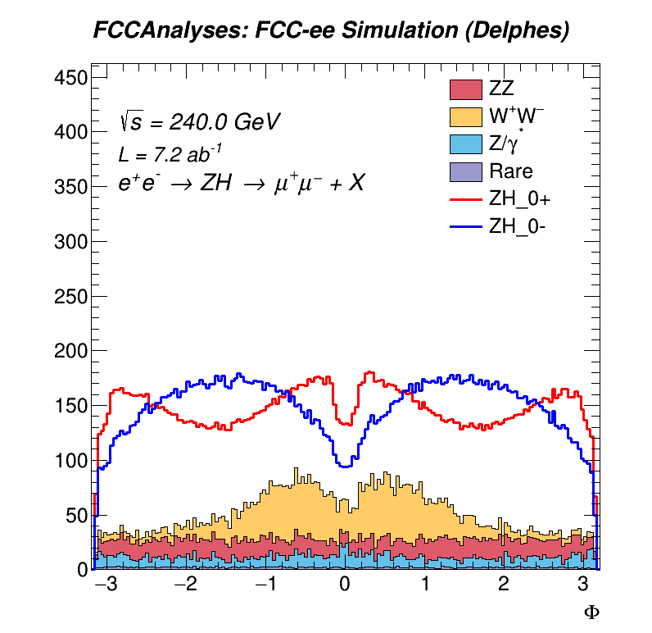
All Cuts Made: Angular Distributions:
Selection effect occurs around $Φ$ = 0.

Slide 12
Comparing Angular Distributions to Snowmass Study:

Slide 13
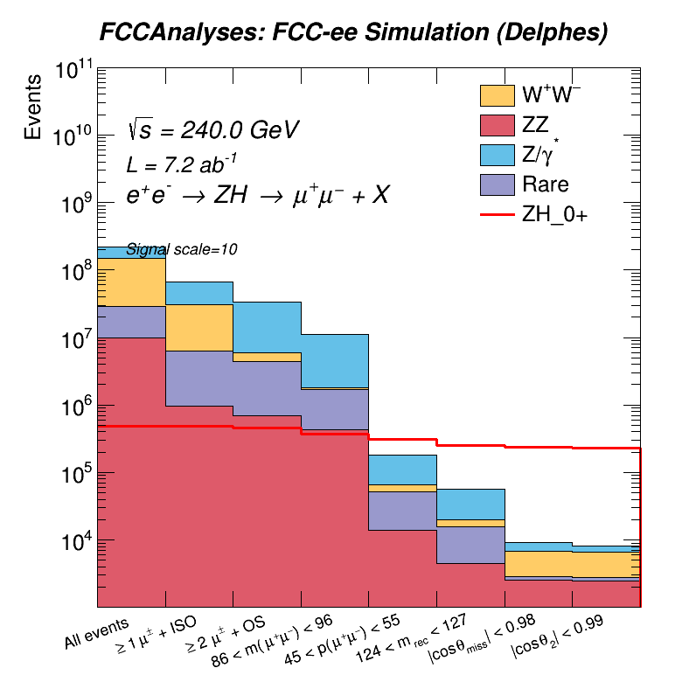
Cut Flow:
Signal Selection Efficiency ~ 47.9%
Signal : Background ~2.5

Slide 14
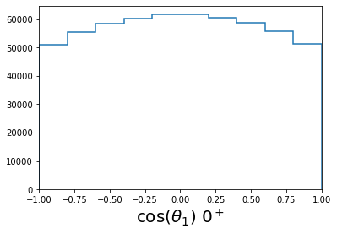
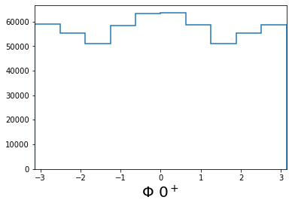
Template Fit Details:
3D histogram filled with 1 angle on each axis. ~55000 entries/bin on average.
10 bins/axis
Example projections for $0^{+}$hypothesis:

Slide 15
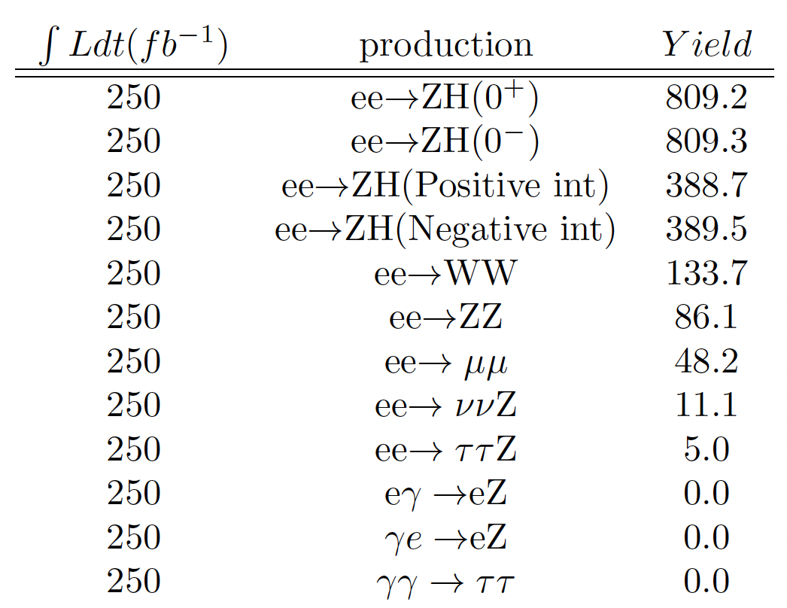
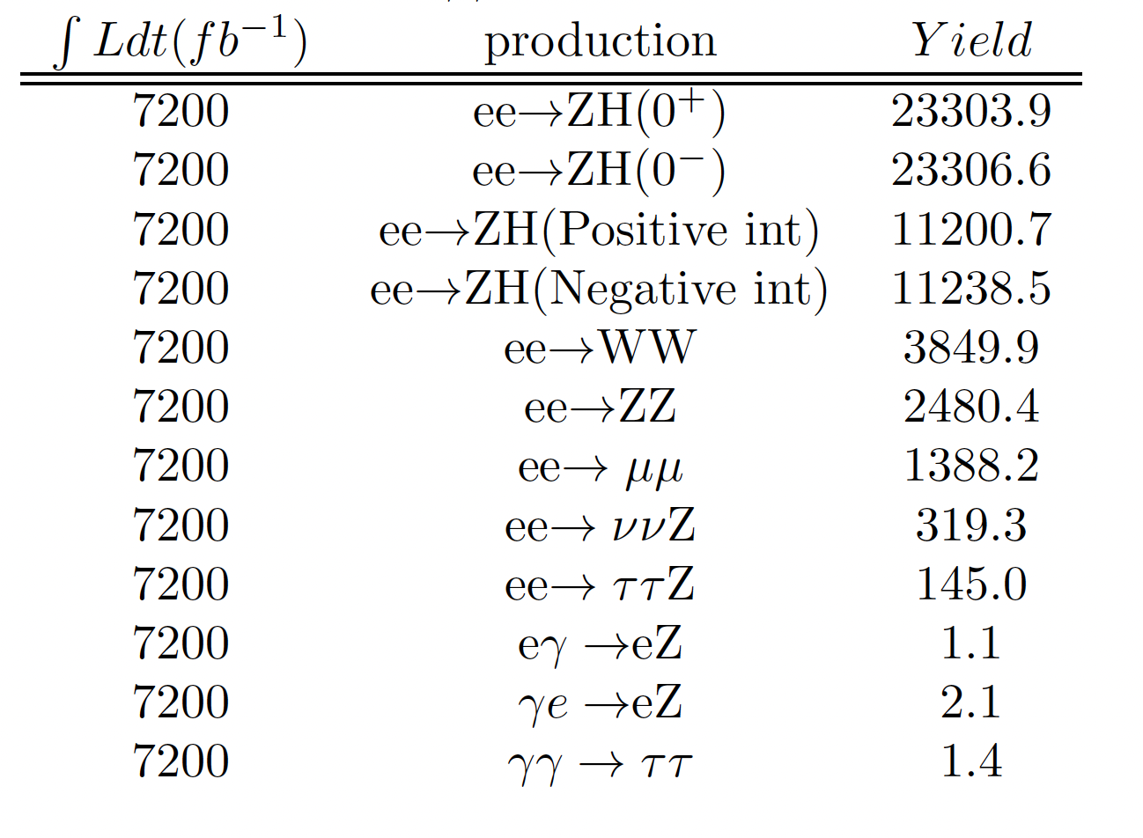
Expected Yields After Reco. + Selection: (Red box = signal yields)

Slide 16
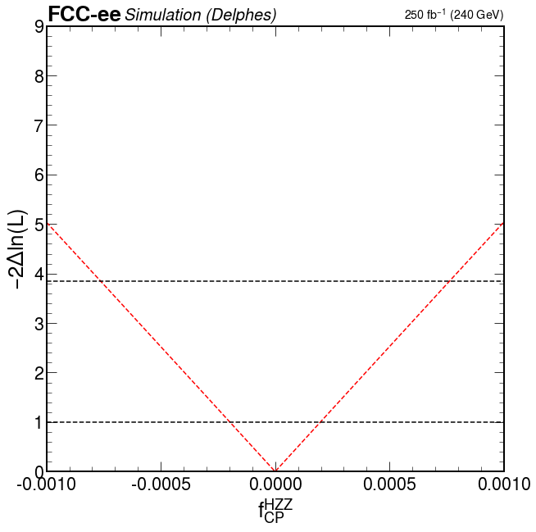
Fits with Reconstructed Signal H $⟶$X, Z $⟶μμ$:
@ 250${fb}^{−1}$
@7200 ${fb}^{−1}$
68% CL ≈ +/- 2.0 E-4
68% CL ≈ +/- 0.7 E-5

Slide 17
MELA:
“Matrix Element Likelihood Approach”
Calculates transition probability from one hypothesis to another using event kinematics.
Used to reweight a distribution in one sample to an alternative hypothesis.
Calculates angular distributions.
Currently interfaced to the FCC framework!

Slide 18
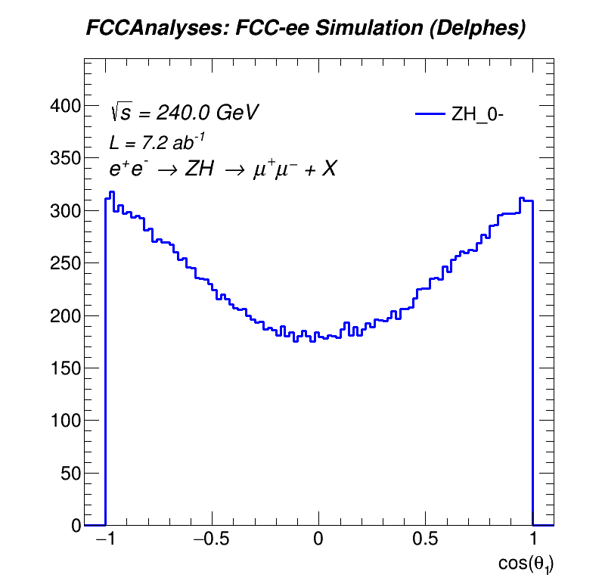
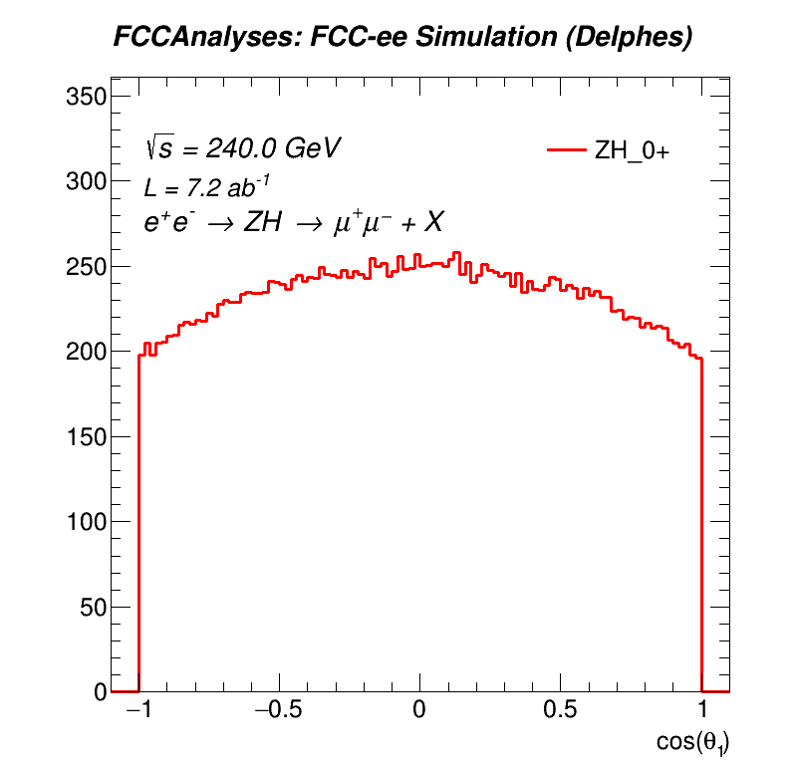
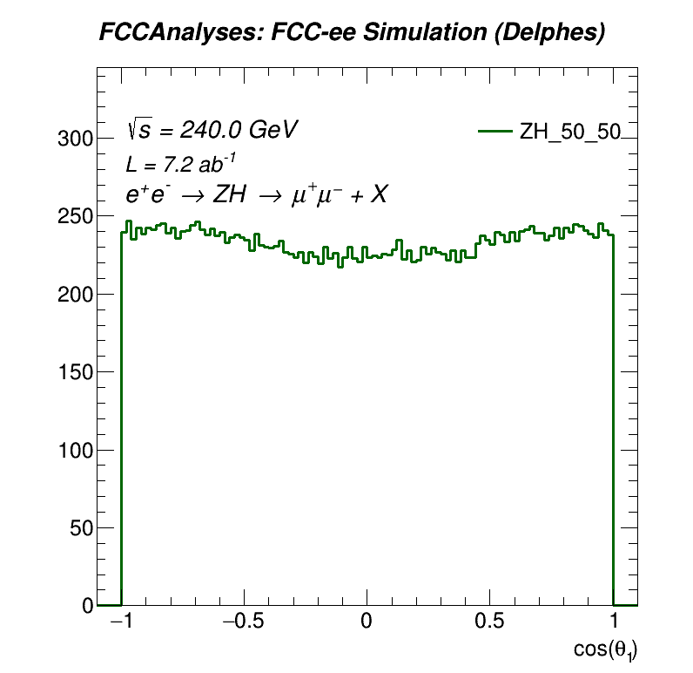
MELA in this study:
Reweighting:
Simulated:
Angular distributions and probabilities calculated by MELA.
Reweights $0^{+}$distribution to $0^{−}$ and 50/50 mixture distributions.

Slide 19
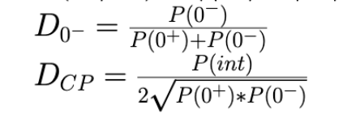
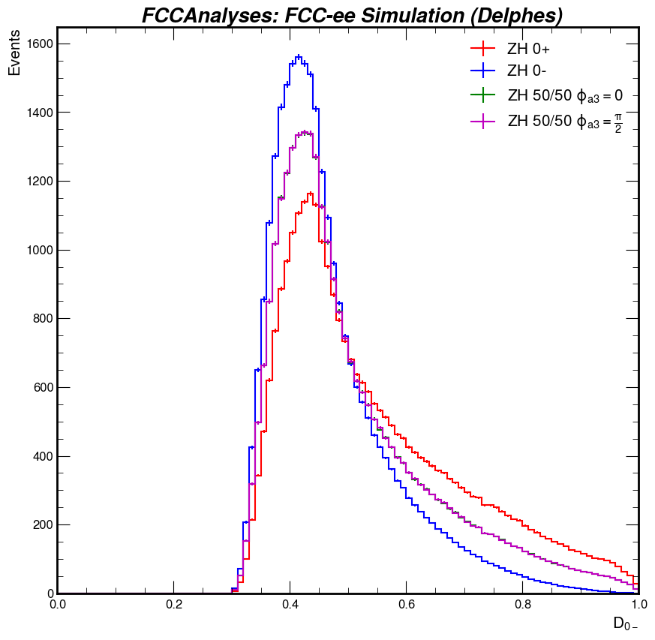
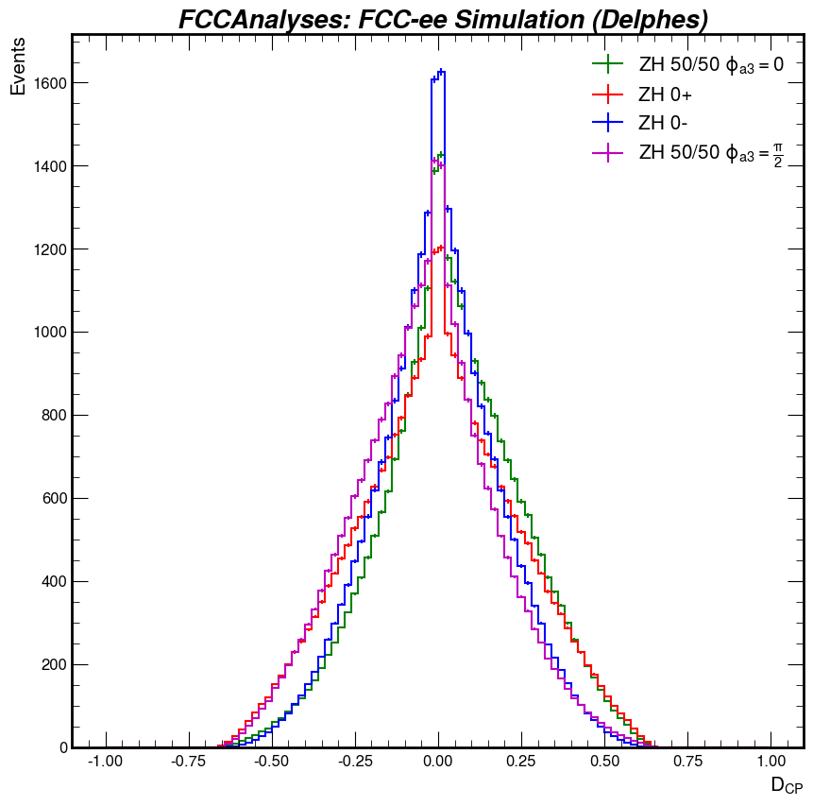
Improving this study with MELA:
Discriminants = Optimal observables from MELA probabilities.
Determine optimal binning, create likelihood fit with $D_{0^{−}, }D_{CP,}$ and $m_{rec}$.

Slide 20
MELA in future studies:
MELA can probe couplings besides $f_{CP}^{HZZ}.$
$f_{CP}^{HZγ∗}$ , $f_{CP}^{Hγ∗γ∗}$studies also possible within FCC framework.
$$e^{−}$$
$$H$$
$$e^{−}$$
$$H$$
$$γ^{∗}$$
$$γ^{∗}$$
$$e^{+}$$
$$Z$$
$$e^{+}$$
$$γ^{∗}$$

Slide 21
Conclusions:
Likelihood fit from angular distributions represents a realistic constraints on $f_{CP}^{HZZ}$.
MELA functional within FCC framework.
Pending review to be officially incorporated.
Update to this study using discriminants in the works!
Plans to extend this study:
$Z→e^{+}e^{−}$ final state
Alternative couplings: $f_{CP}^{HZγ∗}$ , $f_{CP}^{Hγ∗γ∗}$

