Slide 1
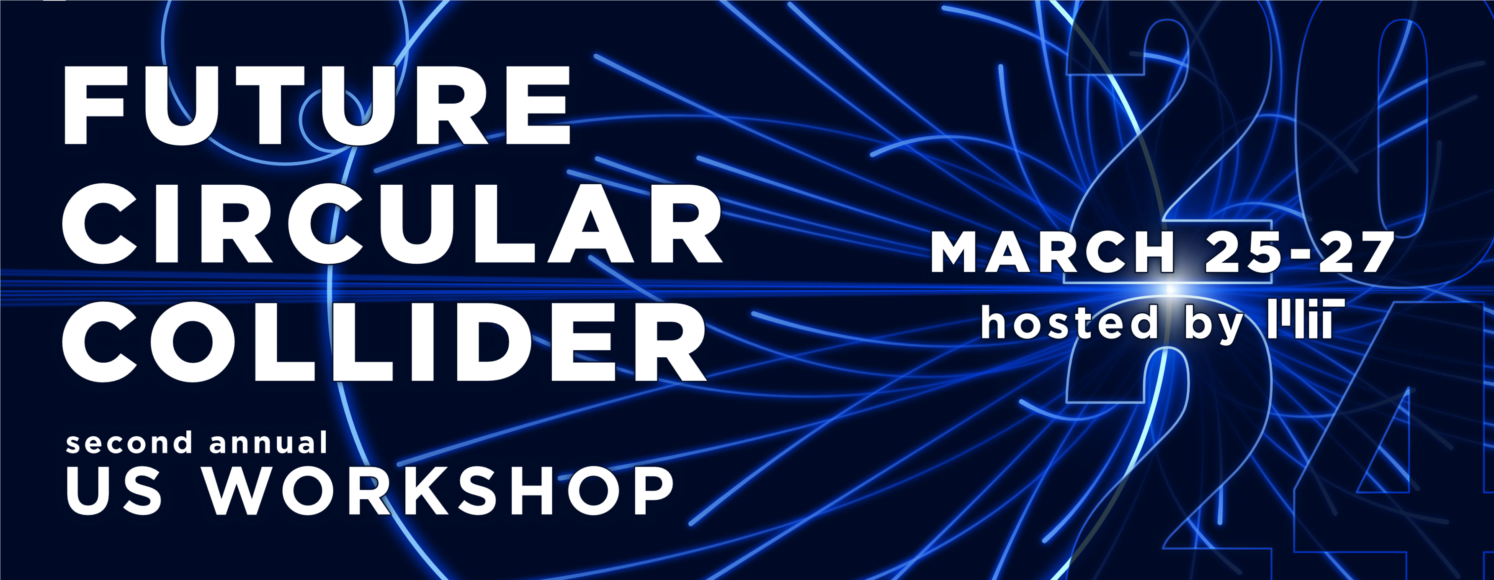
Design by Jordan Lang
Closeout
Christoph Paus
March 27, 2024
Participants: 210

Slide 2
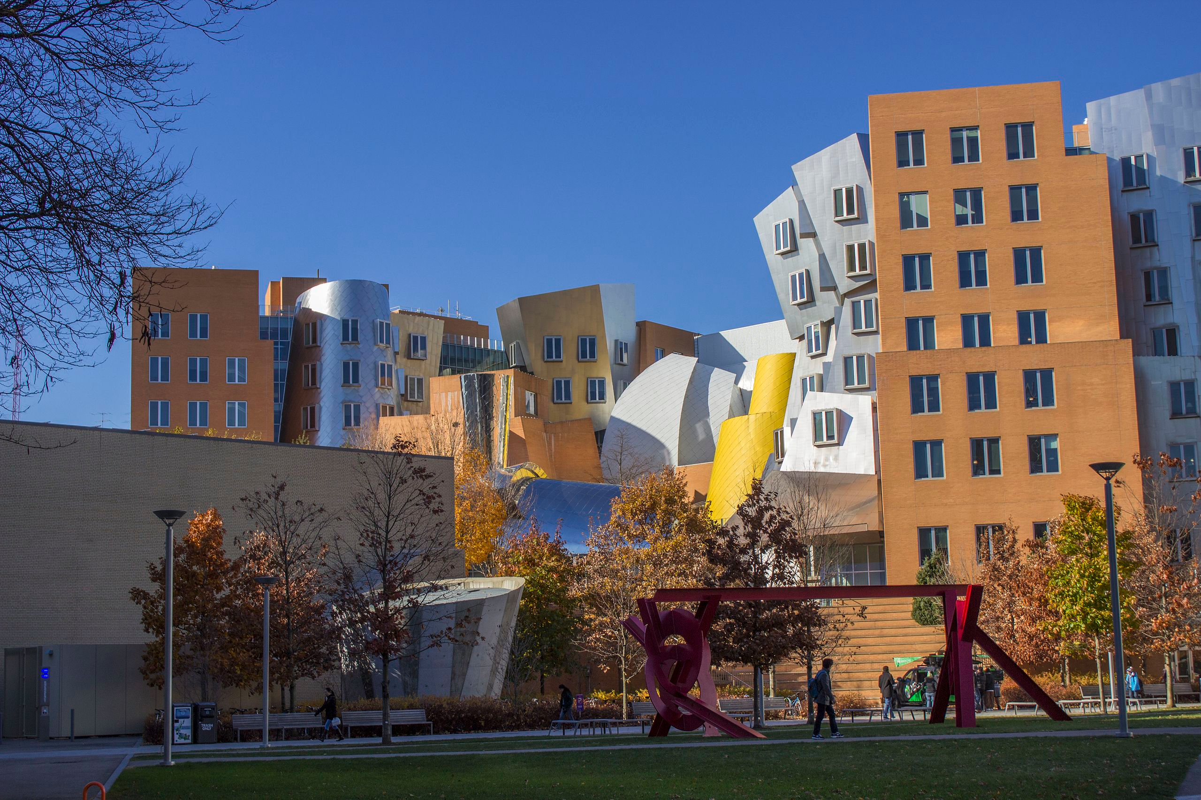

Slide 3
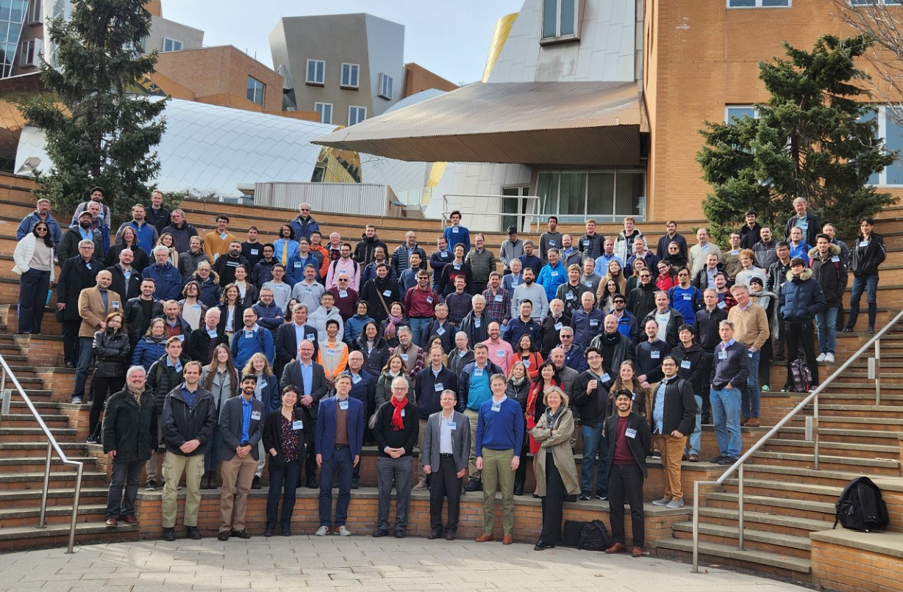
Annual US FCC Workshop 2024 hosted by MIT

Slide 4
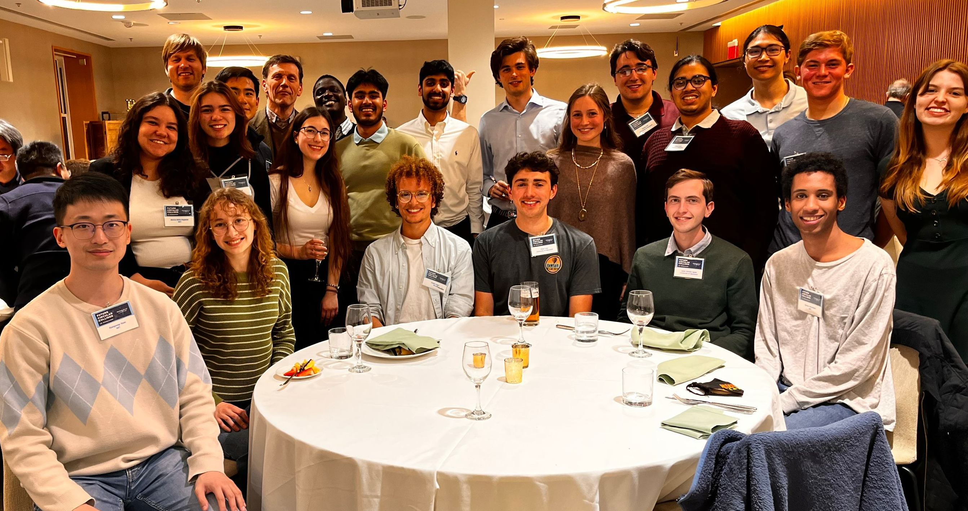
Annual US FCC Workshop 2024 hosted by MIT

Slide 5
Goals for the Workshop
P5 report – offshore Higgs factory
US must make a strong impact on the Higgs factory
Build up an active US FCC community
Accelerator development essential to help FCC-ee design
But detectors are the key for the physics
Develop our own ideas about the physics focus of a detector
What is the way to optimize a detector?
Given a physics goal, where do we spend the money?
Make sure we can ask for R&D funding in a coherent fashion
Synergy with linear collider folks very important
Plenary session today, invited plenty of people

Slide 6
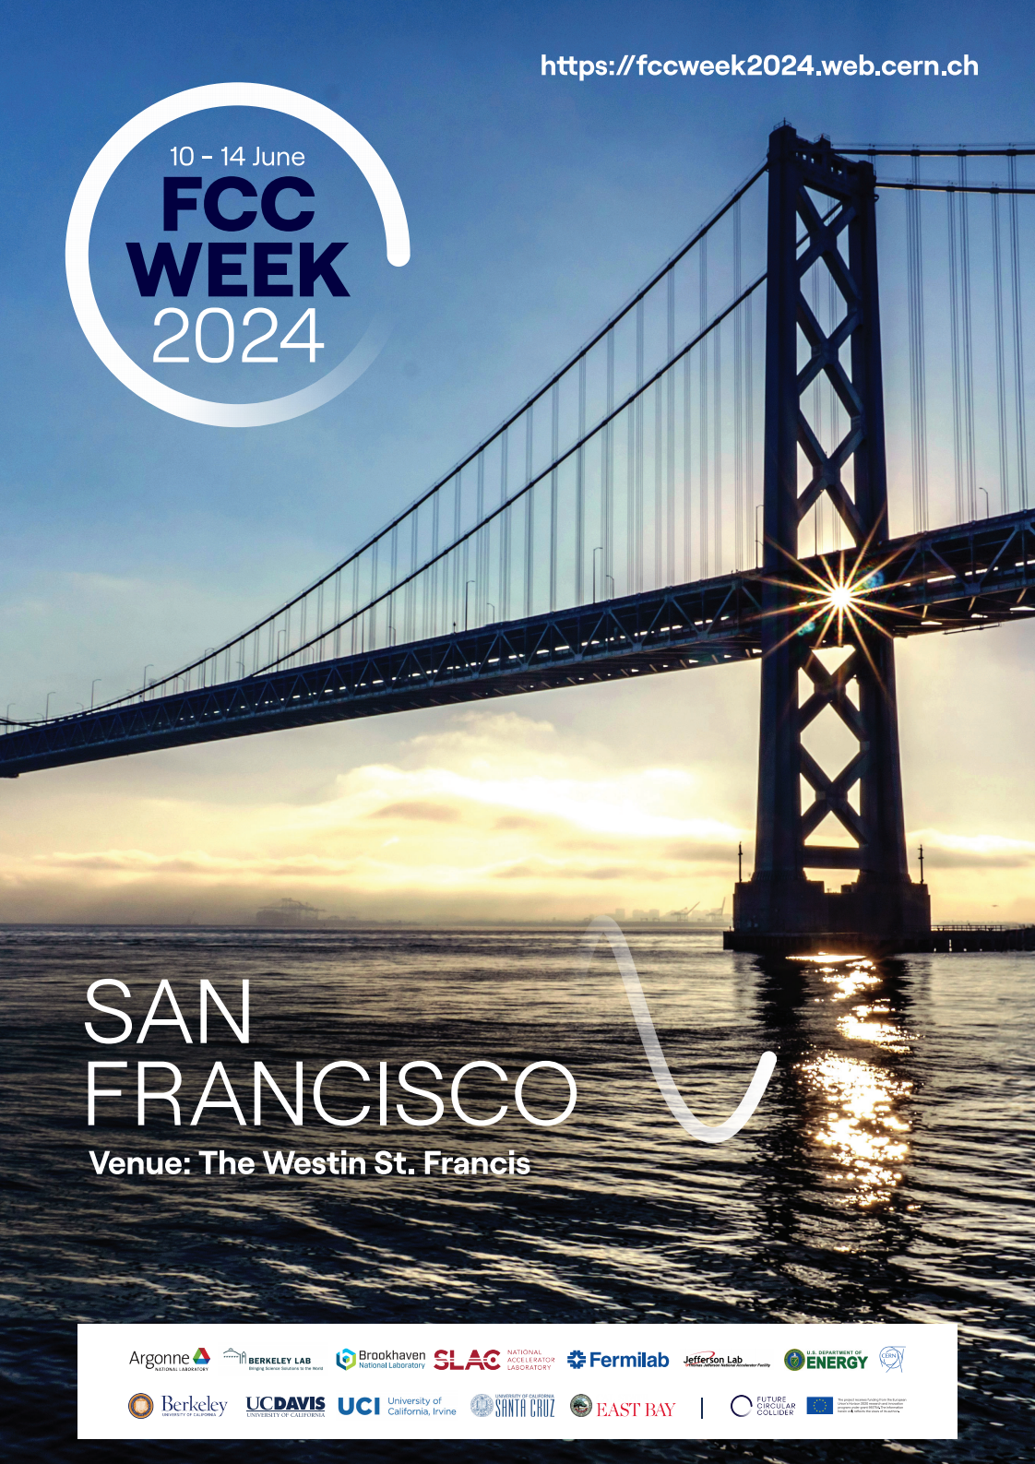
… on to
San Francisco
Seed has been sawn
‘We must water it’
Keep our momentum and enjoy the work on this exciting project
We have much to discuss
Bring your wind breakers to San Francisco it is beautiful, but the wind is brisk

Slide 7
Thank you!
To
All the speakers
Plenary and Parallel,
and
all participants.

Slide 8
Thank you!
To
DOE/BNL,
MIT Physics Department, and
MIT Lab for Nuclear Science
for funding this event.
The money was well spent, mostly to support graduate students and undergraduates to participate in the event.

Slide 9
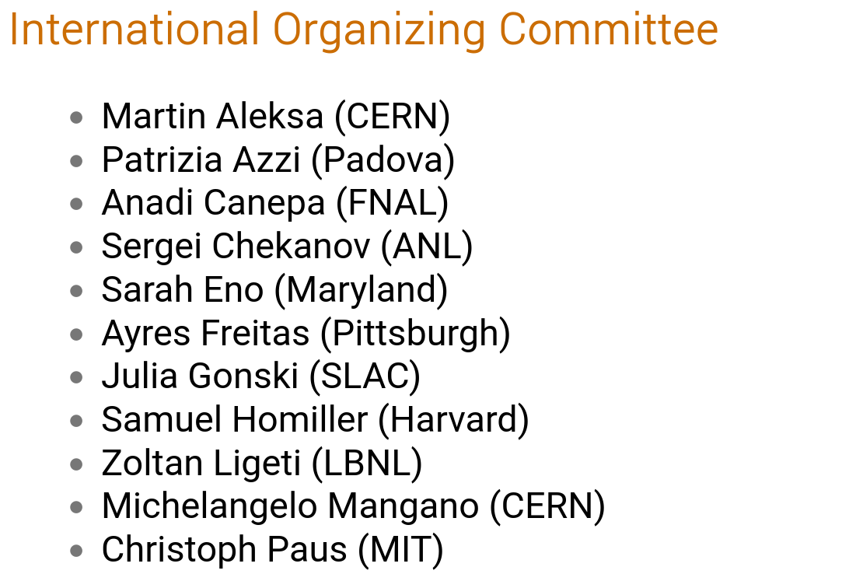
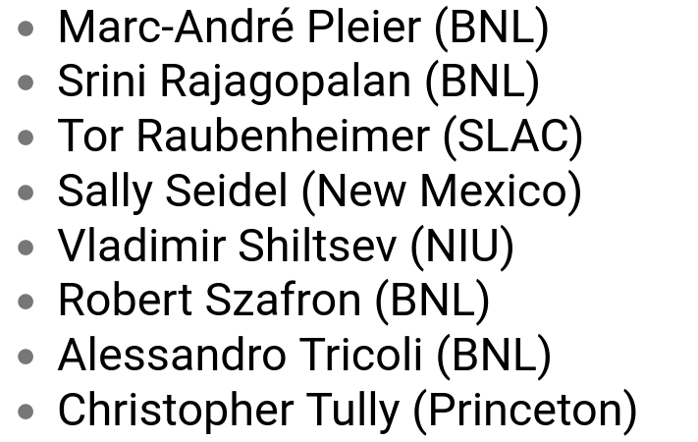
Thank you!
The preparation work was a great experience:
constructive and positive

Slide 10
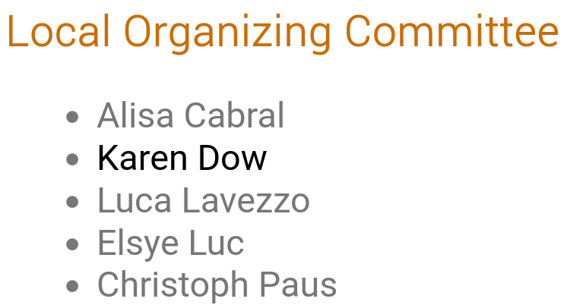
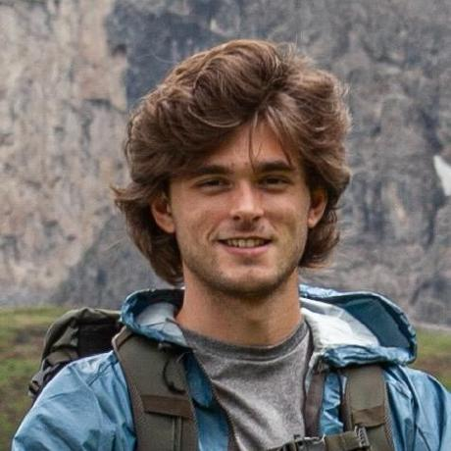
Thank you!
This team has been amazing.
Anything that went wrong was on the last person on the list...

Slide 11
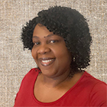
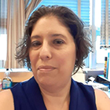
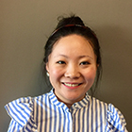
Thank you!
Elsye Luc
Alisa Cabral​
Thank you for being so engaged and
making this a success!
Lily Xu

Slide 12
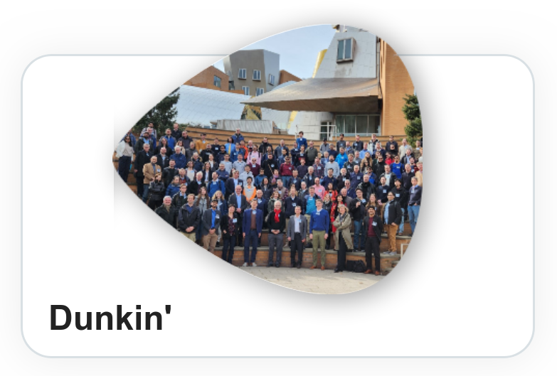
Design by Jordan Lang
Thank you, Alisa
for the marvelous organization!

Slide 13
Design by Jordan Lang
Thank you, Elsye
for the marvelous organization!

Slide 14
Design by Jordan Lang
Thank you, Lily
for stepping in and
helping us out!

Slide 15
Design by Jordan Lang
Thank you, for coming, safe travels!

