Slide 1
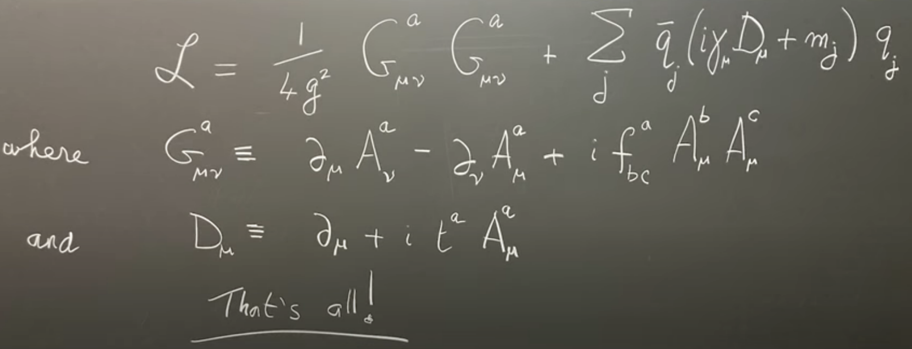
Studying QCD and Beyond with Electron Scattering
QCD Lagrangian
How does the spin-1/2 proton with mass 938 MeV/c² arise?

Slide 2
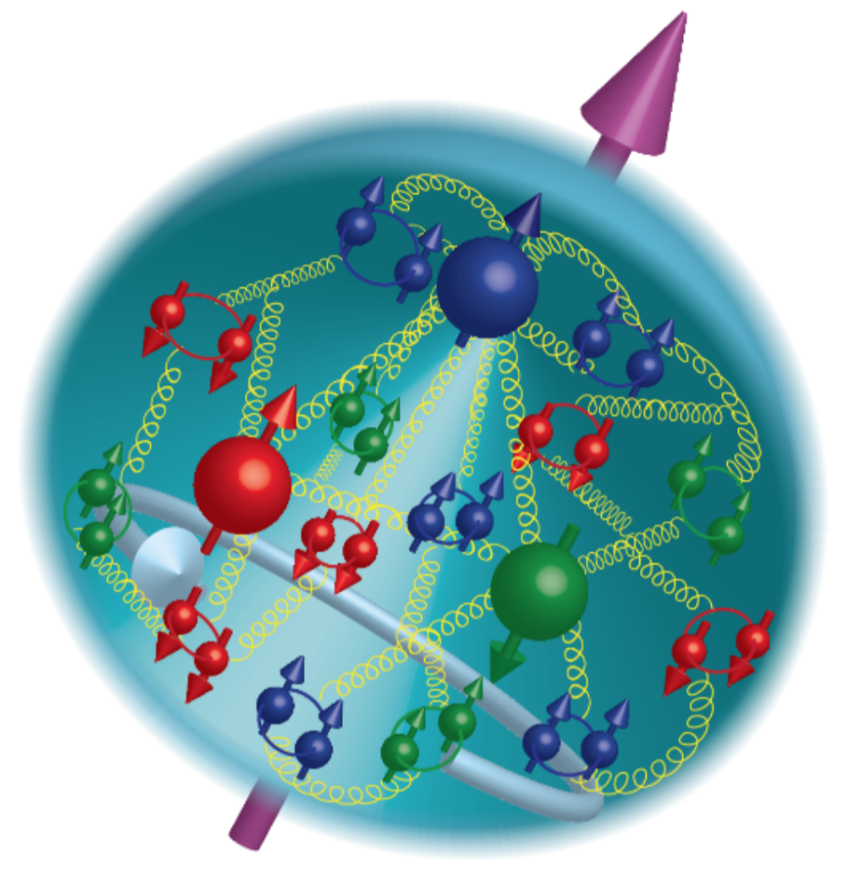
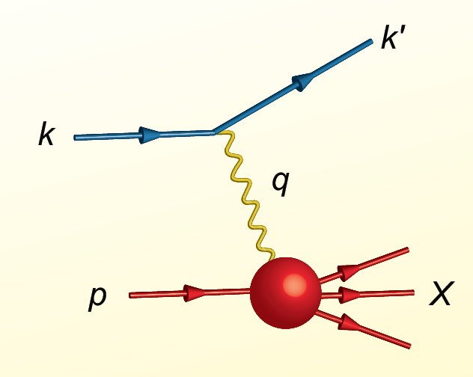
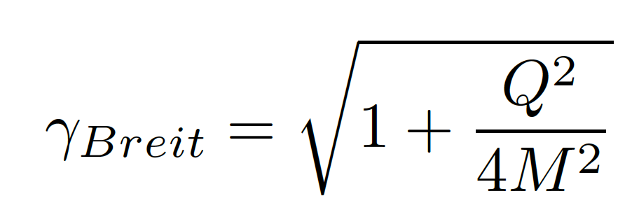
Proton Viewed in High Energy Electron Scattering: 1 Longitudinal Dimension
Proton is smashed into pieces!
Viewed from boosted frame,
length contracted by
Internal motion of the proton’s constituents is slowed down by time dilation – the instantaneous charge distribution of the proton is seen.
In boosted frame x is understood as the longitudinal momentum fraction
valence quarks: 0.1 < x < 1
sea quarks: x < 0.1
Lorentz Invariants
E²_{CM} = (p+k)²
Q² = -(k-k’)²
x = Q²/(2p•q)
J. Bjorken, SLAC-PUB-0571
March 1969

Slide 3
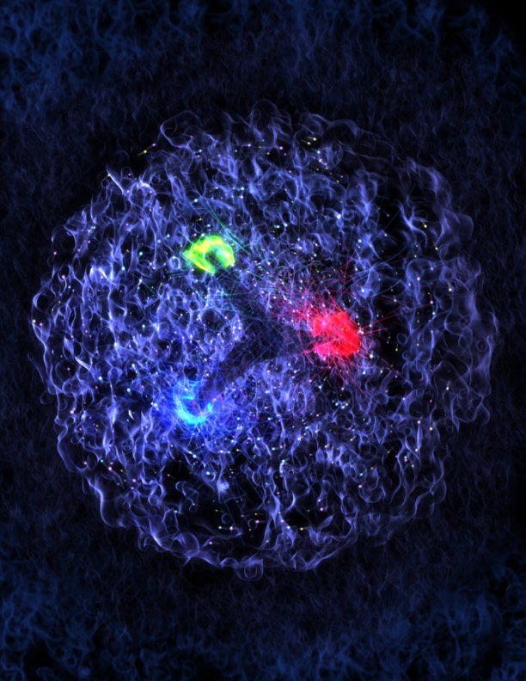
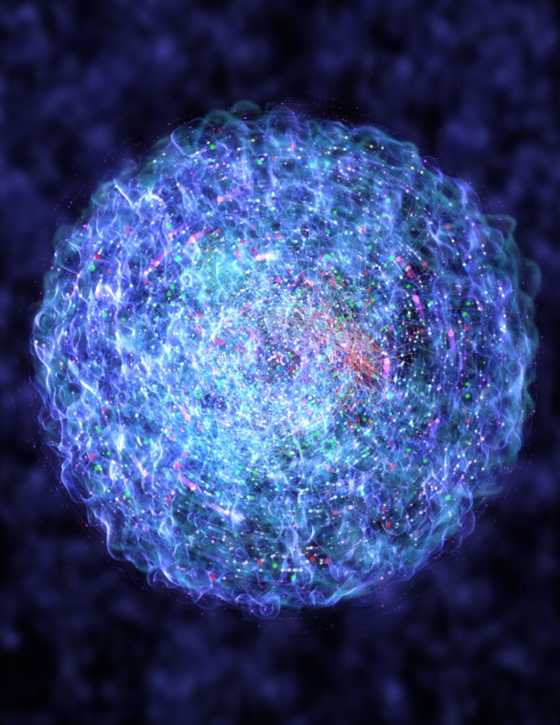
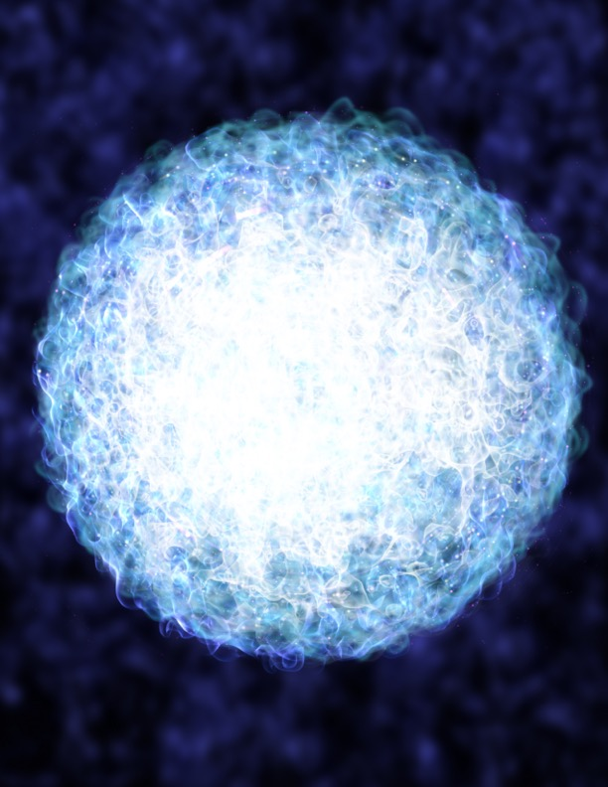
Quark and Gluon Dynamics Dominate Proton Structure
High x ~0.3
Medium x ~ 10⁻²
Low x ~10⁻⁴

Slide 4
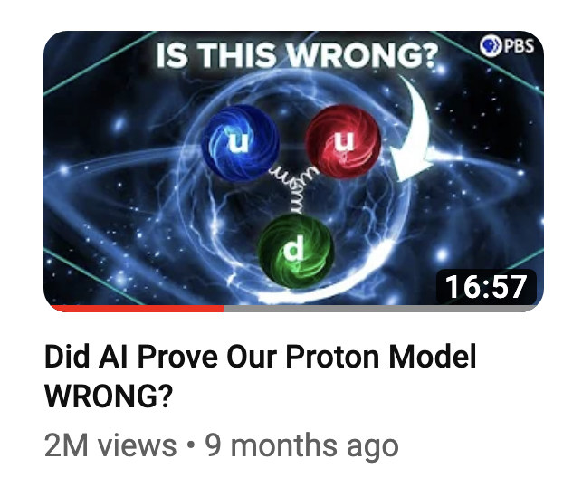
Quark and Gluon Dynamics Dominate Proton Structure
PBS Space Time
High x ~0.3
Medium x ~ 10⁻²
Low x ~10⁻⁴

Slide 5




Charting the Inner Structure of the Proton
https://www.youtube.com/watch?v=G-9I0buDi4s
Christopher Boebel
Rolf Ent
James LaPlante
Joseph McMaster
Richard Milner
Notes:
This video is motivated by the desire to explain the structure of matter, as physicists understand it at present. Studying how the visible matter in the universe is constructed from elementary constituents is a major subfield of science internationally. In the United States, there are two flagship user facilities supported by the Office of Nuclear Physics of the U.S. Department of Energy at Long Island, New York and at Newport News, Virginia where the quark and gluon structure of nuclei is studied in experiments that use large detectors. A major new accelerator, the Electron-Ion Collider (EIC), is being developed in the U.S. for this research and it is anticipated that EIC will start operation in the 2030s.

Slide 6
Proton Viewed in High Energy Electron Scattering: 1 Longitudinal Dimension

Slide 7

Proton Tomography: 2 New Dimensions Transverse to Longitudinal Momentum
Deeply virtual exclusive processes
where proton is left intact
Structure mapped in terms of
b_{T} = transverse position
k_{T} = transverse momentum
Nuclei!
Goal:
Unprecedented
21st Century Imaging
of Hadronic Matter
Direction of longitudinal
momentum normal to
plane of slide
Valence Quarks: JLab 12 GeV
Sea Quarks and Gluons: EIC

Slide 8
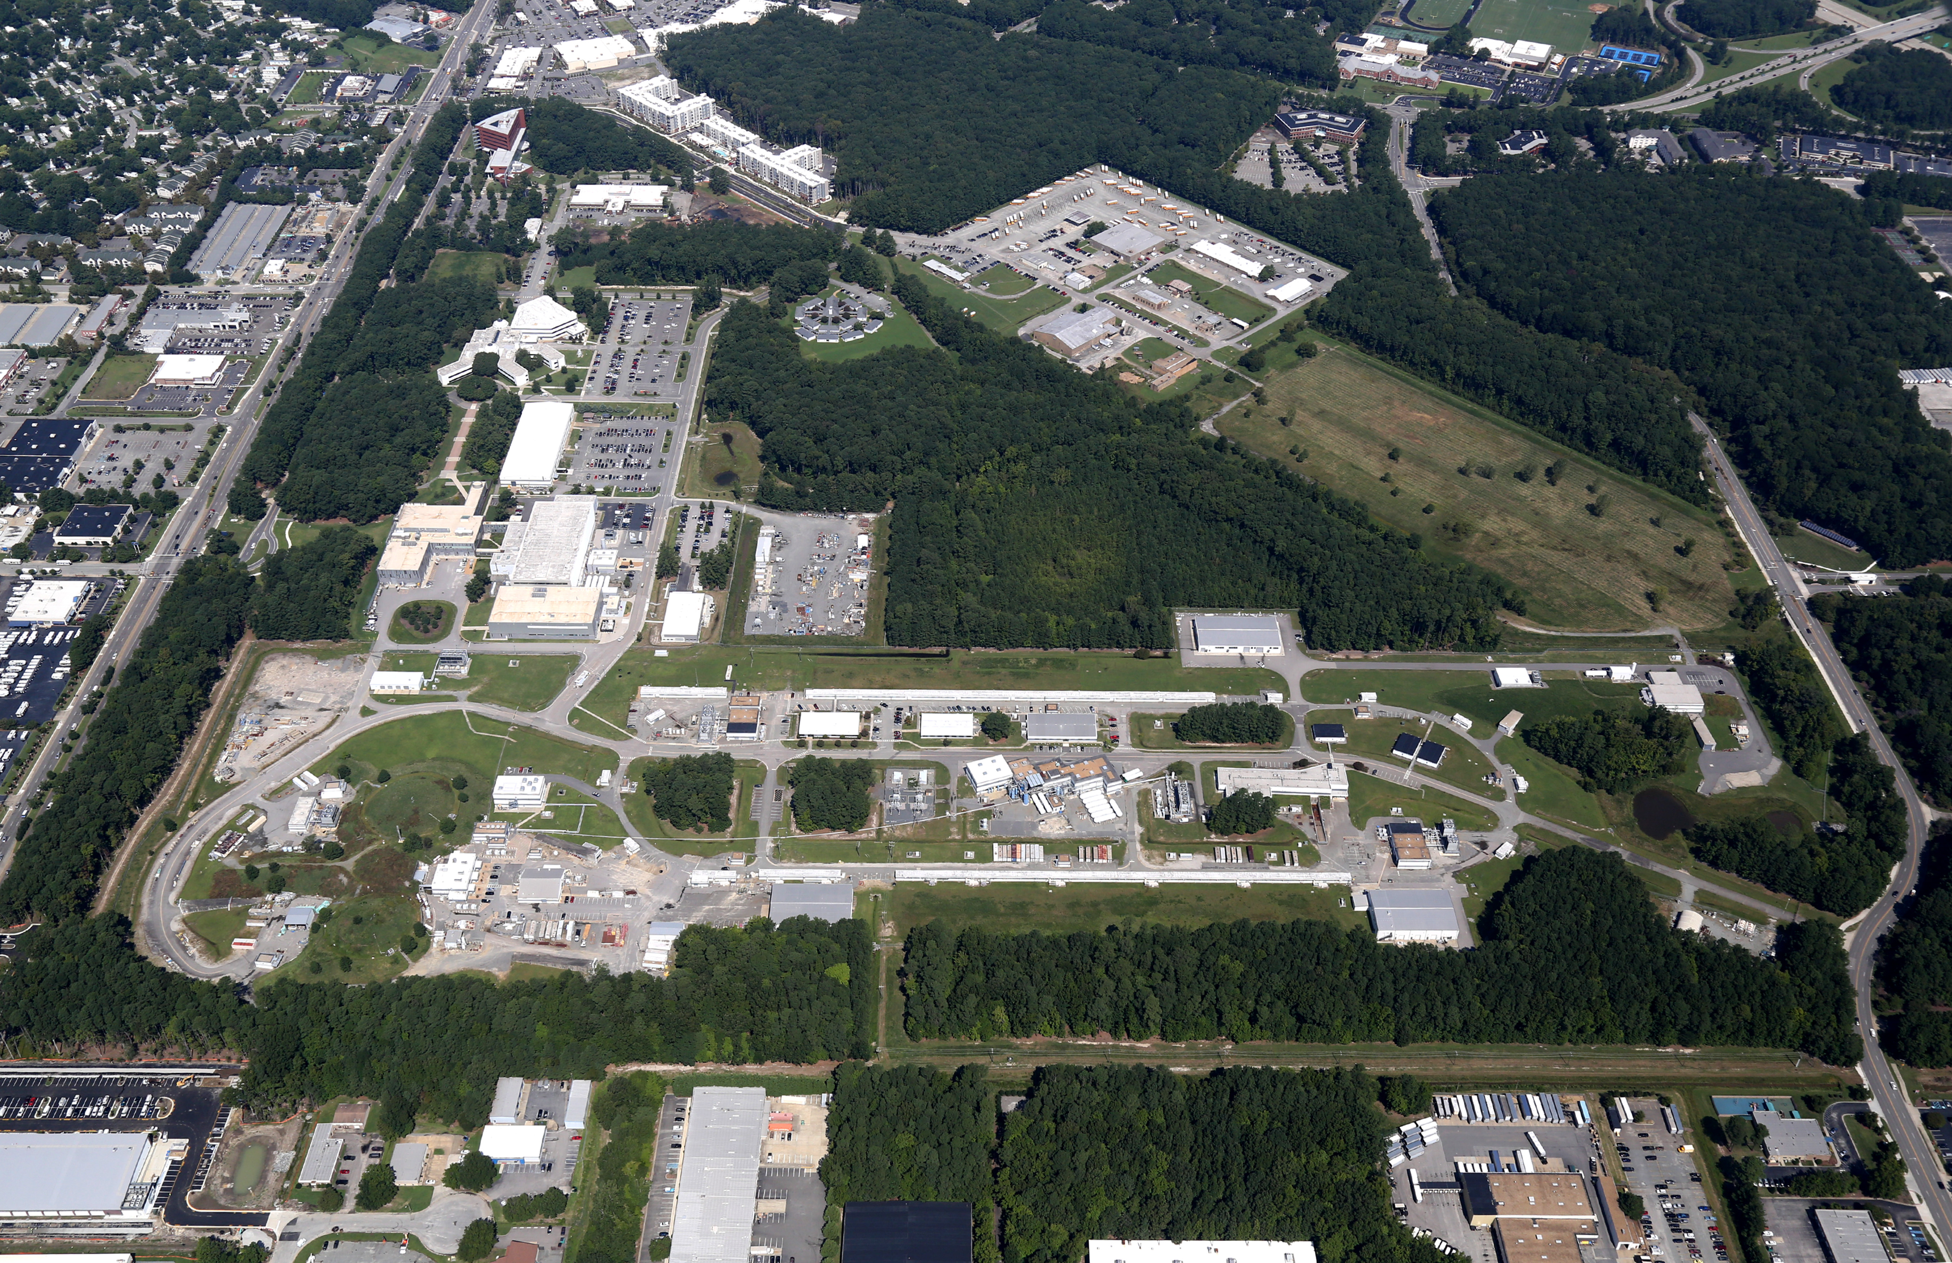

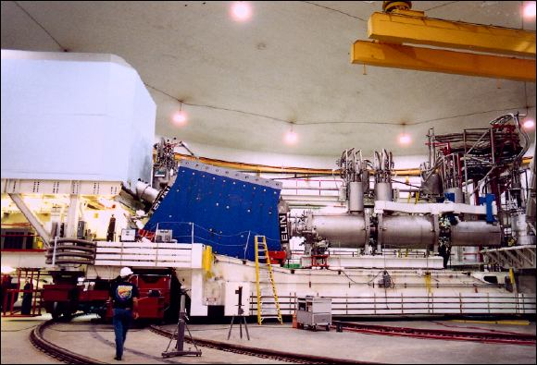

Slide 9
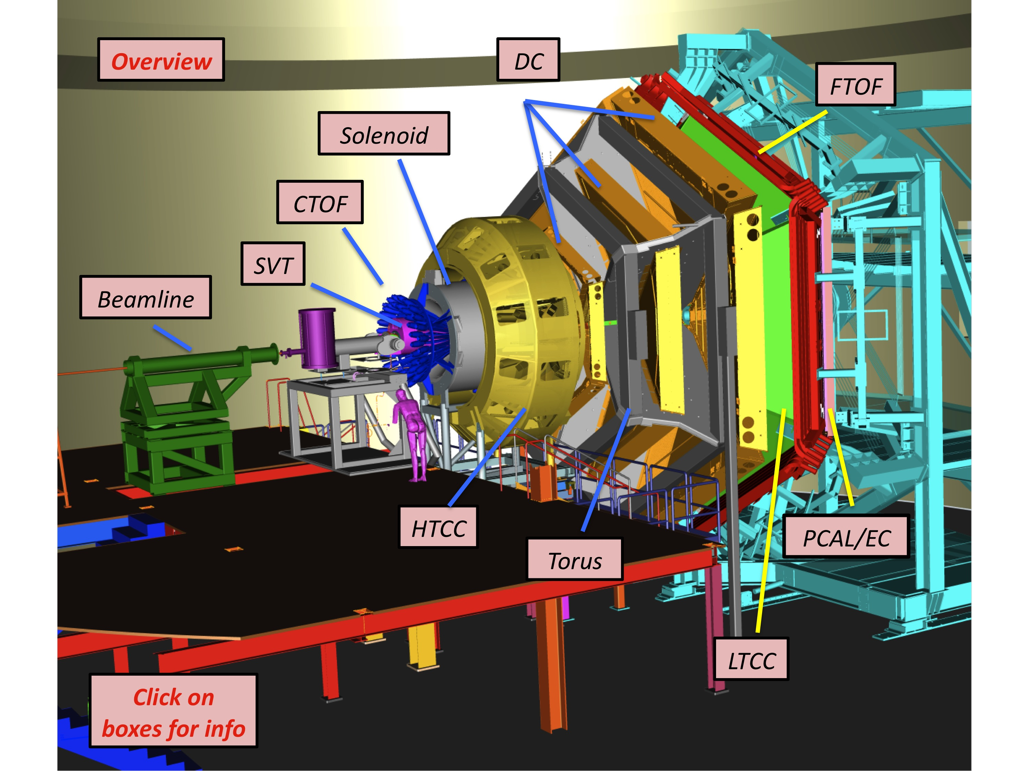
CLAS12
Deeply Virtual Processes
Access to new Generalized Parton Distributions
Our group is a member of the CLAS12 collaboration at Jefferson Lab, VA
Have developed with MIT-LNS high performance computing group (computers located at Bates) the capability to run the CLAS12 Monte-Carlo code by collaborators worldwide
Working on determination of the absolute cross sections for the following processes: p(e,e’π⁰)p – sensitive to GPDs
p(e,e’γ)p - Deeply Virtual Compton Scattering (DVCS)
p(e,e’ϕ)p - sensitive to gluonic radius
Seek new insights into the quark and gluon structure of the proton

Slide 10
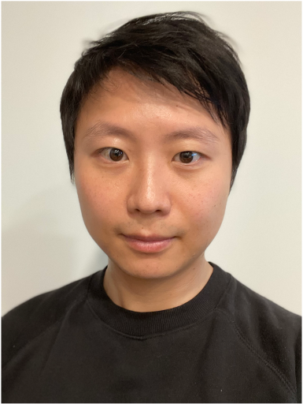
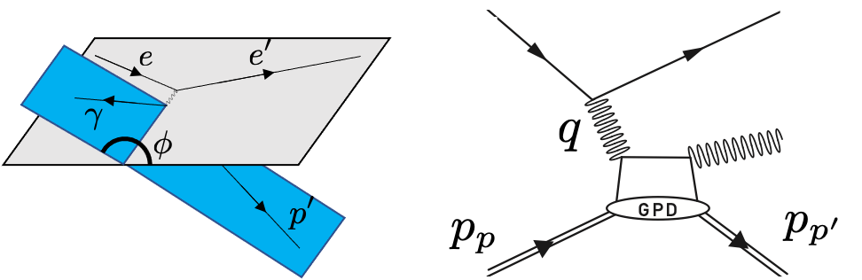
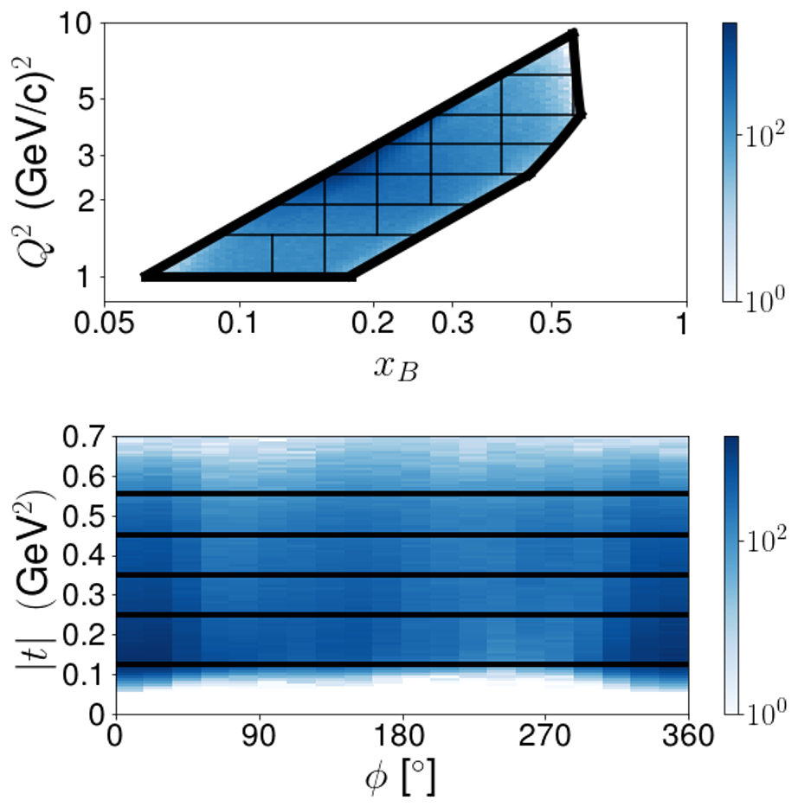
DVCS cross section measurement at CLAS12
Proton left intact!
Sangbaek Lee
  Bjorken x
  4-momentum transfer
  Mandelstam variable
  angle between scattering planes

Slide 11
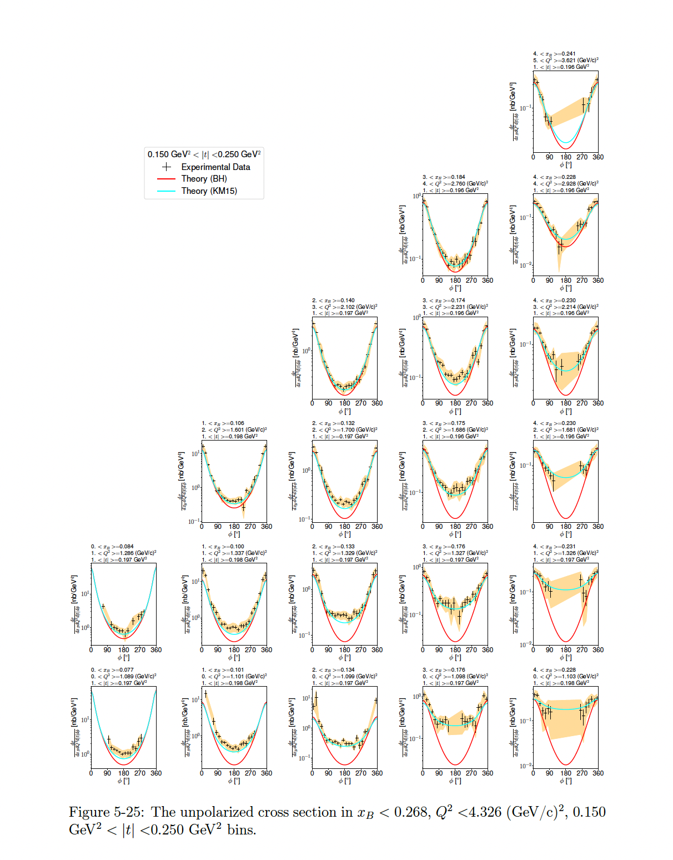
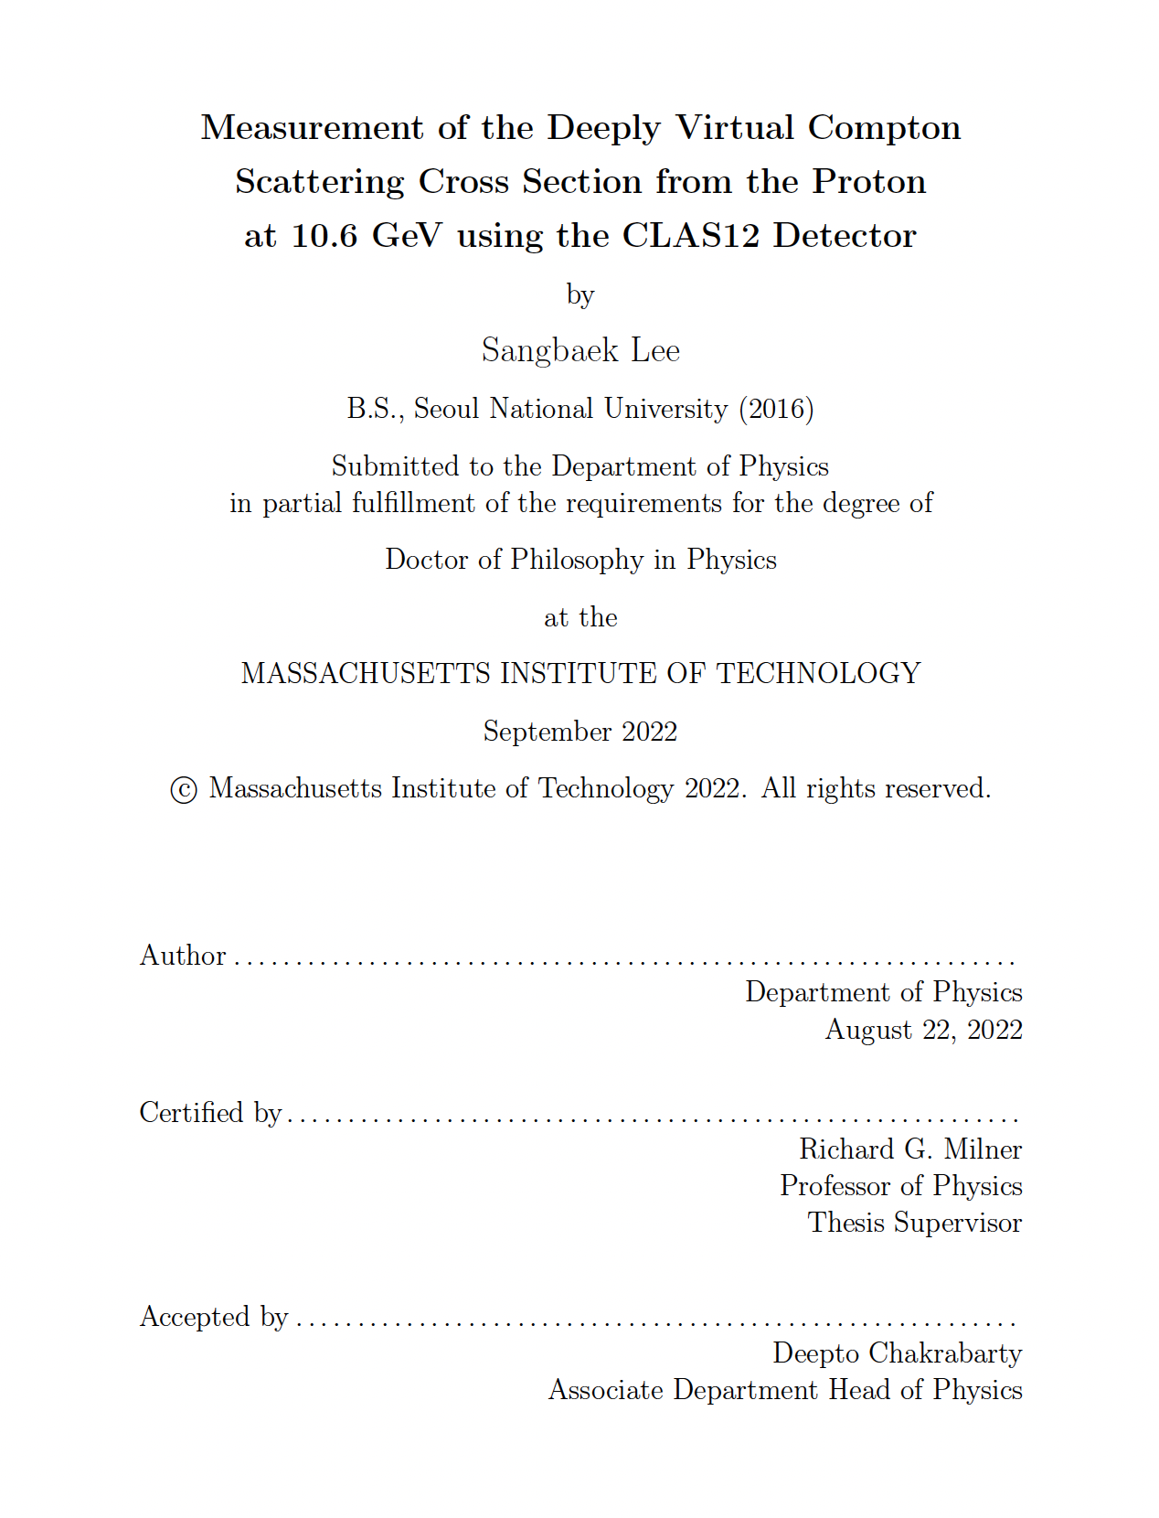
DVCS Cross Section Results

Slide 12
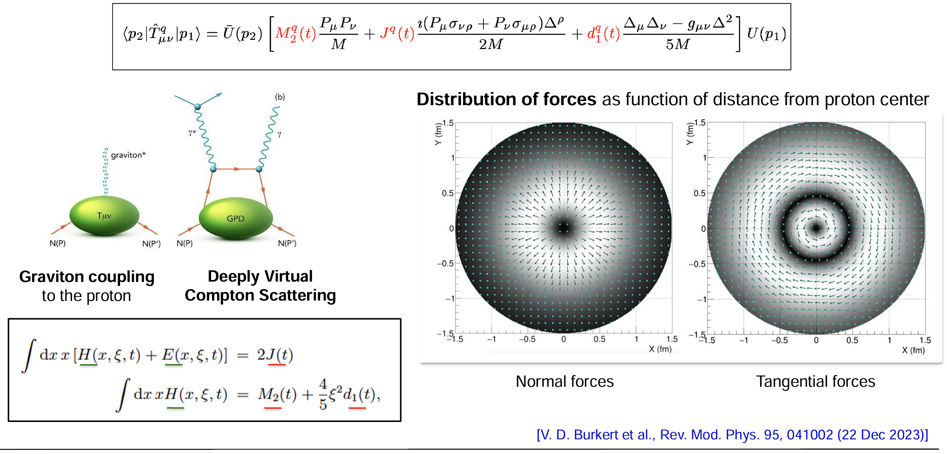
First Determination of Distribution of Forces in the Proton
CLAS 6 GeV data

Slide 13



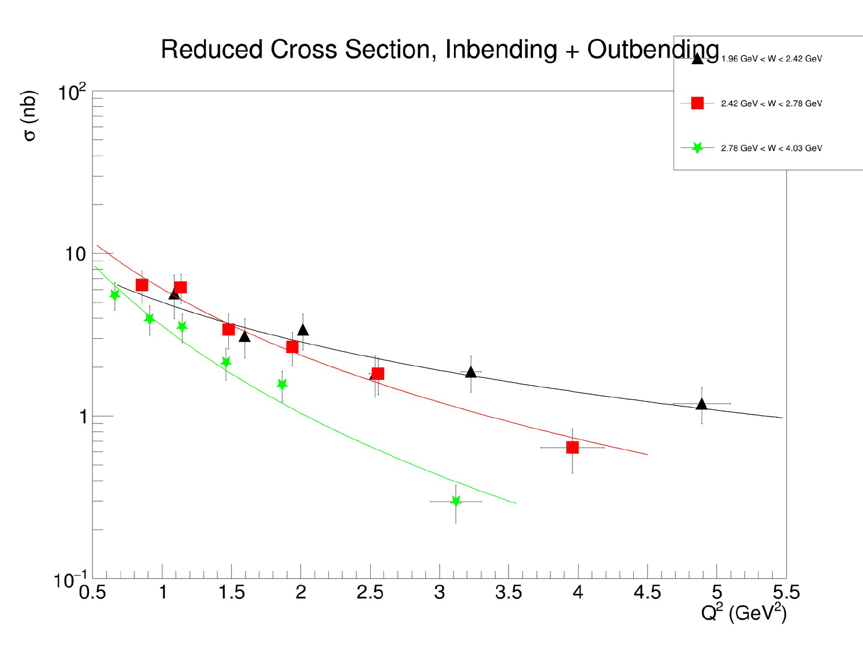
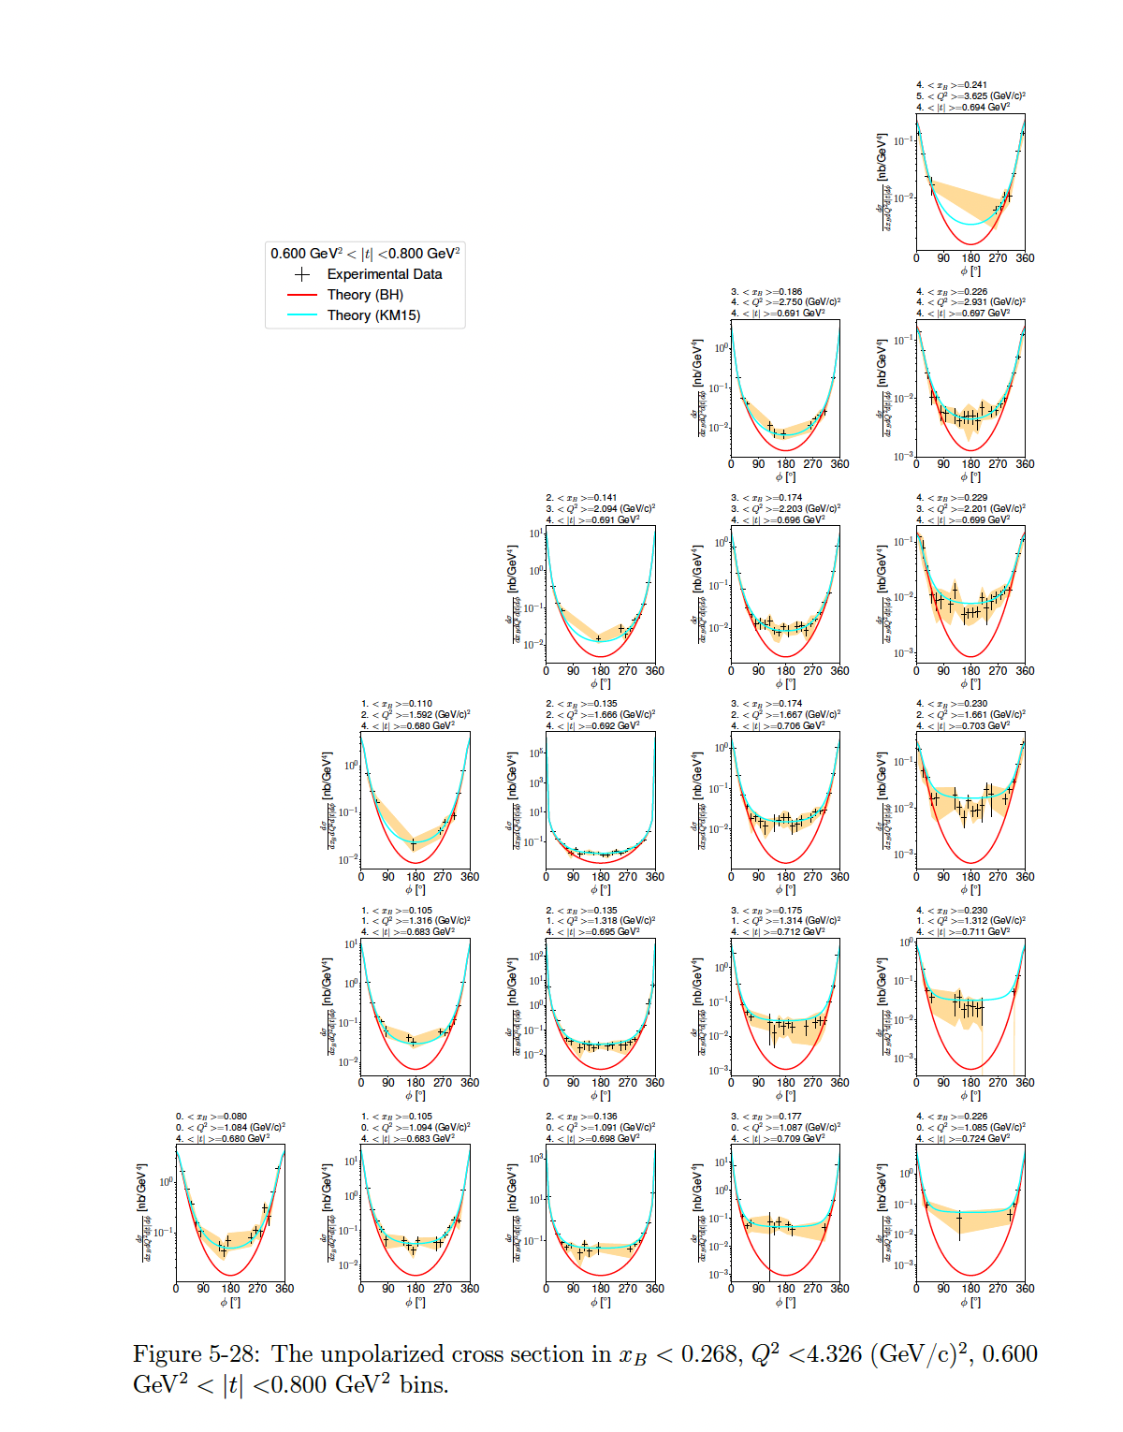


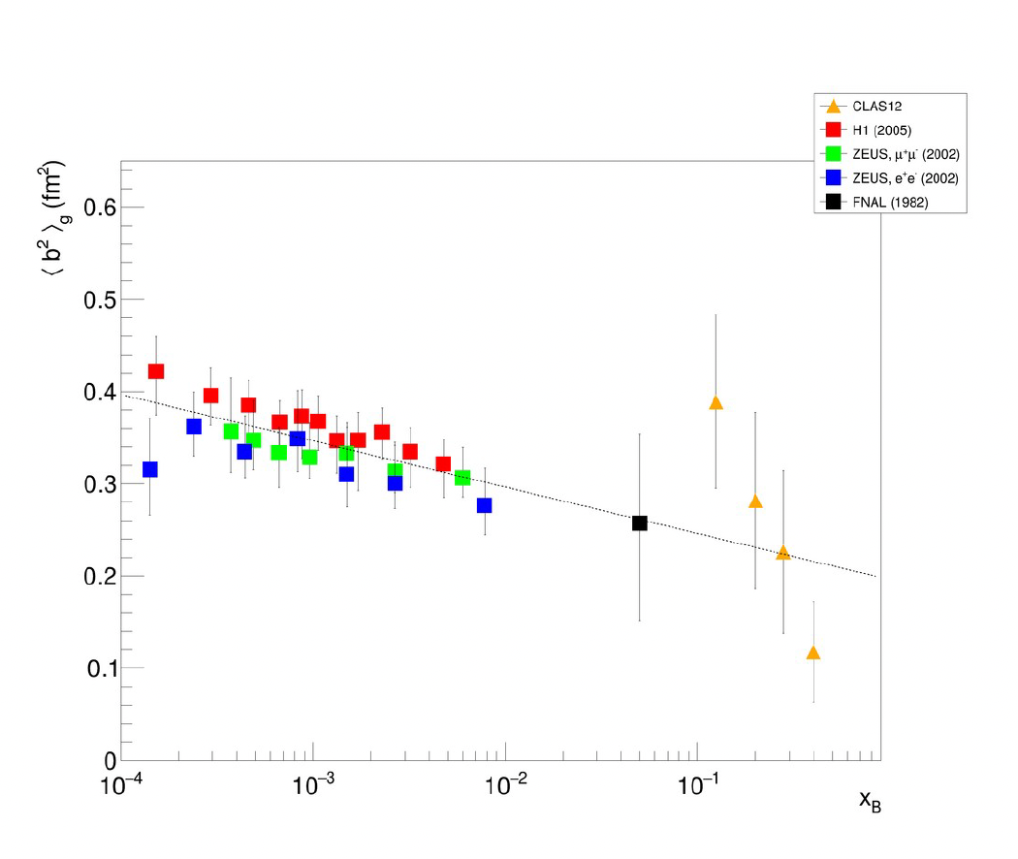
Theses on DV processes with CLAS12
Sangbaek Lee Bobby Johnston Patrick Moran
Aug 2022 Aug 2023 Feb 2024
p(e,e’p)ɣ p(e,e’p)𝝅⁰ p(e,e’p)⏀
Analyses based on Fall 2018 data.
Much more data already taken.
Yijie Wang
Dr. Igor Korover
Gluonic radius of proton

Slide 14
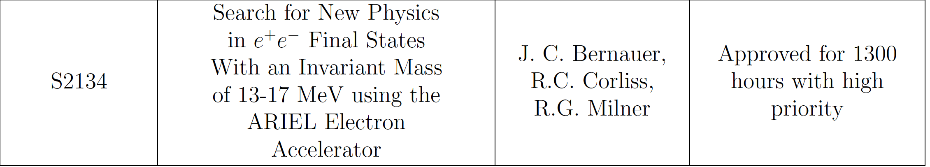
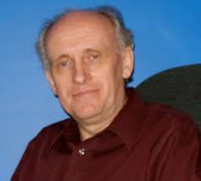

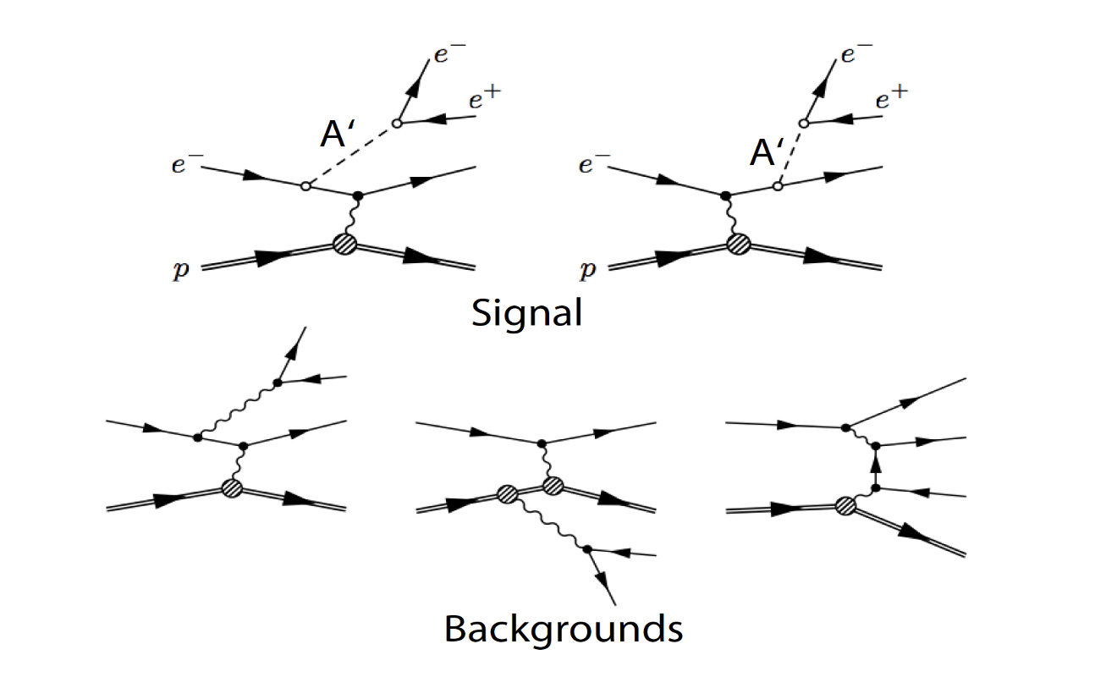
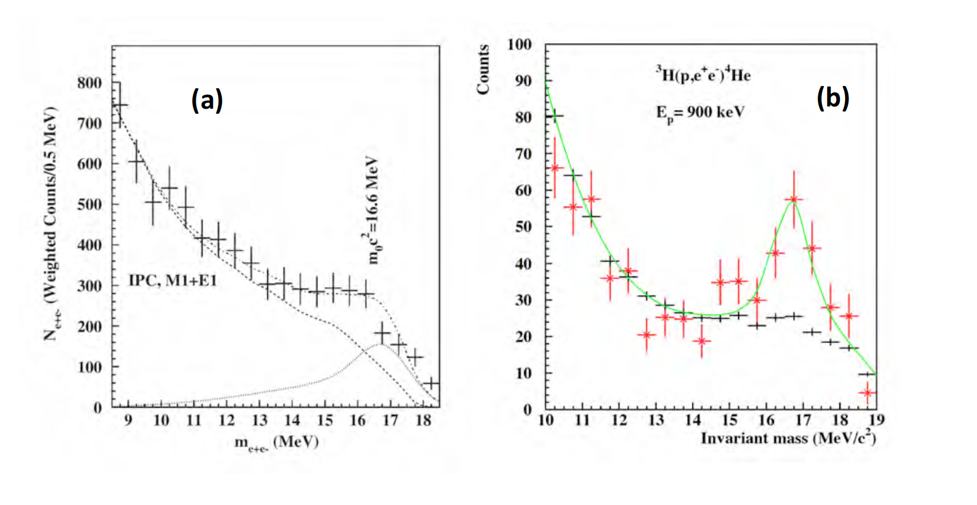
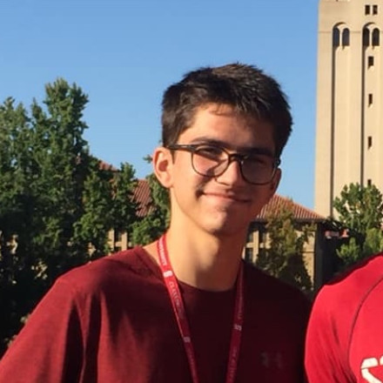
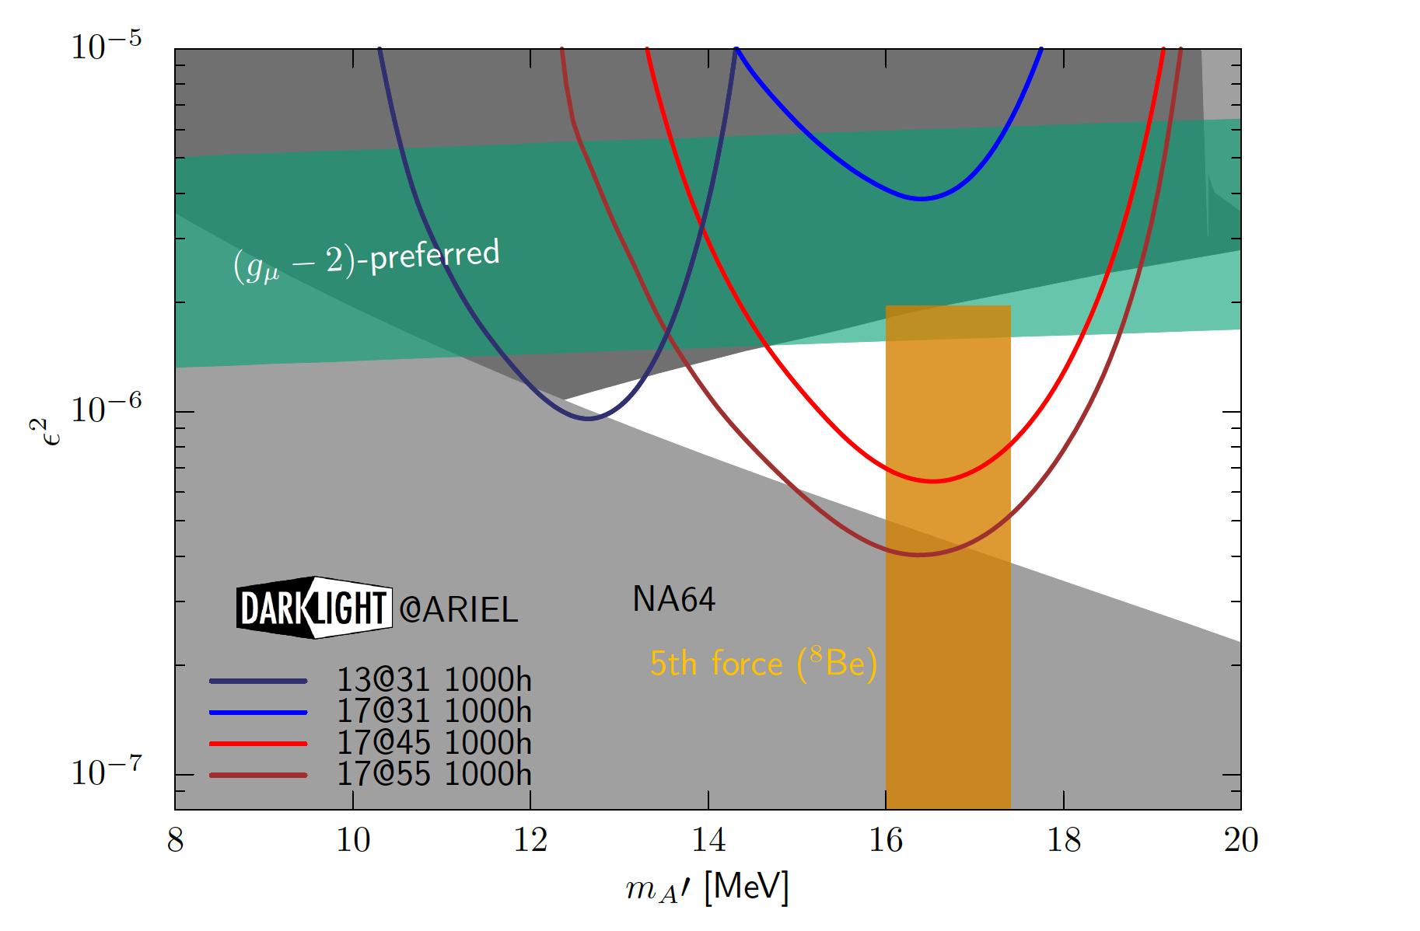
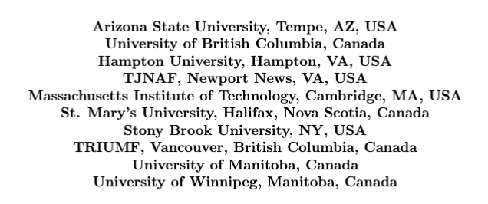
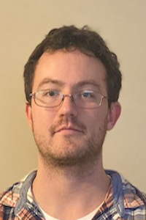
April, 2021
Dr. Douglas Hasell
Story Frantzen
Dr. Ethan Cline

Slide 15
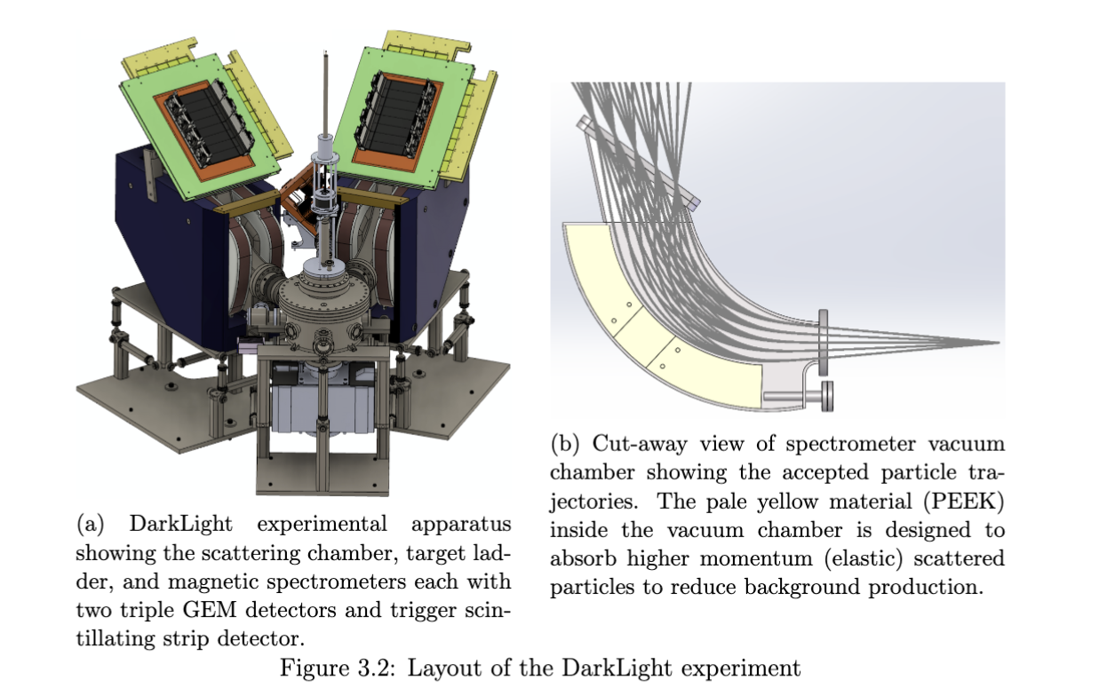


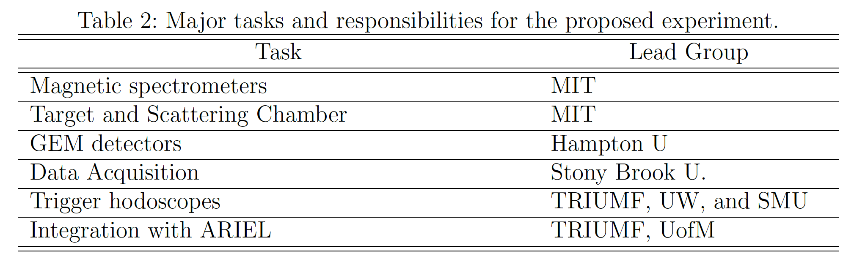
Data taking in 2025.
TRIUMF funded for ARIEL
e-linac energy upgrade!
MIT-Bates lab is coordinating design and construction of the experiment.

Slide 16
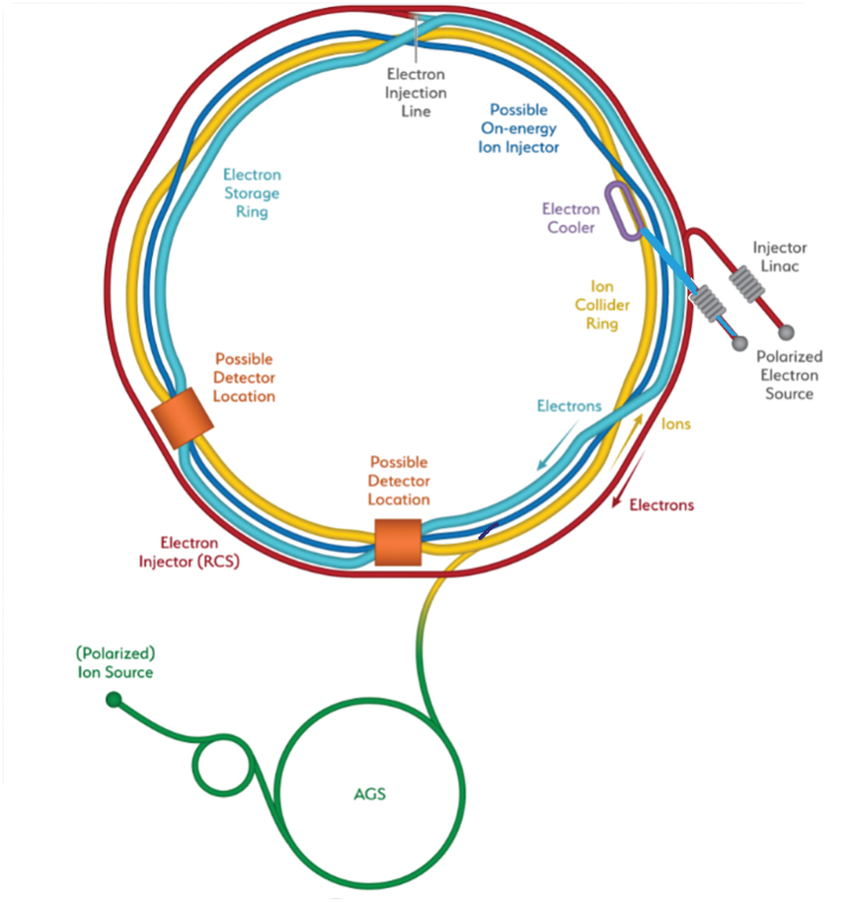
Electron-Ion Collider (EIC)
New high luminosity collider to study QCD to be constructed using RHIC at BNL and expected to come online in early 2030s.
MIT-LNS has played a leadership role in making the case for EIC over two decades: Bates Lab one of the points of origin
Prof. Hen Chair-elect of EICUG.
EIC R&D: Polarized ³He ion source, EM calorimeter and streaming readout development
Beginning graduate students in 2024
will be young faculty who will drive
the scientific program at EIC.

Slide 17
Development of a Polarized He-3 Ion Source
and a
Polarized He-3 Target
Using High-Field Optical Pumping
Brookhaven National Laboratory
Gregor Atoian, Edward Beebe, Sergey Kondrashev, Deepak Raparia, John Ritter
Massachusetts Institute of Technology
Noah Wuerfel and Richard Milner since 2012
Jefferson Laboratory
James Maxwell
Massachusetts Institute of Technolog
Pushpa Pandey and Richard Milner
University of Tennessee
Dien Nguyen since 2021

Slide 18
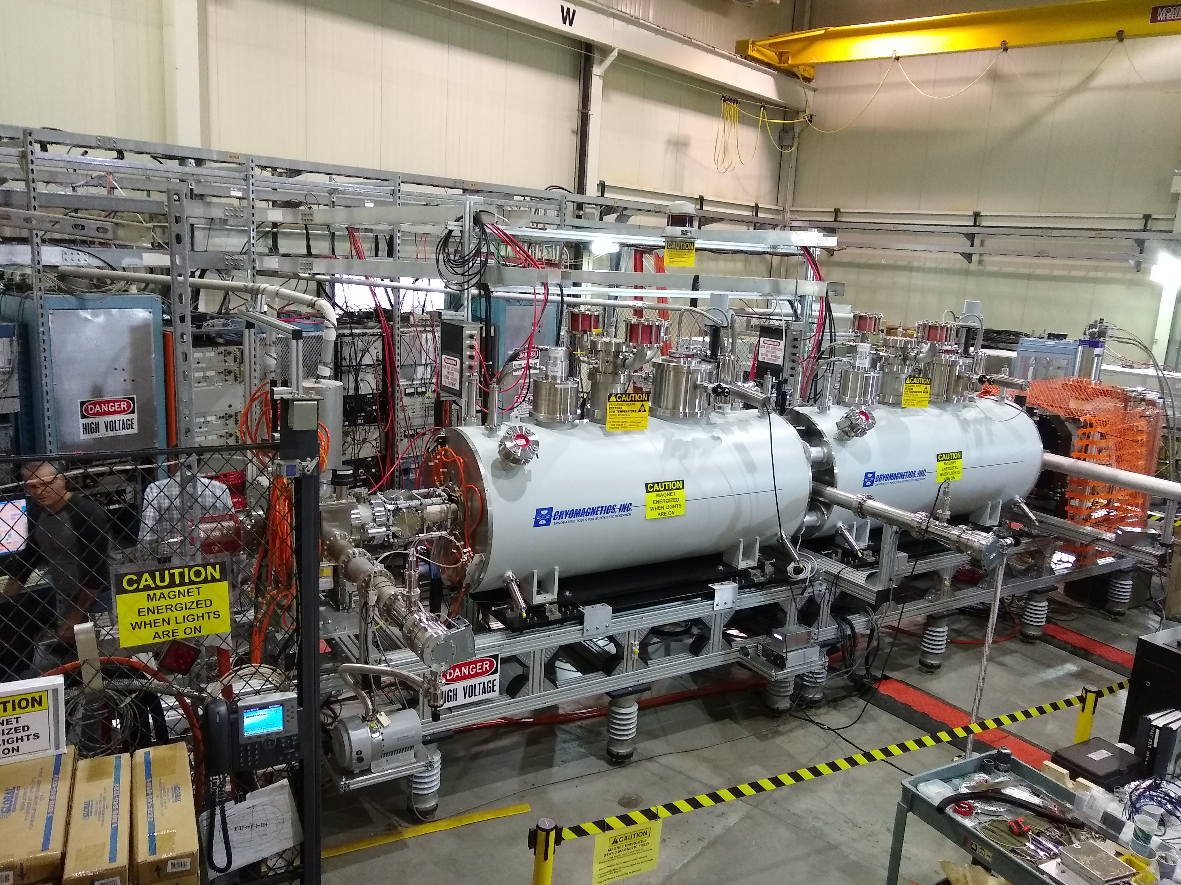
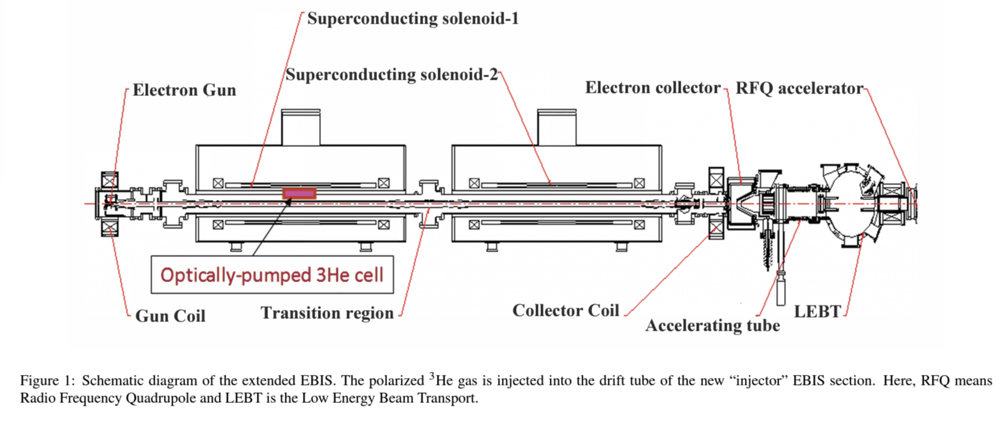

BNL-MIT Development of MEOP in High Magnetic Field
Allows polarization of gas directly in EBIS.
Direct transfer of polarized gas to EBIS vacuum system.
Motivated development of tandem EBIS configuration which also benefits other ions.
Polarized ³He ion source for the EIC at RHIC at Brookhaven National Lab
Extraction and measurement
of He-3 nuclear polarization
anticipated in 2025.
    A. Zelenski et al., Nucl. Instr. and Meth. A 1055, 168494 (2023)
Dr. Noah Wuerfel

Slide 19
Proposed Experiment Using Polarized ³He at CLAS12 JLab
5-T solenoid surrounding the interaction region
CLAS12: CEBAF Large Acceptance Spectrometer for operation at 12 GeV
  High luminosity electron scattering
  Multi-particle final-state response
PR12-20-002: A program of spin-dependent electron scattering using a polarized ³He target at CLAS12
  Spokespeople: H. Avakian, J. Maxwell, R. Milner, and D. Nguyen.
  Approved with A- rating conditionally on the high-field MEOP target development
Novel target design to accommodate to the standard CLAS12 configuration

Slide 20
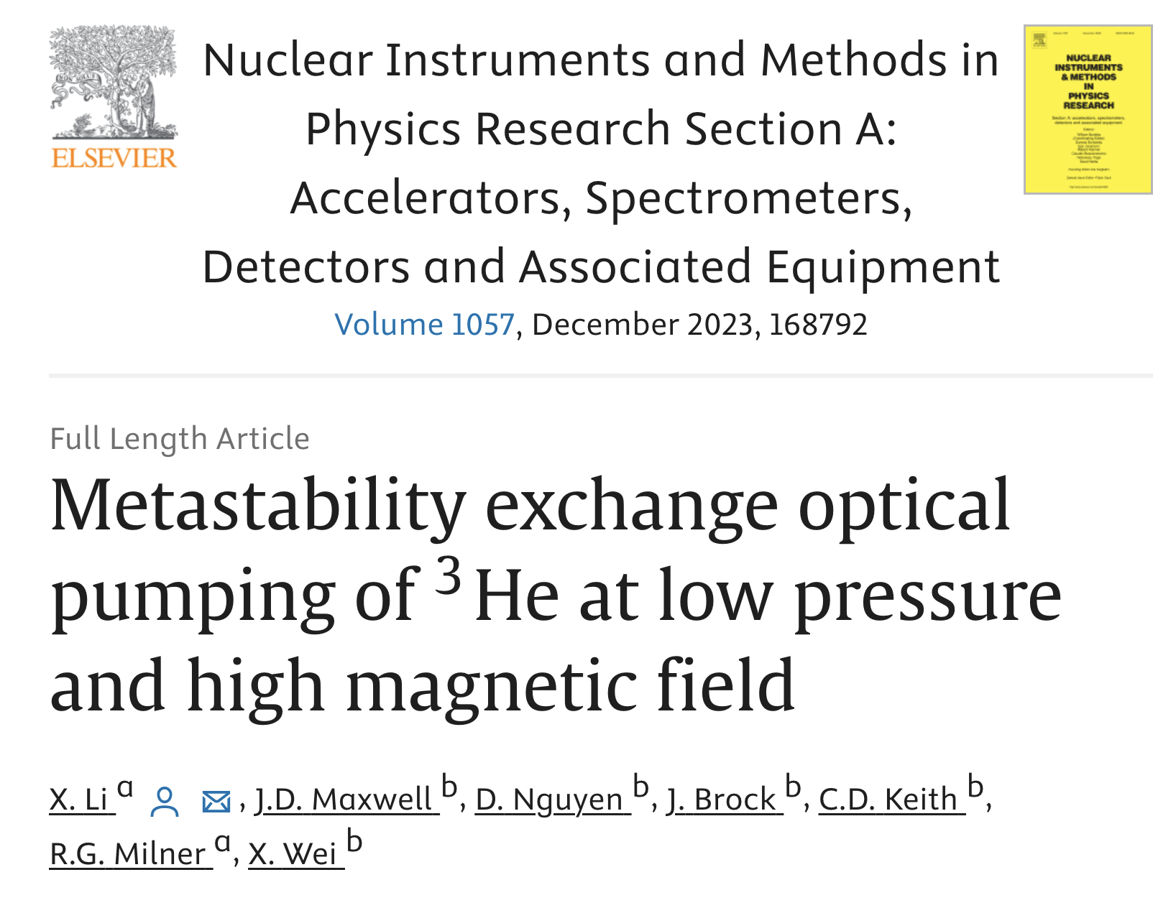

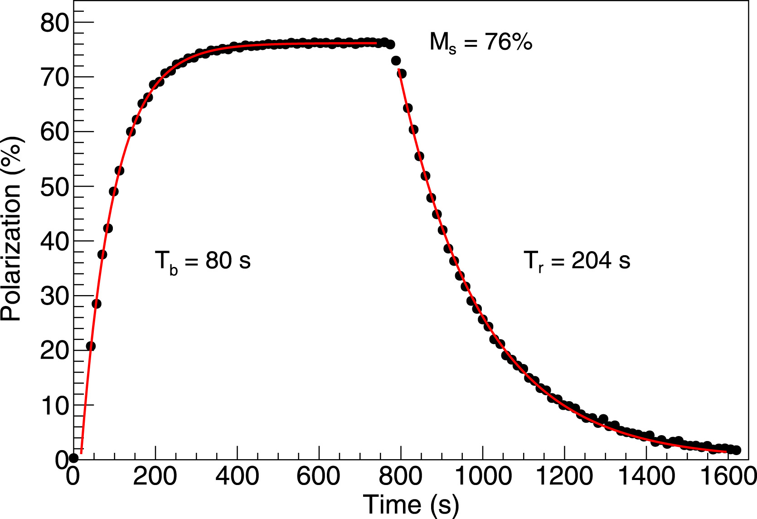
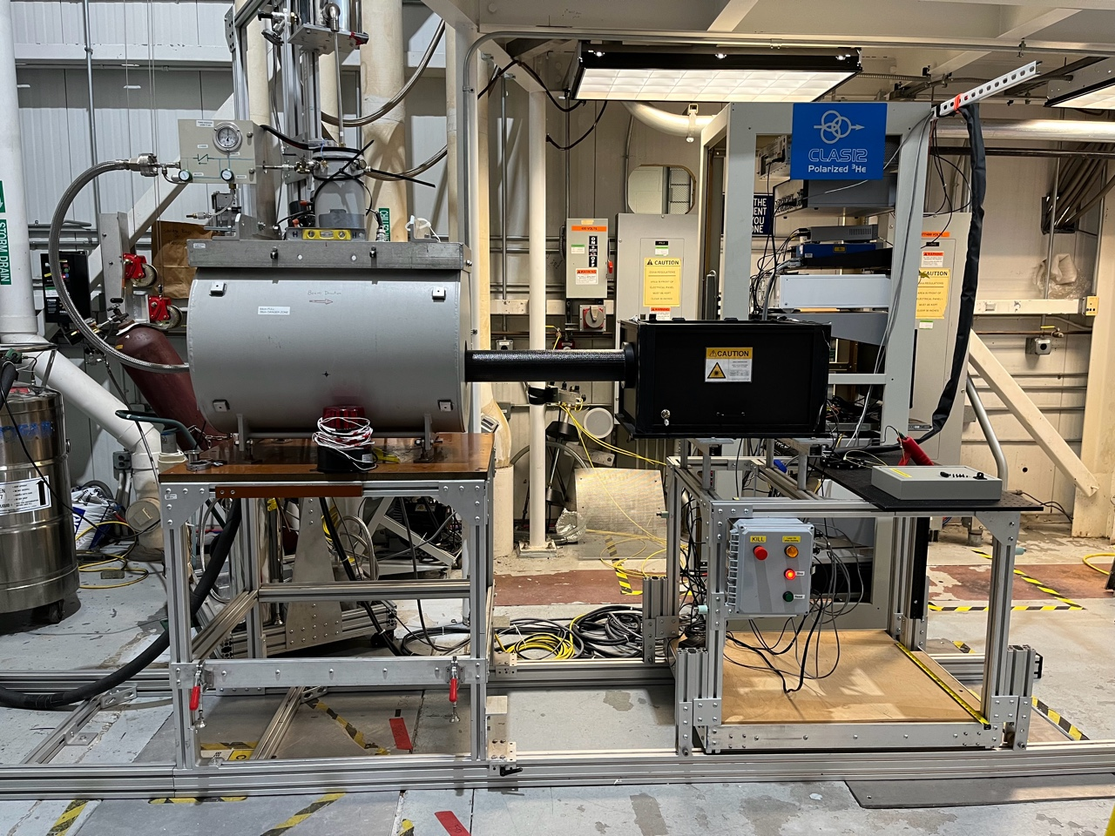
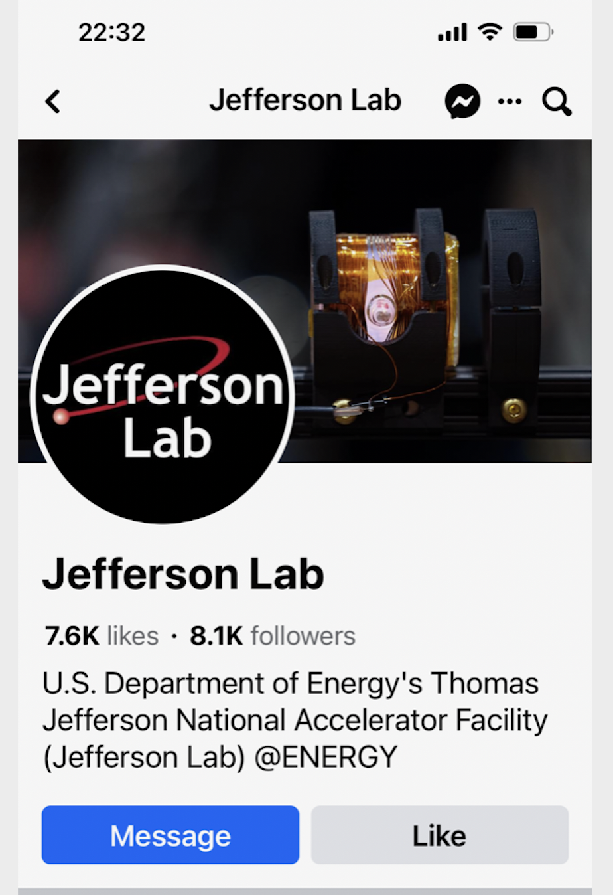
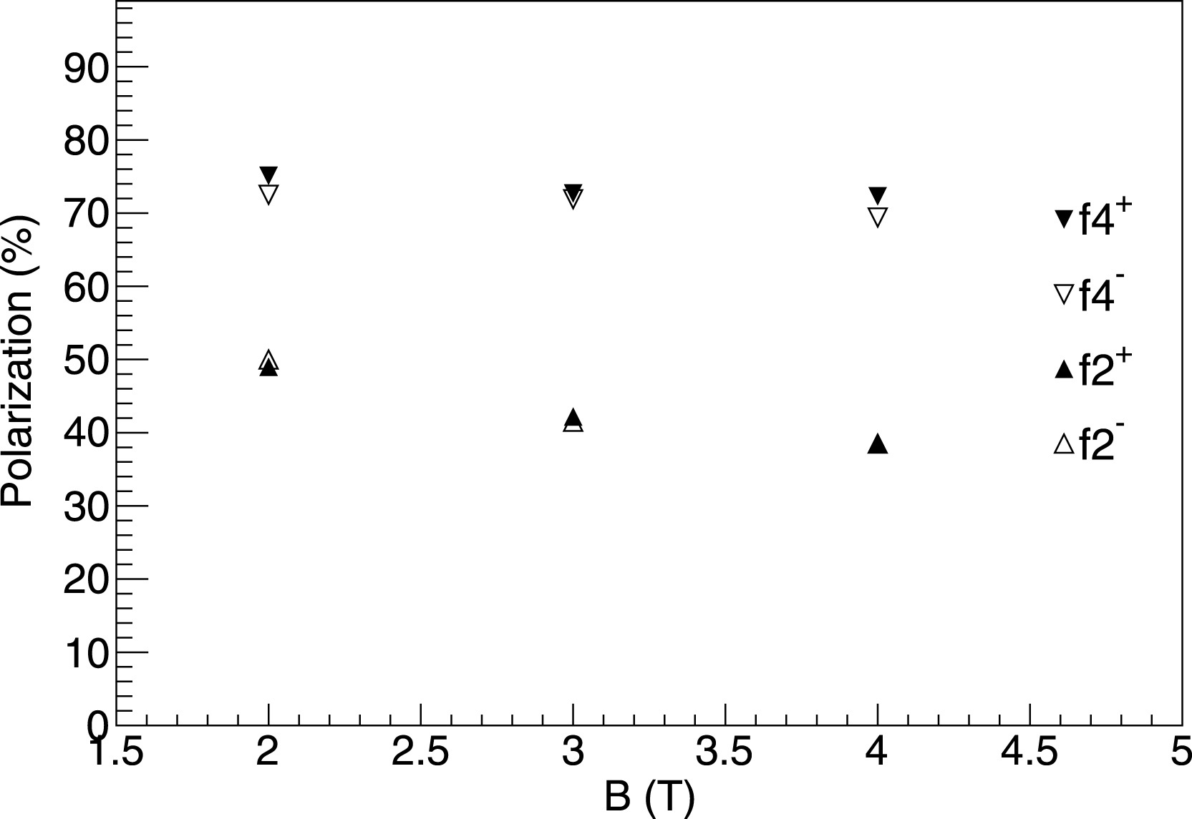
Target Development Status
Dr. Pushpa Pandey
Beam test
with polarized
target anticipated
in 2026.
Our target is photo
on JLab Facebook!

Slide 21
Seeking Two New Students
To work on
the design, construction and commissioning of the polarized ³He ion source at RHIC/EIC at BNL, NY
the data taking and analysis of deeply virtual exclusive processes using CLAS12 at Jefferson Lab, Newport News, VA
Contact info: Email: milner@mit.edu Office 26-411

